Slide 1
A.
Boundaries
Solid
P, Q
Fluid
t_{a}
t
3D Model
Pulsatile 1D Fluid
B.
t_{wall} (t_{a})
P_{BC} (t_{a}), Q_{BC} (t_{a})
σ_{f} (t_{a})
Steady 3D Fluid
Steady 3D Solid
σ_{vm} (t_{a})
Notes:
Fig2_3_fsi_workflow.pdf

Slide 2
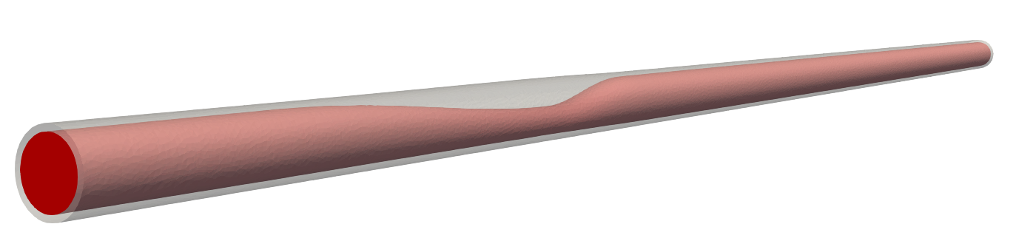








(A) Ideal coronary artery
b
a
$$t=0.02$$
$$D_{min}=0.1$$
$$D=0.2$$
$$0.5$$
$$1$$
$$1.5$$
$$7$$
$$10$$
(a). Pressure inlet waveform
(b). Coronary boundary model
R_{a}
R_{a-mic}
R_{v-mic}
Pressure (mmHg)
C_{cor}
C_{myo}
P_{im}
$R_{v}$
Time (s)
(B) Subject specific AAA
a
(a). Flow-rate inlet waveform
Flow-rate (cc/s)
Time (s)
(b,c). Windkessel RCR
R_{p}
R_{d}
b
c
C
Notes:
Case1 boundary condition

Slide 3
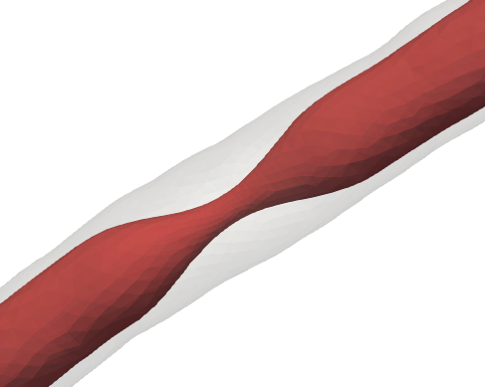
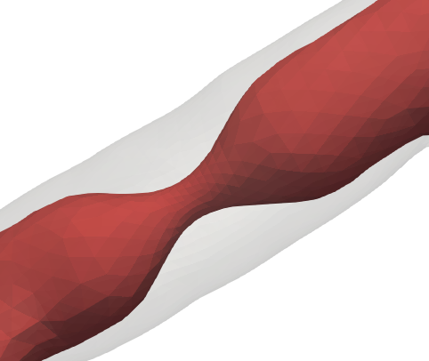
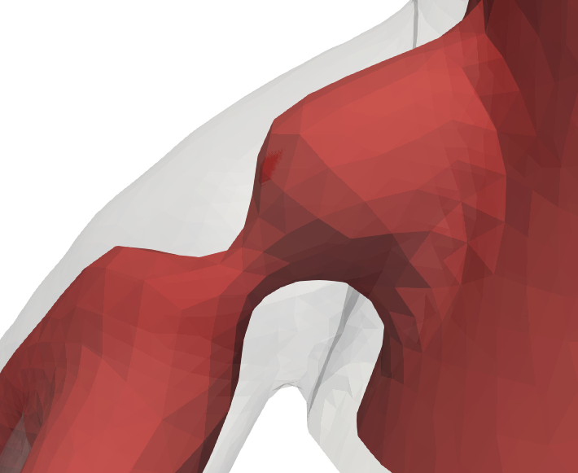
b
(a). Heart boundary model
R_{MV}
L_{MV}
R_{AV}
L_{AV}
k
E_{LV} (t)
m
a
Q = 5 L/min
l
c
(b). Windkessel RCR
j
h
R_{p}
R_{d}
i
C
f
e
d
g
(c~l). Coronary boundary model
R_{a}
R_{a-micro}
R_{v-micro}
C_{cor}
C_{myo}
P_{im}
$R_{v}$
Distal-LAD stenosis
(DOS 70%)
Mid-LAD stenosis
(DOS 69%)
LM stenosis
(DOS 68%)

Slide 4












Predicted
Actual
Absolute Error
$$t_{2}$$
$$t_{3}$$
$$t_{4}$$
5.2E3
1.32E6
2.46E-2
2.57E4
Predicted
Actual
Absolute
Error
Predicted
Actual
Absolute
Error
$$t_{2}$$
$$t_{3}$$
$$t_{4}$$
6.9E3
1.28E6
3.2E-1
1.50E5
3.09E4
5.66E6
5.83E-1
6.69E4
von Mises stress $(dyn / cm^{2})$

Slide 5
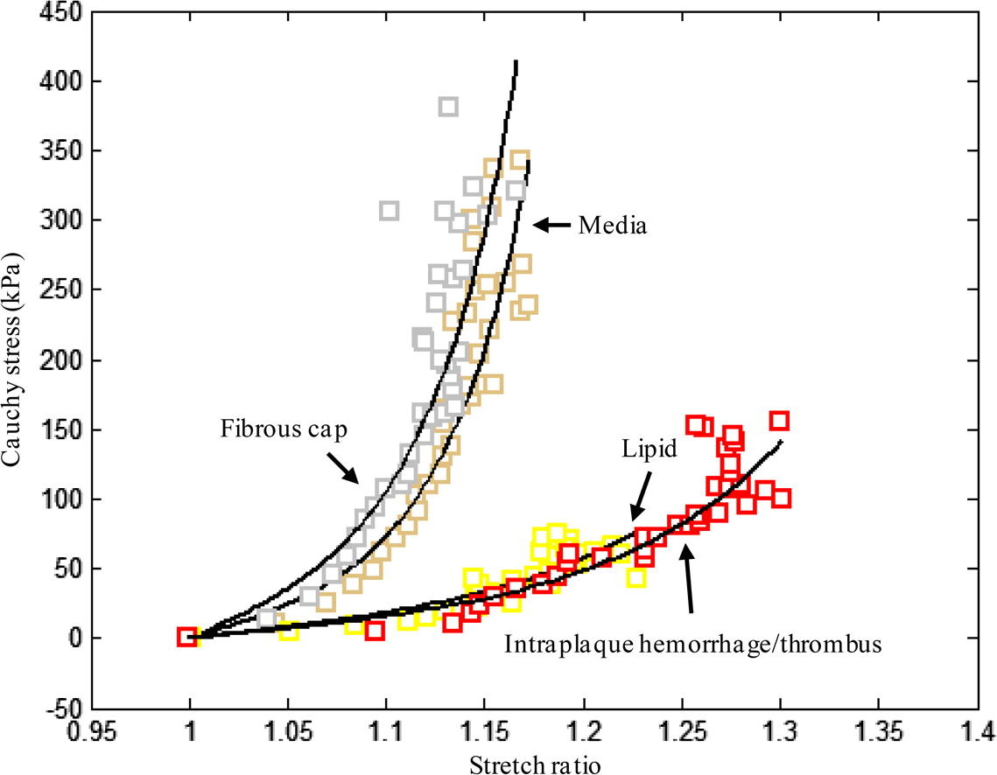
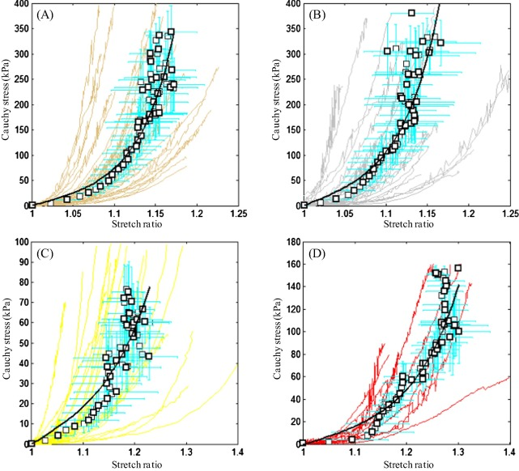
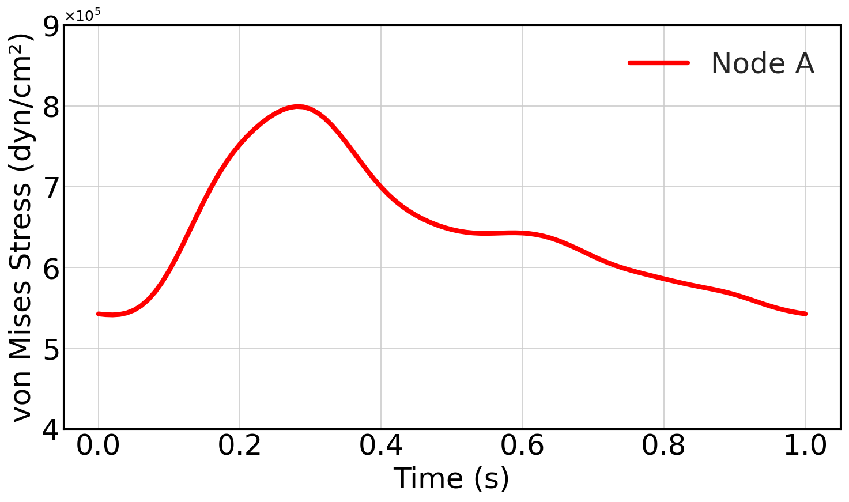

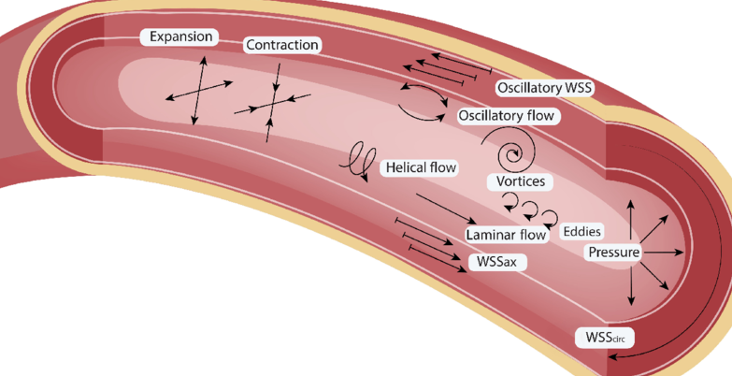
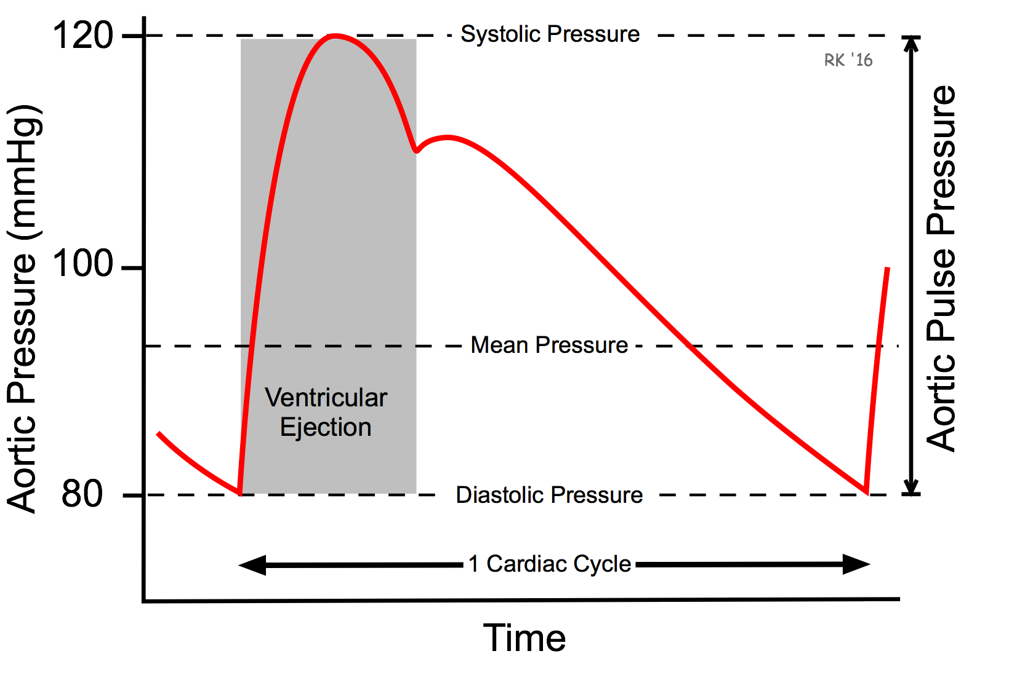
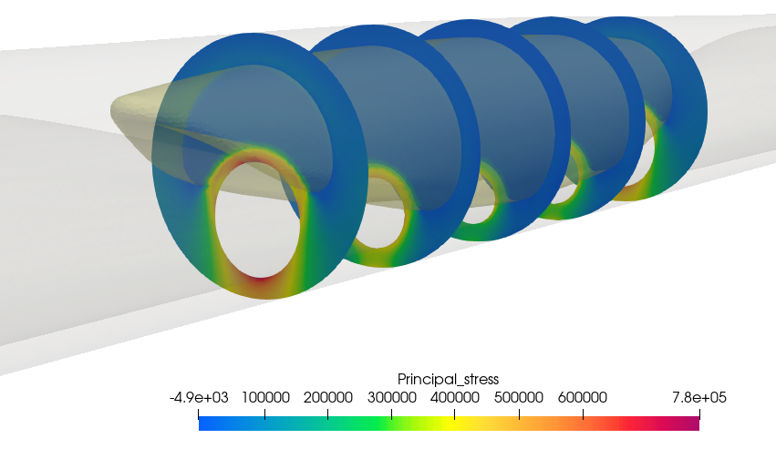
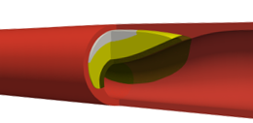

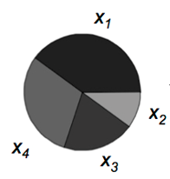

















Step 1. Create data set
Input Parameters
Computational Analysis
Output Parameters
Material properties
Cost-effective FSI simulation
$$σ_{peak}$$
$$Principal stress [\frac{dyn}{cm^{2}}]$$
$$∆σ$$
Hemodynamic
$$Time [s]$$
Morphology
$$PSS≡\max_{i∈N}{σ_{peak,i}}, ∆PSS ≡ \max_{i∈N}{∆σ_{i}}$$
Step 2. Rupture Vulnerability Index (VI) selection
$$VI≡stress/strength$$
$$stress ∈\left\{PSS, ∆PSS\right\}, strength∝E_{fc}^{α}, α∈\left\{0.0, 0.5,1.0\right\}$$
$$VI_{clinical }:VI satisfies all 7 clinical \\ high rupture risk plaque features$$
$$VI_{1}=PSS/E_{fc}^{0.0}$$
$$VI_{2}=PSS/E_{fc}^{0.5}$$
$$VI_{3}=PSS/E_{fc}^{1.0}$$
$$VI_{4}=∆PSS/E_{fc}^{0.0}$$
$$VI_{5}=∆PSS/E_{fc}^{0.5}$$
$$VI_{6}=∆PSS/E_{fc}^{1.0}$$
Step 3. Surrogate Model Training & Sensitivity Analysis
$$VI_{clinical}=f(X_{1}, …X_{N})$$
Input Parameters
Surrogate Model
Sensitivity Analysis
Notes:
Figure 2.1 Pipeline.pdf

Slide 6
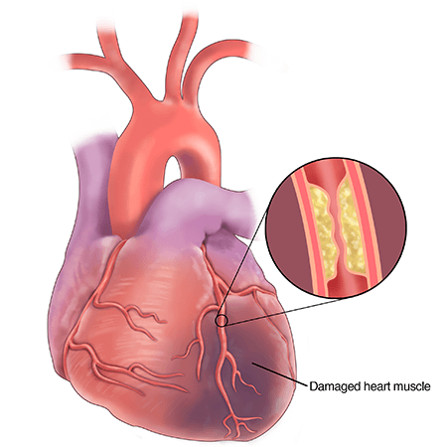
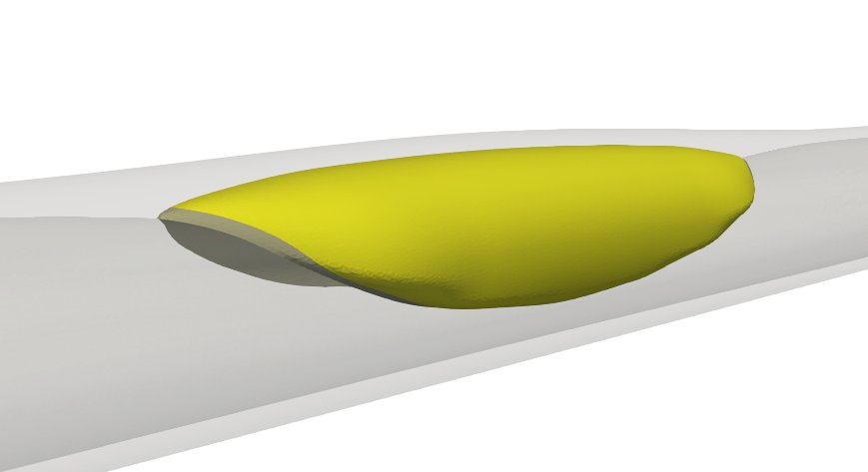
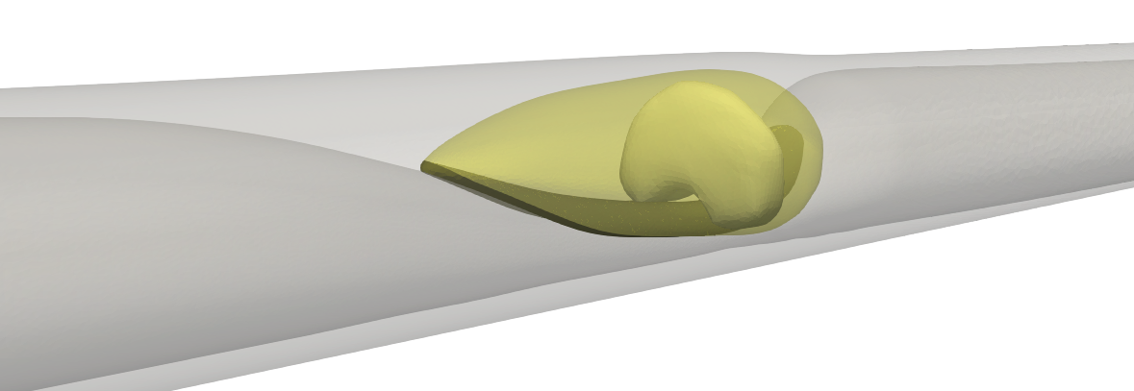
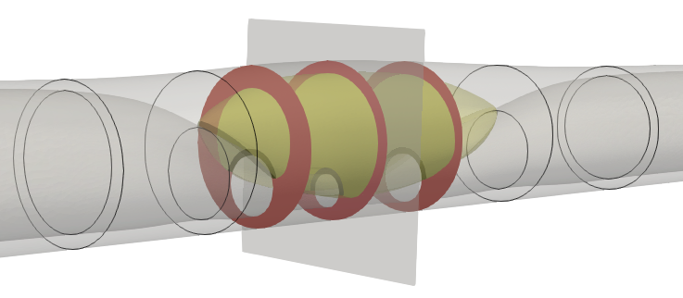
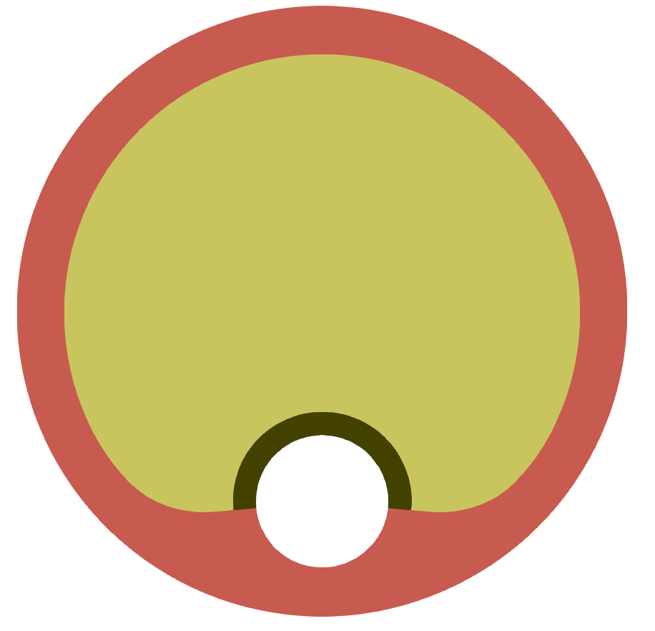


















A) Plaque classification
(i) Low Attenuation Plaque (LAP)
Vessel wall
Lipid core
Lumen
(ii) Calcified Plaque (CP)
Fibrous cap
Calcification
B) Plaque geometry (LAP)
i) Lesion region
$$10cm$$
ii) Minimum Lumen Area Plane(B)
$$R_{ref}$$
$$B(z=z_{MLA})$$
$$R_{max}$$
$$t_{wall}$$
$$R_{max}$$
$$t_{wall}$$
$$r_{min}$$
$$t_{fc}$$
$$θ_{lipid, max}$$
$$r_{ref}$$
$$L_{lipid}$$
$$L_{lesion}$$
$$z=z_{lesion}$$
$$r_{min}$$
$$z=−z_{lesion}$$
$$z=z_{MLA}$$
Vessel wall
Lipid core
Fibrous cap
Notes:
Fig2_2_geometries.pdf

Slide 7
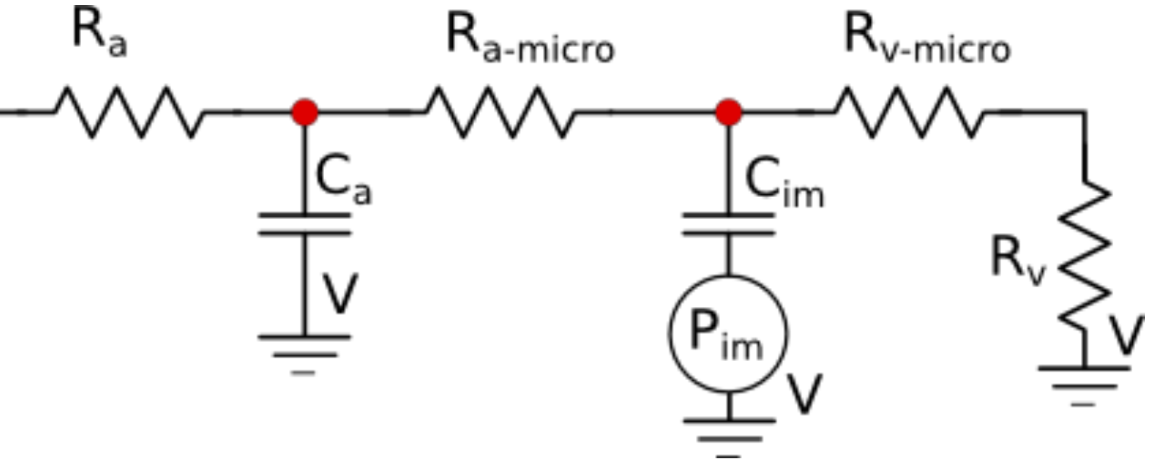
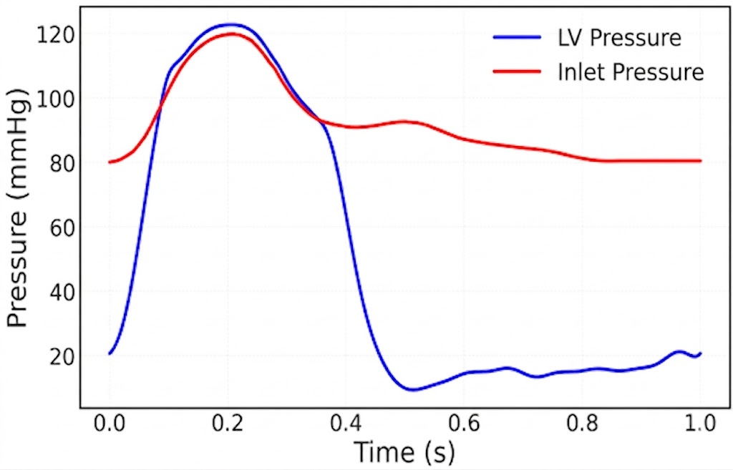







$$Fixed support$$
$$P_{sys}$$
$$unit:R\left[\frac{dyn∙s}{cm^{5}}\right], C[\frac{cm^{5}}{dyn}]$$
$$∆P$$
$$R_{a}$$ | 78,827 | $$C_{im}$$ | 3.2E-6
$$C_{a}$$ | 3.9E-7 | $$R_{v−m}$$ | 19,706
$$R_{a−m}$$ | 128,094 | $$R_{v}$$ | 19,706
$$t_{low}$$
$$t_{peak}$$
(a) Inlet and Left Ventricular pressure
(b) Outlet Coronary Boundary condition
Notes:
Fig2_4_fluid_bc.pdf

Slide 8
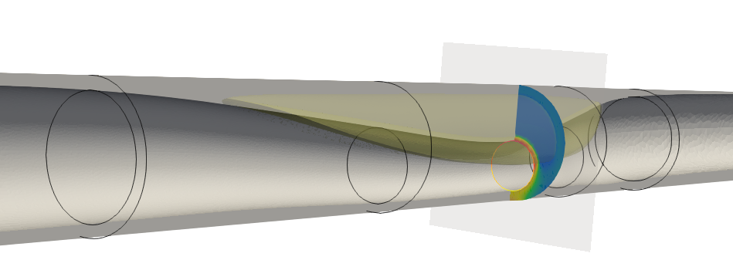
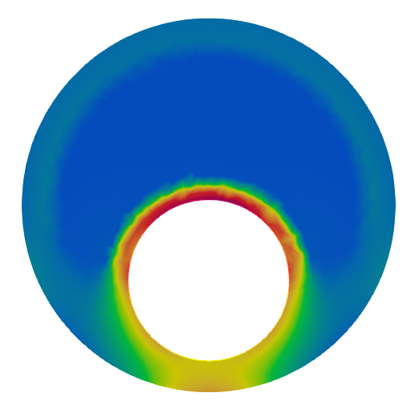











A) Axial Rupture Location
B) Rupture Plane
$${z= −z}_{lesion}$$
$$Rupture Plane$$
$${z= z}_{lesion}$$
$$θ_{rupture}$$
$$Flow$$
$$Proximal$$
$$Mid$$
$$Distal$$
$$θ_{lipid}$$
$$LA=0.3$$
$$LA=0.3$$
$$−1.1E4$$
$$5E5$$
$$1.1E6$$
$$Lumen Area \left(LA\right)=A_{lumen}/A_{normal}$$
$$Plaque Structural Stress [\frac{dyn}{cm^{2}}]$$

Slide 9
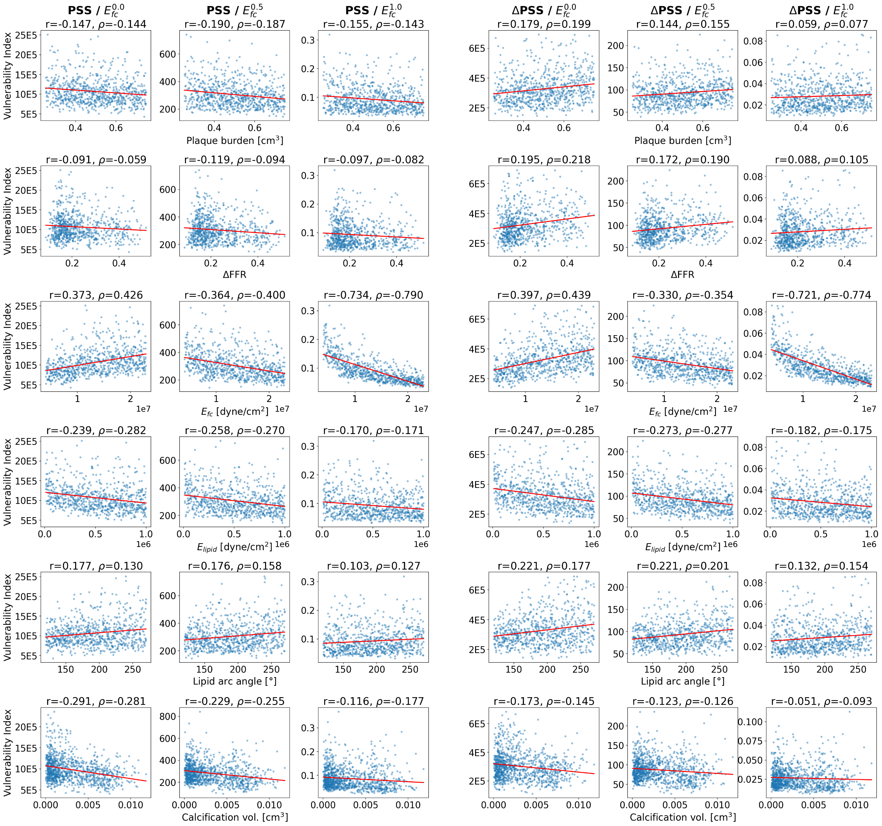
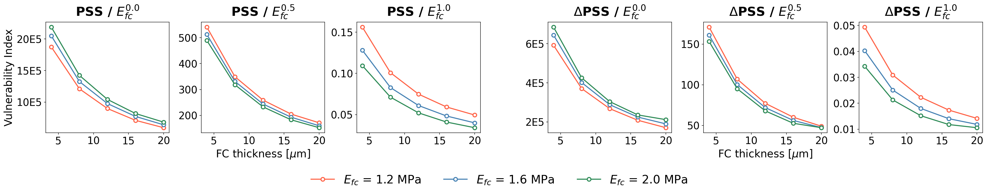
A) LAP and CP data input and output correlation
B) Fibrous cap thickness and output correlation
Notes:
Fig3_vi_compliance_panels.pdf

Slide 10
A) Individual Sobol Indices
B) Group Sobol Indices
Notes:
Figure 4.2 sensitivity analysis individual and group

Slide 11
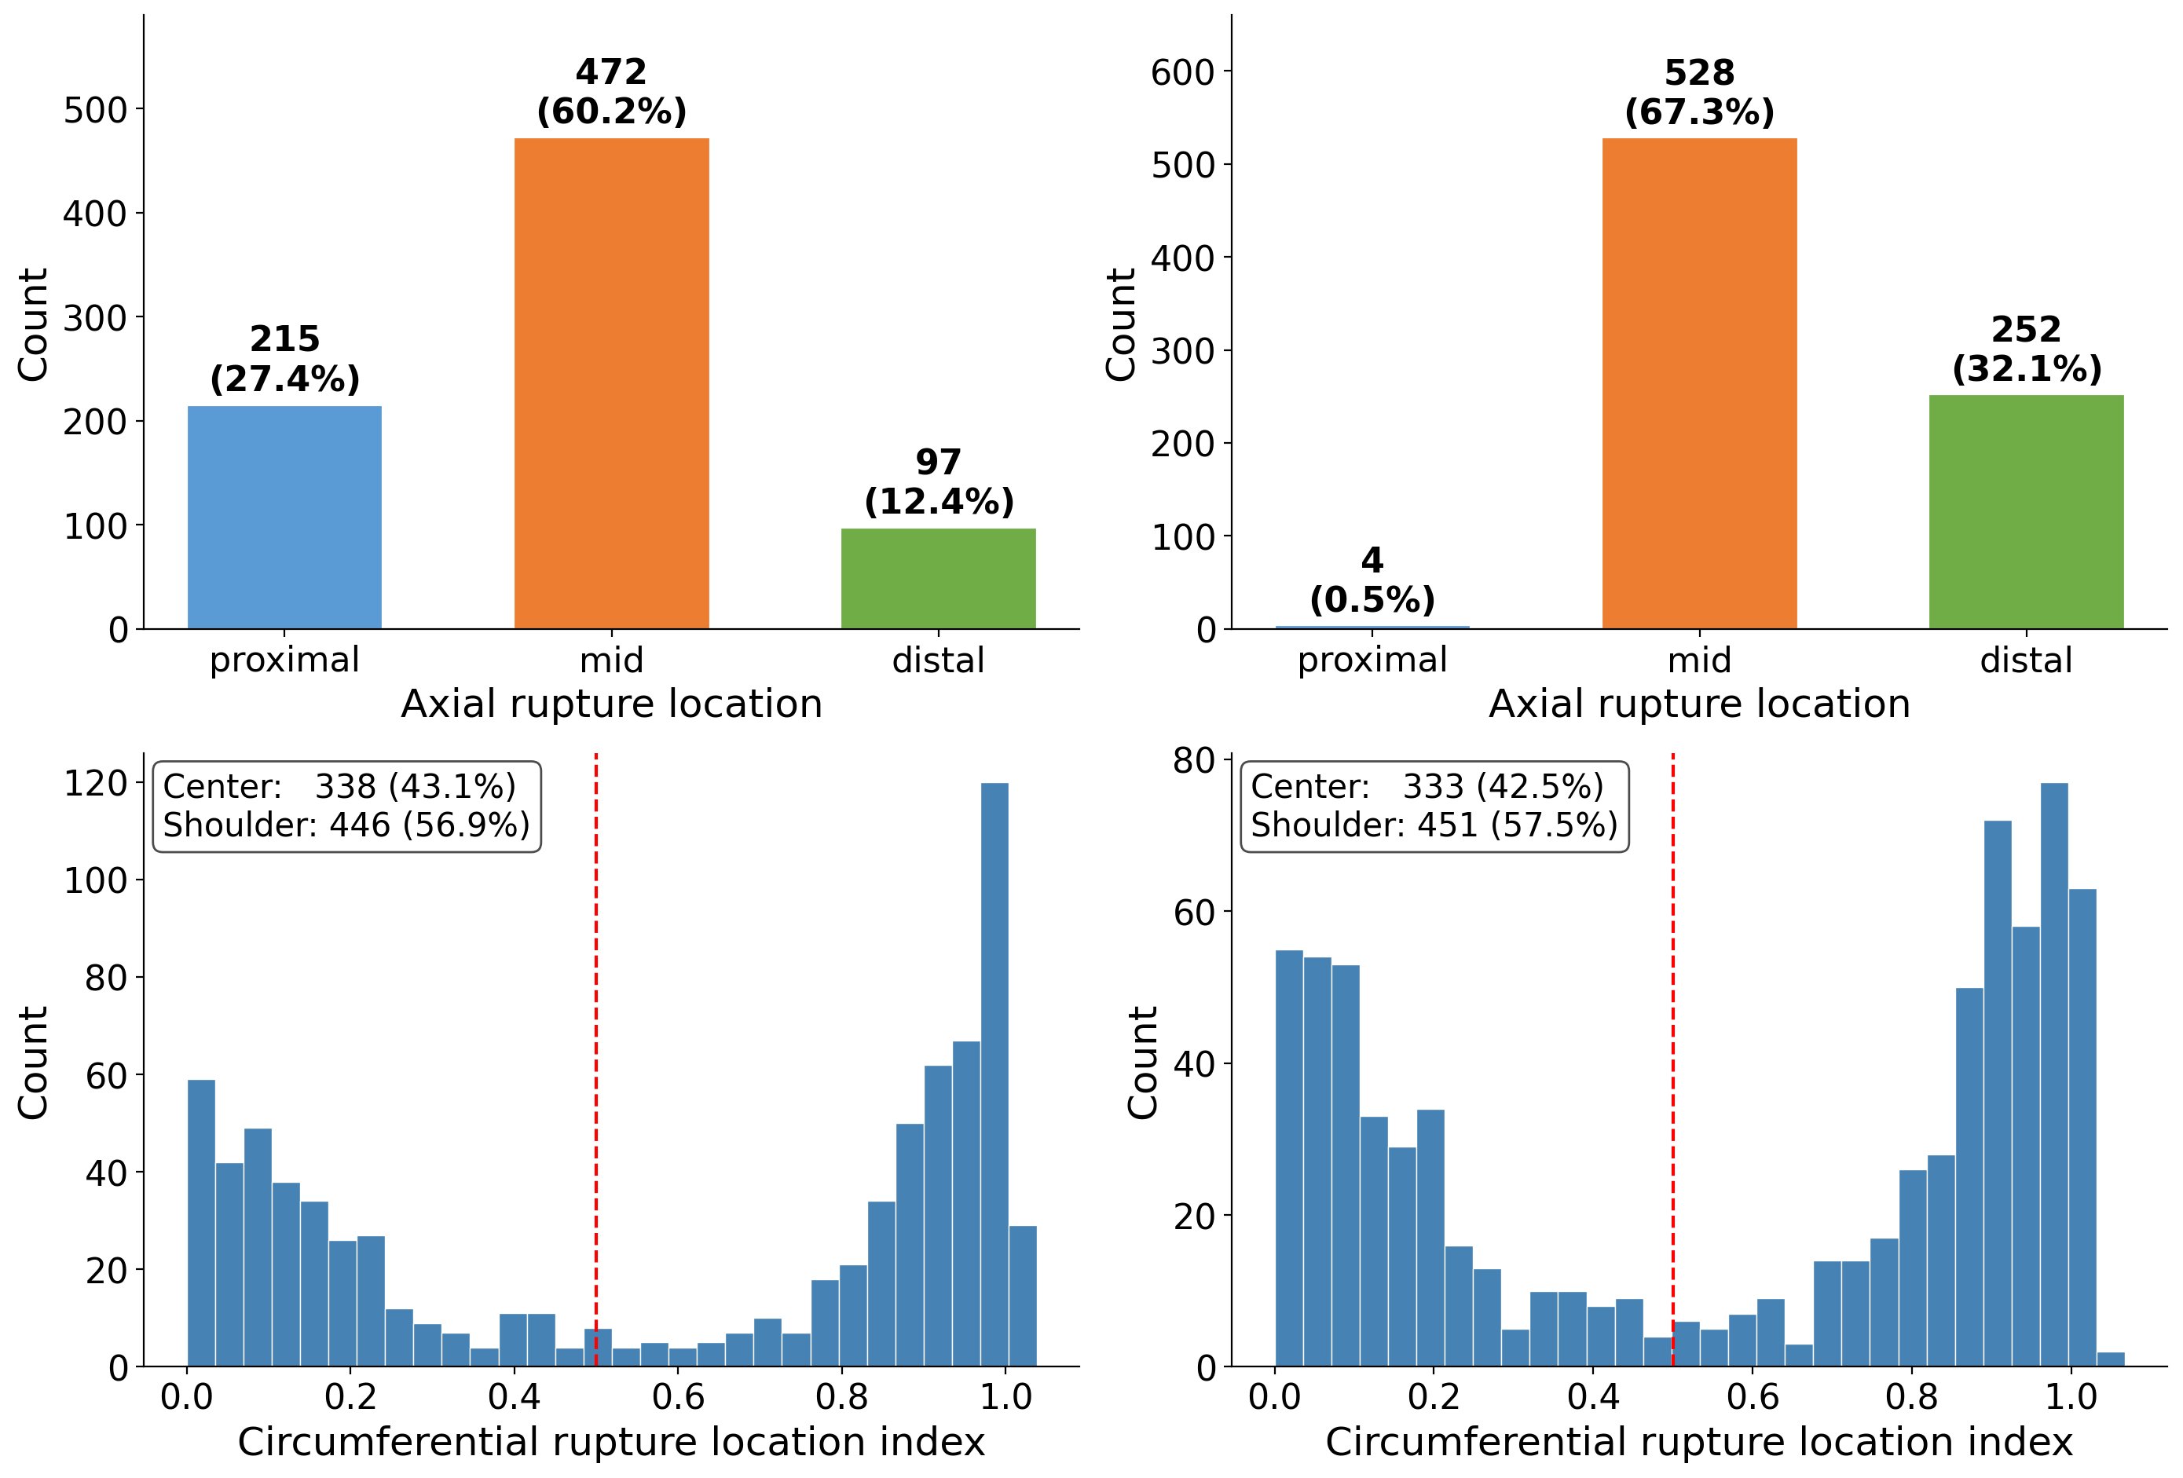

A) Circumferential rupture location
PSS based VI
$∆$PSS based VI
B) Axial rupture location
PSS based VI
$∆$PSS based VI
Notes:
Figure (A) and (B) 파열 위치 지수로부터 얻은 파열 위치분포,

Slide 12
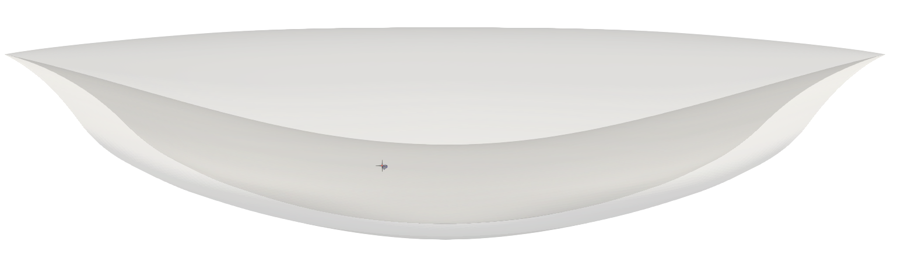
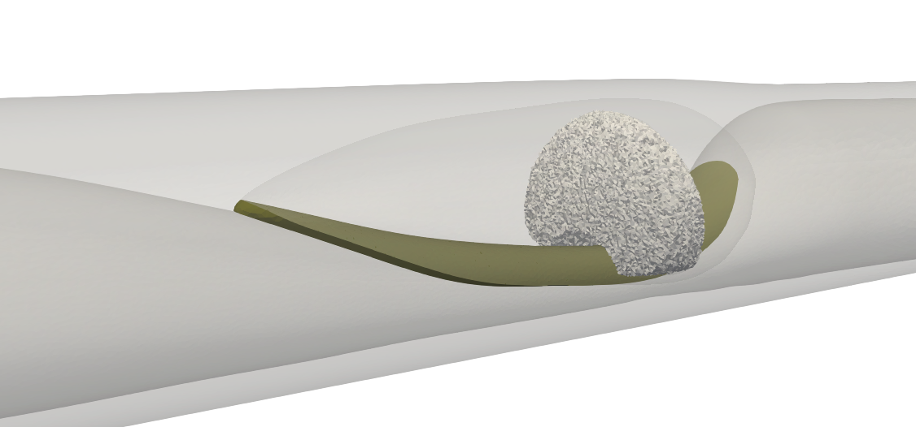
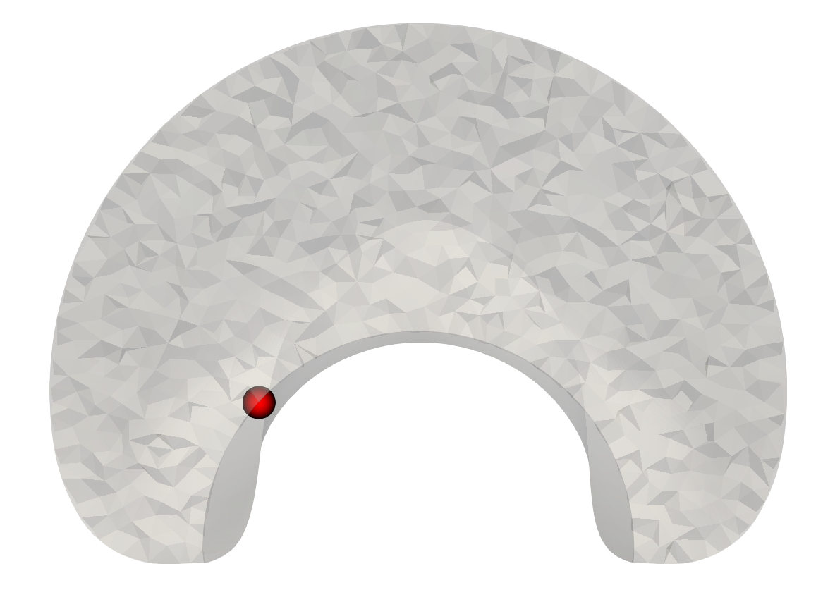
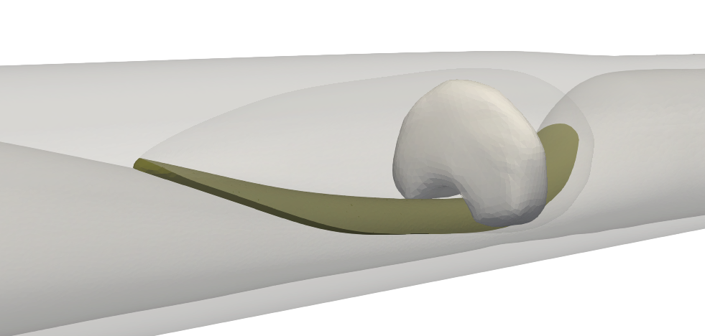
A) Seed location
B) Seed propagation
$$B$$
$$l_{sub}∙s_{ax}$$
$$l_{sub}$$
$$z_{min}$$
$$+z$$
$$z_{seed}$$
$$z_{max}$$
$$Plane B$$
C) Surface smoothing
$${θ_{seed}= θ}_{lipid}\left(z=z_{seed}\right) ∙s_{circ}$$
$$d_{seed}$$
$$θ_{lipid}(z=z_{seed})$$
$$Lumen$$
$$:seed$$
Notes:
Appendix A

Slide 13





$$l_{sub}$$
$$l_{sub}∙s_{ax}$$
$$z_{min}$$
$$z_{max}$$
$$+z$$

Slide 14
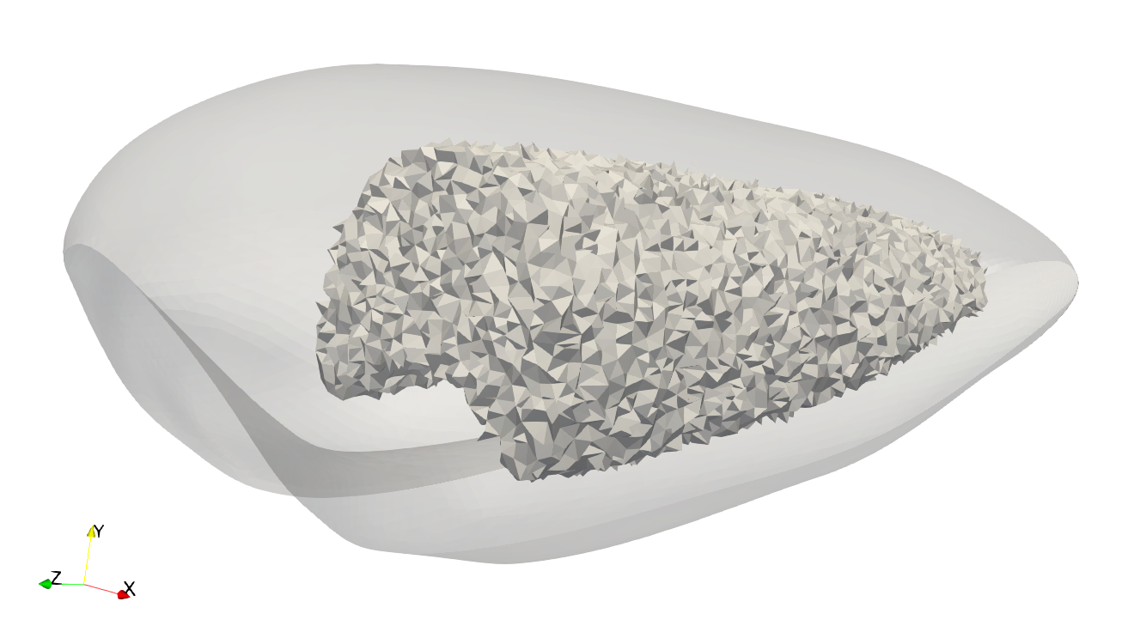
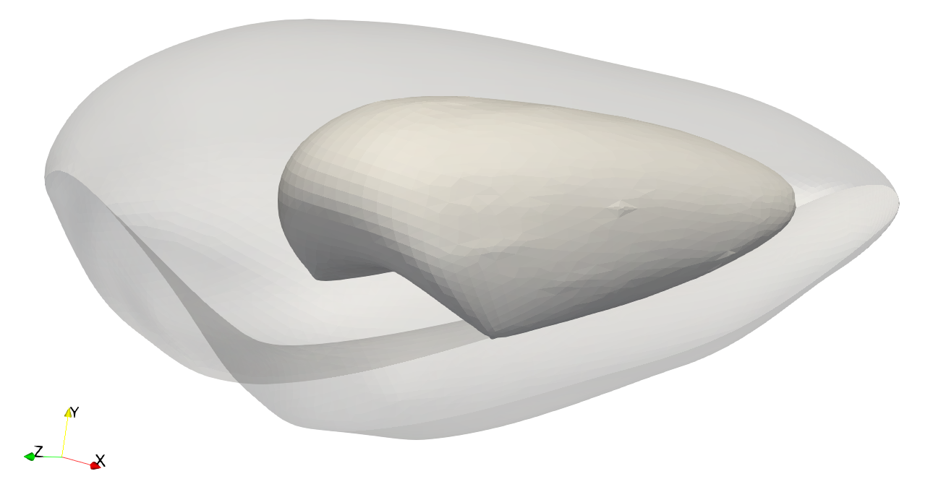
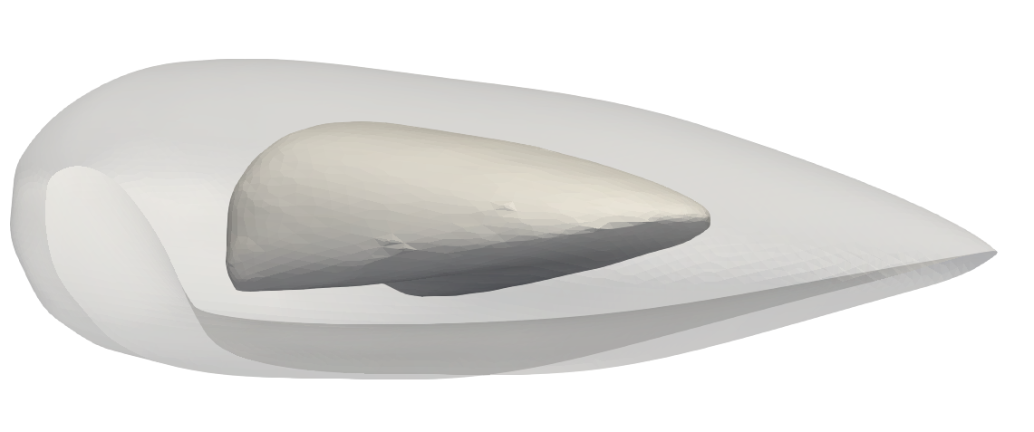
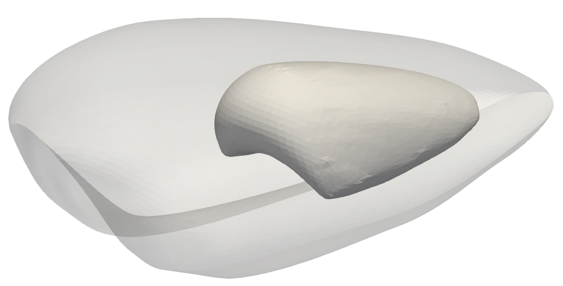
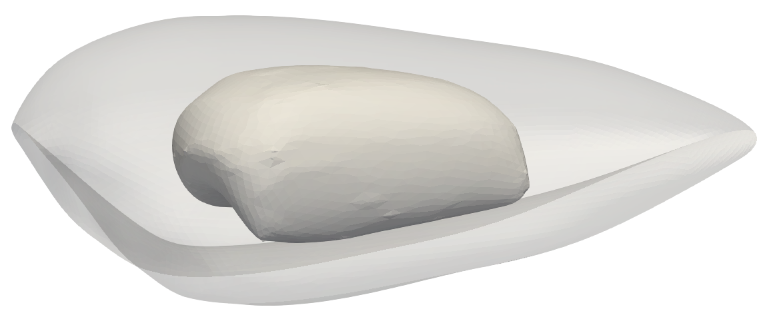
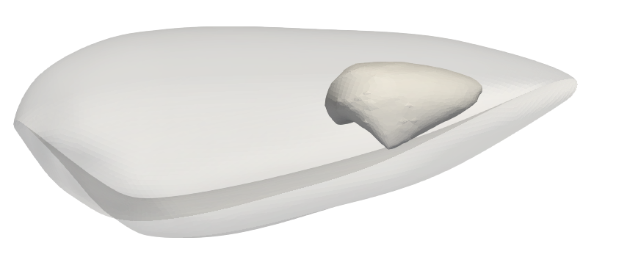
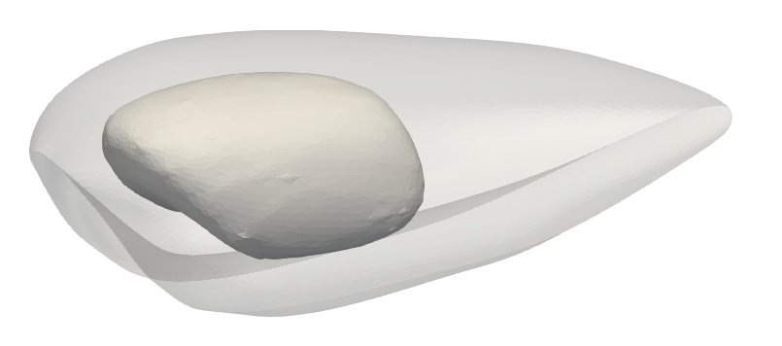
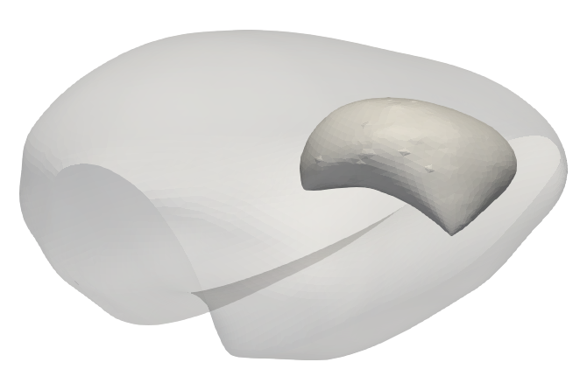
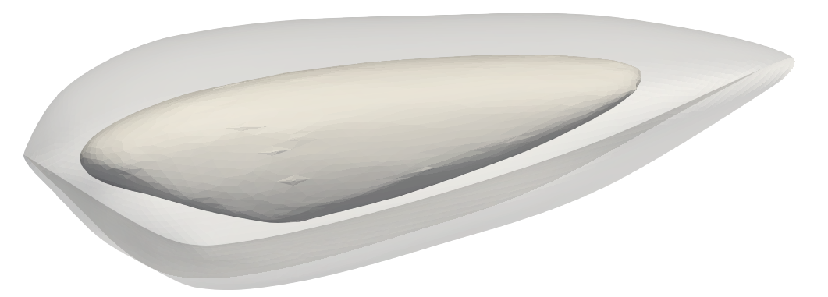
Appendix B - CAD operation
Introduction & Motivation
Seed Propagation
Smooth Surface

Slide 15
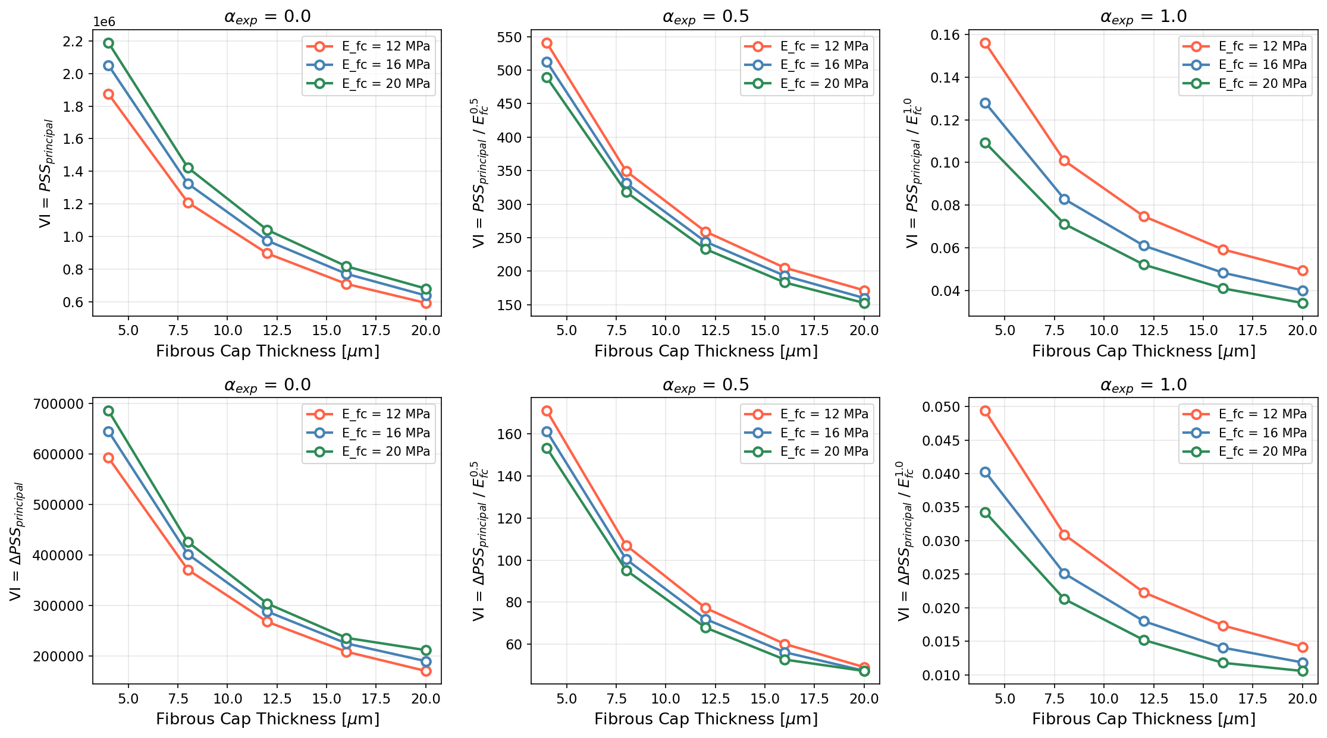
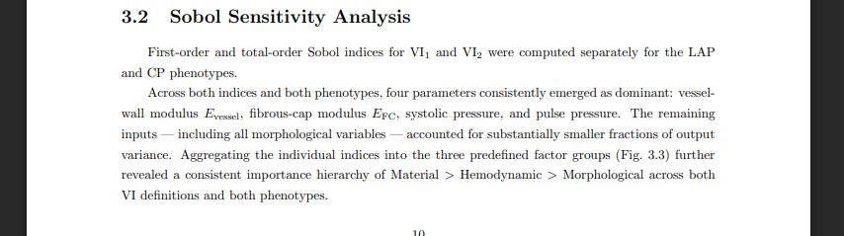

Slide 16
