Slide 1


EMBL-EBI webinars
All microphones will be kept muted throughout the webinar
If you have a question, please type it into the Zoom Q&A box
You can upvote ( ) the questions that you like
We will aim to answer as many questions as possible
Please complete the feedback survey which will launch at the end of the webinar
The webinar will be recorded and added to EMBL-EBI’s on-demand training listings and YouTube
Please note that we do not issue certificates of attendance for our webinars

Slide 2



An introduction to EMBL-EBI data resources
Flaminia Zane
James Blackshaw
Noemi Tejera
Louisse Mirabueno
Scientific Training Officer
Scientific Data Engineer
Scientific Database Curator
Ensembl Outreach Officer
Sandy Rogers
Paulyna Magaña
Aurelien Luciani
Web and Platform Project
Leader
Bioinformatician
Project Leader
(Web Development)

Slide 3
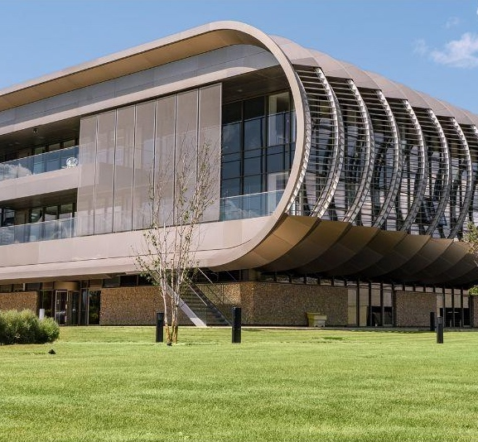
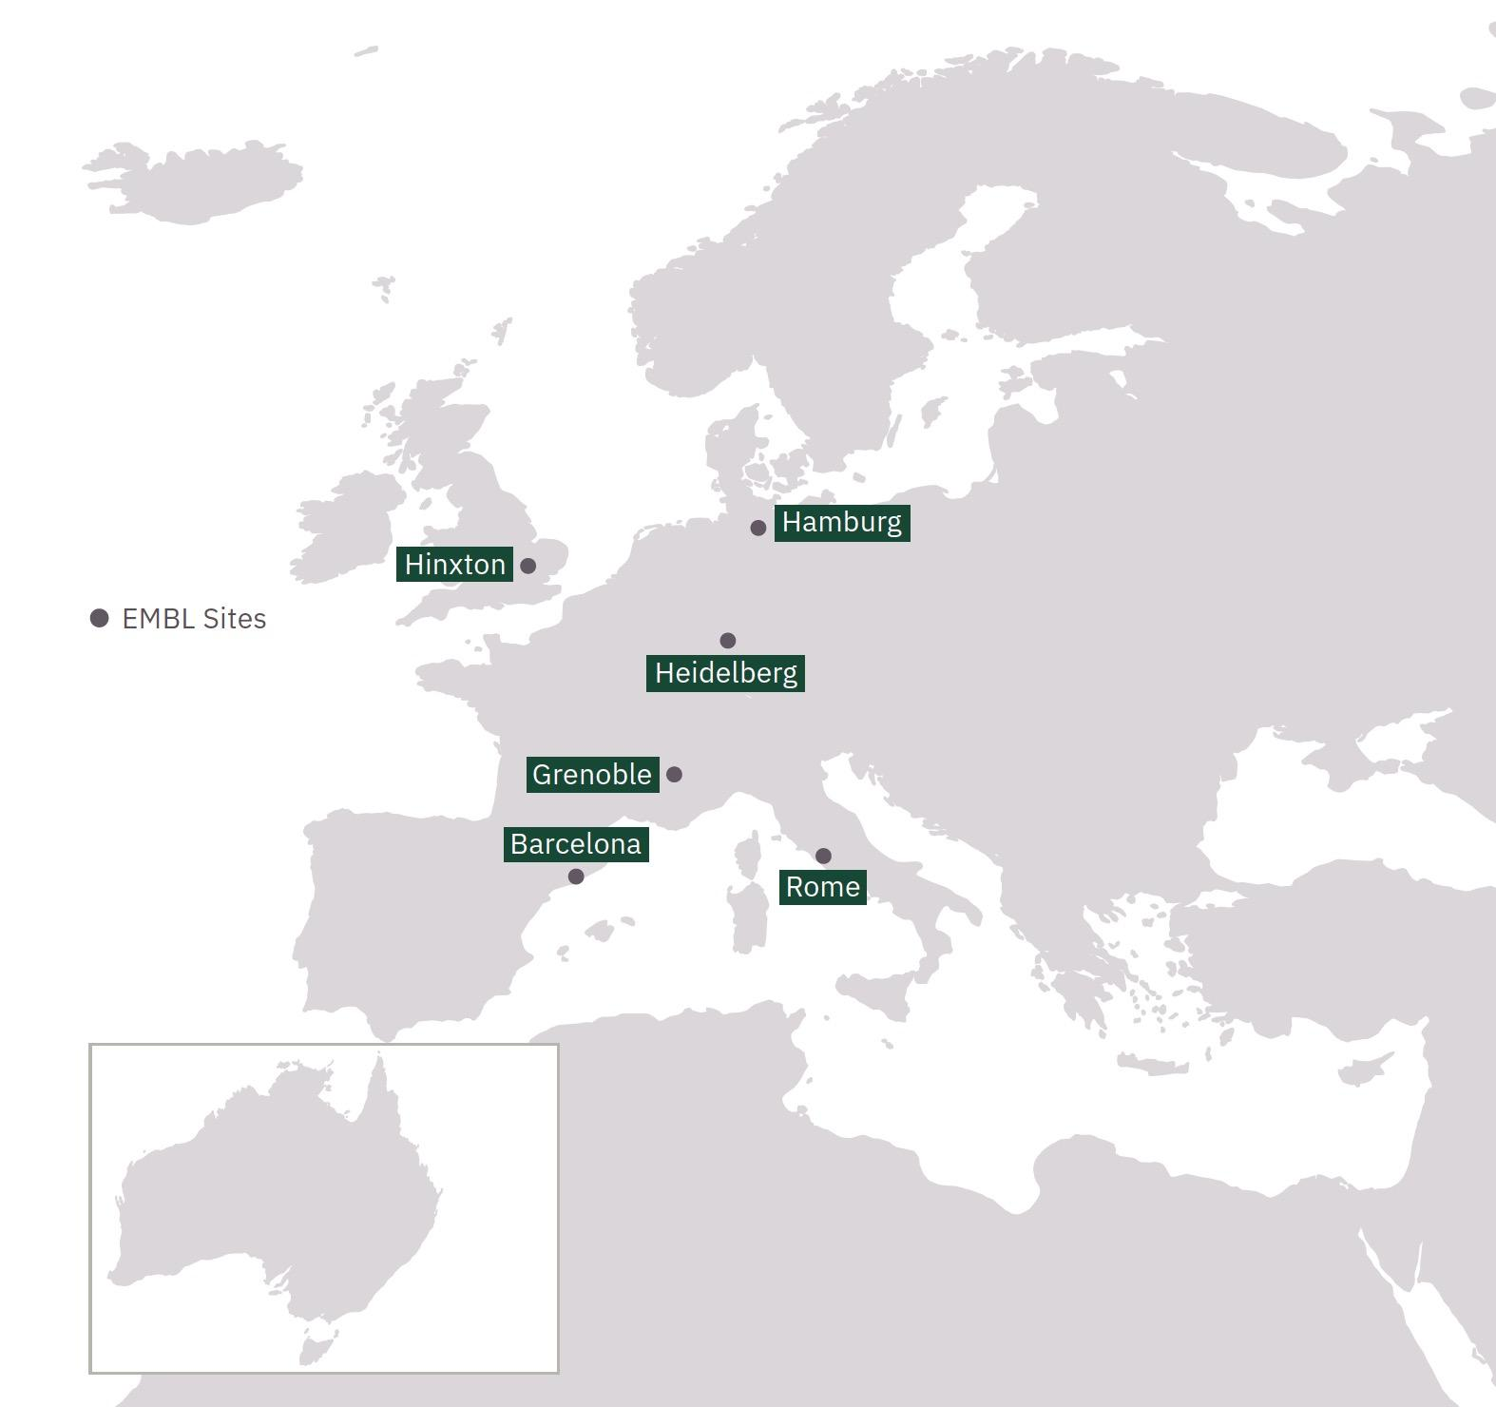
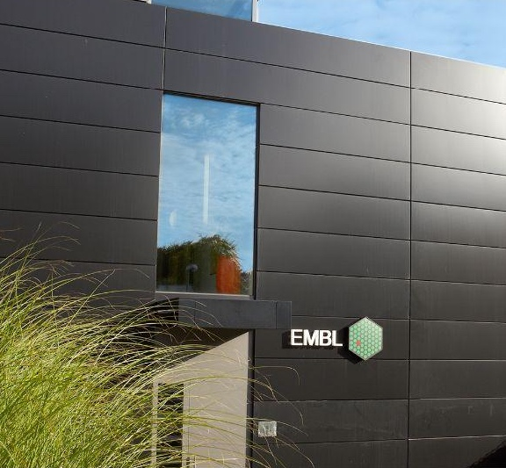
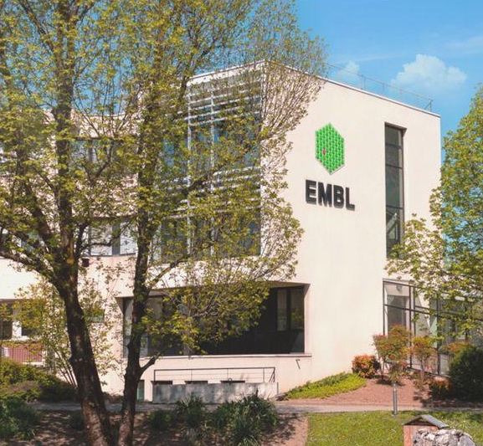
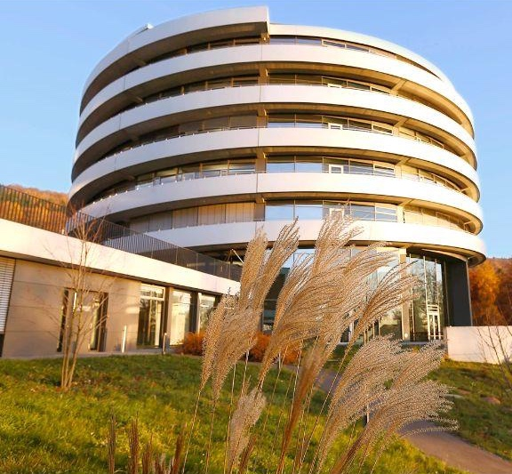
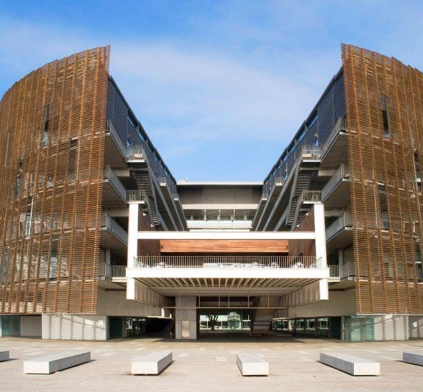
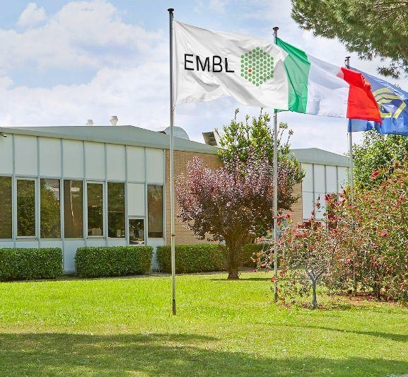
The European Molecular Biology Laboratory
EMBL-EBI
Bioinformatics
Hamburg
Structural biology
Grenoble
Structural biology
Heidelberg
Life sciences
Barcelona
Tissue biology and disease modelling
Rome
Epigenetics
and neurobiology
Looking for an opportunity at EMBL? https://www.embl.org/careers/
Notes:
We’re the second largest of the six EMBL sites. The main lab and administrative centre are in Heidelberg; structural biology labs in Hamburg and Grenoble; epigenetics and neuroscience in Rome, and bioinformatics in Hinxton, UK. Barcelona is the newest site and focuses on tissue biology and disease modelling.
There are around 1,900 staff within EMBL and about 800 of those work at EMBL-EBI.
EMBL was founded in 1974. EMBL-EBI was founded in 1994.
EMBL in numbers:
28 member states.
93 nationalities.
>9000 alumni worldwide

Slide 4
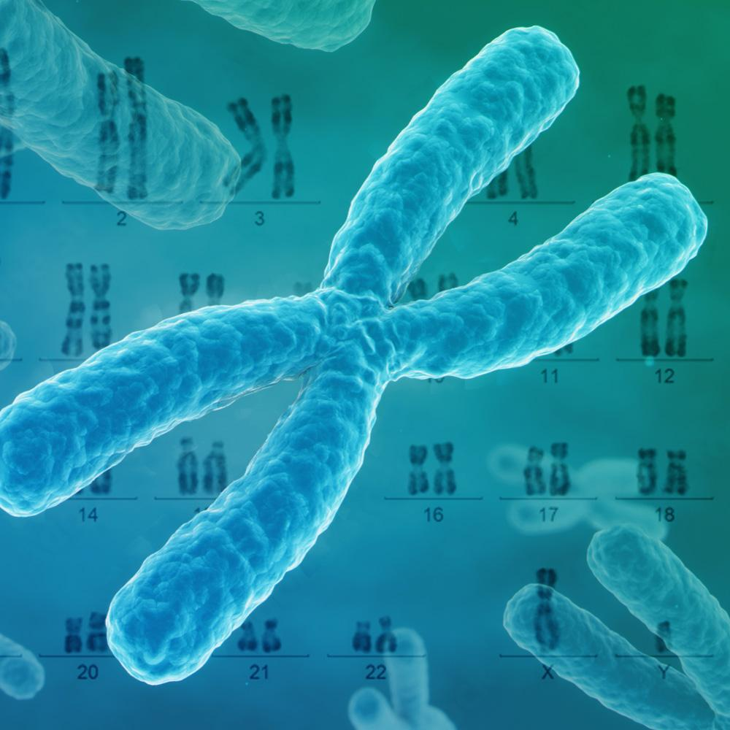
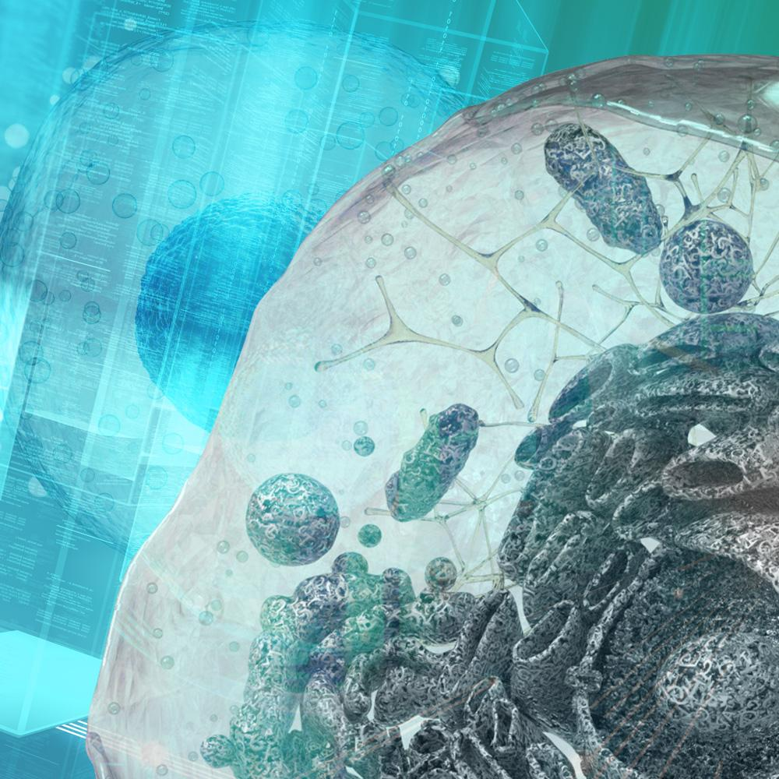


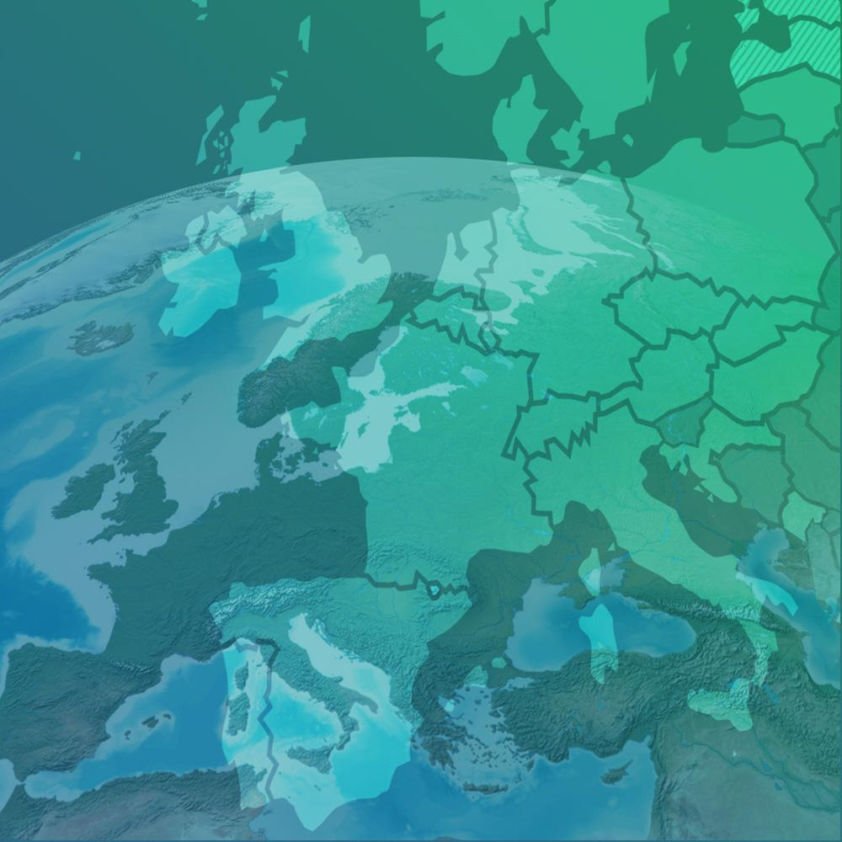
EMBL-EBI mission
Deliver data resources
Perform excellent research
Train the next generation of scientists
Engage with
industry
Coordinate bioinformatics
in Europe
Notes:
Our missions are:
To freely provide data and bioinformatics services to the scientific community in ways that promote scientific progress.
To contribute to the advancement of biology through investigator driven research in bioinformatics.
To provide bioinformatics training to scientists at all levels.
To disseminate cutting-edge technologies to industry and applications of science.
To support, as an ELIXIR Node, the coordination of biomolecular data provision in Europe.

Slide 5































EMBL member states
Member states (29)
Associate
member state
Australia 2008
Austria 1974
Denmark 1974
France 1974
Germany 1974
Israel 1974
Italy 1974
Netherlands 1974
Sweden 1974
Switzerland 1974
United Kingdom 1974
Finland 1984
Greece 1984
Norway 1985
Spain 1986
Belgium 1990
Portugal 1998
Ireland 2003
Iceland 2005
Croatia 2006
Luxembourg 2007
Czech Republic 2014
Malta 2016
Hungary 2017
Slovakia 2018
Montenegro 2018
Lithuania 2019
Poland 2019
Estonia 2023
Latvia 2023
Prospect
member states
Serbia

Slide 6
What’s a data resource?
A data resource is a structured and accessible collection of data.
It includes the tools, infrastructure, and documentation enabling users to:
Store data
Retrieve data
Analyse data
Interpret data
There are currently 45 data resources hosted at EBI.

Slide 7
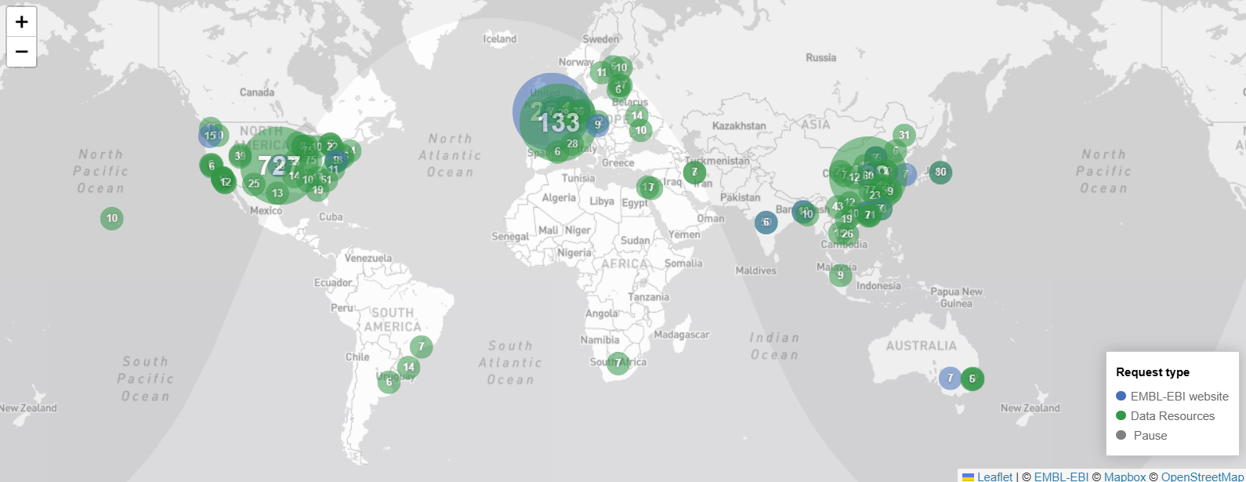
Who uses EMBL-EBI services?
You can check out the live map here : https://www.ebi.ac.uk/web/livemap/

Slide 8
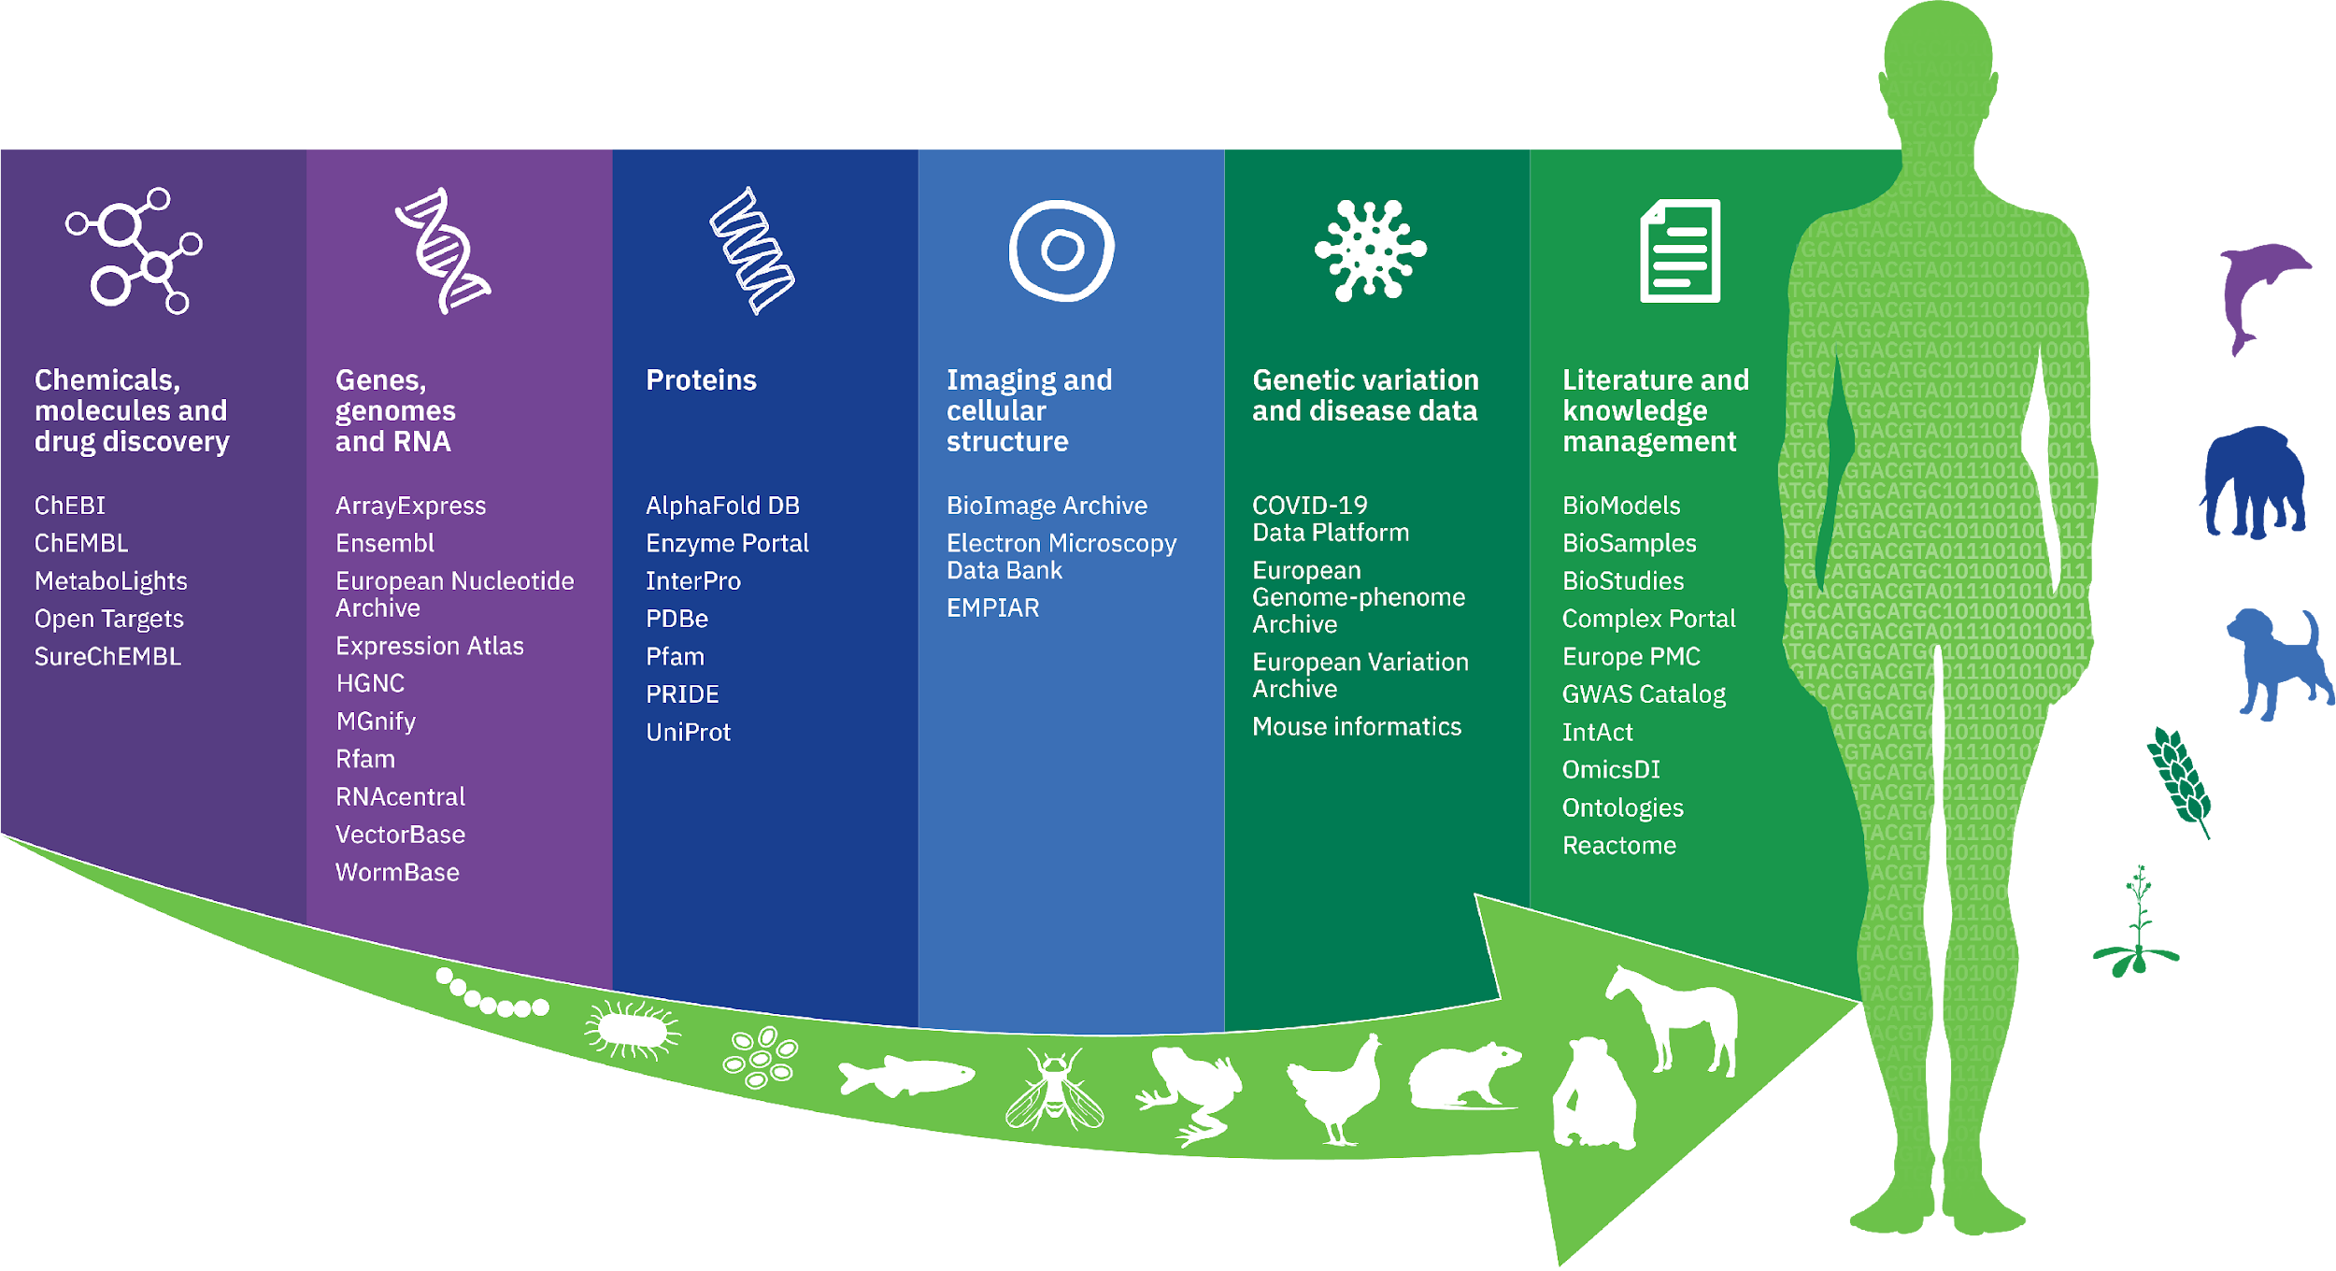
Data resources at EMBL-EBI
*
Notes:
Overview of EMBL-EBI data services which span the whole scope of life science
Key messages: Our data and tools are freely available, without restriction. The only exception is potentially identifiable human genetic information, for which access depends on research consent agreements.

Slide 9
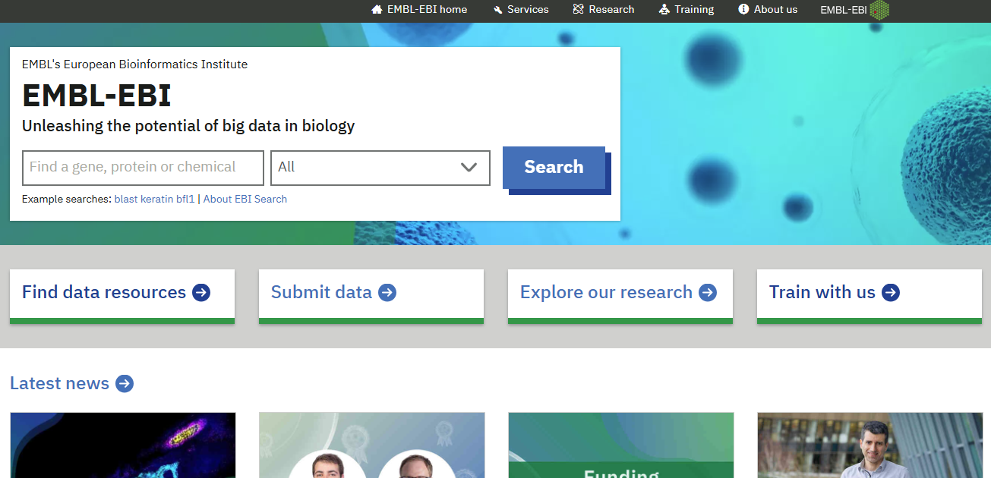
Where to start?
https://www.ebi.ac.uk/
Look for data - Submit data - Training

Slide 10
Look for data

Slide 11
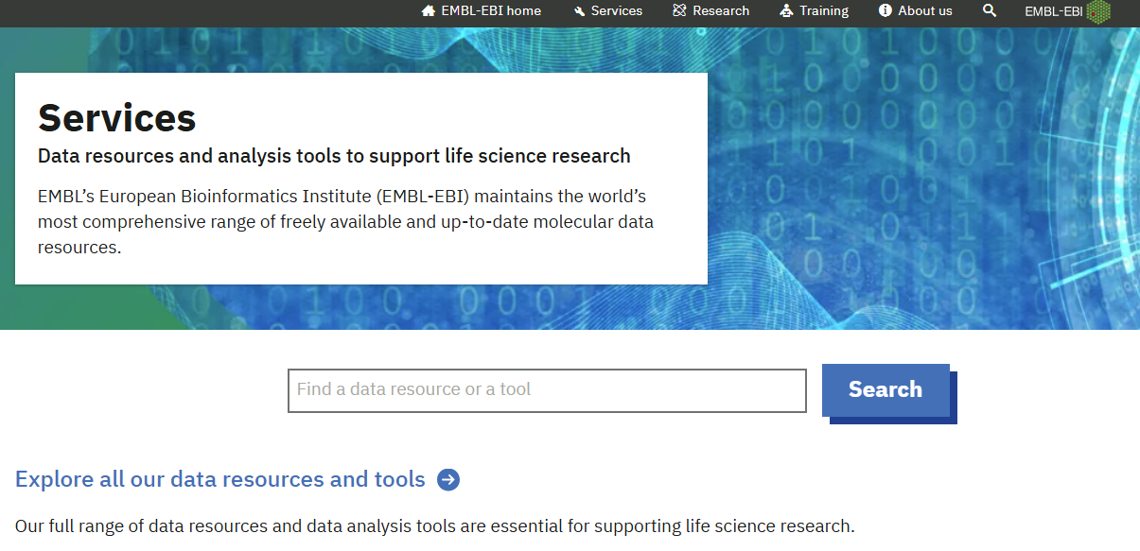
Look for data
https://www.ebi.ac.uk/services/

Slide 12
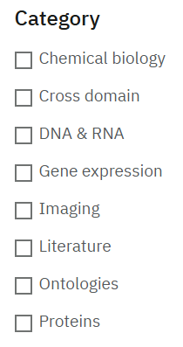
Look for data

Slide 13
Submit data

Slide 14
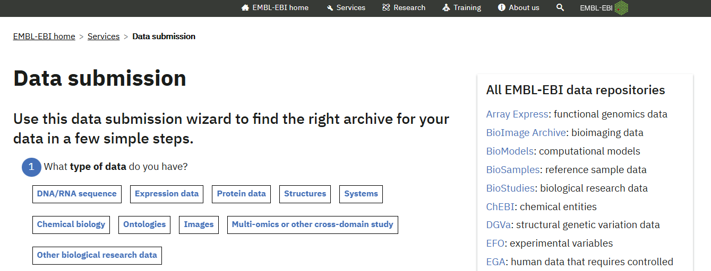
Submit data
https://www.ebi.ac.uk/submission/

Slide 15
Training

Slide 16
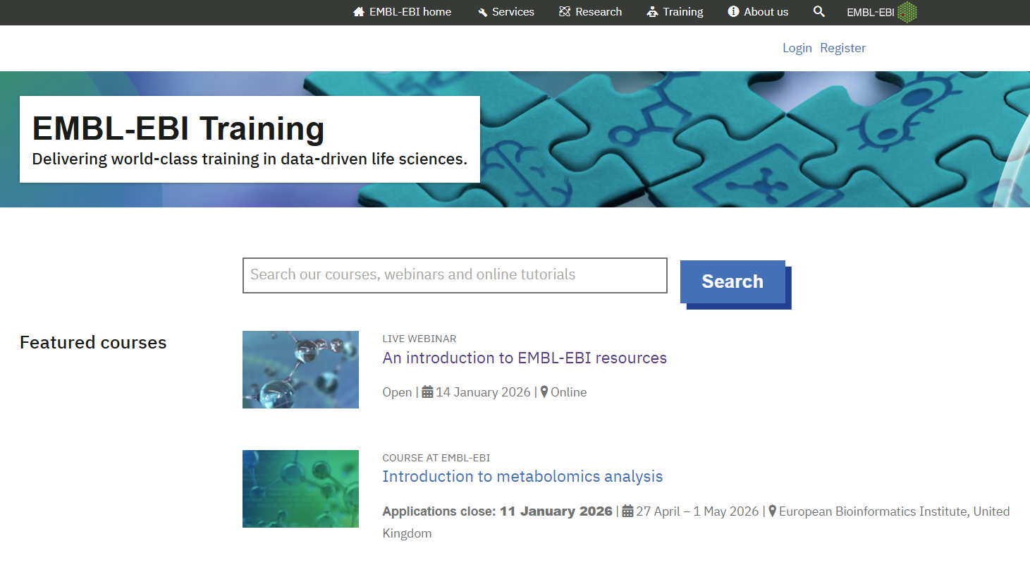
Training
https://www.ebi.ac.uk/training/

Slide 17
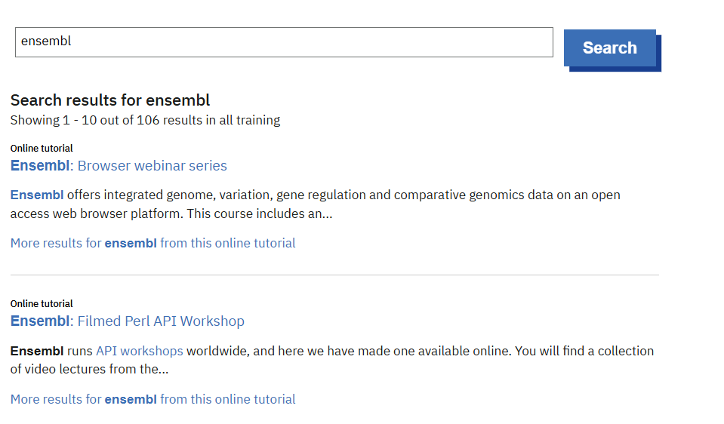
Training

Slide 18
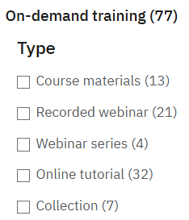
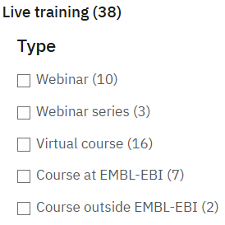
Training

Slide 19
EMBL-EBI resources: flash talks & panel discussion
James Blackshaw
Noemi Tejera Hernandez
Louisse Mirabueno
Scientific Data Engineer
Scientific Database Curator
Ensembl Outreach Officer
Sandy Rogers
Paulyna Magaña
Aurelien Luciani
Web and Platform Project
Leader
Bioinformatician
Project Leader
(Web Development)

Slide 20
Chemicals, DNA & Proteins

Slide 21





Chemicals, DNA & Proteins
James Blackshow
Scientific Data
Engineer
Noemi Tejera Hernandez
Scientific Database
Curator

Slide 22





Chemicals, DNA & Proteins
James Blackshow
Scientific Data
Engineer
Noemi Tejera Hernandez
Scientific Database
Curator
Louisse Mirabueno
Ensembl Outreach
Officer
Sandy Rogers
Web and Platform
Project Leader

Slide 23






Chemicals, DNA & Proteins
James Blackshow
Scientific Data
Engineer
Noemi Tejera Hernandez
Scientific Database
Curator
Louisse Mirabueno
Ensembl Outreach
Officer
Sandy Rogers
Web and Platform
Project Leader
Aurélien Luciani
Project Leader
(Web Development)
Paulyna Magaña
Bioinformatician

Slide 24

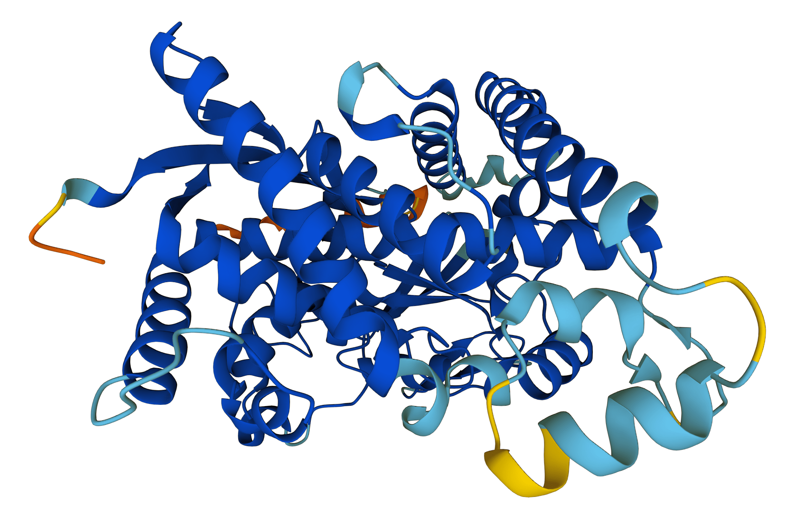

ChEMBL: Exploring compound-target interactions
Activities (24M)
📊
Compounds (2.9M) linked to bioactivity data
Compound-target
interaction (+ve or -ve)
Targets (17.8k)
linked to bioactivity data
Bioassays (1.9M)
Links to tested compound
Links to tested target
ChEMBL links drug-like compounds to their biological targets, via assays and bioactivities. ChEMBL includes diverse assay setups and readouts.

Slide 25

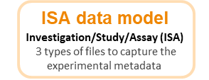
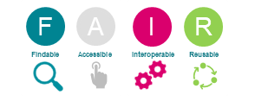
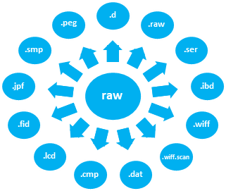
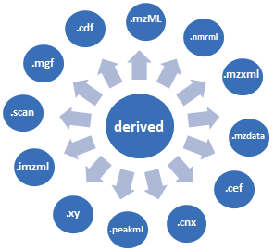
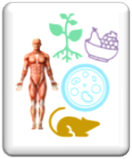
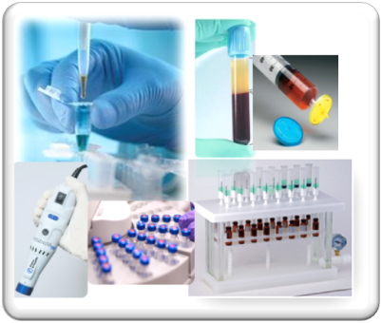
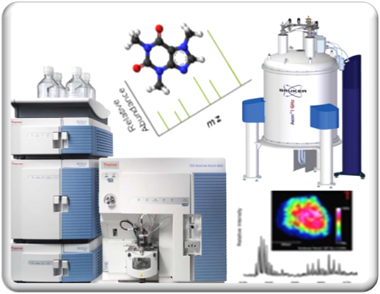


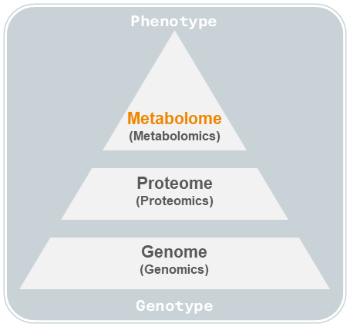










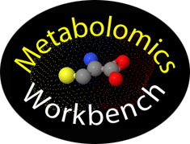



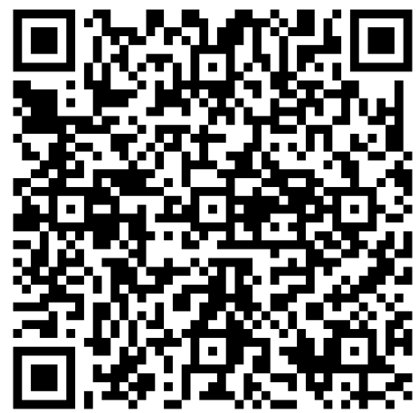
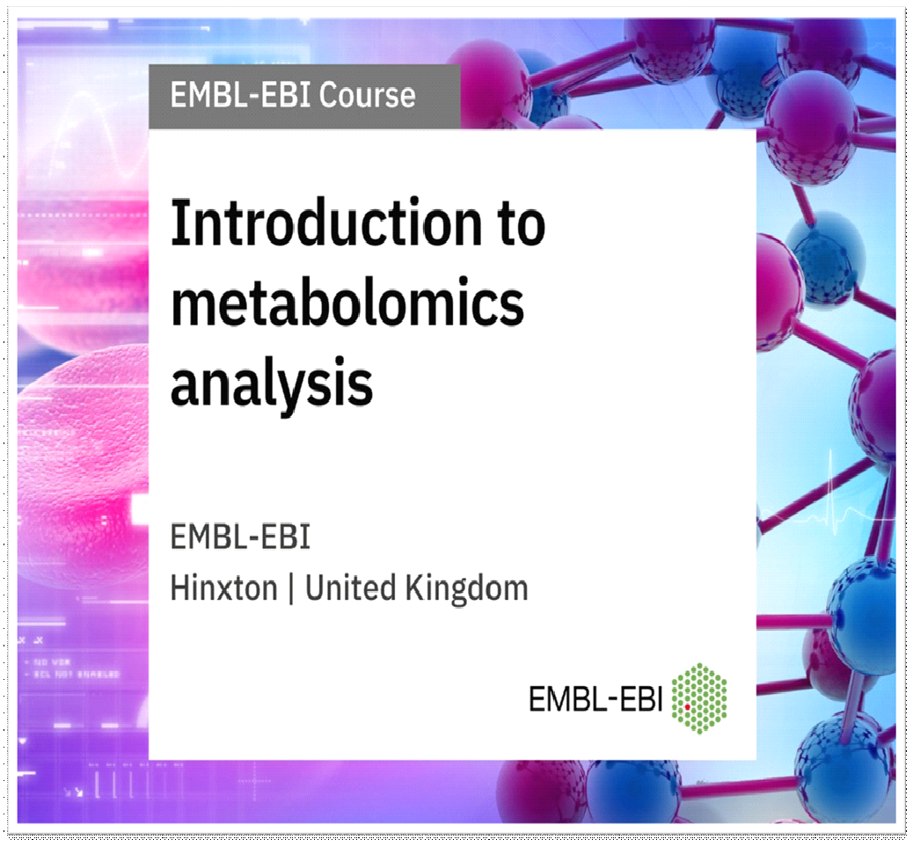

Metabolomics
Metabolomics Analysis
Raw + Derived Data
Metabolite annotations and rich Metadata
The home for Metabolomics Experiments and Derived Information
Open Source / Open Access
Cross species, Cross technique
Comprehensive information collection
Controlled vocabularies / Ontologies
The scientific study of the set of metabolites present within an organism, cell, or tissue
Lipidomics
The scientific study of the of the lipidome of an organism
Sample collection, Preparation, Analysis
Exposomics
PUBLIC REPOSITORIES
Metabolite annotation/identification
The scientific study of all environmental exposures (chemicals, diet, lifestyle, infections, etc.) throughout a person's life.
SUBMISSIONS
RE-USE
COLLABORATIONS
OUTREACH/TRAINING
Partner Resources, Institutions, Core Facilities / Industry partners
2000+ Public Studies
7300+ Organisms
300+ TB of Data
MetabolomicsHub
www.metabolomicshub.org
Individual researchers
Industry/
Companies
Partners:
Funder:
Labs
Phenome Centers
27 Apr-01 May 2026
https://www.ebi.ac.uk/metabolights/

Slide 26
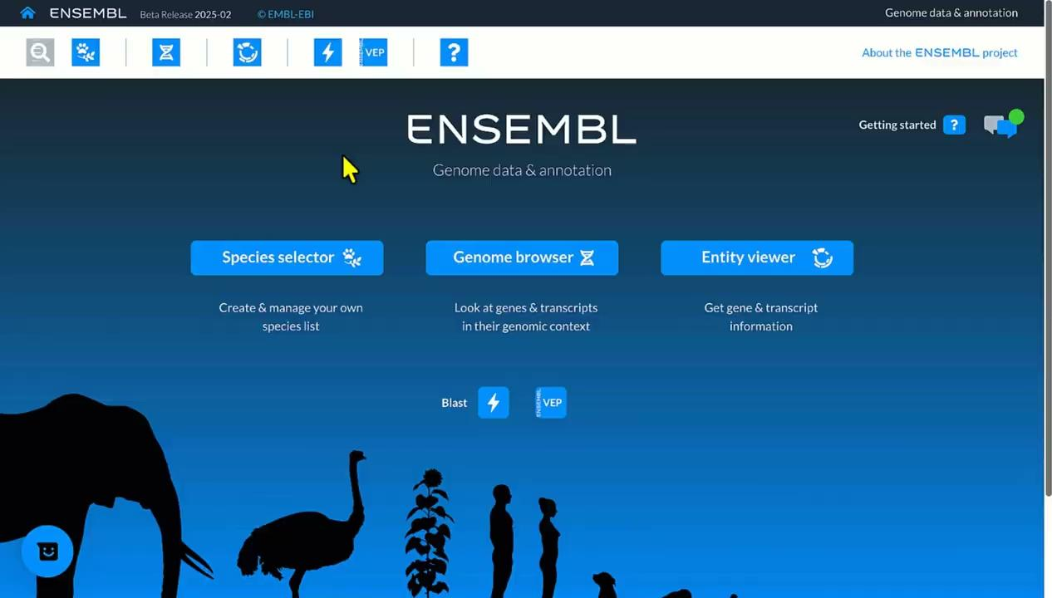
Ensembl Genome Browser
Click here to visit Ensembl

Slide 27
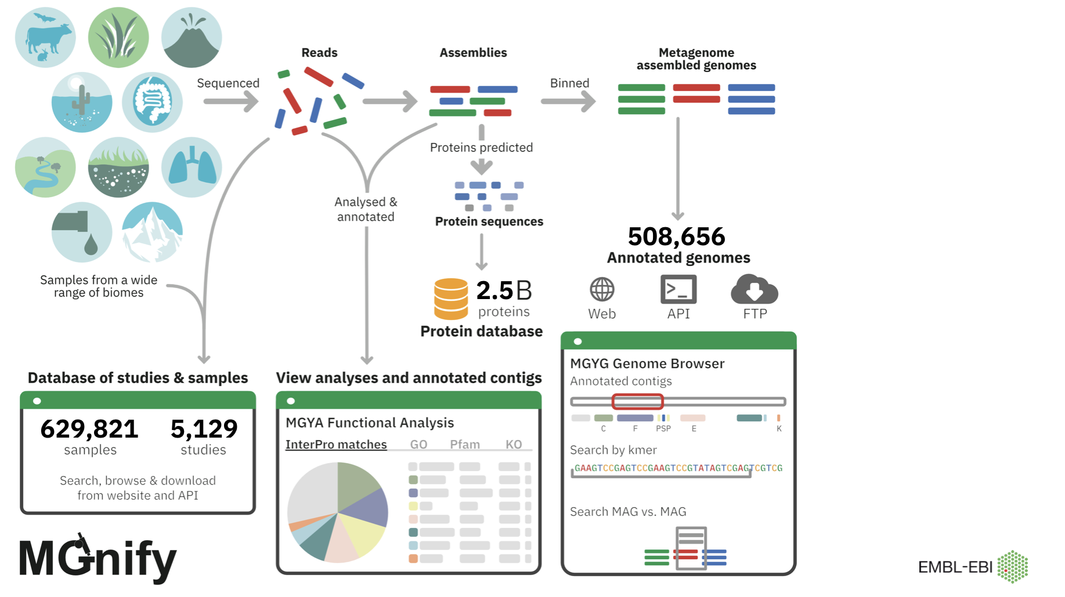

Slide 28

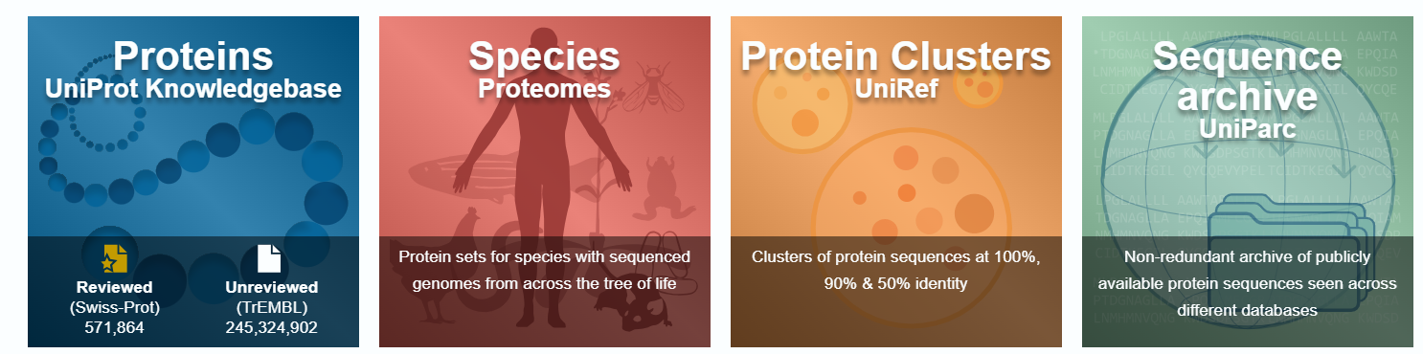
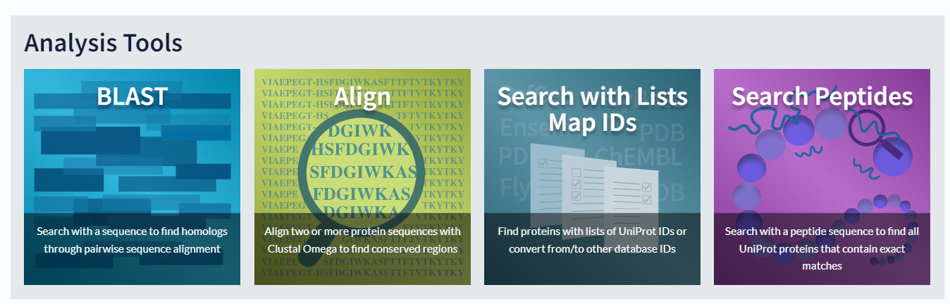
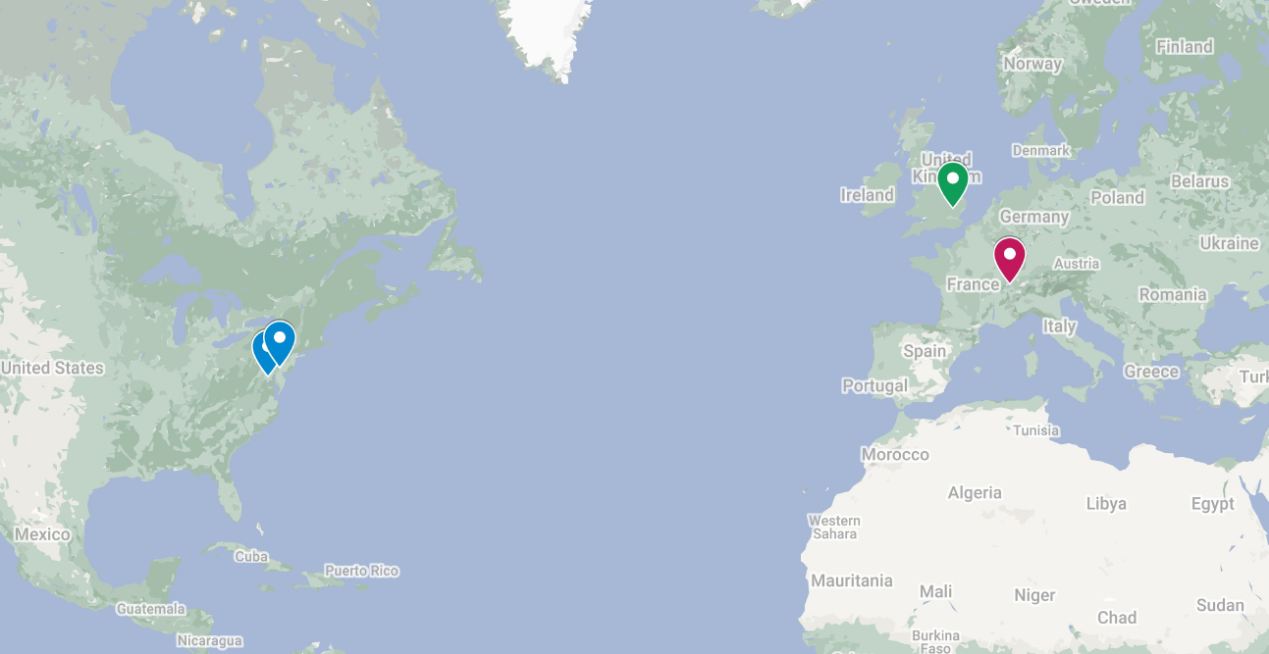



the Universal Protein Resource
A comprehensive, high-quality and publicly accessible resource of protein sequence and functional information
Primary sequences (canonical & isoforms)
Physiological protein functions
Domains, PTMs, mutations, …
Structural information and viewers
The UniProt Consortium:
EBI - SIB - PIR
Xrefs to 180+ resources

Slide 29

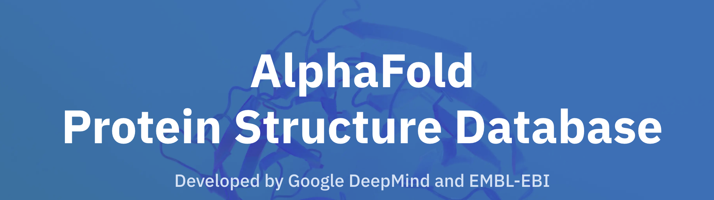

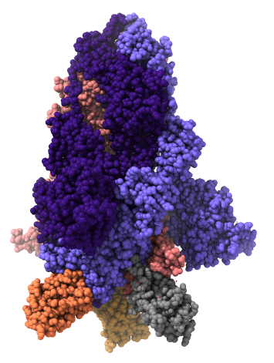
PDBe: The hub of Structural Biology
3D-Beacons
Integrated data access to experimental and predicted structures
241M+ predicted structures, including 40K+ isoforms.
361 million TED annotations, and AlphaMissense pathogenicity scores.
PDBe-KB
Integrated biological context
Ligand-binding sites
Predicted ligand-binding sites
247K+ experimentally determined macromolecules.
Collect, curate, store and distribute experimentally determined 3D structures of biological macromolecules.
Known variants
homotrimer
Macromolecular interaction interfaces
pdbe.org | pdbe-kb.org | alphafold.ebi.ac.uk | 3d-beacons.org

Slide 30
Thank you

Slide 31
Panel discussion

Slide 32
Additional material
In the following slides, you will find a list of useful links compiled together by our speakers. Those will help you as you start navigating through the different resources!
For any questions or query related what discussed at the webinar, feel free to contact us.
For any further questions about a given resource, it may be better to directly reach out to those: you will find the main contact points listed in the “Contacts” slide.

Slide 33
Useful links
Protein Data Bank in Europe
PDBe: Homepage | Protein Data Bank in Europe
Protein Data Bank in Europe Knowledge Base: PDBe - Protein Data Bank in Europe – Knowledge Base
3D-Beacons: 3D-Beacons Network
Trainings:
  PDBe | EMBL-EBI Training
  Analysing and evaluating macromolecular models | EMBL-EBI Training
AlphaFold Database
AlphaFold Protein Structure Database
FAQ for AFDB: Frequently asked questions
API documentation: Programmatic access API endpoints
Trainings:
  AlphaFold | EMBL-EBI Training
  Navigating the AlphaFold database | EMBL-EBI Training

Slide 34
ChEMBL Links
Resources for new ChEMBL users | Exploring drugs and drug-like compounds with ChEMBL ChEMBL quick tour ChEMBL web services documentation For data queries, error reporting or help requests, email: chembl-help@ebi.ac.uk
Resources for prospective depositors | Basic guide to depositing data into ChEMBL ChEMBL deposition process guides and checklists Full data specification for deposited files To contact us about deposition please email data-deposition-chembl@ebi.ac.uk.
Updates on ChEMBL | The ChEMBL-og
DB dumps and downloads | ChEMBL FTP site

Slide 35
UniProt Links
Home page https://www.uniprot.org/
Documentation and help https://www.uniprot.org/help
UniProt training resources at EBI https://www.ebi.ac.uk/training/services/uniprot
Current training webinar series https://www.ebi.ac.uk/training/events/uniprot-2025-26/
UniProt YouTube channel https://www.youtube.com/c/uniprotvideos/featured
UniProt LinkedIn page https://www.linkedin.com/company/uniprot/
UniProt contact page https://www.uniprot.org/contact

Slide 36
Ensembl Genome Browser
A free, open-access platform supporting research across genomics, evolution, functional annotation, and disease studies:
  Gene annotation: Gene and transcript annotation
  Variation: Variant annotation with variant effect prediction, population genetics data
  Regulatory features: Promoters, enhancers, binding sites
  Comparative genomics: Homology, gene trees, whole-genome alignments across species
Ensembl training is available on the EMBL-EBI Training and Ensembl Training portals
News and updates are announced on the Ensembl Blog
Contact the Ensembl Helpdesk for any queries
Click here to visit Ensembl

Slide 37
How to get in touch with the resources?
ChEMBL | Contact links & FAQ
MetaboLights | Contact links
Ensembl | Ensembl Helpdesk
MGnify | Help & Support page
PDBe | Contact links
AlphaFold database | Check “Who should I contact with enquiries?” on FAQs page, or directly reach out to our Helpdesk.
UniProt | Contact page

