Slide 1
Customer Segmentation and Personalization
An analysis using K-means clustering and PCA.

Slide 2
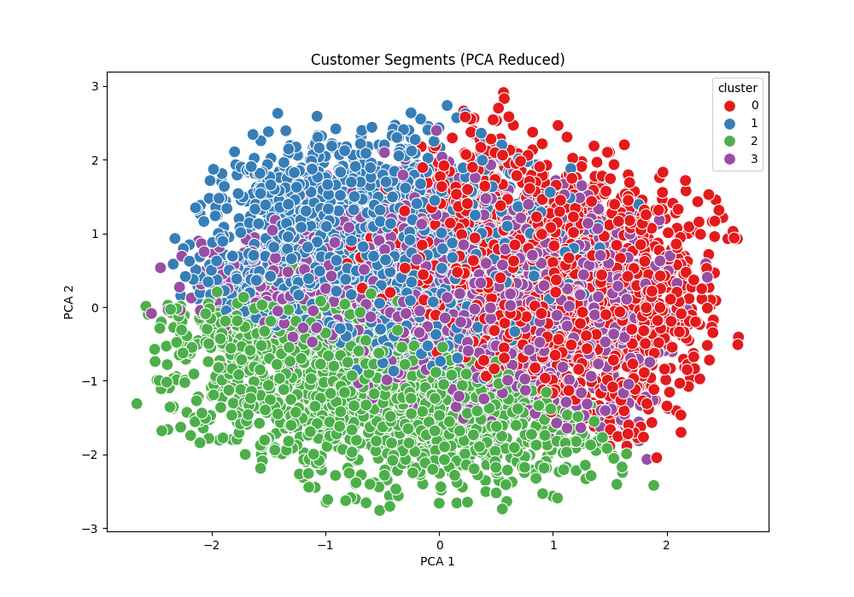
Customer Segments (PCA Reduced)

Slide 3
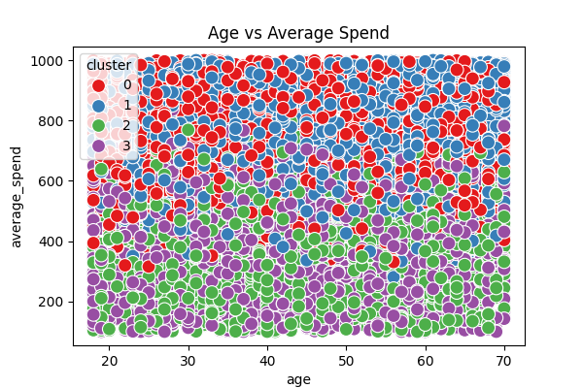
Age vs Average Spend

Slide 4
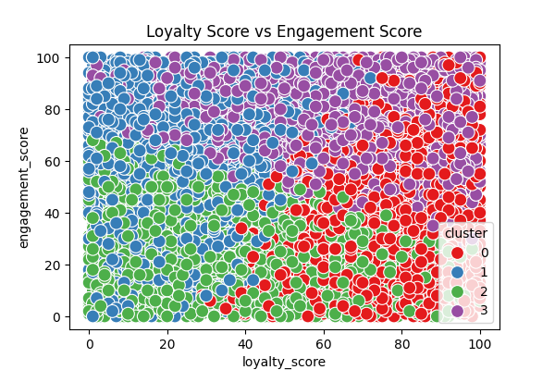
Loyalty Score vs Engagement Score

Slide 5
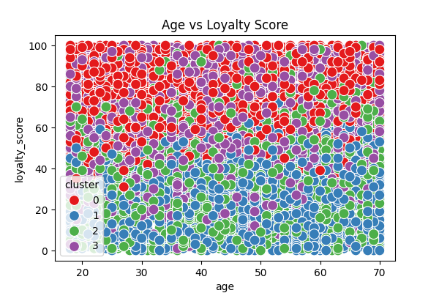
Age vs Loyalty Score

Slide 6
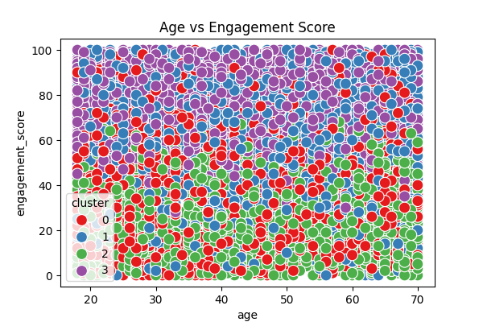
Age vs Engagement Score

Slide 7
Conclusion
We applied K-means clustering to segment customers into 4 distinct groups based on their age, spending behavior, loyalty, and engagement. PCA was used to reduce the dimensionality for visualization purposes. This analysis provides valuable insights into customer segmentation for targeted marketing.

