Slide 1
Sit this way if you want to work on:
Sit this way if you want to work on:
Challenge 1
Extract molecular information from Q-Chem output
Concepts:
Organizing functionality into classes
Parsing text-based files
matplotlib
I want to learn:
General programming concepts
Challenge 2
Analyze transient absorption (TA) data
Concepts/tools:
extracting structured but imperfect info from a file
fitting w/ multiple functions
automated visualization
matplotlib
numpy/scipy
I want to learn:
Automated data analysis

Slide 2
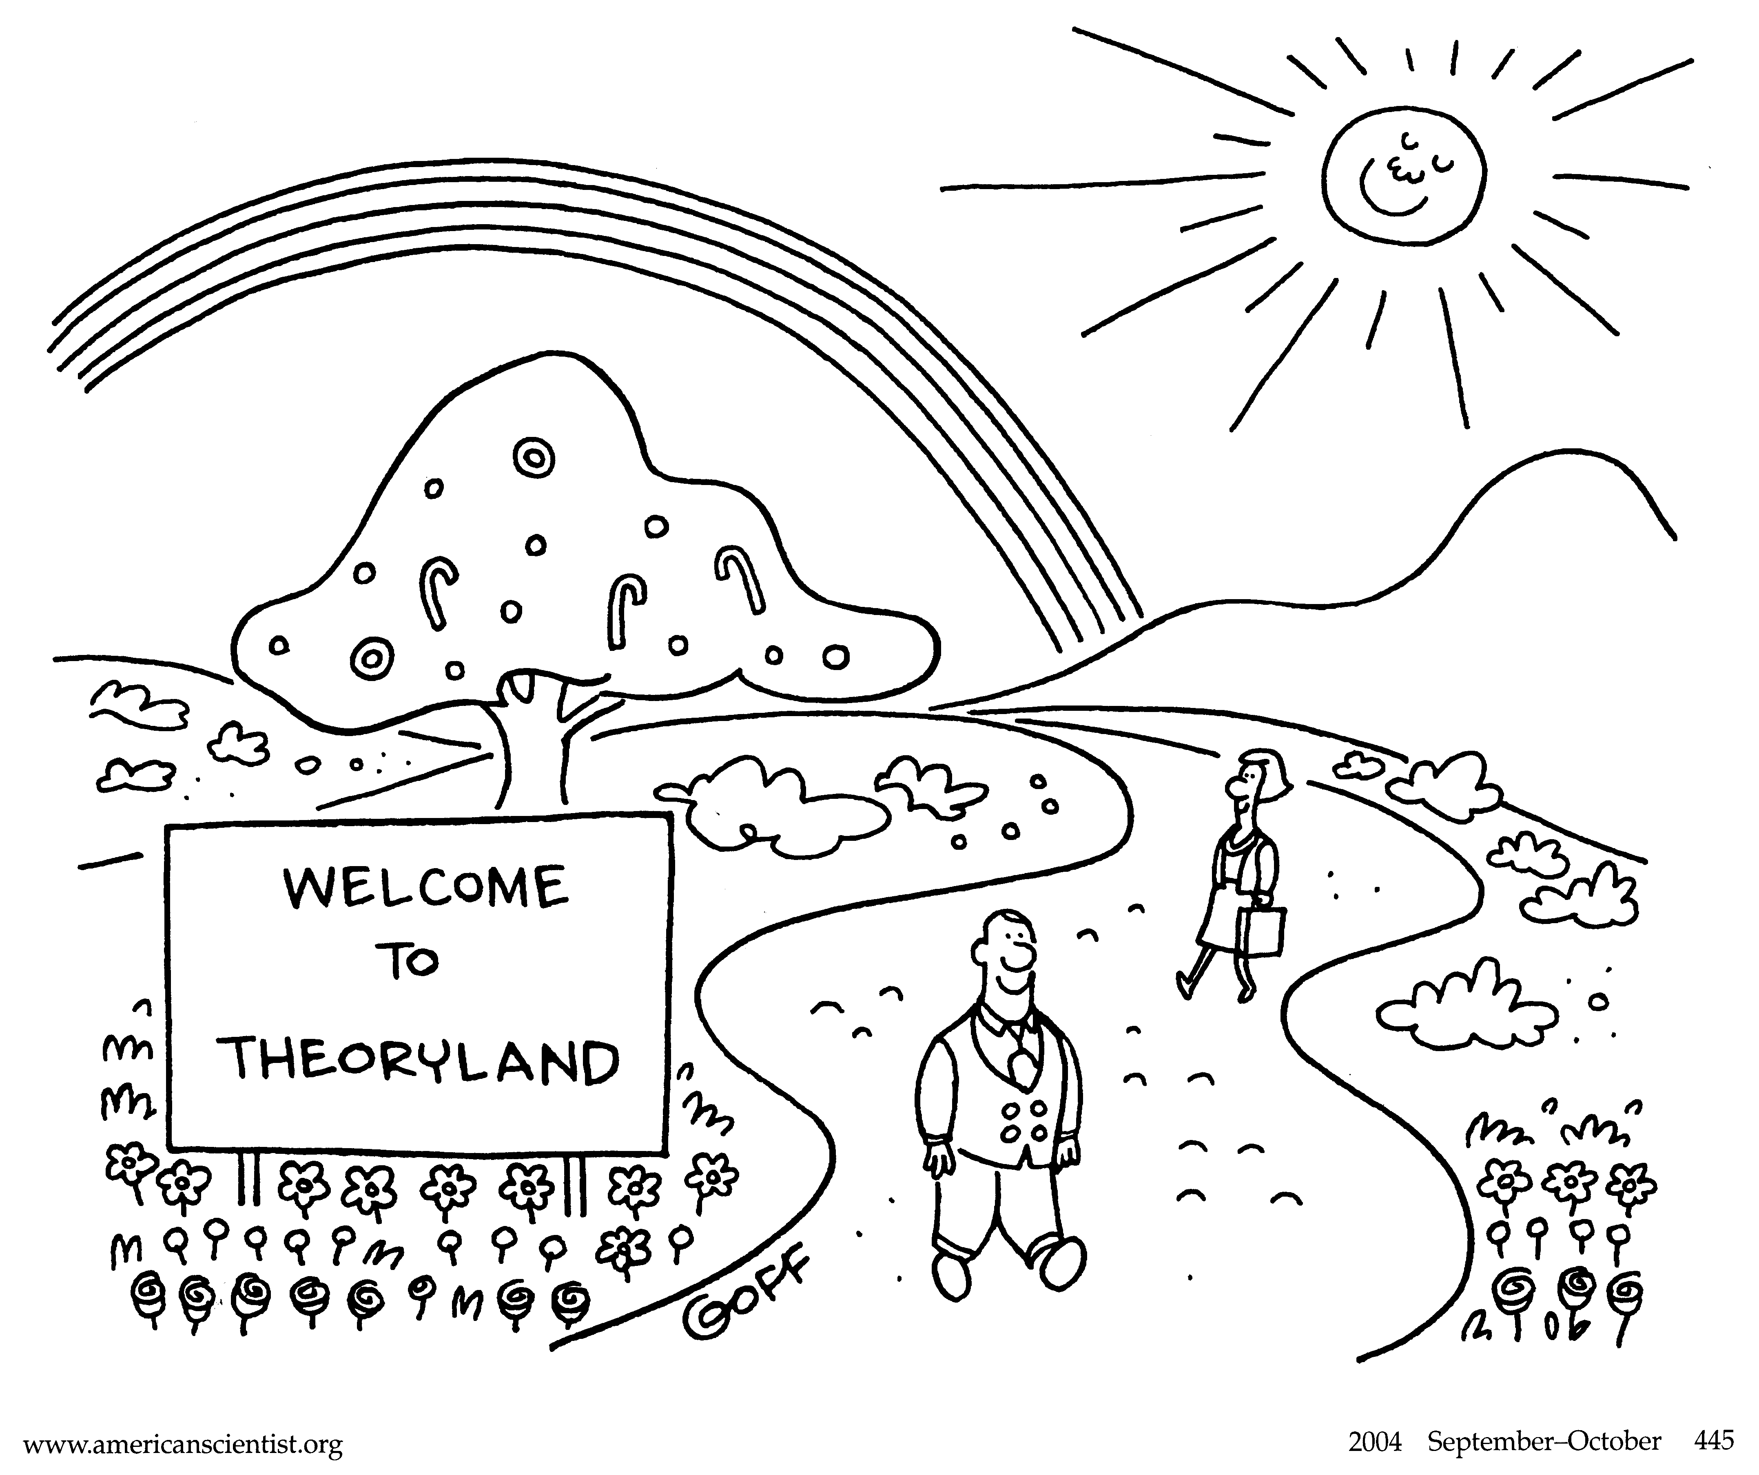
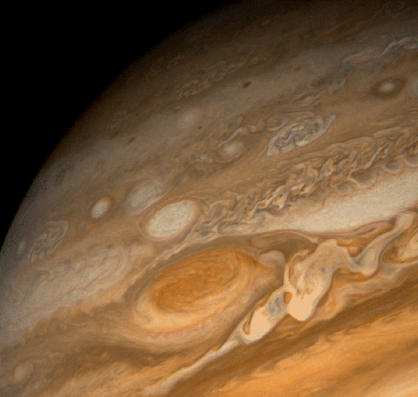
Come to Jupiter!
Thursdays at 2 PM in 4026 (ANSER willing)
Talk about code, things you are building
Productive procrastination!

