Slide 1


Slides and Content
The Guts Of: VSCode PowerShell Extension
Justin Grote
Bluesky: posh.guru

Slide 2


Slide 3
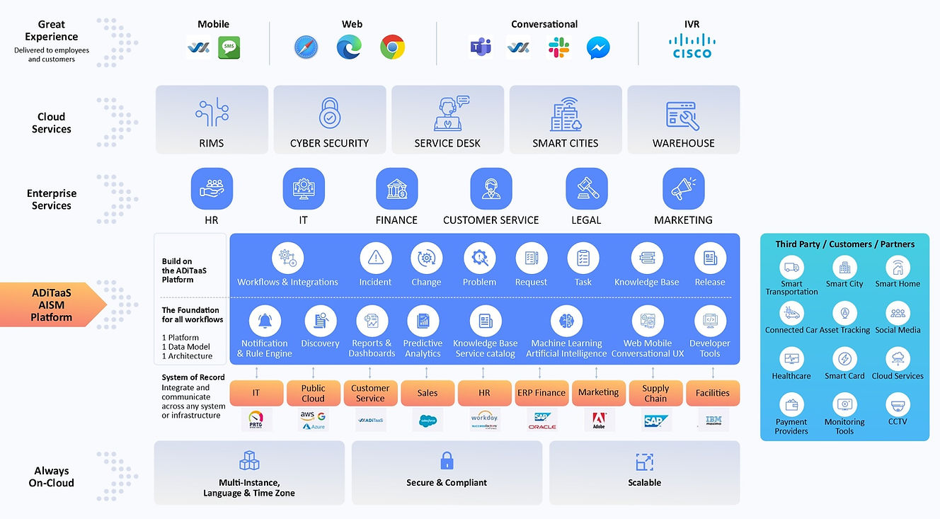
Thank you Allied Digital!

Slide 4







PowerShell Extension Components
Electron
Visual Studio Code
Extension Host
PowerShell Process
PowerShell Extension
Starts
PowerShell Editor Services
PowerShell Runspace
OmniSharp LSP Server
VSCode LSP Client
Named Pipe

Slide 5

PowerShell Extension Components

Slide 6
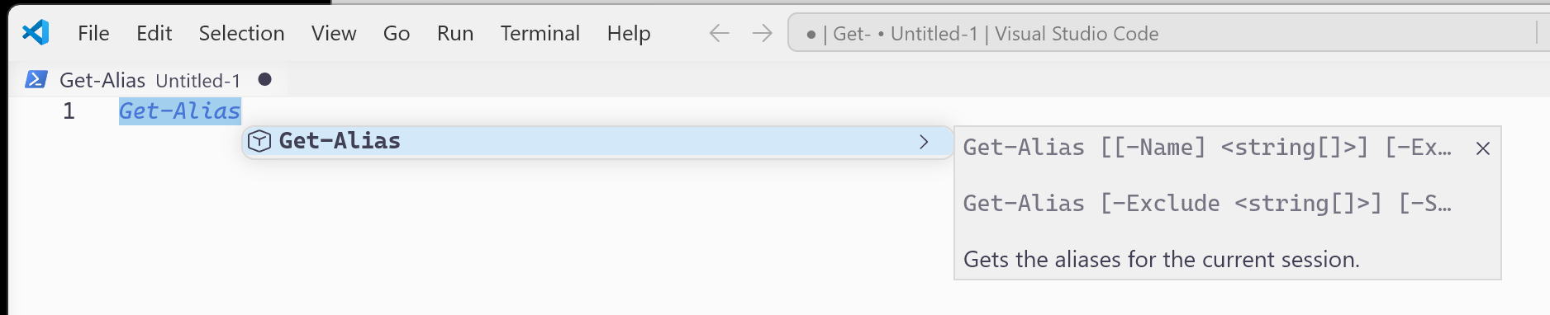
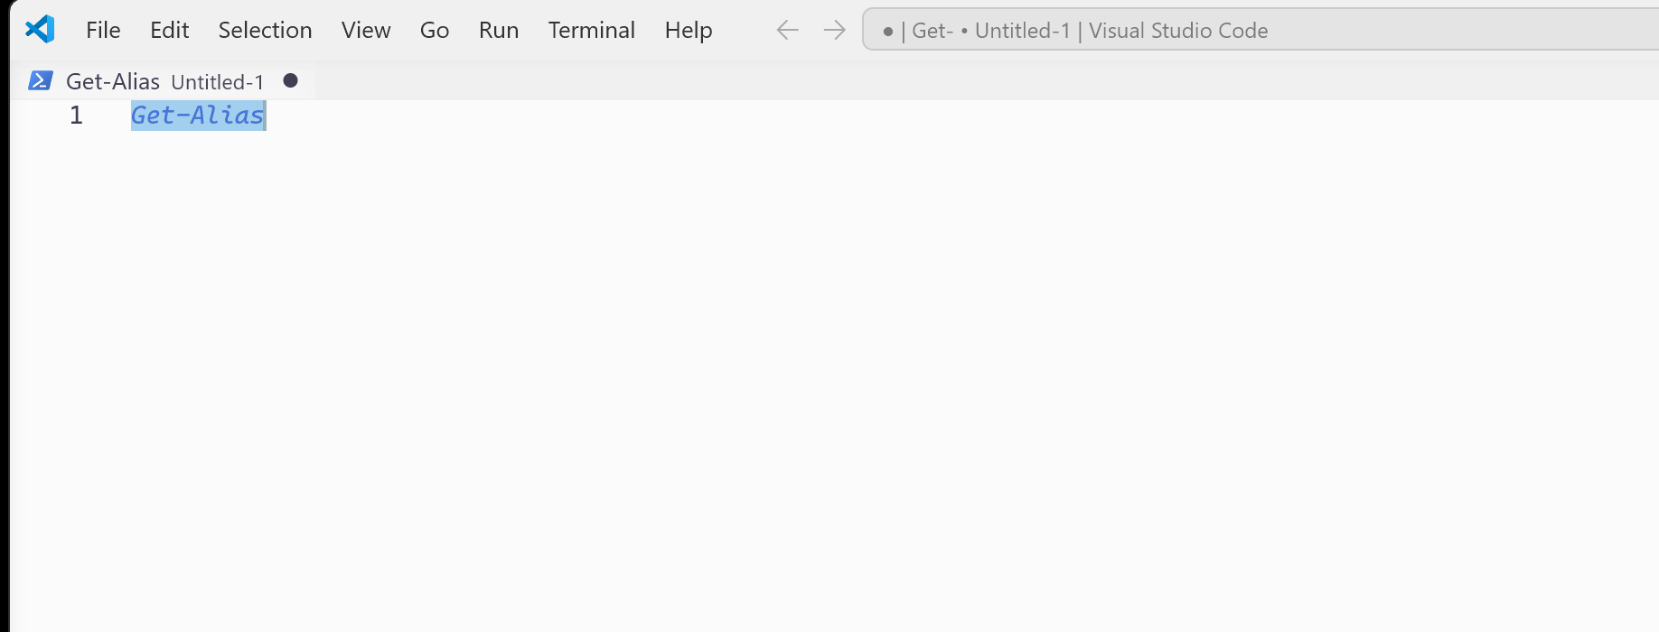

The Pipeline
getCompletion
PowerShell Runspace
VSCode LSP Client
PSES LSP Server
Textdocument/Completion
TabCompletion

Slide 7
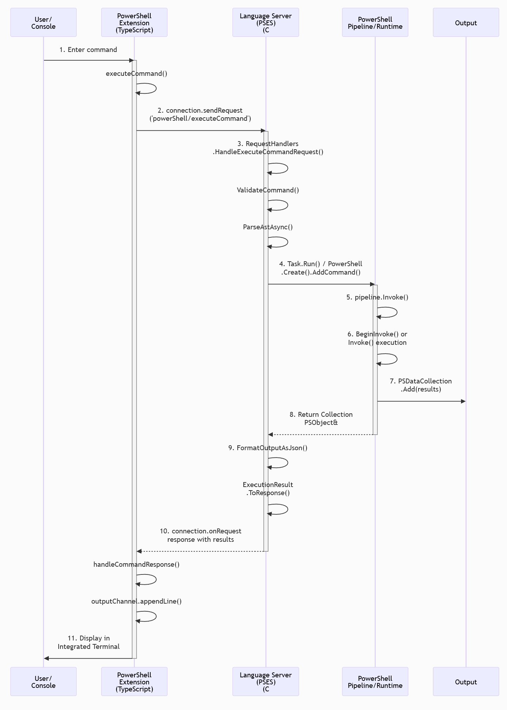
Custom Request

Slide 8
Custom Request

Slide 9
Custom Request

Slide 10

DEMO TIME

Slide 11

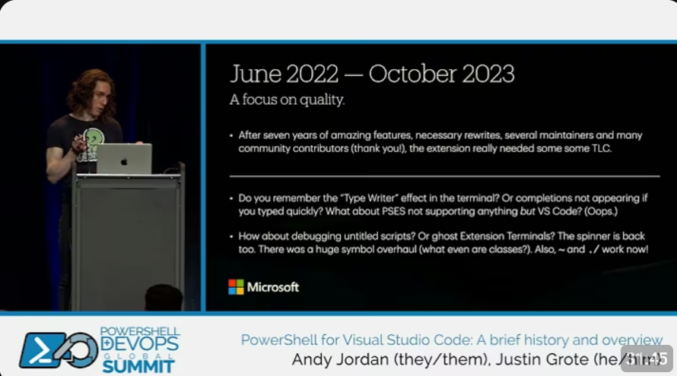
More!
https://www.youtube.com/watch?v=myIE3mst2L
https://www.youtube.com/watch?v=GC0RXrC4rCQ

Slide 12
Q&A

Slide 13
Survey!
Please fill out the survey in the app, it helps everyone!

