Slide 1
Chapter 5
Stacks L6

Slide 2
Chapter Outline
Stack Definition
The stack and its member functions (operations on the stack):
  push, pop, top, empty, and purge
Stack Applications:
  Reversing Data.
  Parsing data.
  Postponing data use.
  Backtracking.
Using stack in applications
  Testing for balanced (properly nested) parentheses
  Evaluating arithmetic expressions using:
    Infix.
    Prefix
    Postfix

Slide 3
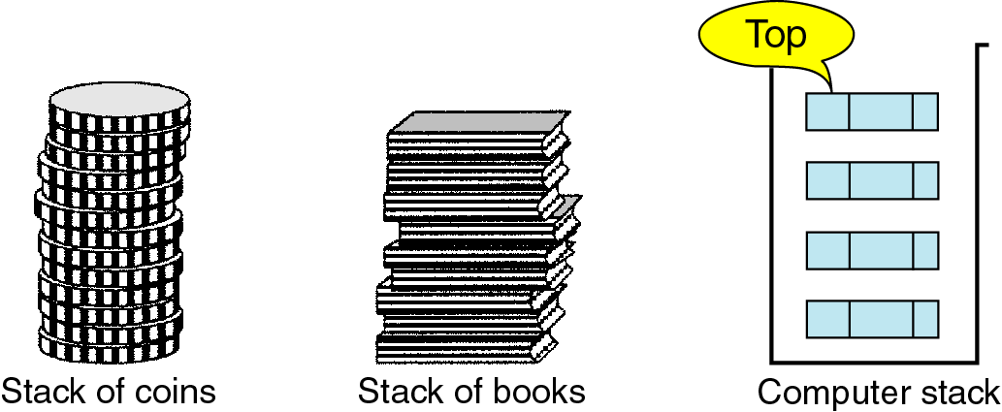
What is a stack?
A stack is a linear list where all deletions and additions are restricted to one end called ”Top”

Slide 4

The stack Abstract Data Type
A stack can be compared to a Pez dispenser
  Only the top item can be accessed
  Can only extract one item at a time
A stack allows access only to the top element
A stack’s storage policy is Last-In, First-Out or First in Last Out FILO
Carl
push Carl ...
Barb
Barb
Alex
Alex

Slide 5

The Stack ADT
The Stack ADT stores arbitrary objects
Insertions and deletions follow the last-in first-out scheme
Think of a spring-loaded plate dispenser
Main stack operations:
  push(object): inserts an element
  object pop(): removes the last inserted element
Auxiliary stack operations:
  object top(): returns the last inserted element without removing it
  integer size(): returns the number of elements stored
  boolean empty(): indicates whether no elements are stored
© 2010 Goodrich, Tamassia
Stacks

Slide 6
Operations on the STACK
S = stack i= item
create_stack(s) creates an empty stack
push(s, i): to insert Data i on the Stack. (insertion)
pop(s, i): to remove Data i from the stack (deletion)
Stack top: return the data at the Top of the stack without deleting it. (does not remove i)
empty(s): determines if the stack is empty.
purge(s) empties the stack

Slide 7
Exceptions
Attempting the execution of an operation of ADT may sometimes cause an error condition, called an exception
Exceptions are said to be “thrown” by an operation that cannot be executed
In the Stack ADT, operations pop and top cannot be performed if the stack is empty
Attempting pop or top on an empty stack throws a StackEmpty exception
© 2010 Goodrich, Tamassia
Stacks

Slide 8
Note
The stack has LINFO behavior.
Can only access the top item in the stack

Slide 9
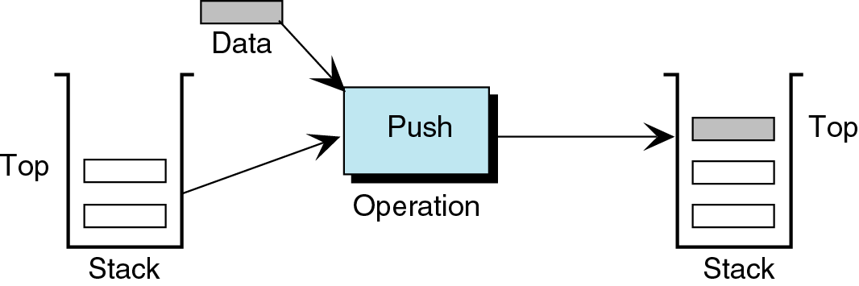
The Push Operation
Adds an item to the top of the Stack.
After the push, the new item becomes Top.
Must make sure that there is room for the new item.
If there isn’t enough room for the new item:
  New item can not be added
  Stack overflow.

Slide 10
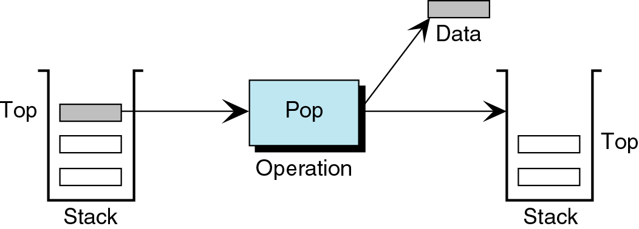
The Pop Operation
When an item is Popped off the Stack, it is removed from the Stack and returned to the user.
The Next item becomes Top.
When last item is deleted the stack becomes empty.
If Pop is called when the stack is empty we get Stack Underflow. Always check!!

Slide 11
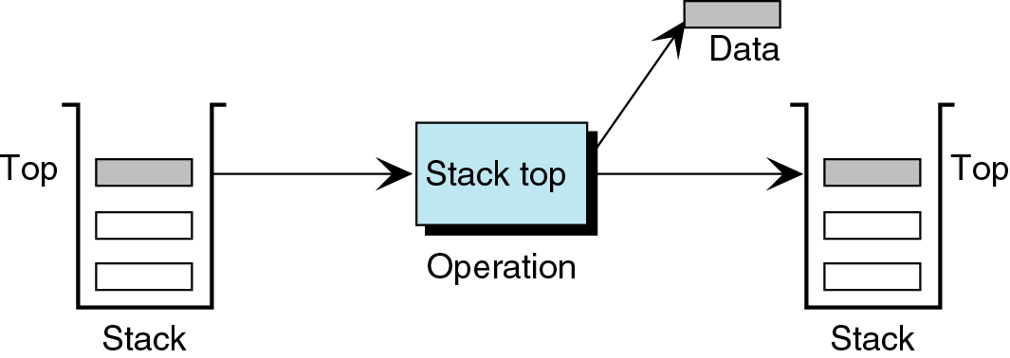
Stack Top
Copies the item at the top of the Stack.
Returns the data to the user.
Does NOT delete the item.
Same as reading the top of the stack.
If Top is called while stack is empty “Underflow”

Slide 12
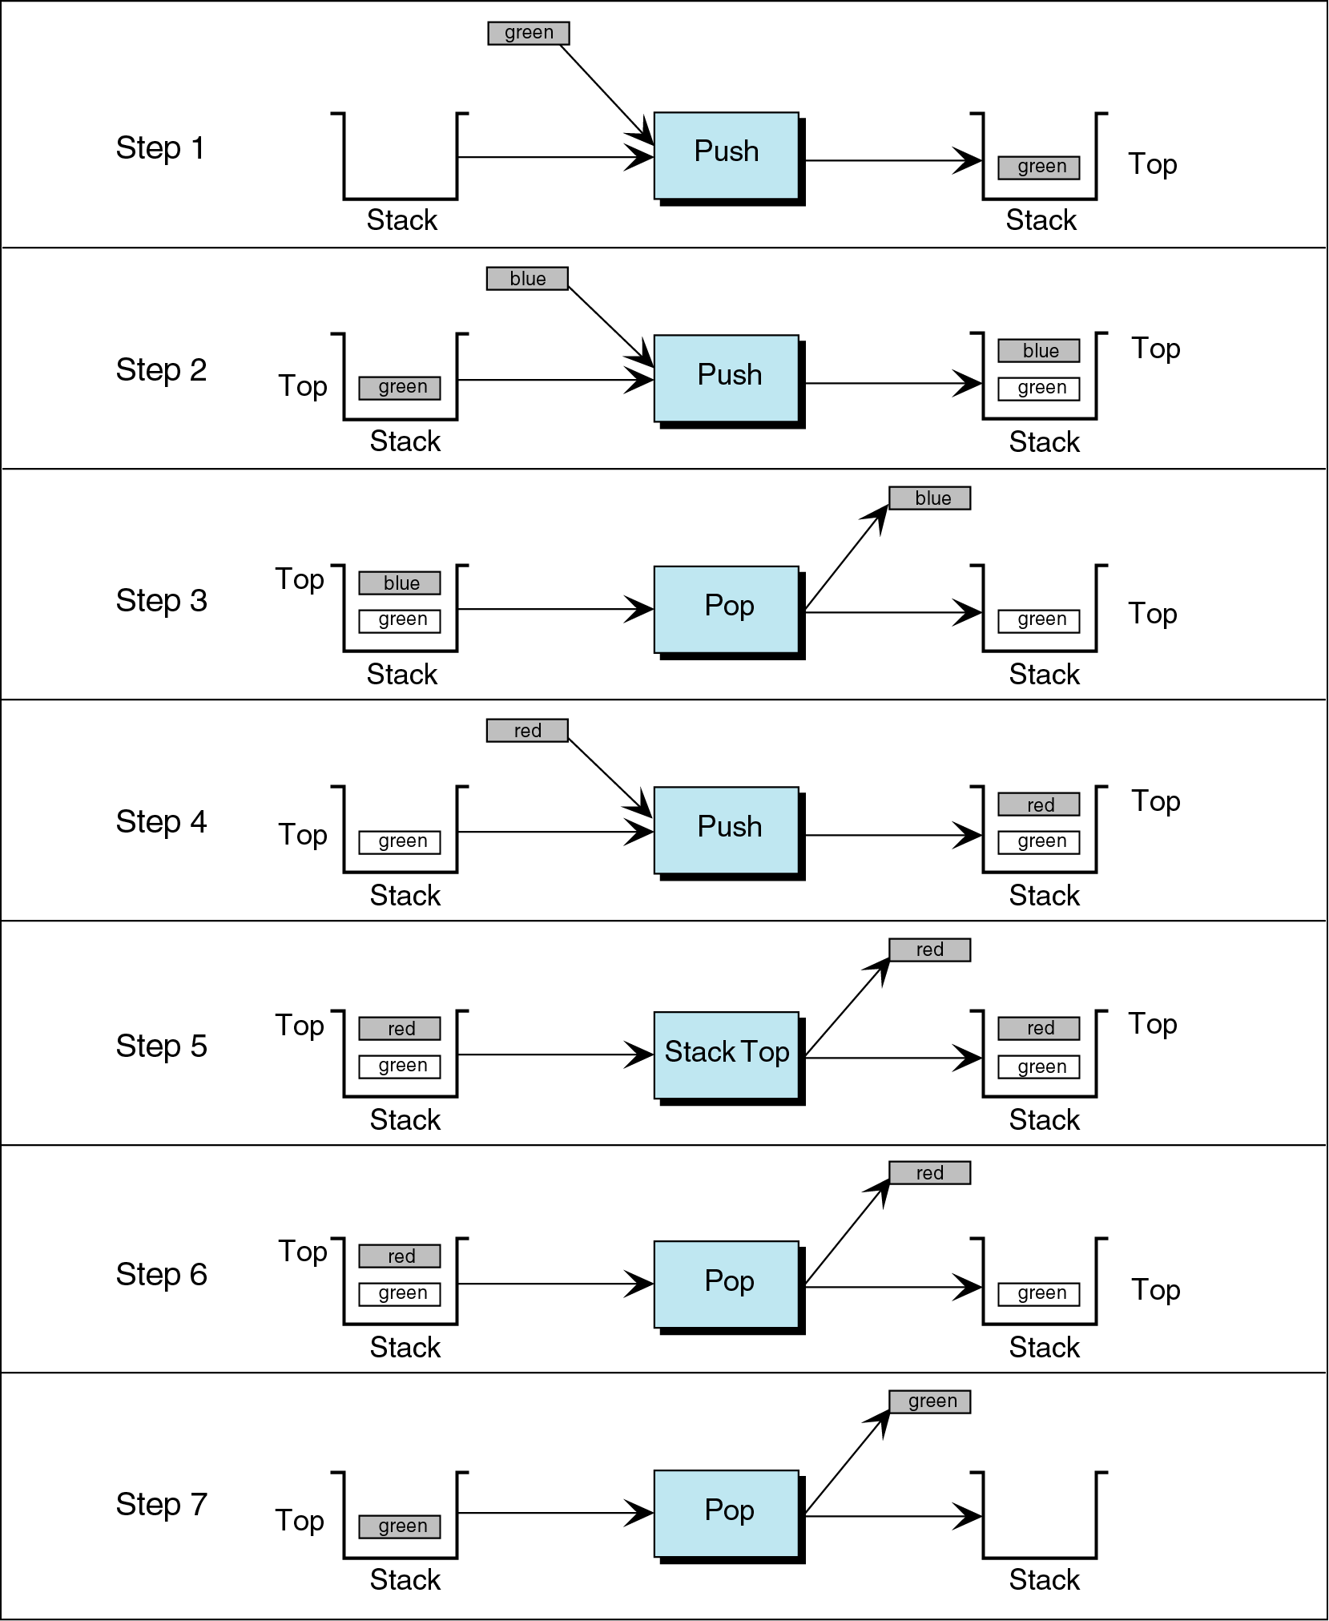
Put all in one !!

Slide 13
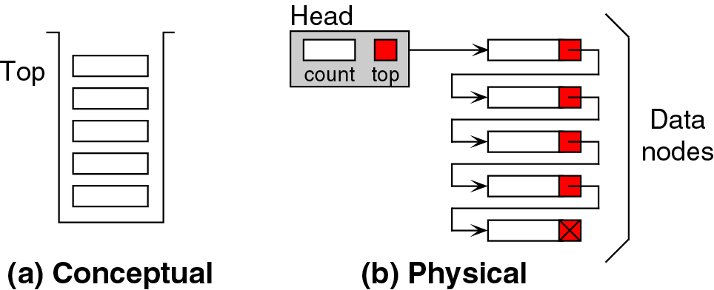
Stacks and Linked list implementation
An idea for now, more deep details later (L 11-4)
Stacks and Arrays implementation will be cover in the end of the this section

Slide 16
Stack Applications
Four common stack applications
Reversing Data.
  i.e: when converting from Decimal to Binary
Parsing data.
  i.e: how to match parenthesis in source program.
Postponing data use:
  i.e: converting Infix to postfix and evaluating postfix notation
Backtracking.
  i.e to choose between 2 or more paths.
  All these applications use Stacks therefore we must understand these Algorithms.

Slide 17
Other Applications of Stacks
Direct applications
  Page-visited history in a Web browser
  Undo sequence in a text editor
  Chain of method calls in the C++ run-time system
Indirect applications
  Auxiliary data structure for algorithms
  Component of other data structures
© 2010 Goodrich, Tamassia
Stacks

Slide 18
Reversing Data.
A set of given data is reordered so that the last and first items are exchanged.
All items between the first and last items are exchanged.
Given the set of numbers: {1, 2, 3, 4}
Reversed list : {4, 3, 2,1}
** Alg for converting data from decimal to binary

Slide 19
Parsing Data
A logic used in breaking data into independent units for future usage
  Translation of HLPL to LLPL.
  The Compiler must parse the source codes into individual parts such as keywords, names and tokens.
  A common programming error when parenthesis are not matched.
  Two types of errors could happen → next slide

Slide 20
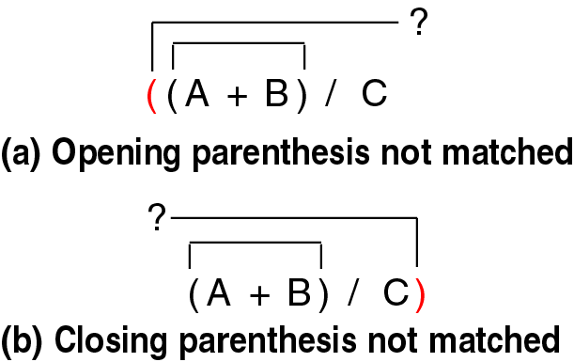
Parsing example Figure 4-11 p.172

Slide 21
Postponing data use:
When the use of data is postponed for later use.
  Applications: the evaluation of arithmetic expressions such as:
        infix
        postfix
        prefix

Slide 22
Evaluating Arithmetic Expressions
Expressions normally written in infix form
  Binary operators appear between their operands:
    a + b c * d e * f - g
A computer normally scans in input order
  One must always compute operand values first
  So easier to evaluate in postfix form:
    a b + c d * e f * g –
Prefix.
  The operator comes before the operands
    + a b

Slide 23
Note:
infix:
  we need to use parentheses to control the evaluations.
  We end up having an evaluation method that includes parenthesis and operator priority class.
HLPL uses infix expressions which can not be evaluated directly.
  Must be analyzed to determine the order of evaluation.
  Common evaluation technique, convert to postfix before generating the code to evaluate them

Slide 24
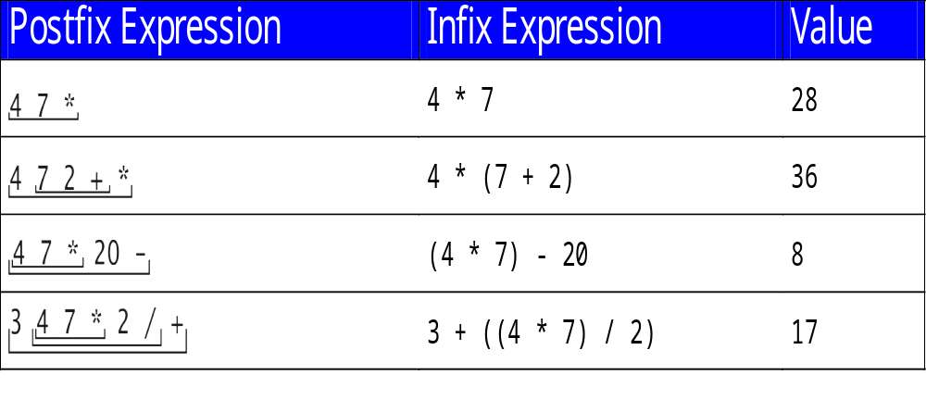
Postfix Expression Evaluation Examples: infix to postfix
This shows the evaluated value of the infix expression
Manual conversion from infix to postfix see slide 24

Slide 25
Advantages of Postfix Form
No need to use parentheses for grouping
No need to use precedence rules:
    Usual meaning of a + b * c is a + (b * c)
    * takes precedence over + ... or ...
    * has higher precedence than +
    Postfix: a b c * +
  For (a+b)*c, postfix is: a b + c *

Slide 26
Manual Conversion from infix to postfix (infix to postfix Alg)
Fully parenthesize the expression using explicit parenthesis and arithmetic precedence ( *, / before +, - )
Change all infix in the parenthesis to postfix notation.
  Start from the inner most expression.
  Conversion is done by moving the operator to the location of the expression’s closing parenthesis..
Remove all parenthesis

Slide 27
infix to Postfix manual conversion example animated slide
(v + a) * (c * (a – t) + i) – o * n
FULLY Parenthesize to force operations order
(((v + a) * (c * (a – t) + i)) – (o * n))
Move the operators to the right of its parenthesis (inner first)
(((v a +)* (c* (a t –) + i)) - (o n *))
(((v a +)* (c (a t –) * i) +) (o n *) -)
(((v a +) (c (a t –) * i) +*) (o n *) –)
Remove the parenthesis
v a + c a t – * i + * o n * –

Slide 28
Exercise
Go back to slide 22 and Show how did we convert the infix expressions to postfix using the rules listed in slide 24

Slide 29
10 min break
More on Stacks

Slide 30
Algorithm for evaluating a postfix using stacks
Empty the operand stack
while there are more tokens
Get the next token
if the first character of the token is a digit
Push the integer onto the stack
else if the token is an operator
Pop the right operand off the stack
Pop the left operand off the stack
Evaluate the operation
Push the result onto the stack
Pop the stack and return the result

Slide 31
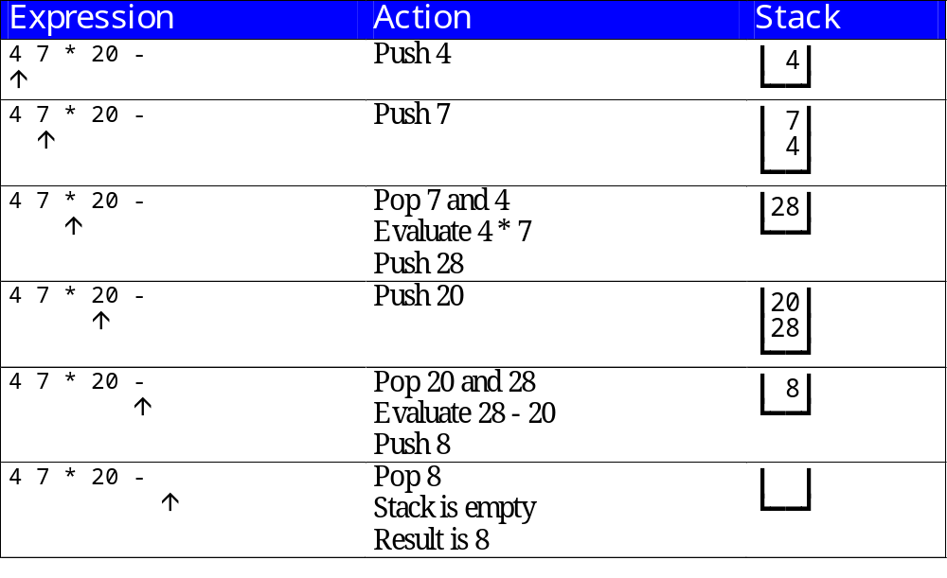
Evaluating Postfix Expressions example
The postfix form is also known as the Reverse Polish Notation
Note 28 -20 not 20 -8
Look at p179 for another example

Slide 32
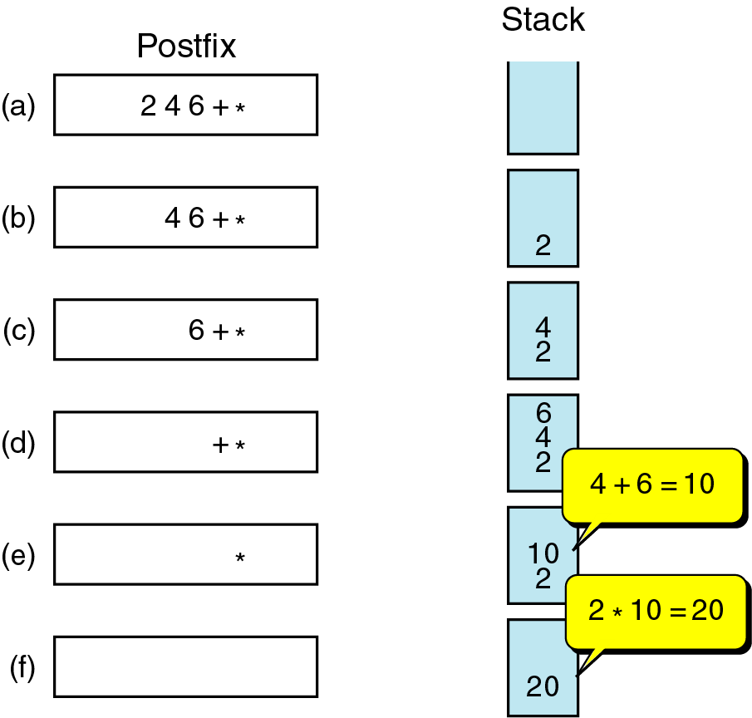
Figure 4-13
Evaluating Postfix Expressions example

Slide 33
Converting Infix to Postfix
Need to handle precedence
Need to handle parentheses
  First implementation handles only precedence
  Input: Infix with variables, integers, operators
  (No parentheses for now)
Output: Postfix form of same expression

Slide 34
Converting Infix to Postfix (using stacks)
Analysis:
  Operands are in same order in infix and postfix
  Operators occur later in postfix
Strategy:
  Send operands straight to output
  Send higher precedence operators first
  If same precedence, send in left to right order
  Hold pending operators on a stack

Slide 35
Operators priorities
Operator input Priority (ip) stack priority (s)
( 3 0
+ - 1 1
* / 2 2
) 0 0
) never gets pushed on the stack, neither gets moved to the postfix expression

Slide 36
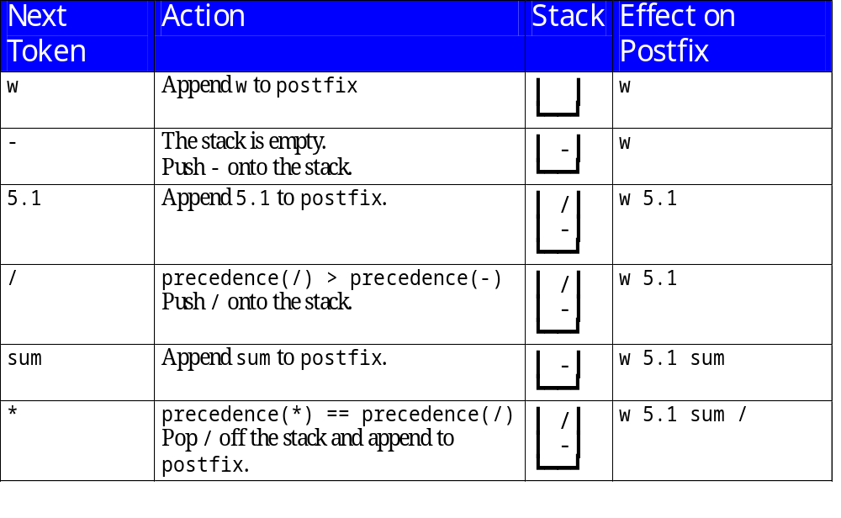
Converting from Infix to Postfix
USING STACKS: Example
Convert w – 5.1 / sum * 2 from infix to Postfix

Slide 37
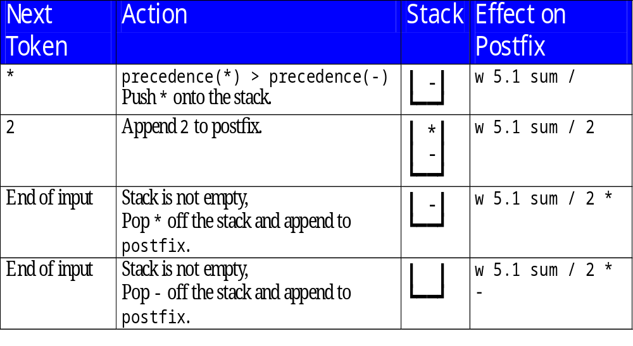

Slide 38
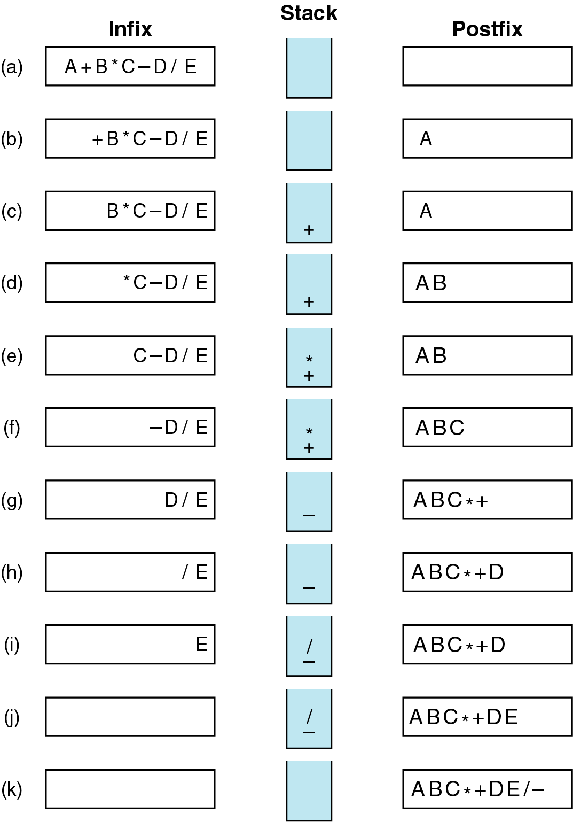
Infix to postfix example 2 using stacks
Figure 4-12
Empty Stack
* Has a higher precedence than +
Since the – has less precedence than the *, * is popped.
and since + and the – are equal in precedence, the + is popped as well, and the – is placed on the stack
The / is higher than -
End of data, pop the / and the -

Slide 39
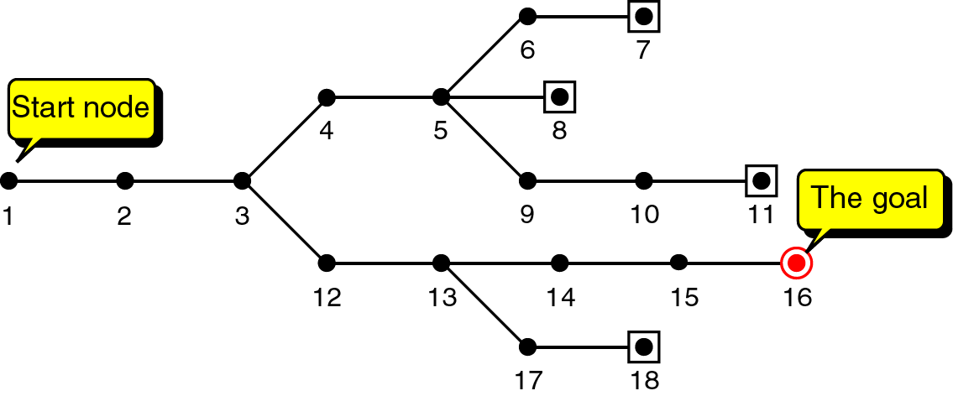
Backtracking and goal seeking example (for games)
Figure 4-14 p.182
The Goal is to reach 16.
Humans can easily visualize the path.
Computers need an Algorithm
  Start from 1, move right until hitting branch at 3 then move up.
  Continue until 5 then move up.
  Once 7 is reached, can’t go further, goal is not reached !!
  Backtrack at 5 the go to 8.. Goal not reached..
  Backtrack at 5 , 9,.. 11, goal not reached.
  Backtrack at 3, 12,13, 14.. 16 GOALLLL
Note: pre work, draw your paths as a graph

Slide 40
Backtracking
A stack is needed whenever a back tracking is needed
A stack is used whenever some type of a process is interrupted, a new process of the same type is initiated, and then the prior process must be resumed (suspend, wait, resume states).
Information must be saved on the stack so that the old process can be resumed when the new one completes.

Slide 41
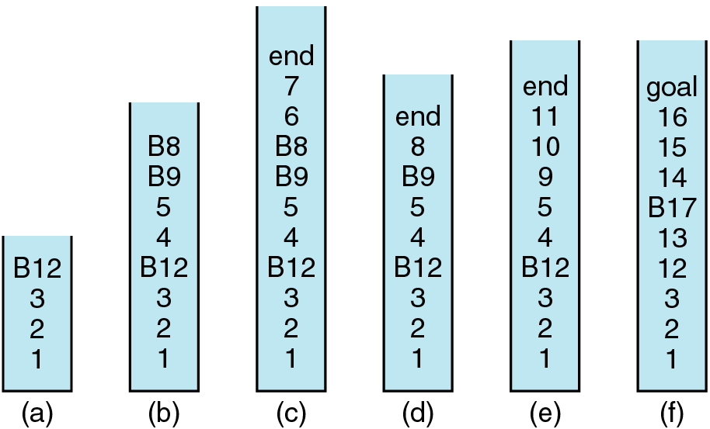
Backtracking using Stacks
If node is in the path push a path token.
If branch push a flag (B for indicating a backtracking node).
if no token then the stack contains a path node.
Push, 1, 2, 3 (branch point) push B12 … a
Push 4,5 (branch point) push B9 and B8 .. b
Push 6, 7, end.. c

Slide 42
Backtracking using Stacks
. Pop 7, 6 go to 8 reached 8 end. Goal not found
Pop 8, go to 9
Push 9, 10, 11 end … e. Goal not found
Pop 11, 10, 9, 5, 4
Push 12, 13, B17, 14, 15, 16 goal

Slide 43
C++ Run-Time Stack
The C++ run-time system keeps track of the chain of active functions with a stack
When a function is called, the system pushes on the stack a frame containing
  Local variables and return value
  Program counter, keeping track of the statement being executed
When the function ends, its frame is popped from the stack and control is passed to the function on top of the stack
Allows for recursion
main() {
int i = 5;
foo(i);
}
foo(int j) {
int k;
k = j+1;
bar(k);
}
bar(int m) {
…
}
bar
PC = 1
m = 6
foo
PC = 3
j = 5
k = 6
main
PC = 2
i = 5
© 2010 Goodrich, Tamassia
Stacks

Slide 44
Analysis: expressions with parenthesis
The Infix expression can contain:
  only a parenthetical set of operators.
  A variable or a constant.
  An Operator.
If open parenthesis pop on the stack, eventually will be paired with a closing one.
Variables and constants go to the output formula.

Slide 45
Analysis: expressions with parenthesis (continued)
See slide 14 for operators priorities.
If (the new operator’s priority <= to the one on top of the stack)
move the token on the top to output.
  Else
  push on the stack.
  Loop to check the operator’s on the top.
Pre work, Check:
is the formula valid? are parenthesis matched? contains operators? Valid operands?
Check for overflow and underflow

Slide 46
Example
Evaluate this post fix expression using an operand Stack
2 3 + 5 * 2 5 3 + * -
Evaluates to 9

Slide 47
Array-based Stack
A simple way of implementing the Stack ADT uses an array
We add elements from left to right
A variable keeps track of the index of the top element
Algorithm size()
return t + 1
Algorithm pop()
if empty() then
throw StackEmpty
else
t ← t − 1
return S[t + 1]
…
S
0
1
2
t
© 2010 Goodrich, Tamassia
Stacks

Slide 48
Array-based Stack (cont.)
The array storing the stack elements may become full
A push operation will then throw a StackFull exception
  Limitation of the array-based implementation
  Not belonging to the Stack ADT
Algorithm push(o)
if t = S.size() − 1 then
throw StackFull
else
t ← t + 1
S[t] ← o
…
S
0
1
2
t
© 2010 Goodrich, Tamassia
Stacks

Slide 49
Performance and Limitations
Performance
  Let n be the number of elements in the stack
  The space used is O(n)
  Each operation runs in time O(1)
Limitations
  The maximum size of the stack must be defined a priori and cannot be changed
  Trying to push a new element into a full stack causes an implementation-specific exception
© 2010 Goodrich, Tamassia
Stacks

Slide 50
Array-based Stack in C++
template <typename E>
class ArrayStack {
private:
E* S; // array holding the stack
int cap; // capacity
int t; // index of top element
public:
// constructor given capacity
ArrayStack( int c) :
S(new E[c]), cap(c), t(-1) { }
void pop() {
if (empty()) throw StackEmpty
(“Pop from empty stack”);
t--;
}
void push(const E& e) {
if (size() == cap) throw
StackFull(“Push to full stack”);
S[++ t] = e;
}
… (other methods of Stack interface)
© 2010 Goodrich, Tamassia
Stacks

Slide 51
Example use in C++
* indicates top
ArrayStack<int> A; // A = [ ], size = 0
A.push(7); // A = [7*], size = 1
A.push(13); // A = [7, 13*], size = 2
cout << A.top() << endl; A.pop(); // A = [7*], outputs: 13
A.push(9); // A = [7, 9*], size = 2
cout << A.top() << endl; // A = [7, 9*], outputs: 9
cout << A.top() << endl; A.pop(); // A = [7*], outputs: 9
ArrayStack<string> B(10); // B = [ ], size = 0
B.push("Bob"); // B = [Bob*], size = 1
B.push("Alice"); // B = [Bob, Alice*], size = 2
cout << B.top() << endl; B.pop(); // B = [Bob*], outputs: Alice
B.push("Eve"); // B = [Bob, Eve*], size = 2
© 2010 Goodrich, Tamassia
Stacks

Slide 52
Homework and assignments
Read chapter 5, Stacks pages 194 - 208
Handout #24 review ADT – stack
  Hw.
  Lap/ group work

