Slide 1
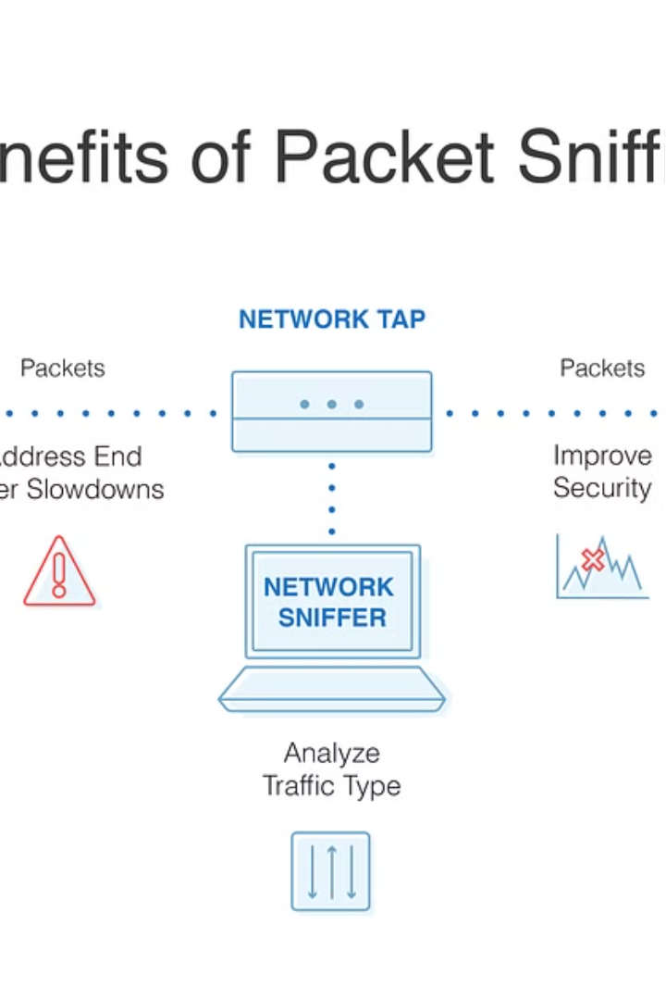
Introduction to Network Packet Sniffers
Powerful tools that capture and analyze network traffic, providing deep visibility into digital communications.

Slide 2
Understanding Packet Sniffing
Monitoring Network Activity
Troubleshooting Connectivity
Data Analysis & Forensics
Identify bottlenecks, security threats, and optimize network performance.
Diagnose and resolve issues by inspecting packet-level data.
Extract insights from network traffic to uncover patterns and anomalies.

Slide 3
Commonly Used Packet Sniffers
1
Wireshark
2
tcpdump
Powerful open-source sniffer with rich protocol decoding capabilities.
Command-line sniffer ideal for scripting and automation tasks.
3
Npcap/WinPcap
4
Snort
Fundamental packet capture libraries used by many sniffers.
Network Intrusion Detection System that can also sniff packets.

Slide 4
Packet Sniffer Features and Capabilities
Filtering & Searching
Decoding & Dissection
Isolate relevant data by protocol, port, IP address, and more.
Interpret packet contents and higher-level protocol information.
Capture & Export
Expert Analysis
Save and replay network traffic for further investigation.
Identify issues and anomalies with advanced diagnosis tools.

Slide 5




Ethical Considerations in Packet Sniffing
Privacy
Security
Legality
Trust
Respect individual privacy and obtain consent before sniffing.
Ensure sniffing tools are used for authorized and legitimate purposes.
Understand relevant laws and regulations around network monitoring.
Build transparency and maintain user trust when conducting sniffing.

Slide 6
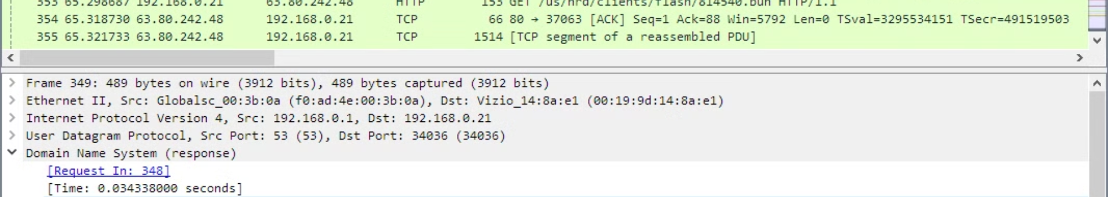



Practical Applications and Use Cases
Network Troubleshooting
Security Monitoring
Performance Optimization
Detect and investigate potential security breaches and unauthorized access.
Identify and resolve connectivity issues, bottlenecks, and performance problems.
Analyze traffic patterns to improve network efficiency and resource utilization.

