Slide 1
Motor Vehicle Collisions Analytics with Holiday Impact
Data Engineering and Visualization Project
Seif Khaled
21-Apr-25

Slide 2
Project Overview
- Goal: Analyze motor vehicle collisions and assess impact of public holidays
- Datasets Used:
• Motor_Vehicle_Collisions_-_Crashes.csv
• Public Holidays API
- Tools: Python, Power BI, Parquet

Slide 3
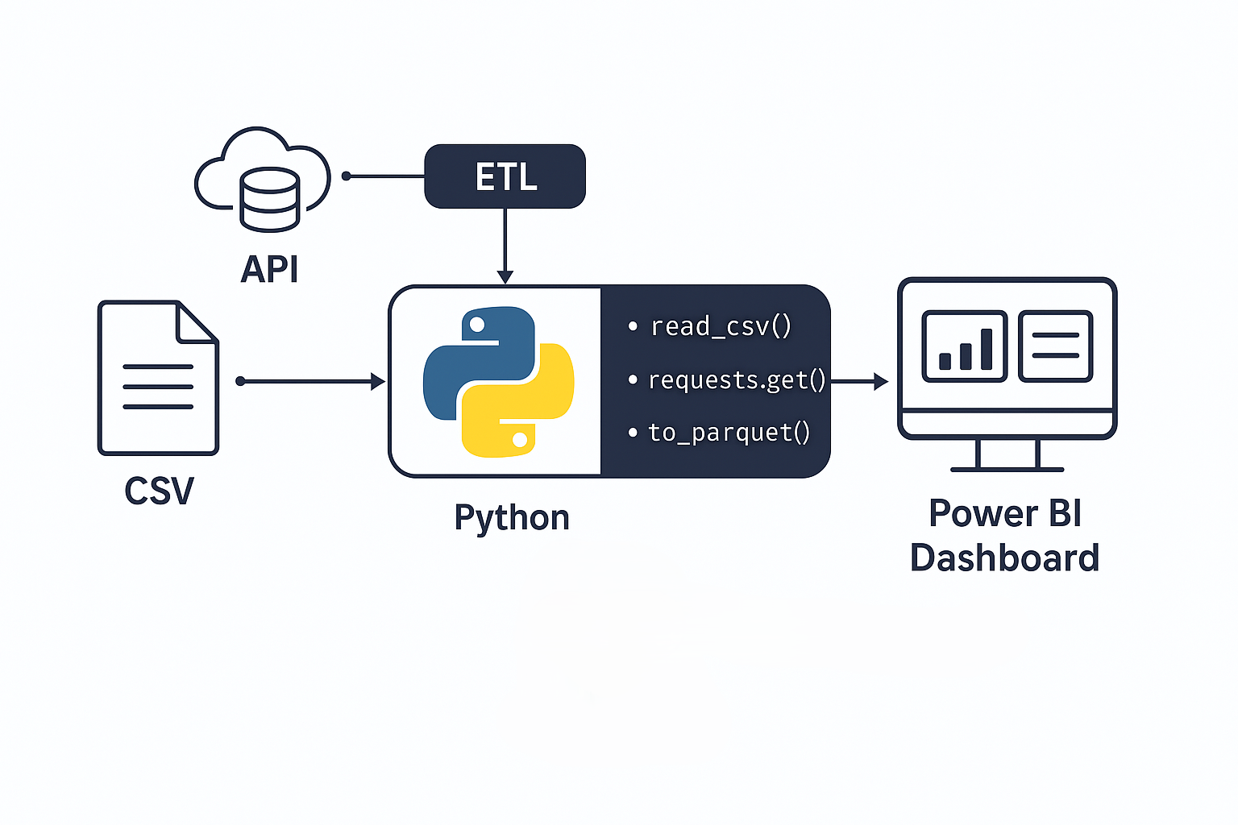
Arichitecture
Extract: Load CSV & API data
Transform: Clean, merge, flag holiday collisions
Load: Write final dataset in Parquet format
Visualization using PowerBI

Slide 4
Dashboard and Visuals
Collision trends analysis
Holiday vs. Non-Holiday comparison
Location heatmaps and other visuals
Increase/decrease in collisions on holidays
Most affected boroughs
Types of vehicles involved
Main causes of collisions

Slide 5
Conclusion and key findings
Brooklyn is the top state with accidents covering 22% of records.
Brooklyn and Queens are on top of all Borough available.
It seems that inattention and distraction plays a high role when it comes to collisions so we can add more safety measure to the cars.
Dates & holidays is not really a factor when it comes to number of accidents .
We can focus on adding more constraints to BELT Parkway and Broadway as the top collision's street locations
Sedan contributes to the highest number of accidents so it might be a family cars (TBC)
1PM to 8PM seems to be the highest when it comes to high number of accidents.

