Slide 1

VLAN & INTER-VLAN
ROUTING WITH FORTIGATE

Slide 2

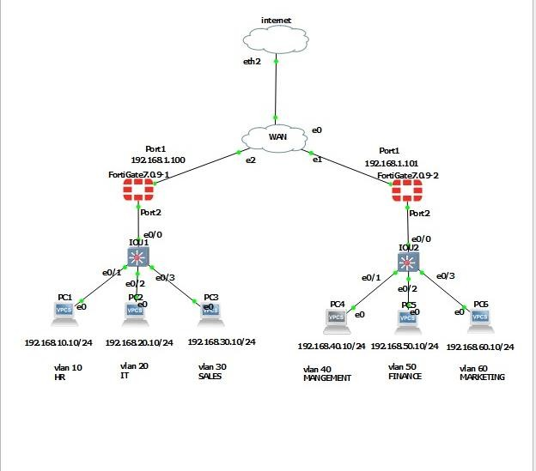
N E T W O R K T O P O L O G Y

Slide 3
N E T W O R K C O M P O N E N T S
T W O P H Y S I C A L L O C A T I O N S ( S I T E S )
A . H E A D Q U A RT E R S ( H Q )
S I MU LA T E S T H E MA I N O F F I C E .
H A S M U LT I P LE D E P A R T ME N T S :
HR (VLAN 10)
IT (VLAN 20)
Sales (VLAN 30)
B. Branch Office (BR)
S I M U L A T E S A R E MO T E O F F I C E .
H A S D I F F E R E N T D E P A R T ME N T S :
Management (VLAN 40)
Finance (VLAN 50)
Marketing (VLAN 60)

Slide 4
N E T W O R K C O M P O N E N T S
I O U R O U T E R S ( L A Y E R 3 S W I T C H E S )
S I M U L A T E D R O U T E R S ( U S I N G I O U – I O S O N U N I X ) T O C R E A T E A N D M A N A G E V L A N S .
E A C H S I T E H A S A T L E A S T O N E I O U D E V I C E :
I O U 1 & I O U 3 A T H Q
I O U 2 & I O U 4 A T B R A N C H
F U N C T I O N S :
C R E A T E V L A N S
A S S I G N A C C E S S / T R U N K P O R T S
C O N N E C T E N D D E V I C E S ( P C S ) T O T H E N E T W O R K

Slide 5
N E T W O R K C O M P O N E N T S
F O R T I G A T E F I R E W A L L S ( F G - H Q & F G - B R )
T H E S E A C T A S T H E C E N T R A L R O U T E R S A N D F I R E W A L L S F O R E A C H S I T E .
H A N D L E :
I N T E R - V L A N R O U T I N G
D H C P S E R V I C E S ( T O A S S I G N I P S T O P C S )
F I R E W A L L P O L I C I E S ( T O A L L O W / B L O C K T R A F F I C )
S I T E - TO - S I T E I P S E C V P N T U N N E L ( S E C U R E L Y C O N N E C T H Q A N D B R A N C H )
P C S ( E N D D E V I C E S )
E A C H V L A N H A S I T S O W N G R O U P O F P C S :
H Q : P C 1 – P C 3 , P C 7 – P C 9
B R A N C H : P C 4 – P C 6 , P C 1 0 – P C 1 2

Slide 6
N E T W O R K C O M P O N E N T S
V L A N S ( V I R T U A L L O C A L A R E A N E T W O R K S )
V L A N I D | D E P A R T ME N T | S U B N E T | L O C A T I O N
10 | HR | 1 9 2 . 1 6 8 . 1 0 . 0 / 2 4 | HQ
20 | IT | 1 9 2 . 1 6 8 . 2 0 . 0 / 2 4 | HQ
30 | S A L E S | 1 9 2 . 1 6 8 . 3 0 . 0 / 2 4 | HQ
40 | M A N A G E M E N T | 1 9 2 . 1 6 8 . 4 0 . 0 / 2 4 | B R A N C H
50 | F I N A N C E | 1 9 2 . 1 6 8 . 5 0 . 0 / 2 4 | B R A N C H
60 | M A R K E T I N G | 1 9 2 . 1 6 8 . 6 0 . 0 / 2 4 | B R A N C H

Slide 7
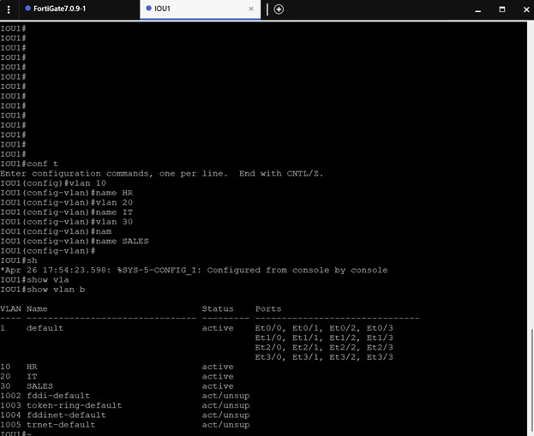
I O U 1 C O N F I G U R A T I O N S
C R E A T I N G V L A N S

Slide 8
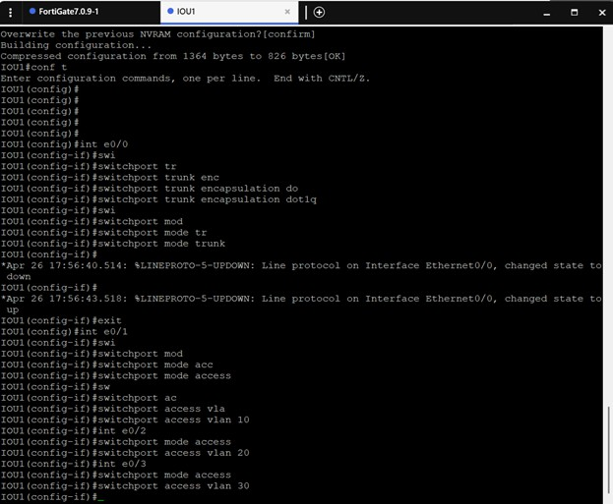
I O U 1 C O N F I G U R A T I O N S
T R U N K & A C C E S S I N T E R F A C E S

Slide 9
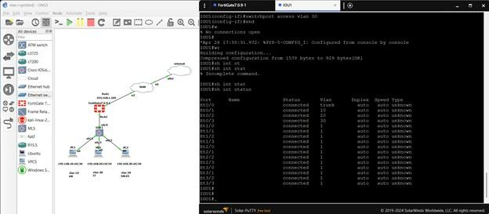
I O U 1 C O N F I G U R A T I O N S
T R U N K & A C C E S S I N T E R F A C E S

Slide 10
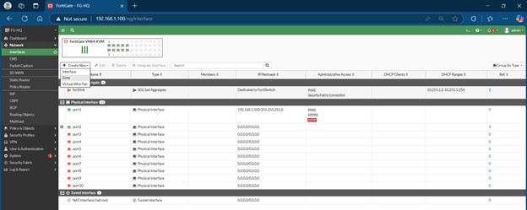
I O U 1 C O N F I G U R A T I O N S
C O N F I G U R I N G I N T E R - V L A N O N F O R T I G A T E
W E N E E D T O C O N F I G U R E I N T E R - V L A N S O T H A T T H E Y C A N R E A C H E A C H O T H E R

Slide 11
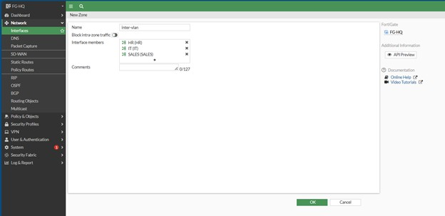
I O U 1 C O N F I G U R A T I O N S
C O N F I G U R I N G I N T E R - V L A N O N F O R T I G A T E
D I S A B L E
B L O C K
I N T R A - Z O N E
T R A F F I C

Slide 12
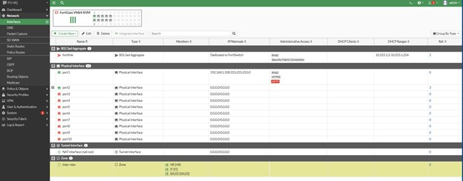
I O U 1 C O N F I G U R A T I O N S
C O N F I G U R I N G I N T E R - V L A N O N F O R T I G A T E
D I S A B L E
B L O C K
I N T R A - Z O N E
T R A F F I C

Slide 13
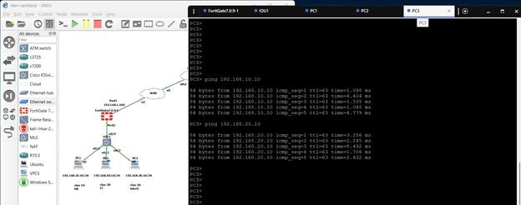
I O U 1 C O N F I G U R A T I O N S
C O N F I G U R I N G I N T E R - V L A N O N F O R T I G A T E
P C 3 N O W C A N P I N G P C 2 A N D P C 1 ( I N T E R V L A N )

Slide 14
S AME S T E PS O F C O NF I G U R AT I ON I S FO LL O WE D O N
I OU 2

Slide 15
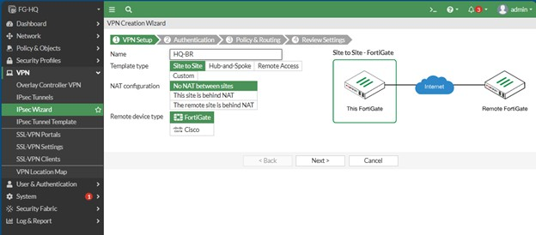
WE N E E D T O C O NFI G U RE S I T E - T O - S I T E V P N

Slide 16
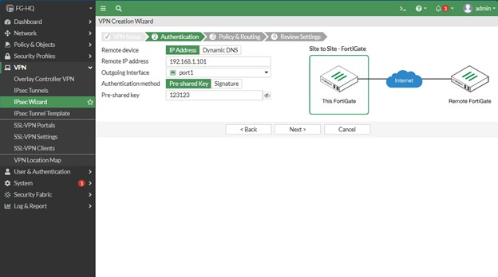
WE N E E D T O C O NFI G U RE S I T E - T O - S I T E V P N

Slide 17
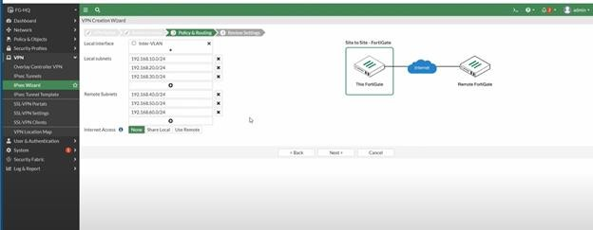
WE N E E D T O C O NFI G U RE S I T E - T O - S I T E V P N

Slide 18
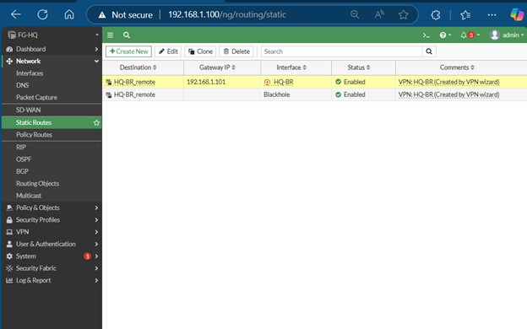
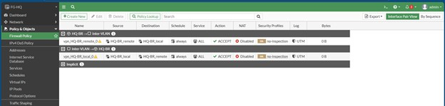
A F T E R C R E A T I N G V P N A S T A T I C
R O U T E & F I R E W A L L P O L I C Y A R E C R E A T E D A U T O M A T I C A L L Y

Slide 19
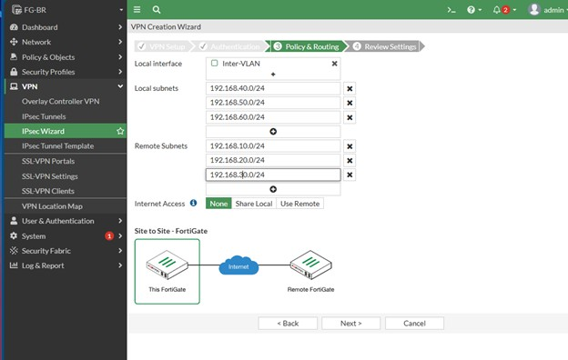
D O I N G T H E S A M E O N F G - B R

Slide 20
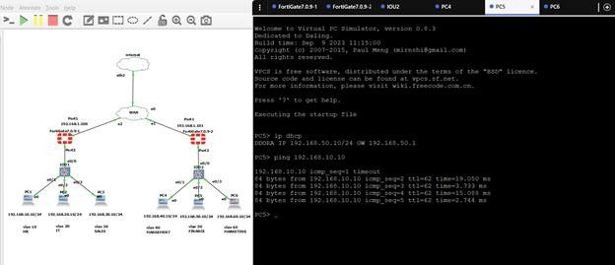
N O W L E T S T E S T P I N G F R O M P C 5 ( V L A N 5 0 ) T O P C 1 ( V L A N 1 0 )

Slide 21

T E S T P A R T
Test No. | Test Type | Source PC (VLAN) | Destination PC (VLAN) | Command to Run | Expected Result
1 | Inter-VLAN (Same Site) | PC1 – 192.168.10.11 (VLAN 10) | PC2 – 192.168.20.11 (VLAN 20) | ping 192.168.20.11 | Ping Success
2 | Inter-VLAN (Same Site) | PC2 – 192.168.20.11 (VLAN 20) | PC3 – 192.168.30.11 (VLAN 30) | ping 192.168.30.11 | Ping Success
3 | Inter-Site via VPN (HQ → Branch) | PC1 – 192.168.10.11 (HQ) | PC5 – 192.168.50.11 (Branch) | ping 192.168.50.11 | Ping Success

Slide 22
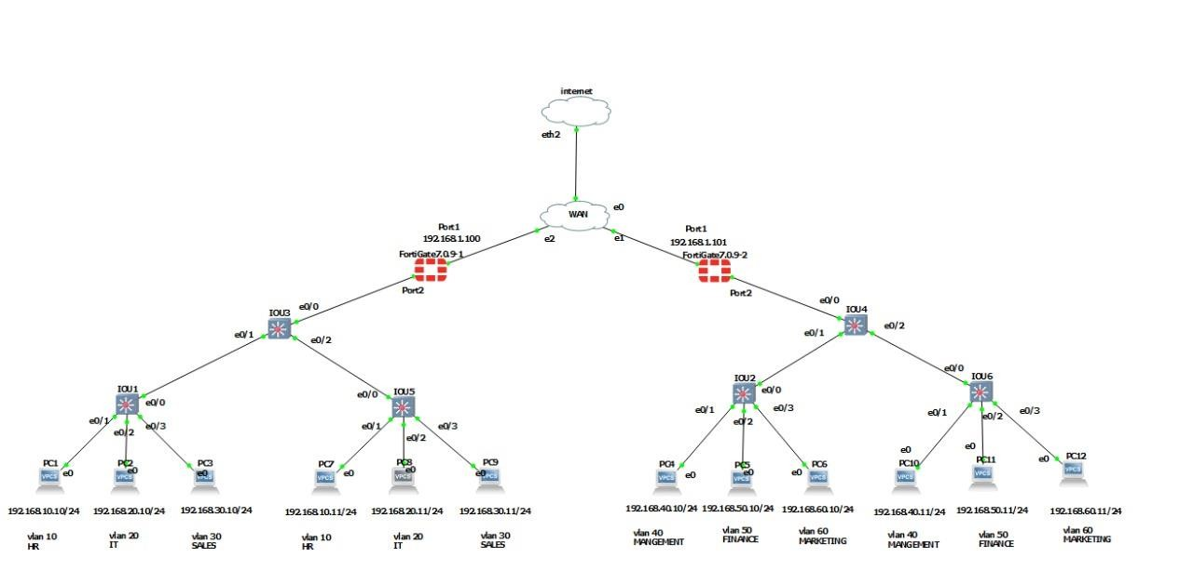
E X P A N D E D N E T W O R K

Slide 23


THANK YOU

