Slide 1

Welcome

Slide 2
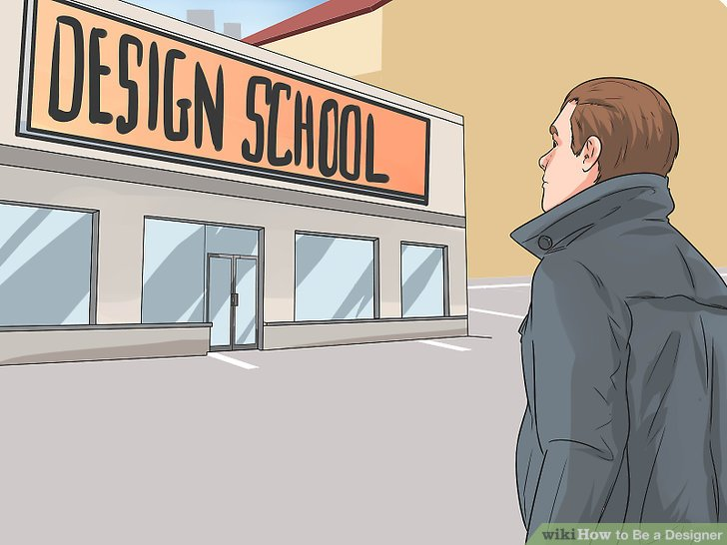

Slide 3


Slide 4


How to be a designer ???

Slide 5


Slide 6

Five steps :

Slide 7
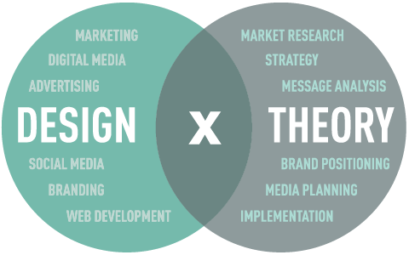

Slide 8


Slide 9


Slide 10

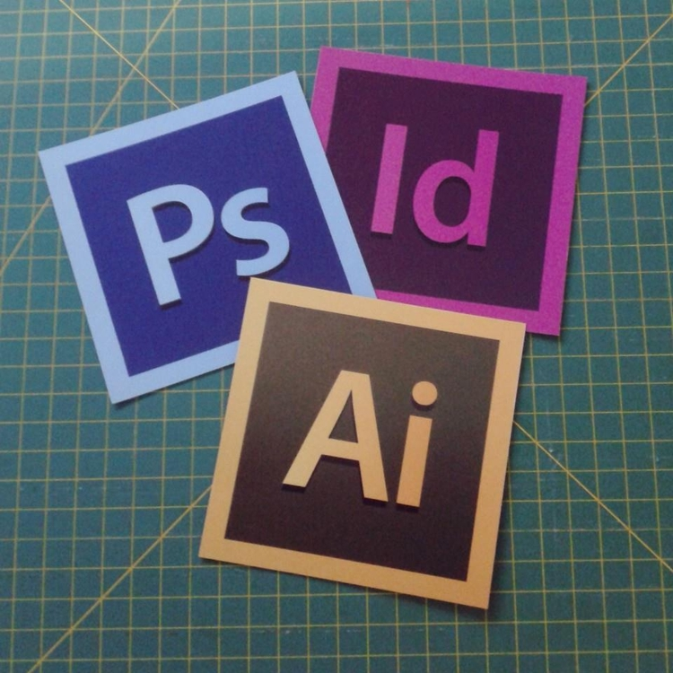
Vector editing
Photo editing

Slide 11


Slide 12


Slide 13


Slide 14


Slide 15


