Slide 1
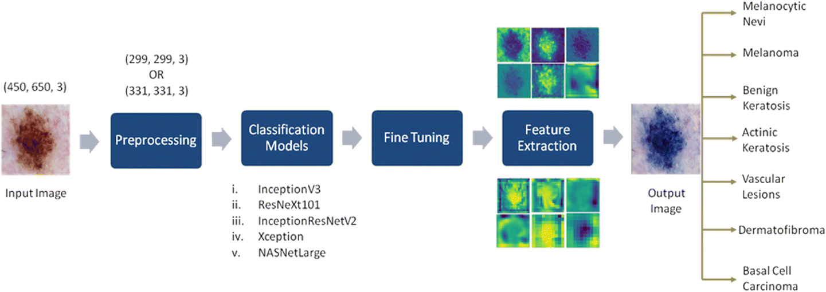
Architecture used in the Paper

Slide 2
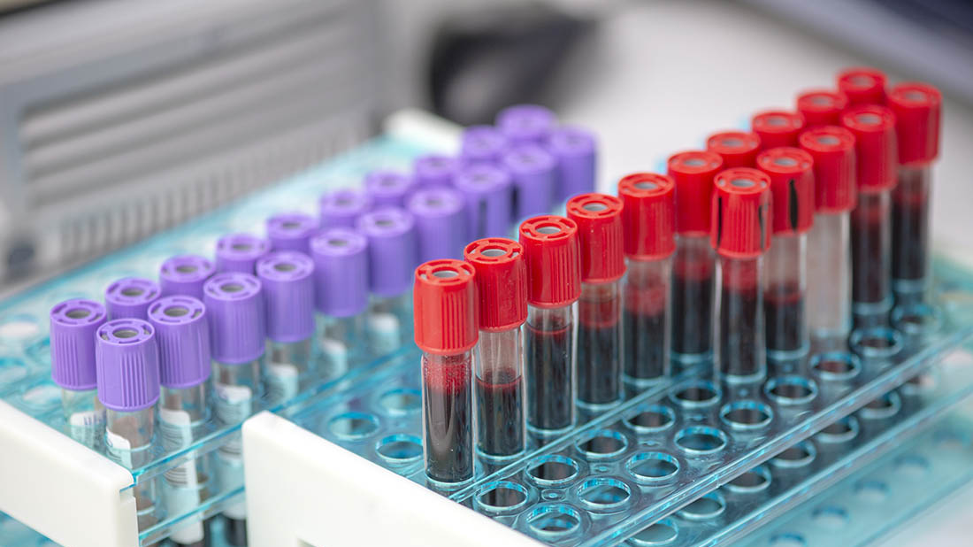
Dataset Details
The dataset contains 12,500 augmented images of blood cells (JPEG) with accompanying cell type labels (CSV). There are approximately 3,000 images for each of 4 different cell types grouped into 4 different folders (according to cell type). The cell types are Eosinophil, Lymphocyte, Monocyte, and Neutrophil. This dataset is accompanied by an additional dataset containing the original 410 images (pre-augmentation) as well as two additional subtype labels (WBC vs WBC) and also bounding boxes for each cell in each of these 410 images (JPEG + XML metadata). More specifically, the folder 'dataset-master' contains 410 images of blood cells with subtype labels and bounding boxes (JPEG + XML), while the folder 'dataset2-master' contains 2,500 augmented images as well as 4 additional subtype labels (JPEG + CSV). There are approximately 3,000 augmented images for each class of the 4 classes as compared to 88, 33, 21, and 207 images of each in folder 'dataset-master'.

Slide 3
Implementation Details
Model Architecture
1- Importing InceptionResNetV2 Pre-Trained Model from Keras Library
2- Freeze earlier layers which is pretrained on ImageNet weights
3- Remove The Fully Connected Top Layer to train the model on new classifier
4- Treat the rest of the pre-trained model as a fixed feature extractor for the new dataset
5- Flatten the output of the pre-trained model
6- Add dense layer of 512 unit with ‘relu’ activation
7- Add dropout layer with 0.2 rate
8- Add dense layer of 256 unit with ‘relu’ activation
9- Add dropout layer with 0.2 rate
10- Add dense layer of 128 unit with ‘relu’ activation
11- Add dropout layer with 0.2 rate
12- Add dense output layer of 4 units with ‘softmax’ activation
13- Use adam as Optimizer
14- Use sparse categorical crossentropy as Loss
15- Use Batchsize of 32 and 10 epochs
Dataset Preprocessing
1- Importing dataset from Kaggle
2- Resize each image to (120,120)
3- Add padding to the image to better detect cell at the edge
4- Thresholding the image to get the target cell
5- Split dataset to images and labels
6- Split images and labels to training, validation and testing sets with ratio 80:10:10 Respectively .
7- Scaling images features

Slide 4
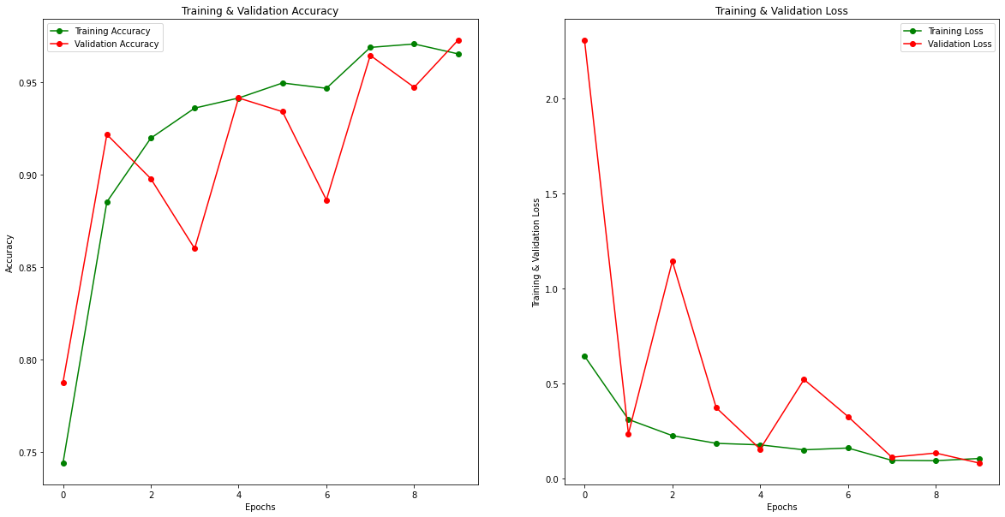
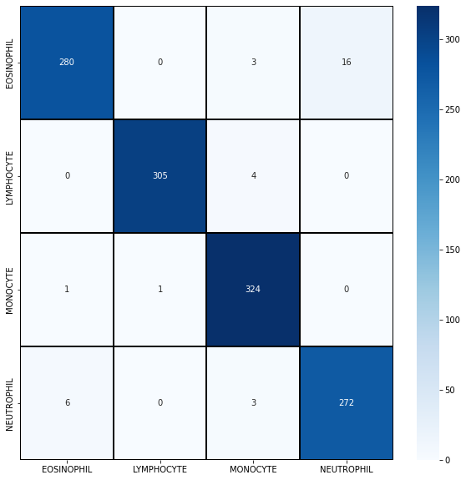
Learning Curves
Confusion Matrix
Results and visualizations
Training Accuracy : 97.7%
Testing Accuracy : 96.20%

