Slide 1
Automation & API Testing Project
End-to-end test automation with parallel execution, retry handling, and Allure reporting
UI Automation
36 automated test cases Functional & end-to-end coverage
API Testing
API validation integrated into the automation suite
Reporting & Reliability
Allure reporting Retry analysis & execution optimization
A scalable testing workflow that turns automated execution into measurable quality insights.
Automation & API Testing Project

Slide 2
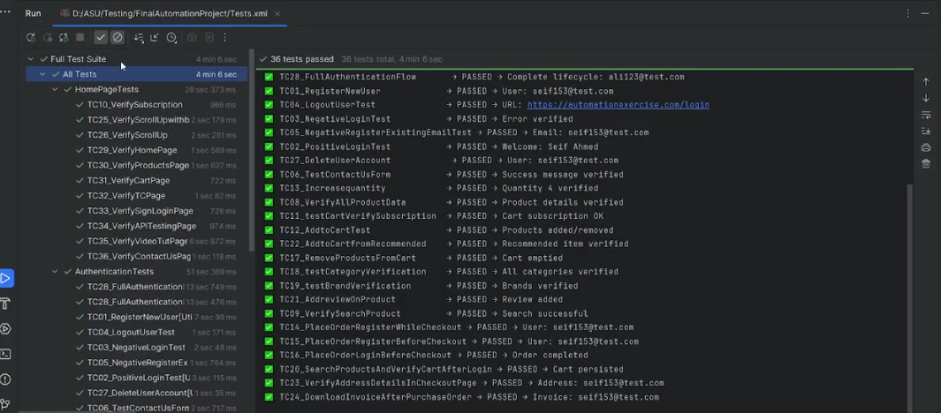
Automated Test Execution
A complete suite of functional, authentication, navigation, shopping cart, and checkout scenarios
36 / 36 PASSED
36 tests passed in a single full-suite execution

Slide 3


Slide 4
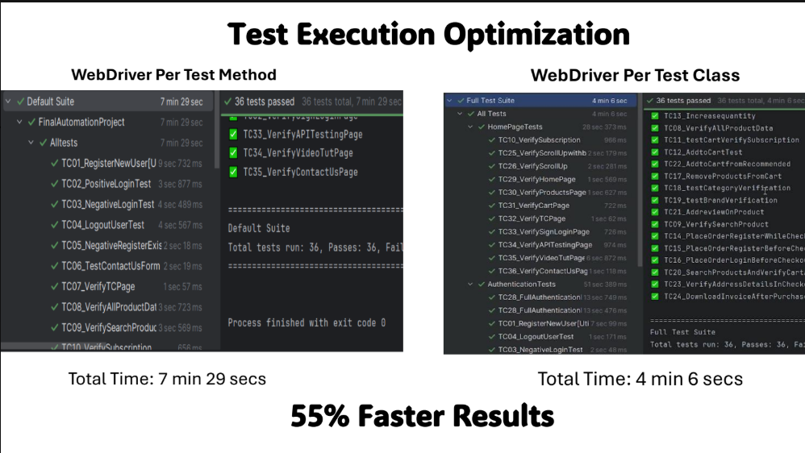
Execution Optimization

Slide 5

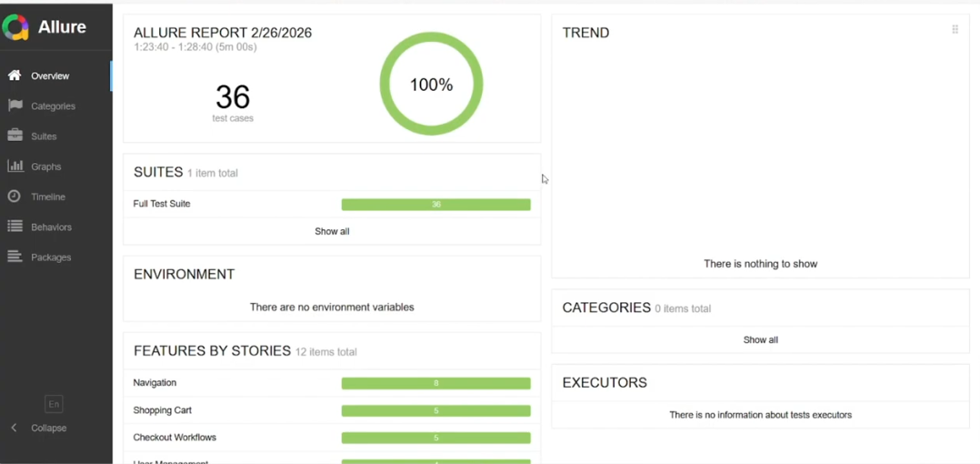
Allure Reporting
Turning test execution into clear, visual quality metrics
SCAN TO EXPLORE
Centralized reporting for execution status, suites, features, and test trends

Slide 6
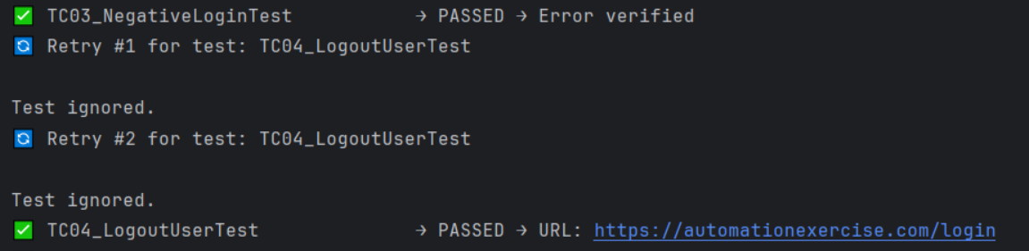
Retry Analysis & Test Stability
Identifying transient failures and distinguishing retries from actual test outcomes
Retry #1 / #2
The framework automatically retries a test when a transient failure is detected.
Final Result
The final execution status is reported separately from intermediate retry attempts.
Traceability
The console output preserves the test name, retry sequence, and final verification result.
Automation & API Testing Project

