Slide 1
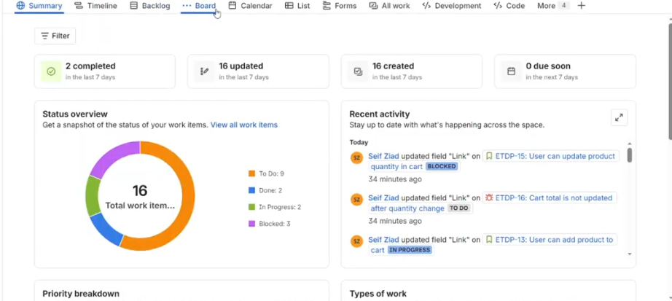
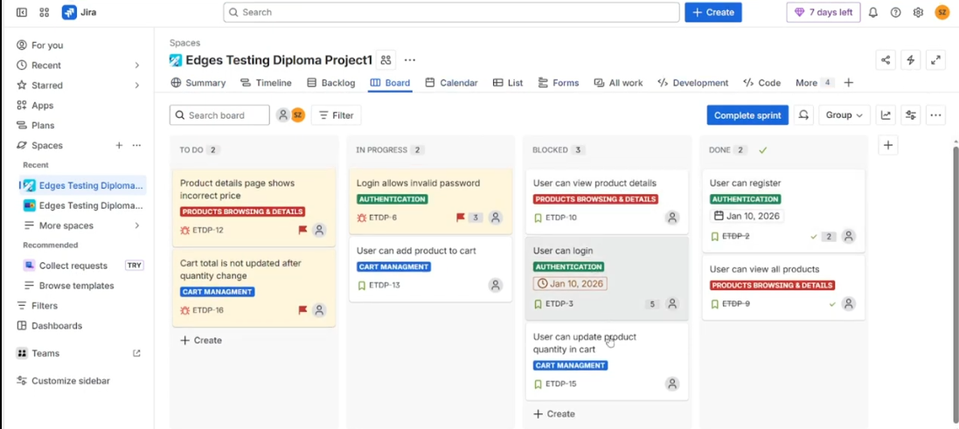
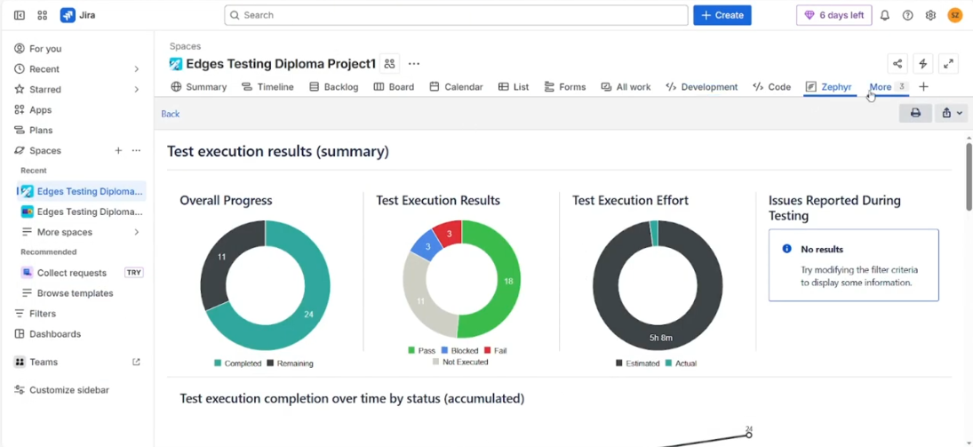
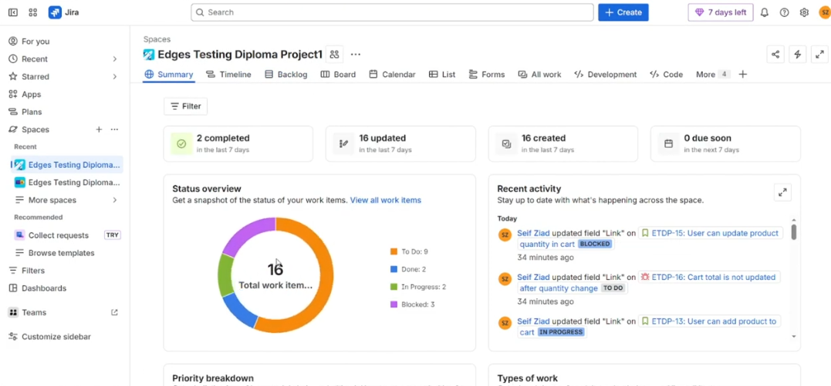
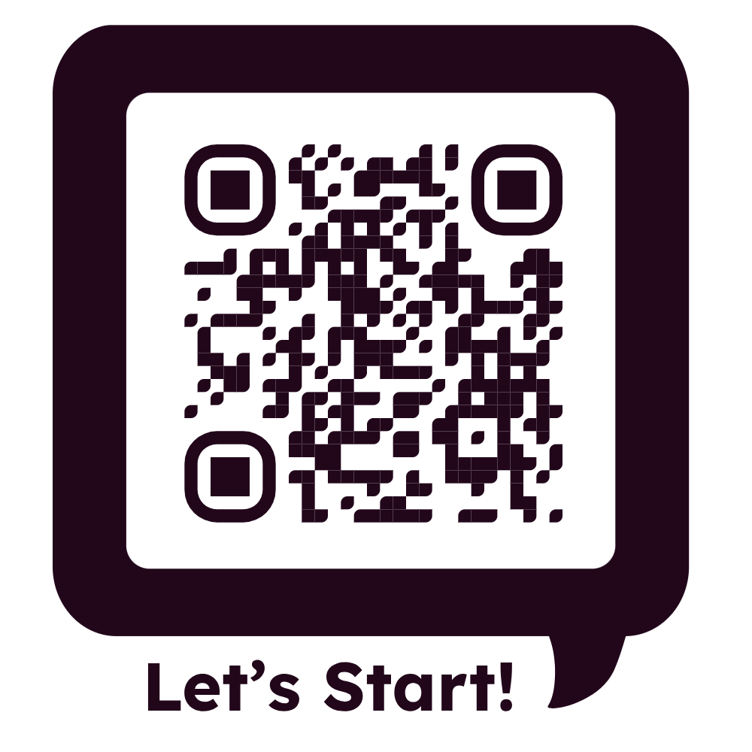
Manual Testing Project
JIRA + Zephyr Scale | Test Management • Execution • Reporting
SCAN TO EXPLORE
Designed, executed, and documented using a professional QA workflow

