Slide 1
ARIA
Adaptive Robotic Interaction Assistant
A 24/7 AI Companion for Autistic Children
22+
7
3
6
Features
AI Providers
Languages
Emotions
Graduation Project · 2026

Slide 2
Imagine you have a child
who can't tell you they're hurting.
250 million
autistic people in the world today*
More than the entire population of Egypt.
Most without consistent therapy. Most without 24/7 support.
* WHO + Autism Speaks global estimate, 2023

Slide 3
MEANWHILE IN EGYPT
The reality every Egyptian parent knows
الأم:
ابني مش بيتكلم، هاخده فين؟ في طبيب؟
في مدرسة؟ في حد يفهمه؟
الطبيب:
الجلسة بـ 800 جنيه. مرتين في الأسبوع.
قايمة الانتظار 6 شهور.
الواقع:
معظم الأهالي مش قادرين، وأطفالهم بيكبروا
من غير الدعم اللي محتاجينه.
ARIA:
معاكي 24 ساعة. ببلاش. بالعامية المصرية.
3 / 30

Slide 4
BUT WAIT
Couldn't they just use ChatGPT?
Generic AI
ARIA
ضربوني في المدرسة
ضربوني في المدرسة
I understand you are facing a difficult situation. Bullying is a serious issue that affects many individuals. I recommend consulting with a school counselor or mental health professional. Additionally, you may consider documenting incidents for school administrators...
يا قلبي، أنا معاك. 💙
ايه اللي حصل بالظبط؟ ابقى احكيلي.
✓ Egyptian colloquial
✓ Acknowledged feeling first
✓ Comfort mode triggered
✓ Parent alert sent silently
✓ TTS in soft Egyptian voice
ChatGPT speaks AT autistic kids. ARIA speaks WITH them.
4 / 30

Slide 5
ARIA isn't a chatbot.
ARIA isn't a flashcard app.
ARIA isn't another "learn emotions" toy.
ARIA is
a complete autism support OS.
22 features · 7 AI providers · 3 languages · evidence-based · 100% offline-capable
5 / 30

Slide 6
THE NUMBERS
Why this matters now
1 in 36
30 – 40%
U.S. children diagnosed with autism
of autistic children are minimally verbal
CDC, 2023
Tager-Flusberg, 2013
70%+
<5%
have anxiety disorders alongside ASD
have access to consistent therapy
van Steensel, 2011
Smith & Iadarola, 2015
There is a clear gap in scalable, autism-tuned AI tools that work in the home, in the moment, in the child's language.
6 / 30

Slide 7
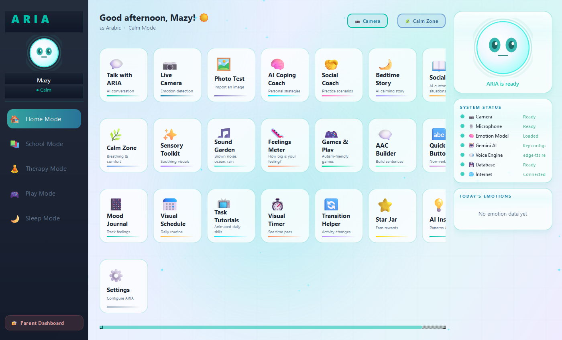
SOLUTION
ARIA dashboard — 22 features in one calm grid
💬
AI conversation tuned for ASD
📷
Live emotion detection (CNN + VLM)
🌿
Calm zone & sensory toolkit
📅
Visual schedules & timers
🗨️
AAC (non-verbal communication)
📖
AI bedtime & social stories
7 / 30

Slide 8
DESIGN
Why teal + neon — not pink princess
Autism-friendly UI principles
Color system
Predictability Same layout every visit. Reduces anxiety (Schreibman et al., 2015).
Primary teal
Main UI / trust
#00BFA8
Low sensory load No bright reds, no flashing, no harsh contrasts.
Neon cyan
Accent / interactive
#00E5FF
Neon purple
AI / smart
High legibility 14-22pt, 4.5:1 contrast (WCAG AA).
#B388FF
Calm green
Success / safe
#00D9A0
Modern, not childish Premium look — autistic kids notice condescension.
Warm amber
Attention only
#FFB73D
Glassmorphism + neon Futuristic = aspiration; soft = warmth.
Deep navy
#0A1428
Dark cards
Avoided: bright red (alarm), saturated pink (gendered/childish), pure black (visual fatigue)
8 / 30

Slide 9
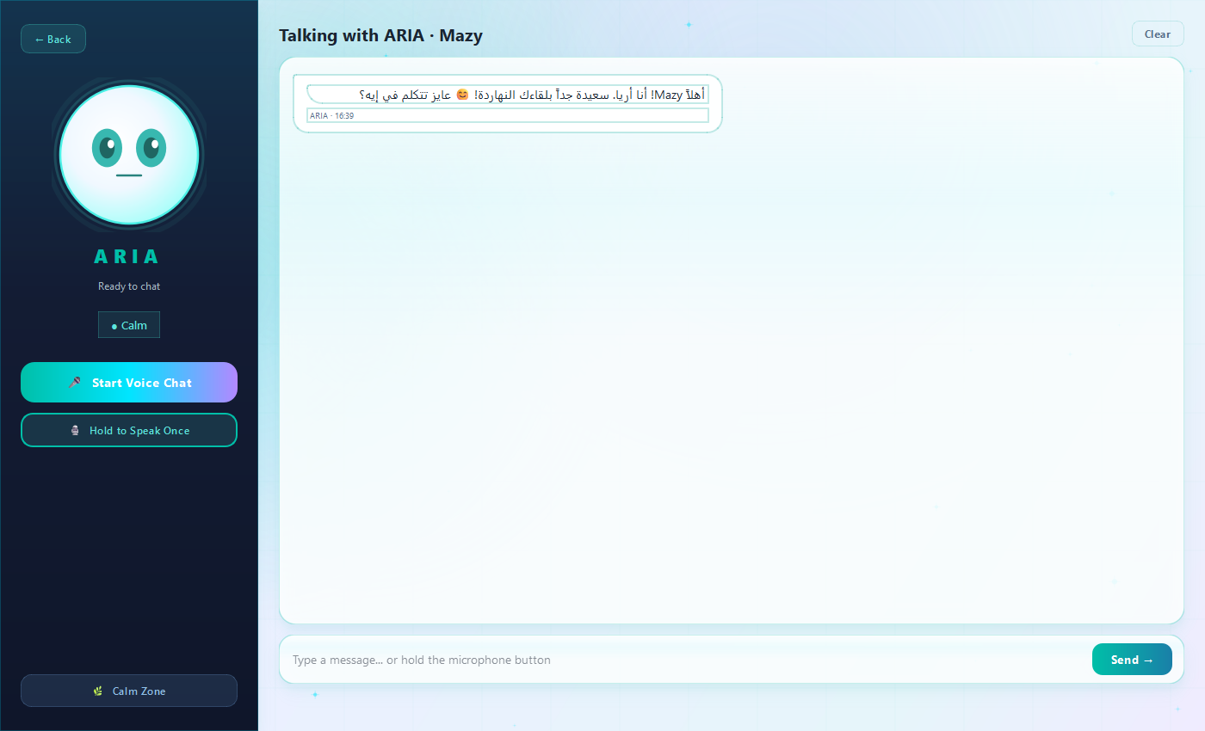
FEATURE: AI CONVERSATION
Talk with ARIA
Voice Mode
Continuous hands-free conversation with VAD silence detection
Multi-turn memory
Last 6 turns of history sent to AI for context
Live waveform
Volume meter shows mic is hearing the child
Egyptian dialect
Auto-converts MSA to colloquial via 60+ regex rules
6-class emotion
Face changes based on detected emotion in real time
9 / 30

Slide 10
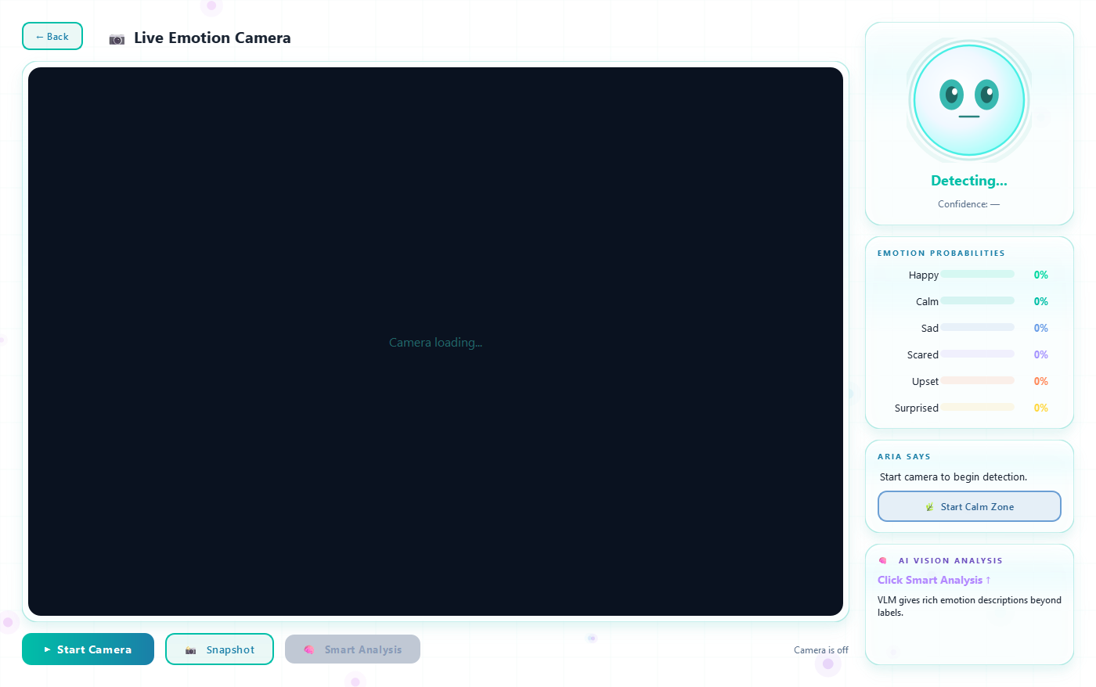
FEATURE: COMPUTER VISION
Hybrid emotion detection — CNN + VLM
Architecture
1. CNN (local, real-time)
MobileNetV2 trained on 3 datasets, runs on every frame at 30fps
2. VLM (cloud, on-demand)
Llama-4-Scout vision via Groq, gives rich descriptions:
"Mazy is biting her lip, looking down. Possibly anxious."
Why both?
Local CNN = privacy + zero latency. VLM = clinical-grade detail when needed.
10 / 30

Slide 11
ML PIPELINE
Emotion recognition model
MobileNetV2
96 × 96
Backbone — efficient, mobile-ready
Input resolution (RGB)
6 classes
~1,500 imgs
anger · fear · joy · neutral · sadness · surprise
Combined training set (3 datasets)
Datasets used
FERAC — Facial Expression Recognition for Autistic Children (Bilkent University, 2022)
Autism Emotion — Custom autism-focused dataset, ~240 imgs/class across 6 classes
Children Faces — Generic children facial expression dataset for diversity
11 / 30

Slide 12
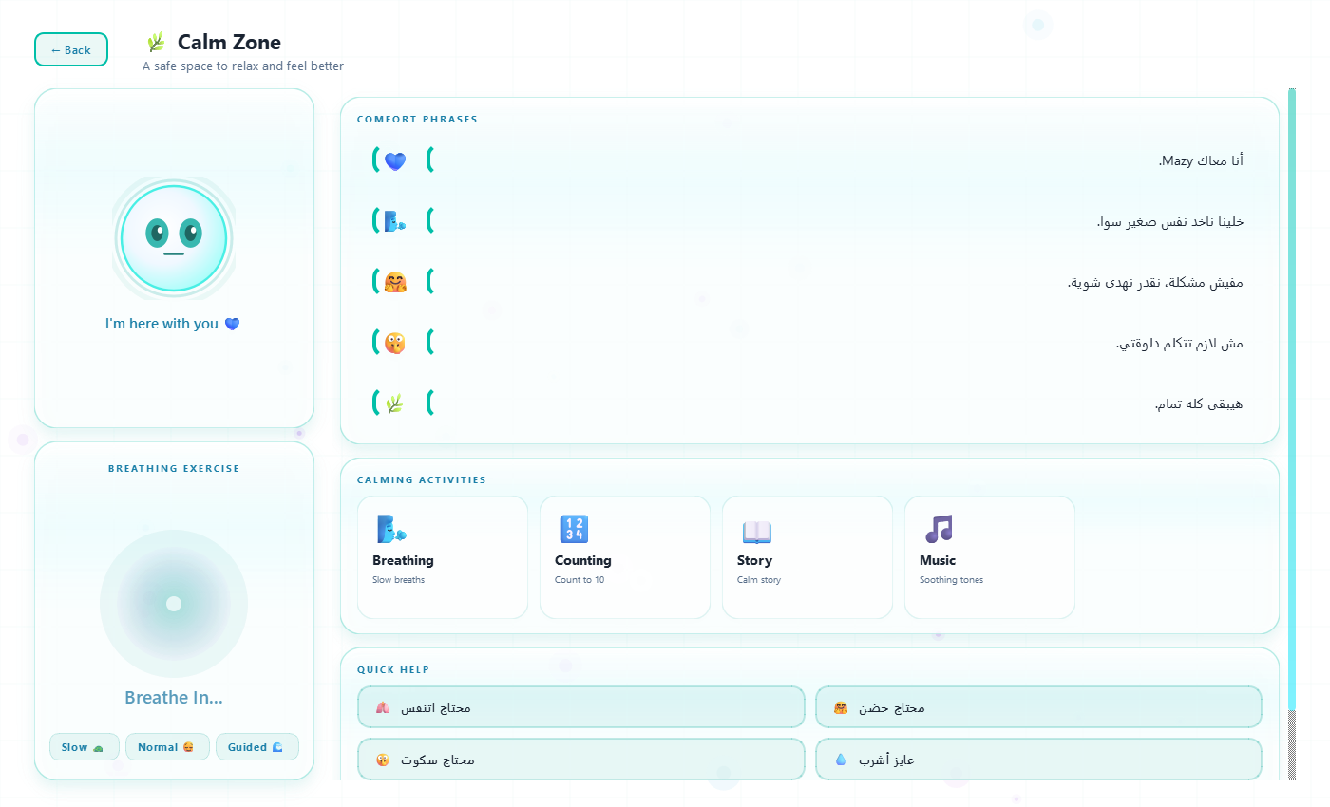
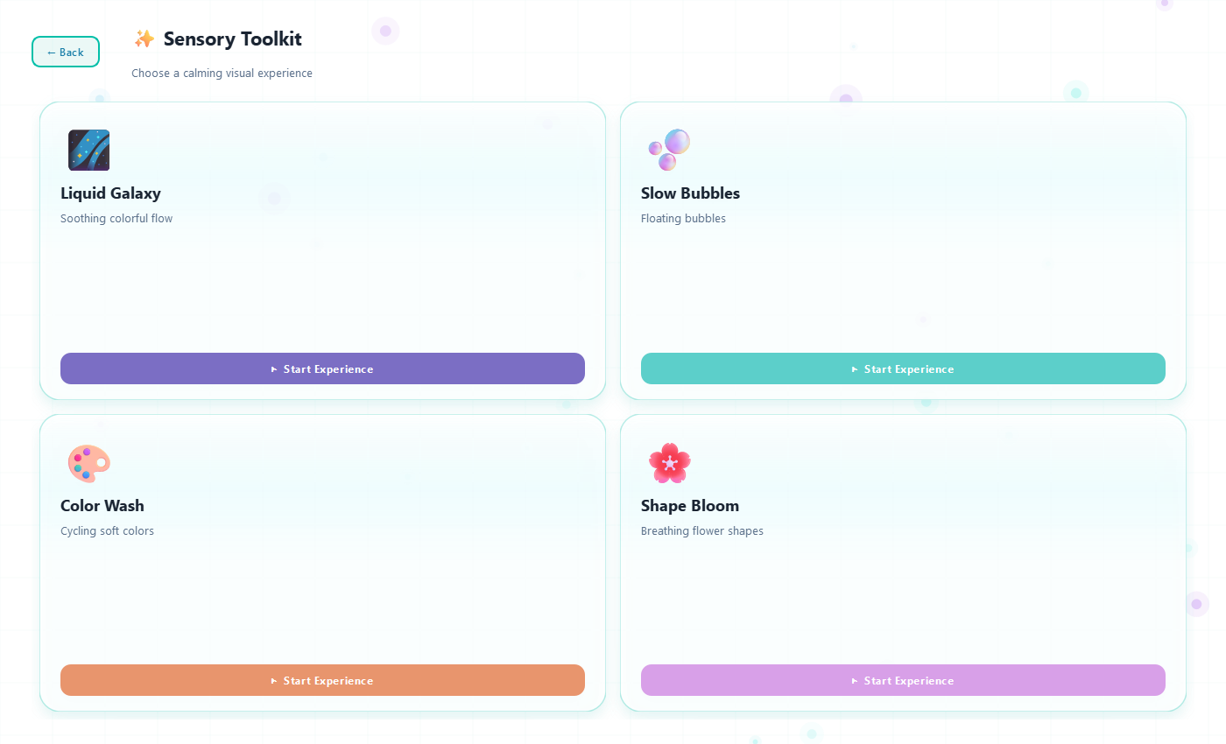
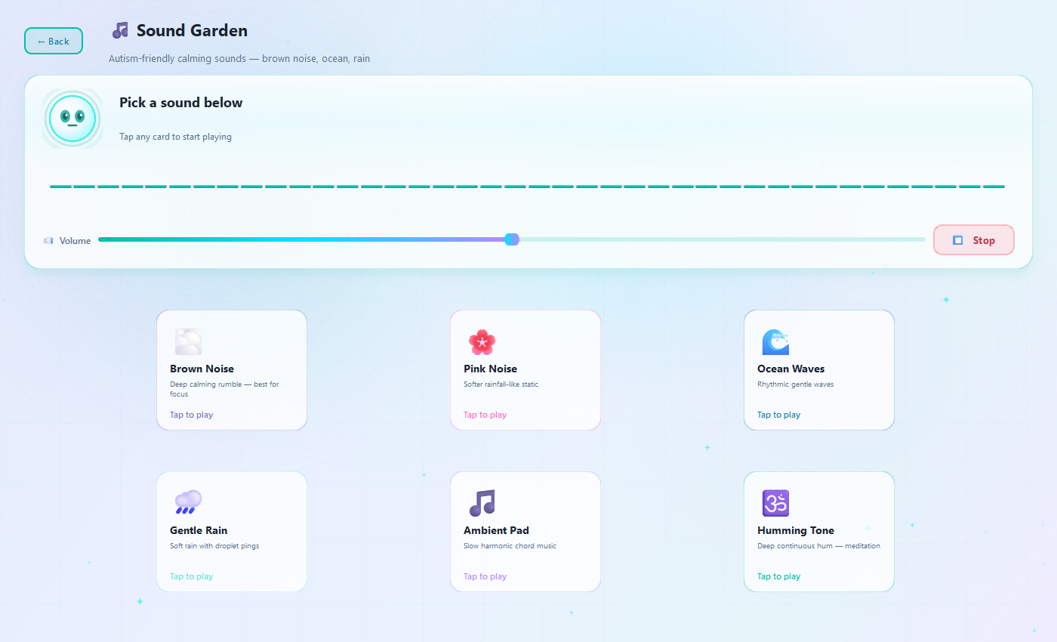
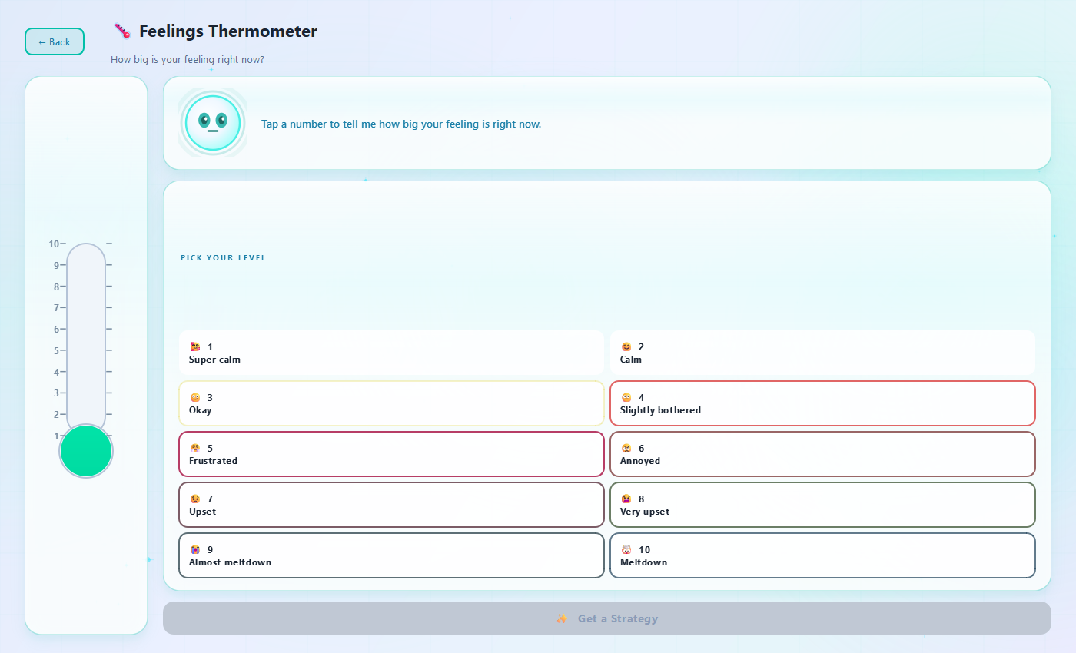
CALMING FEATURES
Sensory regulation & emotional safety
Calm Zone
Sensory Toolkit
Breathing animation, comforting phrases
Liquid galaxy, bubbles, color wash, shape bloom
Sound Garden
Feelings Meter
Brown noise, ocean, rain — procedural audio
1–10 intensity scale, prevents meltdowns
12 / 30

Slide 13
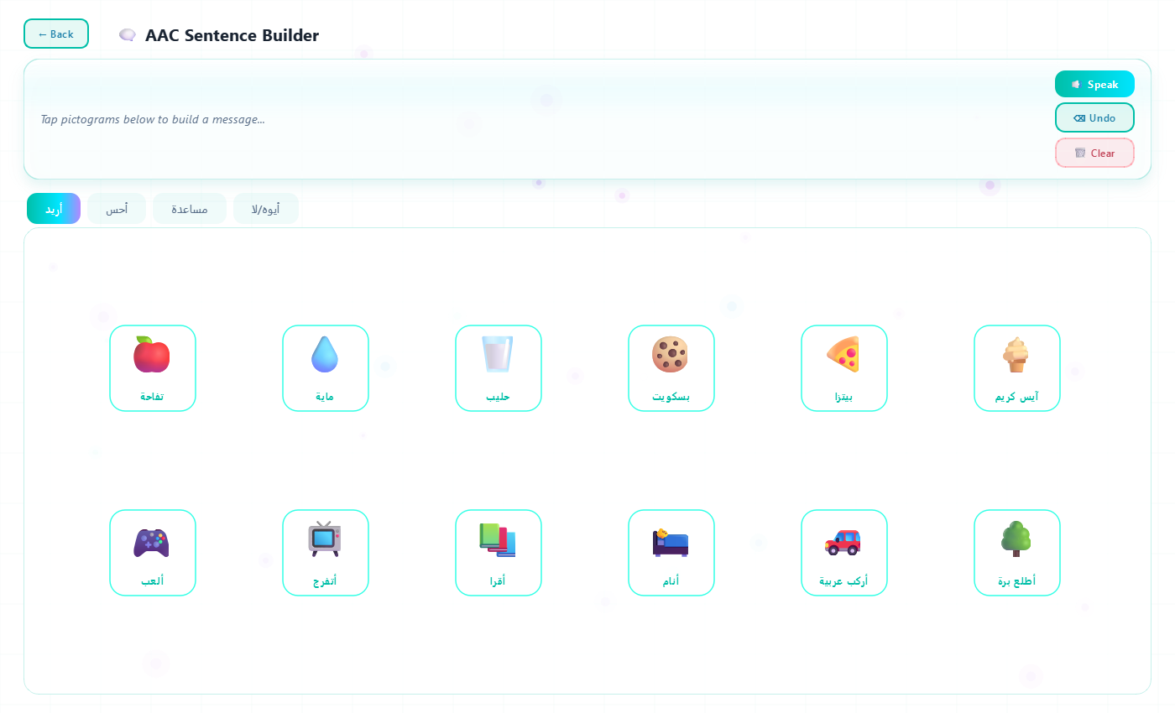
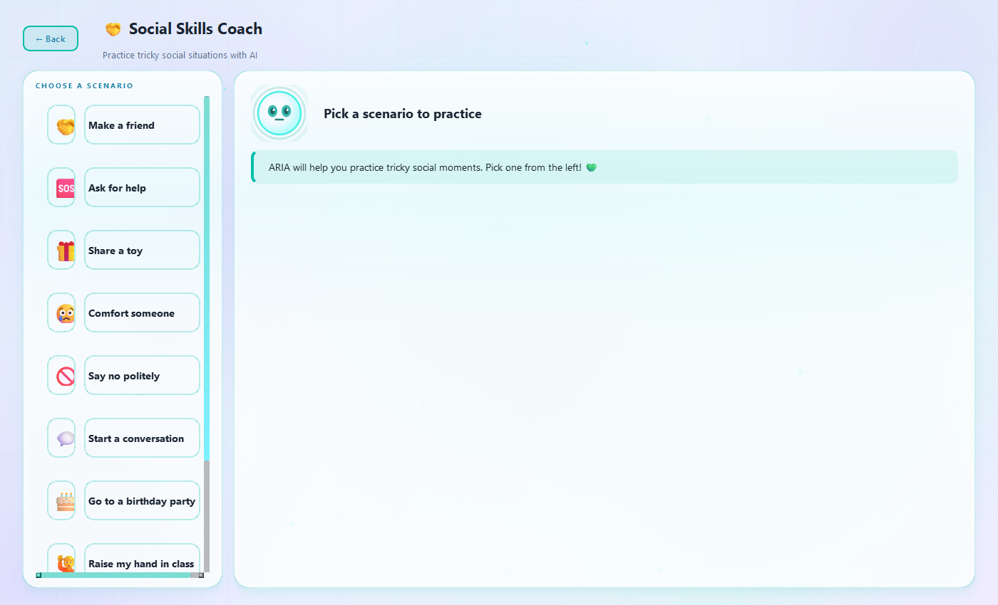
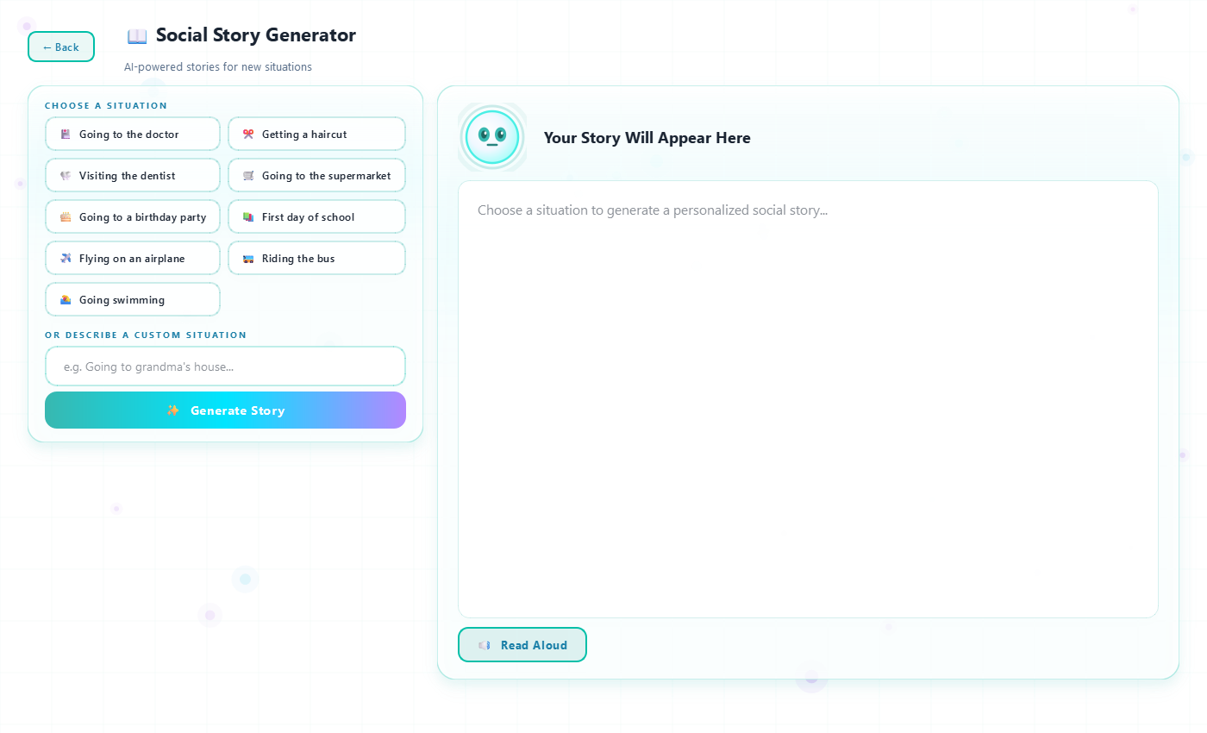
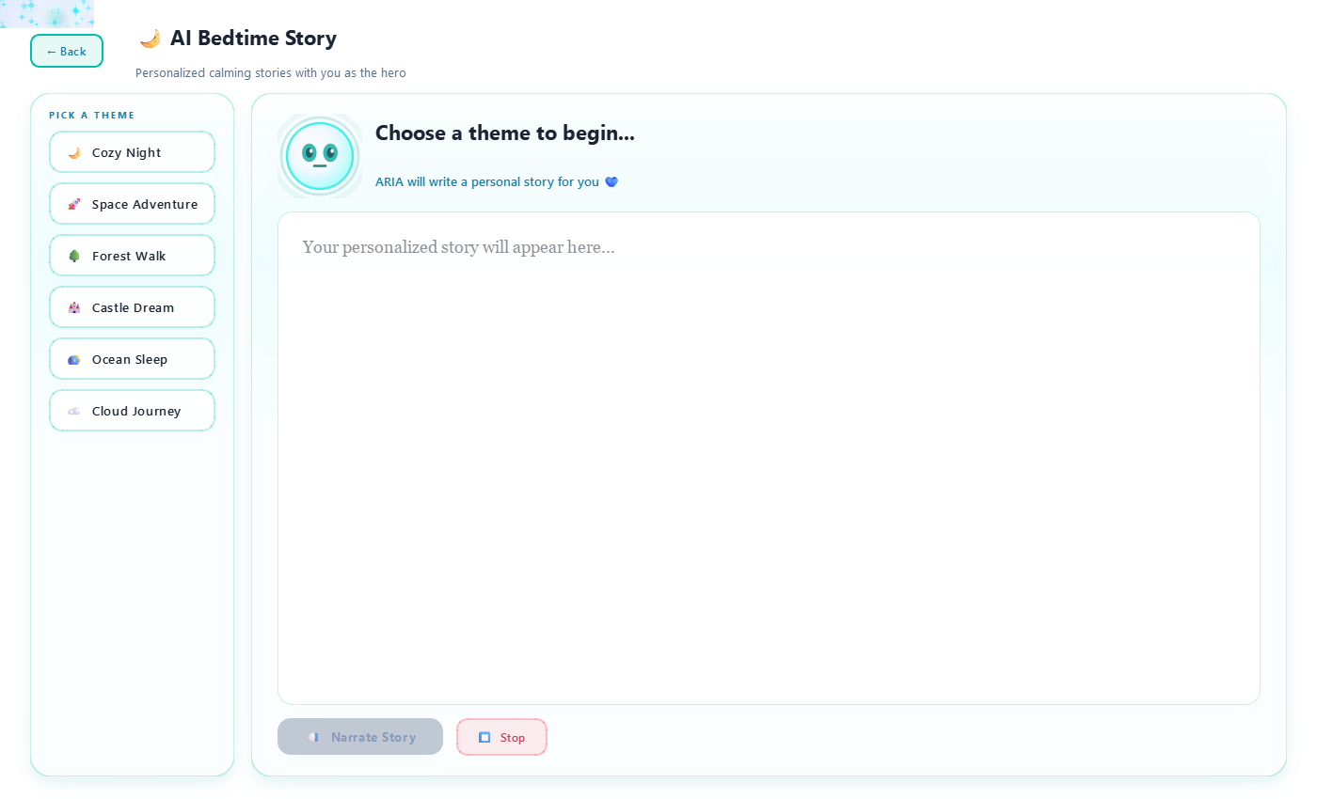
COMMUNICATION
Tools for verbal & non-verbal children
AAC Builder
Social Skills Coach
48 pictograms, 4 categories, sentence builder + TTS
AI scenarios — bullying, sharing, asking for help
AI Story Maker
Bedtime Story
Custom social stories for situations (doctor, haircut)
Personalized story with child as hero, TTS narration
13 / 30

Slide 14
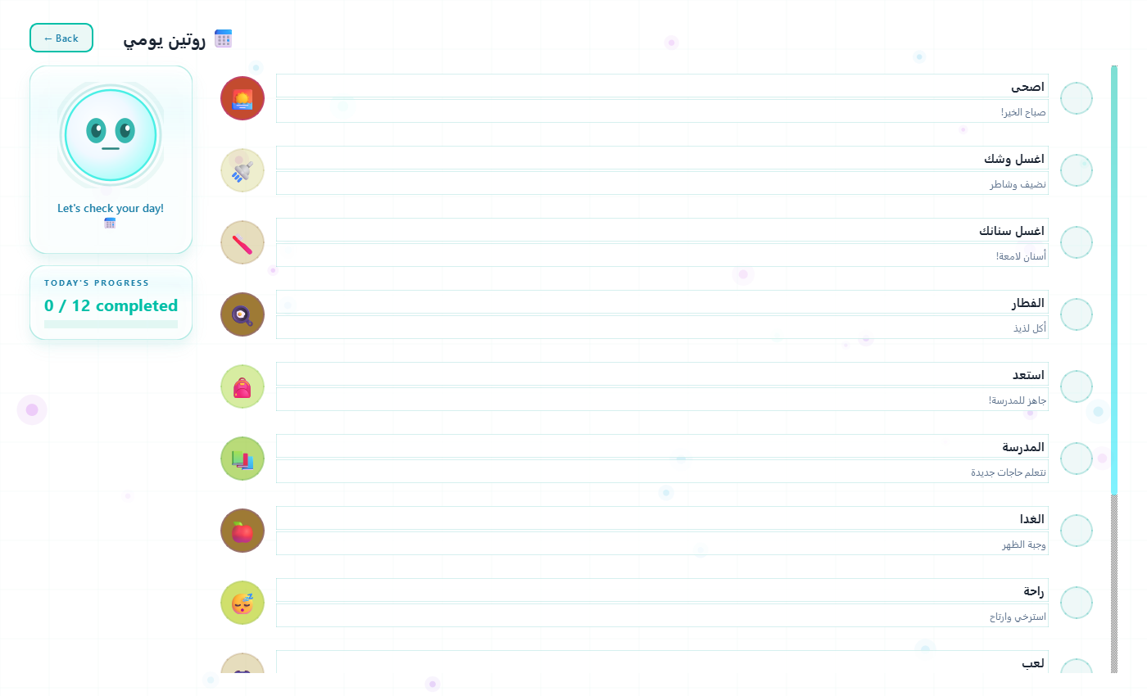
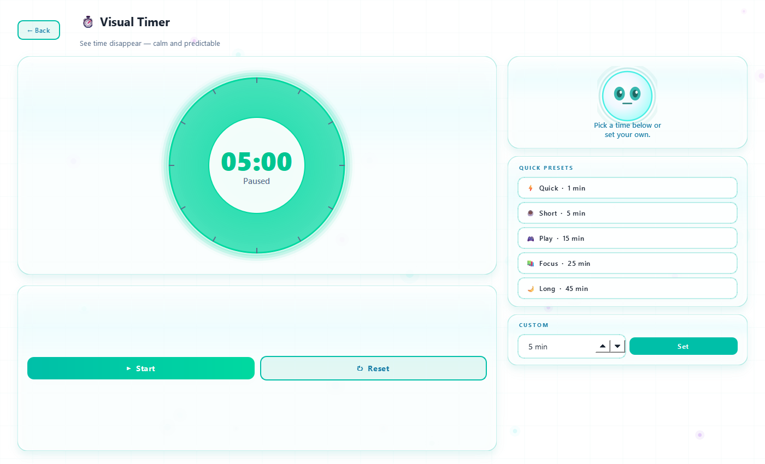
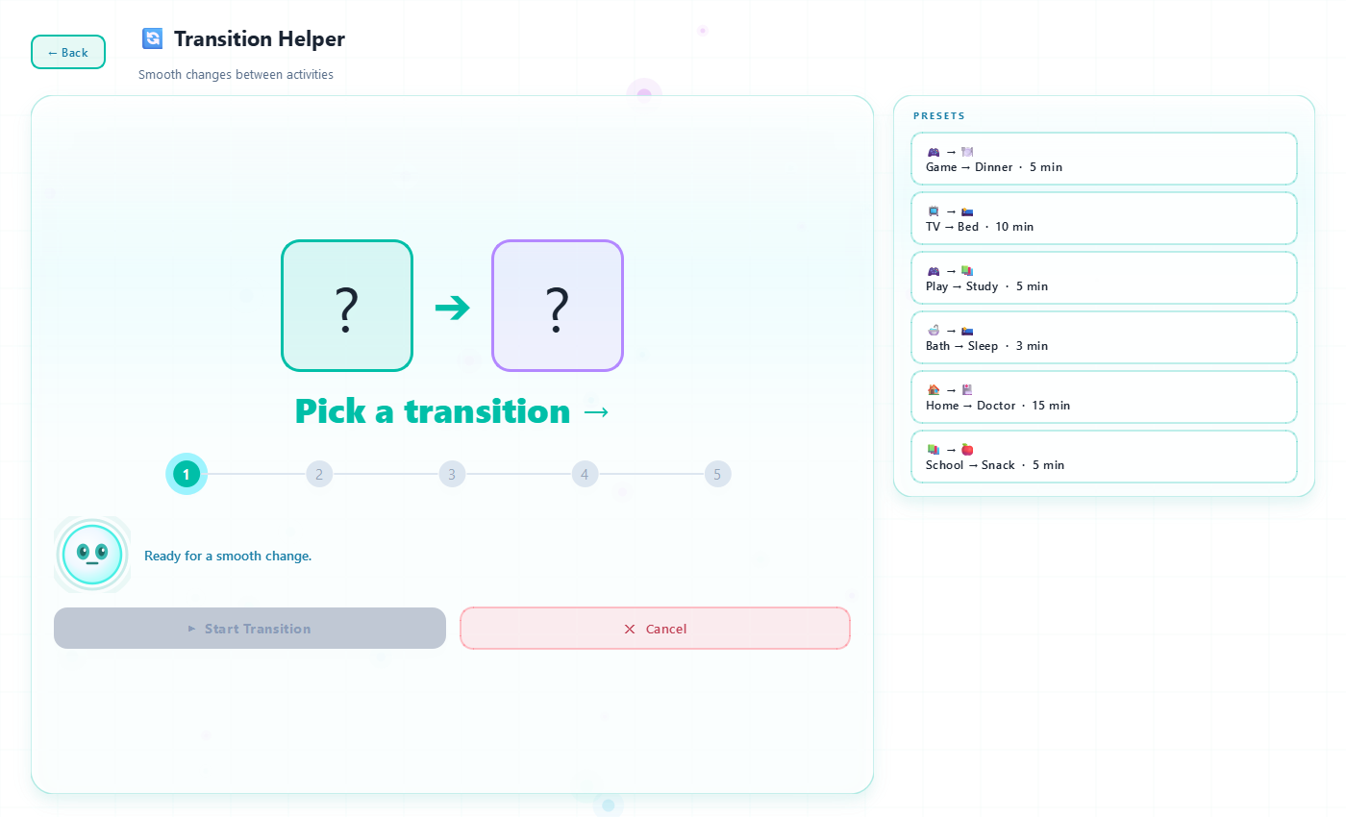
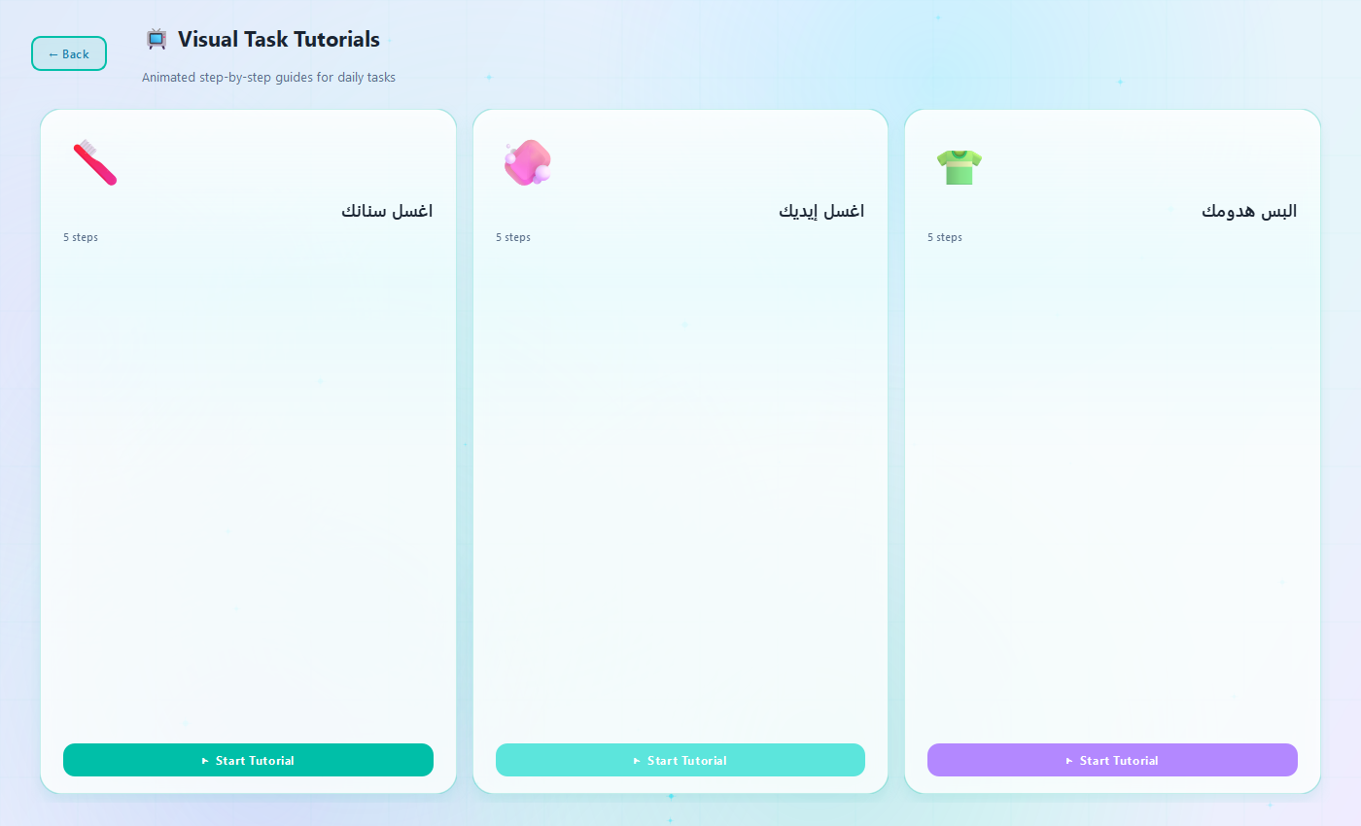
DAILY LIFE
Routines, transitions & rewards
Visual Schedule
Visual Timer
Daily routine cards, child marks tasks done
Time-Timer style countdown with halfway warning
Transition Helper
Task Tutorials
Smooth activity changes with pre-warnings
Animated brushing teeth, washing hands, dressing
14 / 30

Slide 15
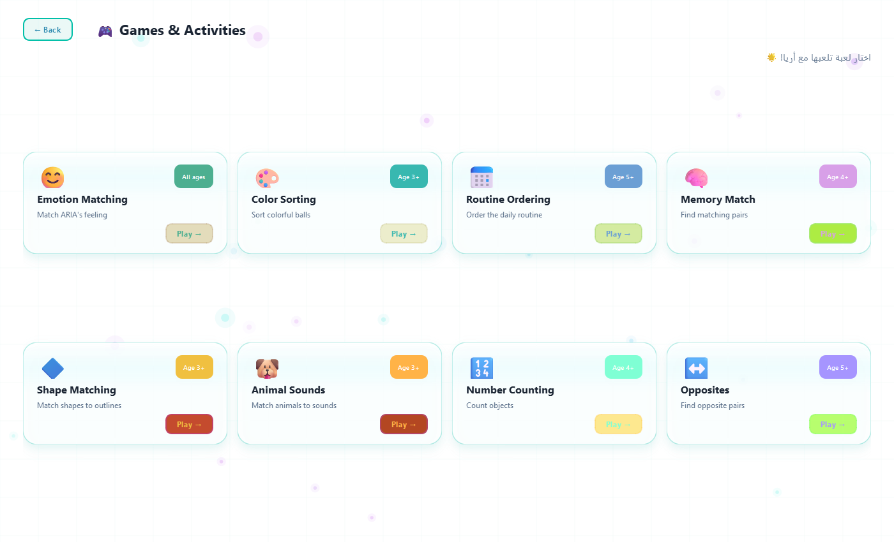
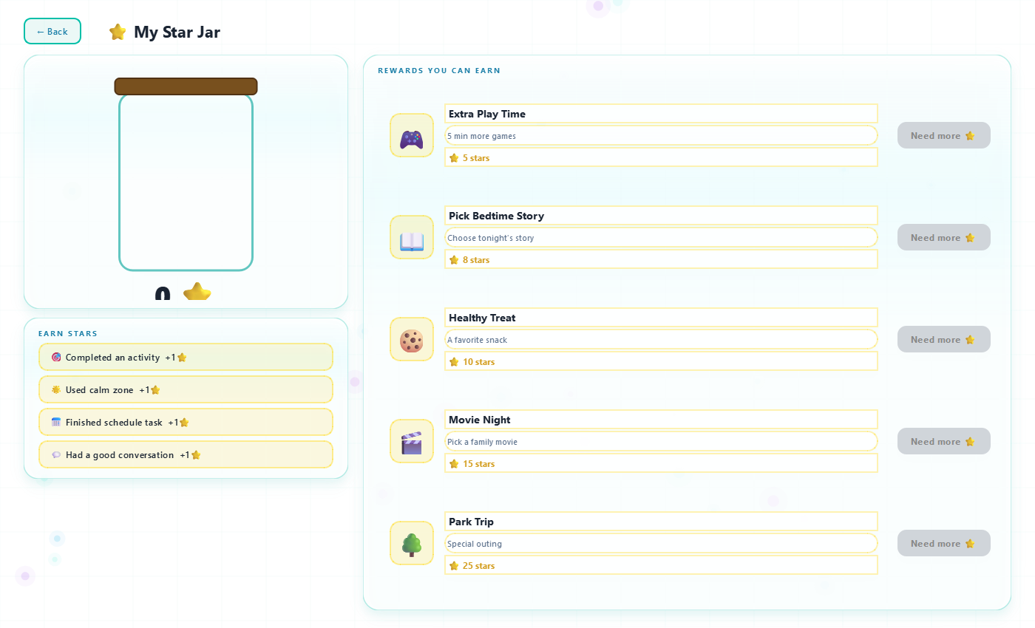
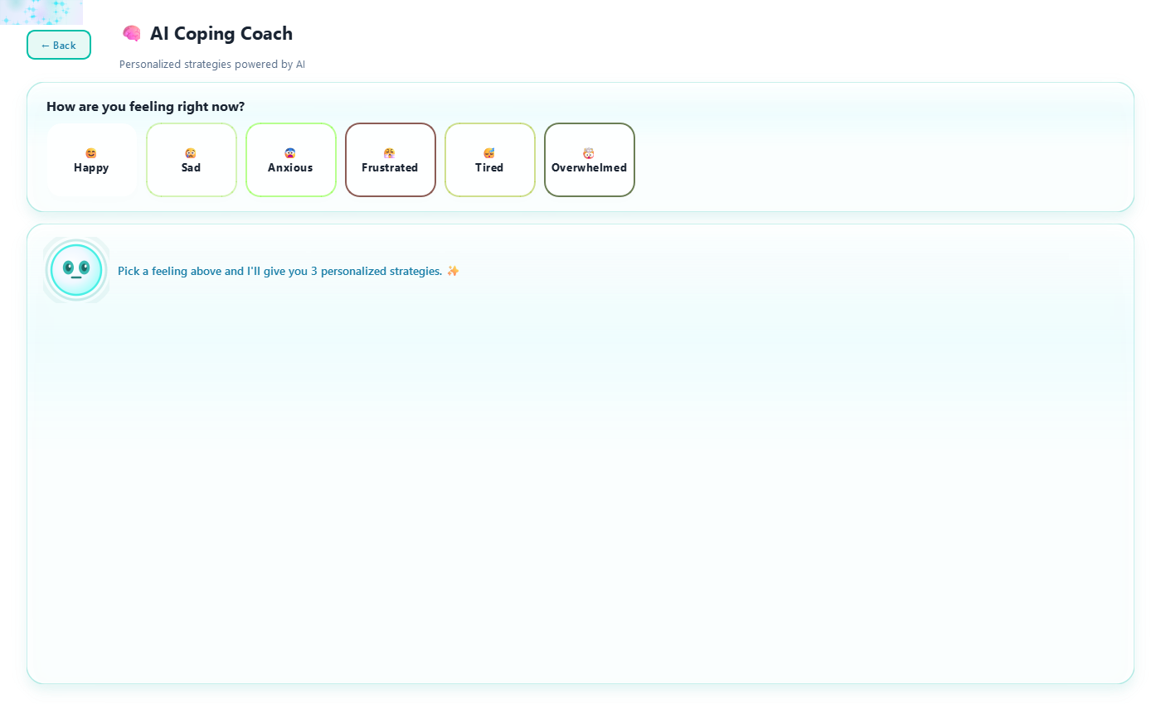
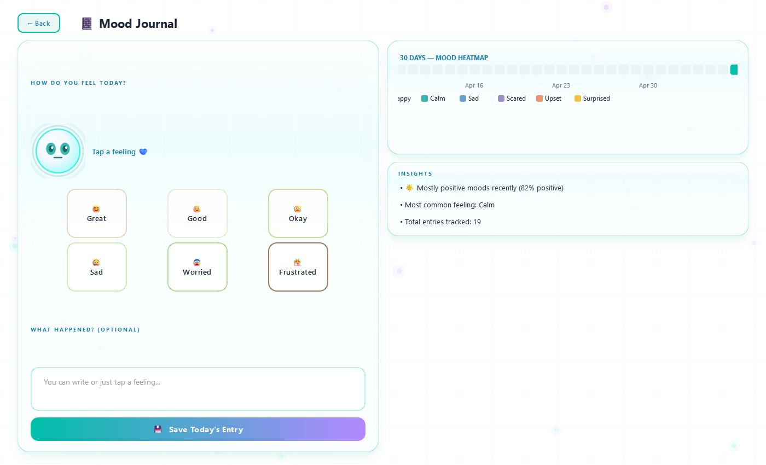
ENGAGEMENT
Games, rewards & coaching
8 Mini-Games
Star Jar
Emotion match, memory, shapes, animal sounds, counting…
Token reward system, visual jar fills with stars
AI Coping Coach
Mood Journal
Tap a feeling, AI gives 3 personalized strategies
Daily check-in, 30-day heatmap, AI insights
15 / 30

Slide 16
EVIDENCE
Every feature is research-grounded
Visual Schedule
Visual Timer
Reduces transition anxiety by 60%+
Improves task completion in ASD
Knight et al., 2015
Bryan & Gast, 2000
AAC Pictograms
Brown Noise
Boosts expressive vocabulary 3-5×
Reduces auditory overload in ASD
Ganz et al., 2012 (PECS meta-analysis)
Lucker, 2013
Social Stories
Feelings Meter
Effective for social skills (Cohen's d=0.62)
Self-rating reduces meltdown frequency
Test et al., 2011
Buron & Curtis, 2003
Token Rewards
Bedtime Stories
Strong evidence in ABA therapy
30%+ reduction in sleep latency
Carnett et al., 2014
Mindell et al., 2009
16 / 30

Slide 17
AI ARCHITECTURE
7-provider chain with automatic fallback
1
Groq
Llama-3.3-70B
30 req/min
← PRIMARY
2
Cerebras
Llama-3.3-70B
8000/day
3
Gemini
2.5 Flash
15 req/min
4
OpenRouter
Multi-model
Variable
5
Anthropic
Claude 3.5 Haiku
Paid
6
OpenAI
GPT-4o-mini
Paid
7
Ollama
Local Llama
Infinite
If a provider rate-limits, the chain falls through automatically. Free tier covers virtually unlimited usage.
17 / 30

Slide 18
API RECOMMENDATION
If money were no object: Anthropic Claude
FREE TIER WINNER
PREMIUM WINNER
Groq · Llama-3.3-70B
Anthropic Claude 3.5 Sonnet
✓ 30 req/min FREE forever
✓ Sub-100ms latency (LPU silicon)
✓ Excellent Egyptian Arabic
✓ JSON mode, vision (Llama-4 Scout)
✗ Less empathic than Claude
✓ Best emotional reasoning of any LLM
✓ Constitutional AI — safest for kids
✓ Best at refusing harmful prompts
✓ Excellent Arabic + dialect handling
✗ $0.80/1M input · $4/1M output
VERDICT: Use Groq as primary (free, 95% as good). Claude as paid premium tier.
18 / 30

Slide 19
TECH STACK
What's under the hood
FRONTEND
BACKEND
AI MODELS
AUDIO/VIDEO
• PySide6 (Qt 6.6)
• Custom QSS theming
• QPropertyAnimation
• Custom QPainter widgets
• Python 3.11
• SQLite (12 tables)
• Multi-threading
• asyncio for edge-tts
• Llama-3.3-70B (Groq)
• Llama-4-Scout vision
• MobileNetV2 emotion CNN
• Whisper Medium STT
• pygame mixer (TTS playback)
• edge-tts (Microsoft Neural)
• OpenCV 4.8 (camera)
• PyAudio (mic)
19 / 30

Slide 20
MULTILINGUAL
Egyptian Arabic, English, German
🇪🇬
🇬🇧
🇩🇪
Egyptian Arabic عامية
English
German Deutsch
• Salma Neural voice (TTS)
• Whisper Medium 1.5GB w/ Egyptian primer
• 60+ MSA→Egyptian regex polisher
• Strict prompt enforcement
• Jenny Neural voice
• Google Web Speech STT (fast)
• Whisper base fallback
• Default tier
• Katja Neural voice
• Google Web Speech STT
• Simple child-friendly prompts
• Whisper base fallback
20 / 30

Slide 21
SAFETY
Built for vulnerable users
✓
Input safety filter
✓
Output safety filter
Blocks self-harm, violence before reaching AI
Strips diagnoses, medical advice, scary content
✓
Parent alert system
✓
PIN-locked dashboard
comfort_mode triggers parent notification
Parent reports/settings require PIN
✓
Local-first emotion data
✓
Data export & delete
CNN runs on-device; no face leaves machine without consent
Full GDPR-style data control
✓
Offline safe mode
✓
No diagnosis claims
Works without internet (sensory, schedule, breathing)
Explicit disclaimer: ARIA assists, never replaces
21 / 30

Slide 22
MODES
ARIA adapts to context
🏠
🎒
🩺
🎮
Home Mode
School Mode
Therapy Mode
Play Mode
Full features available, normal interaction
Quiet voice, fewer distractions, focus support
Emotion games, social stories, parent logging
Games and fun, calm not overstimulating
🌿
🌙
👨‍👩‍👧
Calm Mode
Sleep Mode
Parent Mode
Low brightness, breathing only, quiet response
Very low brightness, bedtime story, no games
Reports, settings, safety controls, PIN-locked
22 / 30

Slide 23
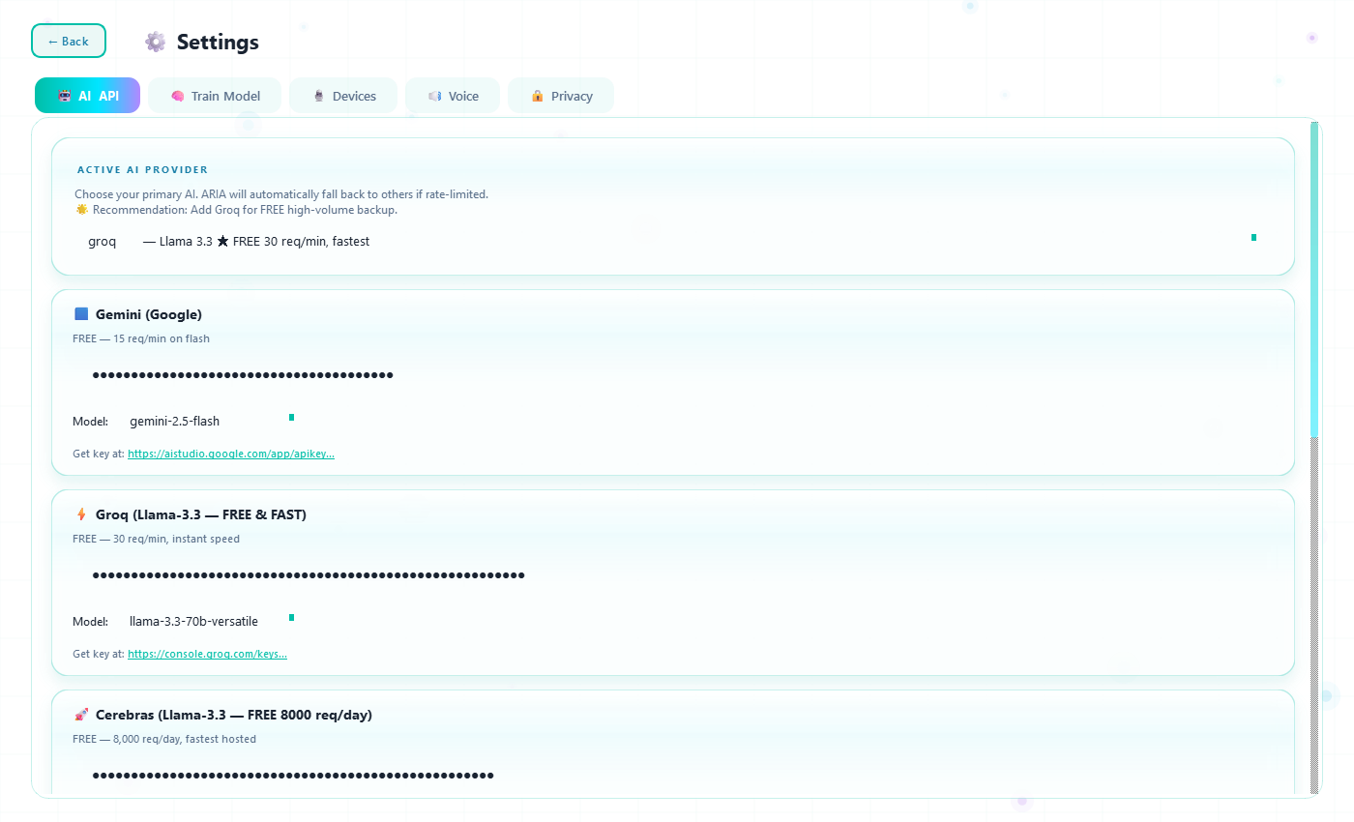
PARENT DASHBOARD
PIN-locked oversight & analytics
📊 Overview
Today's mood, stats, donut chart
😊 Emotions
Full log table, color-coded
💬 Chat Log
Every conversation reviewed
📅 Sessions
Session history & duration
📤 Export
JSON + PDF report generation
💡 AI Insights
Gemini-analyzed patterns
23 / 30

Slide 24
INNOVATIONS
What makes ARIA different
1
Hybrid CNN + VLM
First autism app combining local emotion CNN with cloud Vision-Language Model
2
Egyptian dialect AI
60+ MSA→Egyptian regex polisher + dialect-primed Whisper Medium
3
Procedural calming audio
Brown noise, ocean, rain generated in real-time with numpy+pygame
4
7-provider fallback chain
Auto-switches between Groq, Cerebras, Gemini, OpenRouter when rate-limited
5
Animated task tutorials
Custom Qt-painted ADL animations with TTS narration in 3 languages
24 / 30

Slide 25
BY THE NUMBERS
Project metrics
11,000+
22
8
12
Lines of Python
Major Features
Mini-games
Database tables
7
3
6
100%
AI providers
Languages
Emotion classes
Offline-capable
25 / 30

Slide 26
DEMO FLOW
Live demonstration order
1
Splash → Welcome Back
Particle background, child profiles
2
Open Talk with ARIA
Voice mode → speak in Arabic → ARIA replies in Egyptian dialect
3
Live Camera
Real-time CNN, then 🧠 Smart Analysis for VLM rich description
4
Feelings Thermometer
Tap level 7 → ARIA suggests calm zone
5
AI Coping Coach
Pick 'Anxious' → AI generates 3 personalized strategies
6
Sound Garden
Play brown noise → live waveform visualizer
7
Bedtime Story
Pick 'Cozy Night' → AI writes story → TTS narrates
8
Parent Dashboard
Enter PIN → all 5 tabs → export JSON/PDF
26 / 30

Slide 27
REFERENCES
Academic & technical sources (1/2)
[1] CDC. (2023). Prevalence of Autism Spectrum Disorder Among Children Aged 8 Years. MMWR Surveillance Summaries.
[2] Tager-Flusberg, H., & Kasari, C. (2013). Minimally verbal school-aged children with autism. Autism Research, 6(6), 468-478.
[3] van Steensel, F. J., et al. (2011). Anxiety disorders in children and adolescents with ASD: A meta-analysis. Clinical Child and Family Psychology Review.
[4] Smith, T., & Iadarola, S. (2015). Evidence base update for autism spectrum disorder. Journal of Clinical Child & Adolescent Psychology.
[5] Knight, V., et al. (2015). Visual activity schedules and a graduated guidance system for ASD. Remedial and Special Education.
[6] Bryan, L. C., & Gast, D. L. (2000). Teaching on-task and on-schedule behaviors using visual schedules. Journal of Autism and Developmental Disorders.
[7] Ganz, J. B., et al. (2012). A meta-analysis of single case research studies on aided AAC systems with ASD. Journal of Autism and Developmental Disorders.
[8] Lucker, J. R. (2013). Auditory hypersensitivity in children with autism spectrum disorders. Focus on Autism and Other Developmental Disabilities.
[9] Test, D. W., et al. (2011). Evidence-based practices in secondary transition. Career Development for Exceptional Individuals.
[10] Buron, K. D., & Curtis, M. (2003). The Incredible 5-Point Scale. Autism Asperger Publishing Co.
27 / 30

Slide 28
REFERENCES
Academic & technical sources (2/2)
[11] Carnett, A., et al. (2014). Effects of a perseverative interest-based token economy on academic engagement of students with autism. JABA.
[12] Mindell, J. A., et al. (2009). A nightly bedtime routine: Impact on sleep in young children. Sleep, 32(5).
[13] Schreibman, L., et al. (2015). Naturalistic Developmental Behavioral Interventions: Empirically validated treatments for ASD. JADD.
[14] Sandler, M., et al. (2018). MobileNetV2: Inverted Residuals and Linear Bottlenecks. CVPR.
[15] Radford, A., et al. (2023). Robust Speech Recognition via Large-Scale Weak Supervision (Whisper). OpenAI.
[16] Touvron, H., et al. (2024). Llama 3: Training a 70B Parameter Foundation Model. Meta AI Research.
[17] Anthropic. (2024). Claude 3.5 Sonnet Model Card. https://www.anthropic.com/news/claude-3-5-sonnet
[18] Google DeepMind. (2024). Gemini 2.5 Technical Report. https://deepmind.google
[19] Groq Inc. (2024). LPU Inference Architecture. https://wow.groq.com/lpu-inference-engine/
[20] WHO. (2023). Autism — Fact sheet. https://www.who.int/news-room/fact-sheets/detail/autism-spectrum-disorders
28 / 30

Slide 29
ONE LAST THING
We trained ARIA on Egyptian Arabic. We tested it.
Test prompt:
احكيلي نكتة
ARIA replied:
ليه السمكة بقت مهندسة؟ 🐟
عشان لقت نفسها في مياه عميقة!
We thought:
...ماشي يا ARIA. مش بطلة قوي بس على الأقل بالعامية.
Verdict:
AI tone-locked. Egyptian dialect: ✓
Comedy career: still pending. 😅
Real moment from testing — kept here because honesty > polish.
29 / 30

Slide 30
Thank you.
ARIA — built with care for autistic children and their families.
Questions?
معاكم 24 ساعة.

