Slide 1




Slide 2


LearnAI
From Lesson PDFs to Playable 3D Missions

Slide 3
PROJECT SCOPE
What we’re building
A lesson PDF becomes a short mission in a reusable 3D level.
Upload a lesson
The student selects a text-based PDF about electric circuits.
Restore power
Walk through a 3D lab and use three consoles. At one console, choose the circuit that will light a bulb.
Complete the mission
Correct answers activate the consoles. The exit opens when all three are complete.
What changes per PDF
The AI generates the story, challenges and feedback. The level, controls and exit rules are shared.
LEARNAI / SEMESTER PROJECT
03

Slide 4
METHODOLOGY
Prototype, generate, verify
Build a playable example first, then check the generated missions in two ways.
01 Build by hand
Make the lab playable with a mission written by the team.
02 Generate content
Give a language model the lesson text and a fixed format for the mission, challenges and source evidence.
03 Evaluate separately
Play through the mission in a browser. Then check each answer and explanation against its cited PDF page.
OpenGame influence
Figure 2(a) trains a code model in advance. LearnAI uses an existing model and borrows the reusable template and browser checks.
LEARNAI / SEMESTER PROJECT
04
Notes:
OpenGame, Figure 2 and sections 3.1–3.3. https://arxiv.org/abs/2604.18394v2

Slide 5
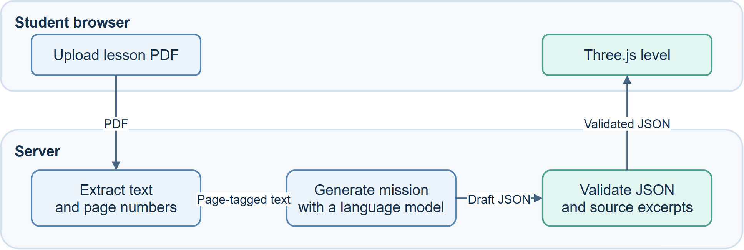
SYSTEM DESIGN
LearnAI architecture
The server turns a lesson into a validated game specification. Three.js plays it in the browser.
LEARNAI / SEMESTER PROJECT
05
Notes:
The model provider is called from the server. PDF.js extracts the text with page numbers. The browser gets validated mission data and runs game rules in the existing Three.js scene.

Slide 6
DATA FLOW
PDF-to-game pipeline
Follow the lesson data from the uploaded document to the mission loaded by the game.
Objective and mission
Identify a closed circuit. Restore power to the lab.
Challenge and answer
Which circuit lights the bulb? Choose the circuit with a closed path.
Feedback and evidence
“A closed path lets current flow.” Illustrative source page: 2.
LEARNAI / SEMESTER PROJECT
06
Notes:
The circuit lesson is illustrative. The actual page number and excerpt come from the student’s uploaded PDF.

Slide 7
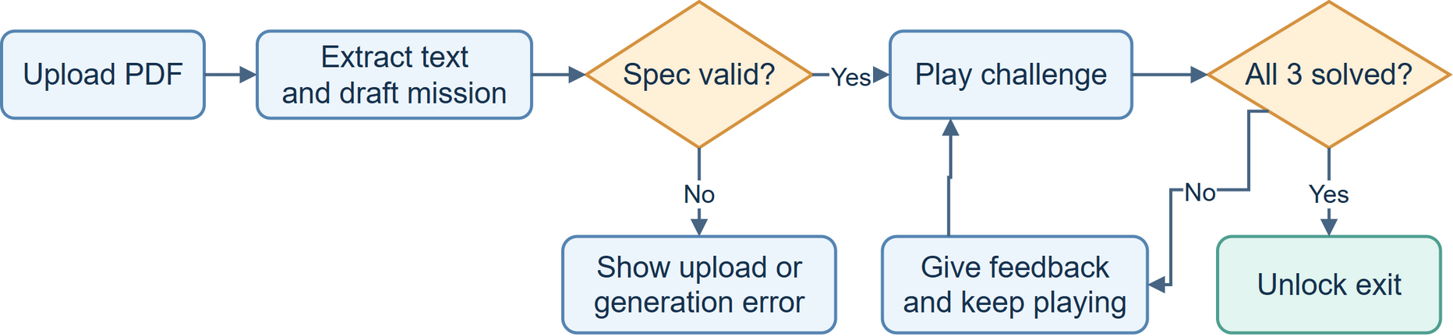
STUDENT AND SYSTEM ACTIONS
Activity workflow
The activity diagram follows the upload, the validation decision and the gameplay loop.
A wrong answer gives feedback. The exit unlocks after all three stations are solved.
LEARNAI / SEMESTER PROJECT
07

Slide 8
BUILD ORDER
How we’ll start
The first playable milestone is one console, one correct answer and one door.
01 One-console demo
Build the Three.js room, movement, one hand-written challenge and an exit that opens after a correct answer.
02 Connect one PDF
Extract page-tagged text. Generate and validate a mission specification, then load it into the room.
03 Expand and test
Add the other two stations. Generate missions from two PDFs and test a full playthrough for each.
LEARNAI / SEMESTER PROJECT
08

Slide 9
SEMESTER TARGET
Deliverables and acceptance
Demonstrate the same 3D level with two missions generated from different lesson PDFs.
Playable browser demo
Upload each PDF and complete its three challenges. Show feedback on a wrong answer and the exit opening after the third correct answer.
Source code and setup
Hand over the project repository, a setup guide, the two sample PDFs and the mission specification format.
Short evaluation
Record whether both missions load and can be completed. Check all six answers and explanations against their cited source pages.
LEARNAI / SEMESTER PROJECT
09

Slide 10
IMPLEMENTATION STACK
Technologies and GitHub
Each tool has a specific role in the semester prototype.
Three.js + TypeScript
Render the 3D lab and implement movement, interactions and game state.
PDF.js + Node.js
Extract page-tagged text. Run the model call and validate its response on the server.
Language model + JSON Schema
Generate the lesson mission as JSON and check its required fields and allowed values.
Playwright + draw.io
Exercise the browser gameplay and maintain the architecture, pipeline and activity diagrams.
LEARNAI / SEMESTER PROJECT
10
Notes:
https://github.com/mrdoob/three.js
https://github.com/mozilla/pdf.js
https://nodejs.org/
https://json-schema.org/
https://github.com/microsoft/playwright
https://github.com/jgraph/drawio

Slide 11
READING AND REPOSITORIES
Papers and project links
Start with OpenGame Figure 2 and §3 before reading the rest of the paper.
OpenGame paper
Reusable templates and execution checks for generated web games.
OpenGame on GitHub
Reference implementation and playable demos.
Retrieval-Augmented Generation
Background reading on grounding generation in external text.
Implementation repositories
Three.js | PDF.js | Playwright | draw.io
LEARNAI / SEMESTER PROJECT
11
Notes:
https://arxiv.org/abs/2604.18394v2
https://github.com/leigest519/OpenGame
https://arxiv.org/abs/2005.11401
https://github.com/mrdoob/three.js
https://github.com/mozilla/pdf.js
https://github.com/microsoft/playwright
https://github.com/jgraph/drawio

