Slide 1
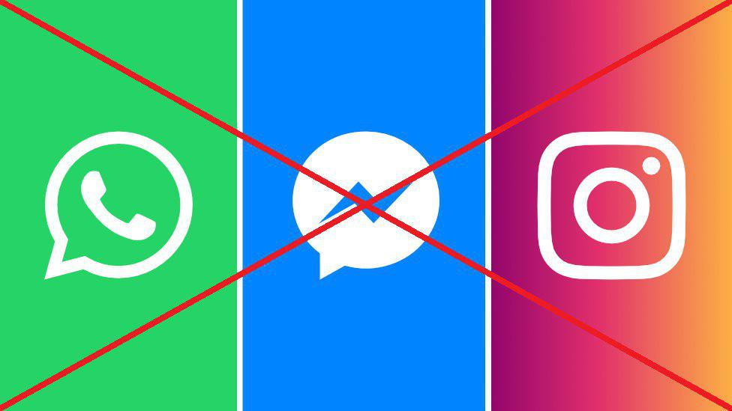
Telegram

Slide 2
What is?
Telegram is a messaging app with a focus on speed and security, it’s super-fast, simple and free.
You can use Telegram on all your devices at the same time — your messages sync seamlessly across any number of your phones, tablets or computers.

Slide 3
Available for Android, iOS, Windows Phone, WIndows, macOS and Linux.
Users can send messages, images, videos, stickers, audio and files of any type.
Launched in 2013 by the brothers Nikolai and Pavel Durov
Open Source
with
GNU GPL v2 or v3
Telegram has an open API and protocol free for everyone.
Over 200 million monthly active users

Slide 4
Features
Bots
Stickers and Gifs
Secret Chats
Channels and Groups
Drafts Messages, Archived Chats
Live locations
Voice Calls ( peer-to-peer)
Privacy Settings and Proxy Server
Full Control Messages and Data

Slide 5
Bots
What can I do with bots?
Get customized notifications and news.
Integrate with other services.
Accept payments from Telegram users.
Create custom tools.
Build single- and multiplayer games.
Build social services.

Slide 6
How to get started?

Slide 7
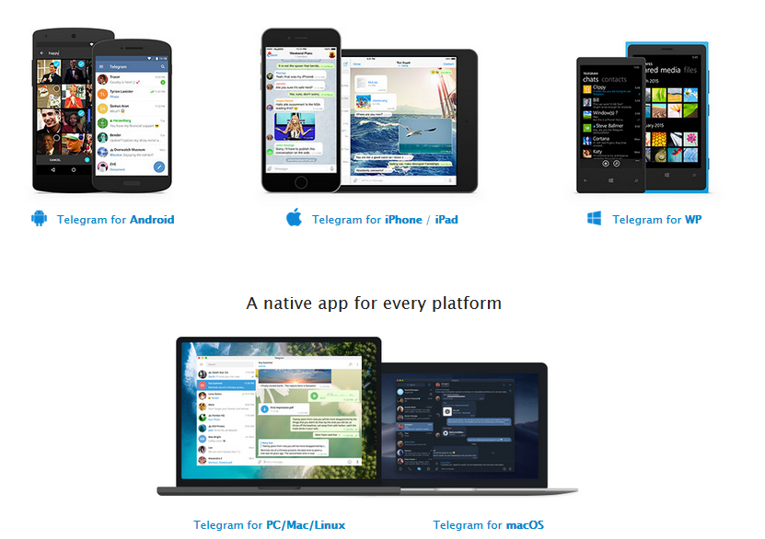
Download Application

Slide 8

Tutorial

Slide 9


