Slide 1
Chapter 3: SQL

Slide 2
Contents
Data Definition
Basic Query Structure
Set Operations
Aggregate Functions
Null Values
Nested Subqueries
Complex Queries
Views
Modification of the Database
Joined Relations**
Notes:
1

Slide 3
History
IBM Sequel language developed as part of System R project at the IBM San Jose Research Laboratory
Renamed Structured Query Language (SQL)
ANSI and ISO standard SQL:
SQL-86, SQL-89, SQL-92, SQL:1999, SQL:2003

Slide 4
History
Cont.
Commercial systems offer most, if not all, SQL-92 features, plus varying feature sets from later standards and special proprietary features.
Not all examples here may work on your particular system

Slide 5
Data Definition Language
Allows the specification of information about each relation, including:
The schema for each relation.
The domain of values associated with each attribute.
Integrity constraints
The set of indices to be maintained for each relations.
Security and authorization information for each relation.
The physical storage structure of each relation on disk.

Slide 6
Domain Types in SQL
char(n). Fixed length character string, with user-specified length n.
varchar(n). Variable length character strings, with user-specified maximum length n.
int. Integer (a finite subset of the integers that is machine-dependent).
smallint. Small integer (a machine-dependent subset of the integer domain type).

Slide 7
Domain Types in SQL
Cont.
numeric(p,d). Fixed point number, with user-specified precision of p digits, with d digits to the right of decimal point.
real, double precision. Floating point and double-precision floating point numbers, with machine-dependent precision.
float(n). Floating point number, with user-specified precision of at least n digits.
More are covered in Chapter 4.

Slide 8
Create Table Construct
An SQL relation is defined using the create table command:
r is the name of the relation
each A_{i} is an attribute name in the schema of relation r
D_{i} is the data type of values in the domain of attribute A_{i}
create table r (A1 D1, A2 D2, ..., An Dn, (integrity-constraint1), ..., (integrity-constraintk))

Slide 9
Create Table Construct
Cont.
null values is not allowed in attribute brach_name
Example:
create table branch (branch_name char(15) not null, branch_city char(30), assets integer)

Slide 10
Integrity Constraints
automatically ensures not null in SQL-92 onwards
not null
primary key (A₁, ..., A_{n} )
Example: Declare branch_name as the primary key for branch
create table branch (branch_name char(15), branch_city char(30), assets integer, primary key (branch_name))

Slide 11
Drop Table Constructs
The drop table command deletes all information about the dropped relation from the database.
Deletes not only all tuples of r, but also the schema for r
drop table r
More drastic than
Retains relation r, but deletes all tuples in r
delete from r

Slide 12
Alter Table Constructs
The alter table command is used to add attributes to an existing relation:
where A is the name of the attribute to be added to relation r, D is the domain of A.
alter table r add A D
All tuples in the relation are assigned null as the value for the new attribute

Slide 13
Alter Table Constructs
Cont.
The alter table command can also be used to drop attributes of a relation:
where A is the name of an attribute of relation r
alter table r drop A
Dropping of attributes ➔not supported by many databases

Slide 14
Basic Query Structure
SQL is based on relational algebra and relational calculus
A typical SQL query has the form:
Attributes
select A₁, A₂, ..., A_{n} from r₁, r₂, ..., r_{m} where P
Relations
Predicate

Slide 15
Basic Query Structure
Cont.
equivalent to the relational algebra expression
The result of an SQL query is a relation

Slide 16
The select Clause
The select clause list the attributes desired in the result of a query
corresponds to the projection operation of the relational algebra
Example
find the names of all branches in the loan relation
select branch_nam
from loan
∏_{branch_name} (loan)
corresponds to

Slide 17
The select Clause
Cont.
SQL names are case insensitive (i.e., you may use upper- or lower-case letters.)
SQL allows duplicates in relations as well as in query results
Example
Branch_Name ≡ BRANCH_NAME ≡ branch_name

Slide 18
The select Clause
Cont.
To force the elimination of duplicates, insert the keyword distinct after select.
Example
Find the names of all branches in the loan relations, and remove duplicates
select distinct branch_name from loan

Slide 19
The select Clause
Cont.
The keyword all specifies that duplicates not be removed.
Default is all
select all branch_name from loan

Slide 20
The select Clause
Cont.
An asterisk in the select clause denotes “all attributes”
select * from loan
Equal to
select loan_number, branch_name, amount from loan

Slide 21
The select Clause
Cont.
The select clause can contain arithmetic expressions involving the operation, +, –, ∗, and /, and operating on constants or attributes of tuples
would return a relation that is the same as the loan relation, except that the value of the attribute amount is multiplied by 100
select loan_number, branch_name, amount*100
from loan

Slide 22
The where Clause
The where clause specifies conditions that the result must satisfy
Corresponds to the selection predicate of the relational algebra
Example
find all loan number for loans made at the Perryridge branch with loan amounts greater than $1200
select loan_number from loan where branch_name = 'Perryridge' and amount > 1200

Slide 23
The where Clause
Cont.
SQL use the logical connectives and, or, not in the where clause
Operands of logical connectives can be expressions involving the comparison operation ＜, ＞, ＜=, ＞=, ==, ＜＞
Comparisons can be applied to results of arithmetic expressions, strings, special types such as date types

Slide 24
The where Clause
Cont.
SQL includes a between comparison operator
Example
Find the loan number of those loans with loan amounts between $90,000 and $100,000 (that is, ≥$90,000 and ≤$100,000)
select loan_number from loan where amount between 90000 and 100000

Slide 25
The from Clause
The from clause lists the relations involved in the query
Corresponds to the Cartesian product operation of the relational algebra.
Example
Find the Cartesian product borrower × loan
select *
from borrower, loan

Slide 26
Example
Find the name, loan number and loan amount of all customers having a loan at the Perryridge branch
select customer_name, borrower.loan_number, amount from borrower, loan where borrower.loan_number = loan.loan_number and branch_name = ‘Perryridge’

Slide 27
The Rename Operation
The SQL allows renaming attributes in the select clause using the as clause:
old-name as new-name
Example
Find the name, loan number and loan amount of all customers; rename the column name loan_number as loan_id
select customer_name,
borrower.loan_number as loan_id, amount from borrower, loan where borrower.loan_number = loan.loan_number

Slide 28
Tuple Variables_
Tuple variables are defined in the from clause via the use of the as clause.
Example
Find the customer names and their loan numbers and loan amounts for all customers having a loan at some branch
select customer_name, T.loan_number, S.amount from borrower as T, loan as S where T.loan_number = S.loan_number

Slide 29
Example
Find the names of all branches that have greater assets than some branch located in Brooklyn
select distinct T.branch_name from branch as T, branch as S where T.assets > S.assets and S.branch_city = 'Brooklyn'
Keyword as is optional and may be omitted borrower as T ≡ borrower T

Slide 30
String Operations
SQL includes a string-matching operator for comparisons on character strings.
The operator “like” uses patterns that are described using two special characters:
percent (%). The % character matches any substring that have any length (can be 0).
underscore (_). The _ character matches any character.

Slide 31
Example
Find the names of all customers whose street includes the substring “Main”.
select customer_name from customer where customer_street like '% Main%'
Match the string “80%”
like ‘80\%' escape '\'

Slide 32
String Operations
Cont.
SQL supports a variety of string operations such as
concatenation (using “||”)
converting from upper to lower case (and vice versa)
finding string length, extracting substrings, etc.

Slide 33
Ordering the Display of Tuples
The order by clause causes the tuples in the result of a query to appear in sorted order
Example
List in alphabetic order the names of all customers having a loan in Perryridge branch
select distinct customer_name from borrower, loan where borrower loan_number = loan.loan_number and branch_name = 'Perryridge' order by customer_name

Slide 34
Ordering the Display of Tuples
Cont.
We may specify desc for descending order or asc for ascending order
Ordering can be performed on multiple attributes
select * from loan order by amount desc, loan_number asc
For each attribute, ascending order is the default

Slide 35
Duplicates
Multiset versions of some of the relational algebra operators – given multiset relations r₁ and r₂:
1. σ_{θ} (r₁): If there are c₁ copies of tuple t₁ in r₁, and t₁ satisfies selections σ_{θ,}, then there are c₁ copies of t₁ in σ_{θ} (r₁).
2. Π_{A} (r ): For each copy of tuple t₁ in r₁, there is a copy of tuple Π_{A} (t₁) in Π_{A} (r₁) where Π_{A} (t₁) denotes the projection of the single tuple t₁.
3. r₁ x r₂: If there are c₁ copies of tuple t₁ in r₁ and c₂ copies of tuple t₂ in r₂, there are c₁ x c₂ copies of the tuple t₁. t₂ in r₁ x r₂

Slide 36
Duplicates
Cont.
Example: Suppose multiset relations R₁ (A, B) and R₂ (C) are as follows:
r₁ = {(1, a) (2,a)} r₂ = {(2), (3), (3)}
Then Π_{B}(r₁) would be {(a), (a)}, while Π_{B}(r₁) x r₂ would be
{(a,2), (a,2), (a,3), (a,3), (a,3), (a,3)}
SQL duplicate semantics:
select A₁,, A₂, ..., A_{n} from r₁, r₂, ..., r_{m} where P
is equivalent to the multiset version of the expression

Slide 37
Set Operations
The set operations union, intersect, and except operate on relations and correspond to the relational algebra operations ∪, ∩, −.
Each of the above operations automatically eliminates duplicates

Slide 38
Set Operations
Cont.
To retain all duplicates use the corresponding multiset versions union all, intersect all and except all
Suppose a tuple occurs m times in r and n times in s, then, it occurs:
m + n times in r union all s
min(m,n) times in r intersect all s
max(0, m – n) times in r except all s

Slide 39
Example
Find all customers who have a loan, an account, or both
(select customer_name from depositor) union (select customer_name from borrower)
Find all customers who have both a loan and an account
(select customer_name from depositor) intersect (select customer_name from borrower)
Find all customers who have an account but no loan.
(select customer_name from depositor) except (select customer_name from borrower)

Slide 40
Aggregate Functions
These functions operate on the multiset of values of a column of a relation, and return a value
avg: average value min: minimum value max: maximum value sum: sum of values count: number of values

Slide 41
Example
Find the average account balance at the Perryridge branch
select avg (balance) from account where branch_name = 'Perryridge'
Find the number of tuples in the customer relation.
select count (*) from customer
Count the number of tuples in a relation
Find the number of depositors in the bank.
select count (distinct customer_name) from depositor
eliminate duplicates

Slide 42
Aggregate Functions – Group By
Find the number of depositors for each branch
select branch_name, count (distinct customer_name) from depositor, account where depositor.account_number = account.account_number group by branch_name
Attributes in select clause outside of aggregate functions must appear in group by list

Slide 43
Aggregate Functions – Having
Find the names of all branches where the average account balance is more than $1,200
select branch_name, avg (balance) from account group by branch_name having avg (balance) > 1200
predicates in the having clause are applied after the formation of groups whereas predicates in the where clause are applied before forming groups

Slide 44
Null Values
It is possible for tuples to have a null value, denoted by null, for some of their attributes
null signifies an unknown value or that a value does not exist.
The predicate is null can be used to check for null values
Example
Find all loan number which appear in the loan relation with null values for amount
select loan_number from loan where amount is null

Slide 45
Null Values
Cont.
The result of any arithmetic expression involving null is null
Any comparison with null returns unknown
5 + null returns null
5 < null or null <> null or null = null
null is null
true
null = null
unknown

Slide 46
Null Values
Cont.
Three-valued logic using the truth value unknown:
OR: (unknown or true) = true, (unknown or false) = unknown (unknown or unknown) = unknown
AND: (true and unknown) = unknown, (false and unknown) = false, (unknown and unknown) = unknown
NOT: (not unknown) = unknown

Slide 47
Null Values
Cont.
Result of where clause predicate is treated as false if it evaluates to unknown
All aggregate operations except count(*) ignore tuples with null values on the aggregated attributes
select sum (amount ) from loan
Example
Total all loan amounts
Above statement ignores null amounts
Result is null if there is no non-null amount

Slide 48
Nested Subqueries
SQL provides a mechanism for the nesting of subqueries.
A subquery is a select-from-where expression that is nested within another query.
A common use of subqueries is to perform tests for set membership, set comparisons, and set cardinality

Slide 49
Set Membership
Set is produced by subquery
Find all customers who have both an account and a loan at the bank.
Test for set membership
select distinct customer_name from borrower where customer_name in (select customer_name from depositor )
Find all customers who have a loan at the bank but do not have an account at the bank
Test for absence of set membership
select distinct customer_name from borrower where customer_name not in (select customer_name from depositor )

Slide 50
Example Query
Find all customers who have both an account and a loan at the Perryridge branch
select distinct customer_name from borrower, loan where borrower.loan_number = loan.loan_number and branch_name = 'Perryridge' and (branch_name, customer_name ) in (select branch_name, customer_name from depositor, account where depositor.account_number = account.account_number )

Slide 51
Set Comparison
Find all branches that have greater assets than some branch located in Brooklyn.
select distinct T.branch_name from branch as T, branch as S where T.assets > S.assets and S.branch_city = 'Brooklyn'
Same query using > some clause
select branch_name from branch where assets > some (select assets from branch where branch_city = 'Brooklyn')

Slide 52
Definition of Some Clause
F <comp> some r
∃ t ∈ r such that (F <comp> t ), Where <comp> can be: <, ≤, >, =, ≠
0
0
(5 ≠ some
) = true (since 0 ≠ 5)
)
5
) = true
(5 < some
)
5
6
(= some) ≡ in
However, (≠ some) ≡ not in
0
(5 < some
) = false
)
5
5
) = true
(5 = some
)

Slide 53
Example Query
Find the names of all branches that have greater assets than all branches located in Brooklyn
select branch_name from branch where assets > all (select assets from branch where branch_city = 'Brooklyn')

Slide 54
Definition of all Clause
F <comp> all r ⇔ ∀ t ∈ r (F <comp> t)
0
6
(5 < all
) = true
(5 < all
5
) = false
)
)
10
6
4
) = false
(5 = all
)
5
4
(5 ≠ all
) = true (since 5 ≠ 4 and 5 ≠ 6)
)
6
(≠ all) ≡ not in
However, (= all) ≡ in

Slide 55
Test for Empty Relations
The exists construct returns the value true if the argument subquery is nonempty.
exists r ⇔ r ≠ Ø
not exists r ⇔ r = Ø
Notes:
SELECT Sname
FROM Student
WHERE (not) EXISTS
(SELECT *
FROM SC
WHERE Sno=Student.Sno )
查询没有选修1号课程的学生姓名。此例用连接运算难于实现
SELECT Sname
FROM Student
WHERE NOT EXISTS
(SELECT *
FROM SC
WHERE Sno = Student.Sno
AND Cno='1')；

Slide 56
Example Query
Find all customers who have both an account and a loan at the bank.
select distinct customer_name from borrower where exists (select *
from depositor
where depositor.customer_name =
borrower.customer_name )
select distinct customer_name from borrower where customer_name in (select customer_name from depositor )

Slide 57
Example Query
Find all customers who have an account at all branches located in Brooklyn.
select distinct S.customer_name from depositor as S where not exists ( (select branch_name from branch where branch_city = 'Brooklyn') except (select R.branch_name from depositor as T, account as R where T.account_number = R.account_number and S.customer_name = T.customer_name ))
Notes:
查询选修了全部课程的学生姓名。
SELECT Sname
FROM Student
WHERE NOT EXISTS
（SELECT *
FROM Course
WHERE NOT EXISTS
(SELECT *
FROM SC
WHERE Sno= Student.Sno
AND Cno= Course.Cno）；
查询至少选修了学生95002选修的全部课程的学生号码。
SELECT DISTINCT Sno
FROM SC SCX
WHERE NOT EXISTS
(SELECT *
FROM SC SCY
WHERE SCY.Sno = ' 95002 ' AND
NOT EXISTS
(SELECT *
FROM SC SCZ
WHERE SCZ.Sno=SCX.Sno AND
SCZ.Cno=SCY.Cno))；

Slide 58
Test for Absence of Duplicate Tuples
The unique construct tests whether a subquery has any duplicate tuples in its result.
Find all customers who have at most one account at the Perryridge branch
select T.customer_name
from depositor as T
where unique (
select R.customer_name from account, depositor as R where T.customer_name = R.customer_name and R.account_number = account.account_number and account.branch_name = 'Perryridge')

Slide 59
Example Query
Find all customers who have at least two accounts at the Perryridge branch.
select distinct T.customer_name
from depositor as T
where not unique (
select R.customer_name
from account, depositor as R
where T.customer_name = R.customer_name and
R.account_number = account.account_number and
account.branch_name = 'Perryridge')
Variable from outer level is known as a correlation variable

Slide 60
Derived Relations
SQL allows a subquery expression to be used in the from clause
Find the average account balance of those branches where the average account balance is greater than $1200
select branch_name, avg_balance from (select branch_name, avg (balance) from account group by branch_name ) as branch_avg ( branch_name, avg_balance ) where avg_balance > 1200

Slide 61
With Clause
The with clause provides a way of defining a temporary view whose definition is available only to the query in which the with clause occurs.
Find all accounts with the maximum balance
with max_balance (value) as select max (balance) from account select account_number from account, max_balance where account.balance = max_balance.value
Notes:
select account_number,balance
from account
where balance = max(balance)
select account_number,balance
from account
where balance = (select max(balance) from account)

Slide 62
Complex Queries using With Clause
Find all branches where the total account deposit is greater than the average of the total account deposits at all branches.
with branch_total (branch_name, value) as select branch_name, sum (balance) from account group by branch_name with branch_total_avg (value) as select avg (value) from branch_total select branch_name from branch_total, branch_total_avg where branch_total.value >= branch_total_avg.value

Slide 63
Views
In some cases, it is not desirable for all users to see the entire logical model (that is, all the actual relations stored in the database.)
Consider a person who needs to know a customer’s name, loan number and branch name, but has no need to see the loan amount. This person should see a relation described, in SQL.
(select customer_name, borrower.loan_number, branch_name
from borrower, loan
where borrower.loan_number = loan.loan_number )

Slide 64
Views
Cont.
A view is defined using the create view statement which has the form
where <query expression> is any legal SQL expression. The view name is represented by v
create view v as < query expression >

Slide 65
Views
Cont.
Once a view is defined, the view name can be used to refer to the virtual relation that the view generates.
When a view is created, the query expression is stored in the database; the expression is substituted into queries using the view

Slide 66
Example Query
A view consisting of branches and their customers
create view all_customer as (select branch_name, customer_name from depositor, account where depositor.account_number =
account.account_number )
union (select branch_name, customer_name from borrower, loan where borrower.loan_number = loan.loan_number)

Slide 67
Example Query
Find all customers of the Perryridge branch
select customer_name from all_customer where branch_name = 'Perryridge'

Slide 68
Views Defined Using Other Views
One view may be used in the expression defining another view
A view relation v₁ is said to depend directly on a view relation v₂ if v₂ is used in the expression defining v₁

Slide 69
Views Defined Using Other Views
Cont.
A view relation v₁ is said to depend on view relation v₂ if either v₁ depends directly to v₂ or there is a path of dependencies from v₁ to v₂
A view relation v is said to be recursive if it depends on itself.

Slide 70
View Expansion
A way to define the meaning of views defined in terms of other views.
Let view v₁ be defined by an expression e₁ that may itself contain uses of view relations.

Slide 71
View Expansion
Cont.
View expansion of an expression repeats the following replacement step:
As long as the view definitions are not recursive, this loop will terminate
repeat Find any view relation vi in e1 Replace the view relation vi by the expression defining vi until no more view relations are present in e1

Slide 72
Modification of the Database Deletion
Delete all account tuples at the Perryridge branch
delete from account where branch_name = 'Perryridge'
Delete all accounts at every branch located in the city ‘Needham’.
delete from account where branch_name in
(select branch_name from branch where branch_city = 'Needham')

Slide 73
Example Query
Delete the record of all accounts with balances below the average at the bank.
delete from account where balance < (select avg (balance ) from account )
Problem: as we delete tuples from deposit, the average balance changes
Solution used in SQL:
1. First, compute avg balance and find all tuples to delete
2. Next, delete all tuples found above (without recomputing avg or retesting the tuples)

Slide 74
Modification of the Database Insertion
Add a new tuple to account
insert into account values ('A-9732', 'Perryridge', 1200)
Or Equivalently
insert into account (branch_name, balance, account_number) values ('Perryridge', 1200, 'A-9732')
Add a new tuple to account with balance set to null
insert into account values ('A-777','Perryridge', null )

Slide 75
Example Query
Provide as a gift for all loan customers of the Perryridge branch, a $200 savings account. Let the loan number serve as the account number for the new savings account
insert into account select loan_number, branch_name, 200 from loan where branch_name = 'Perryridge'
insert into depositor select customer_name, loan_number from loan, borrower where branch_name = 'Perryridge' and loan.account_number = borrower.account_number

Slide 76
Modification of the Database Updates
Increase all accounts with balances over $10,000 by 6%, all other accounts receive 5%.
Write two update statements:
The order is important
Can be done better using the case statement (next slide)
1.
2.
update account set balance = balance ∗ 1.06 where balance > 10000
update account set balance = balance ∗ 1.05 where balance ≤ 10000

Slide 77
Case Statement for Conditional Updates
Same query as before: Increase all accounts with balances over $10,000 by 6%, all other accounts receive 5%.
update account set balance = case when balance <= 10000 then balance *1.05 else balance * 1.06 end

Slide 78
Update Through Views
Create a view of all loan data in the loan relation, hiding the amount attribute
Add a new tuple to branch_loan
create view loan_branch as select loan_number, branch_name from loan
insert into loan_branch values ('L-37‘, 'Perryridge‘)
represented by the insertion of the tuple ('L-37', 'Perryridge', null ) into the loan relation

Slide 79
Update Through Views611
Cont.
Some updates through views are impossible to translate into updates on the database relations
create view v as select loan_number, branch_name, amount from loan where branch_name = ‘Perryridge’
insert into v values ( 'L-99','Downtown', 23)

Slide 80
Update Through Views
Cont.
Others cannot be translated uniquely
Have to choose loan or account, and create a new loan/account number!
Most SQL implementations allow updates only on simple views (without aggregates) defined on a single relation
insert into all_customer values ('Perryridge', 'John')

Slide 81
Joined Relations
Join operations take two relations and return as a result another relation.
These additional operations are typically used as subquery expressions in the from clause
Join condition – defines which tuples in the two relations match, and what attributes are present in the result of the join

Slide 82
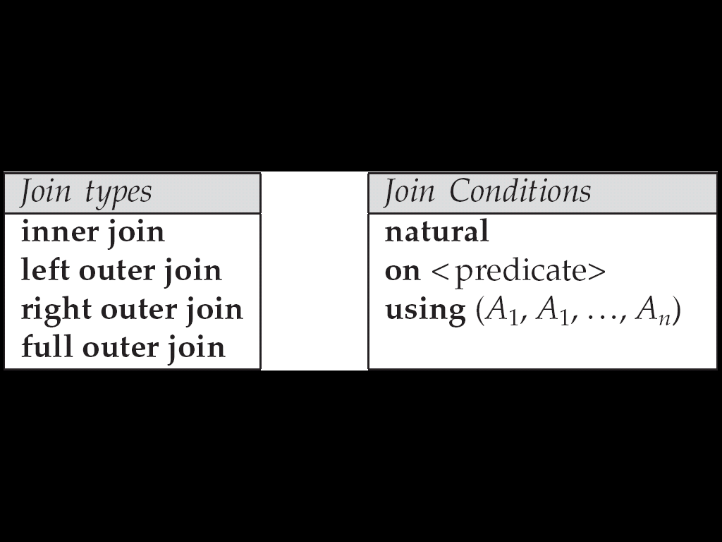
Joined Relations
Cont.
Join type – defines how tuples in each relation that do not match any tuple in the other relation (based on the join condition) are treated

Slide 83
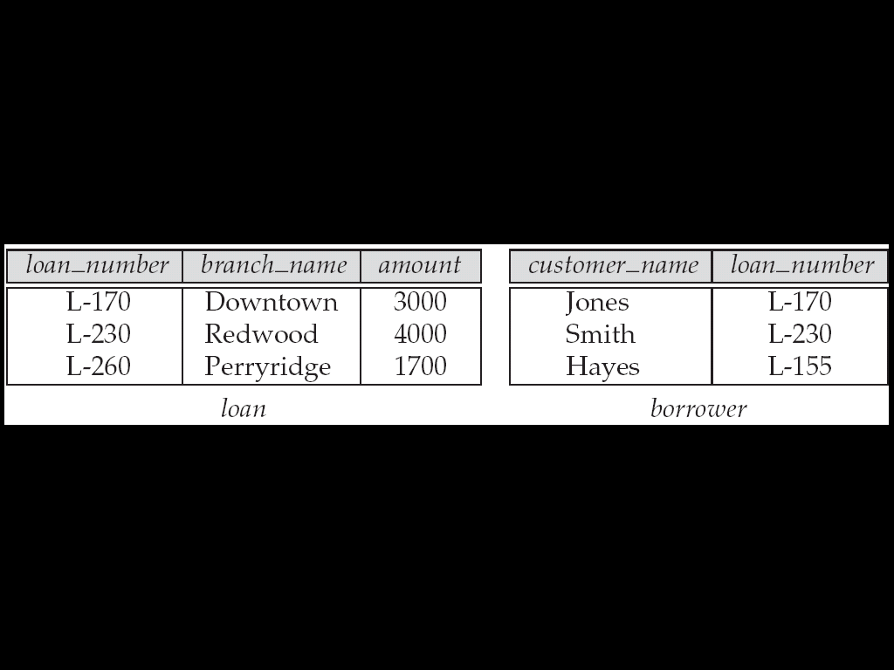
Joined Relations Datasets for Examples
Relation loan
Relation borrower
borrower information missing for L-260 and loan information missing for L-155

Slide 84
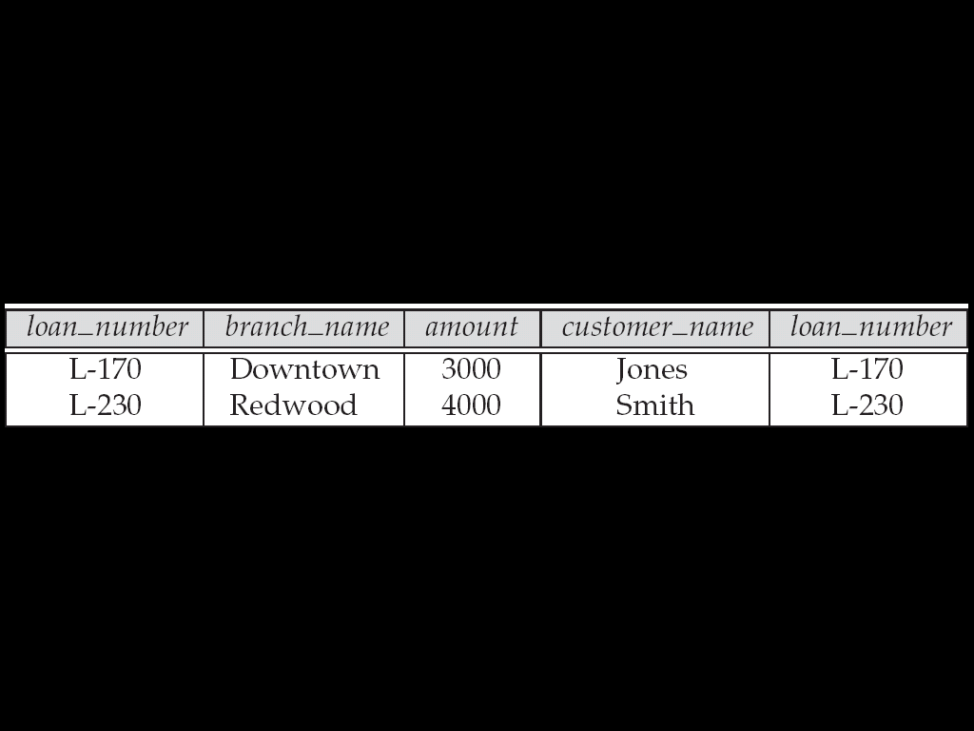
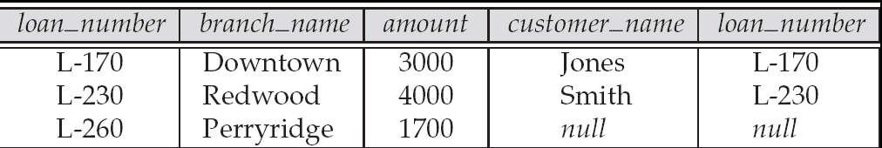
Joined Relations – Examples
loan inner join borrower on loan.loan_number = borrower.loan_number
loan left outer join borrower on loan.loan_number = borrower.loan_number

Slide 85
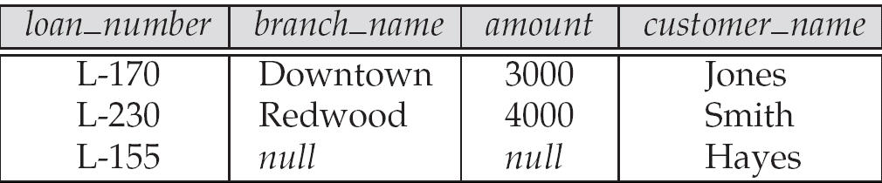
Joined Relations – Examples
Cont.
loan natural inner join borrower
loan natural right outer join borrower

Slide 86
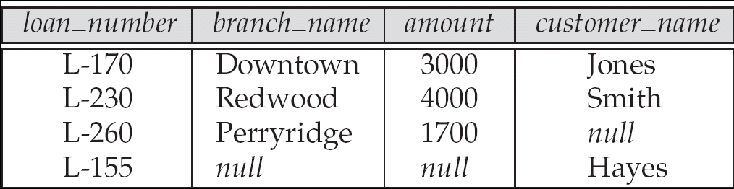
Joined Relations – Examples
Cont.
loan full outer join borrower using (loan_number)
Find all customers who have either an account or a loan (but not both) at the bank.
select customer_name from (depositor natural full outer join borrower ) where account_number is null or loan_number is null

Slide 87
Conclusions

Slide 88
Questions?

Slide 89
End of Chapter 3

