Slide 1

Early Childhood Investments Substantially Boost Adult Health
by Frances Campbell, Gabriella Conti, James J. Heckman, Seong Hyeok Moon, Rodrigo Pinto, Elizabeth Pungello, and Yi Pan
Science
Volume 343(6178):1478-1485
March 28, 2014
Copyright © 2014, American Association for the Advancement of Science

Slide 2
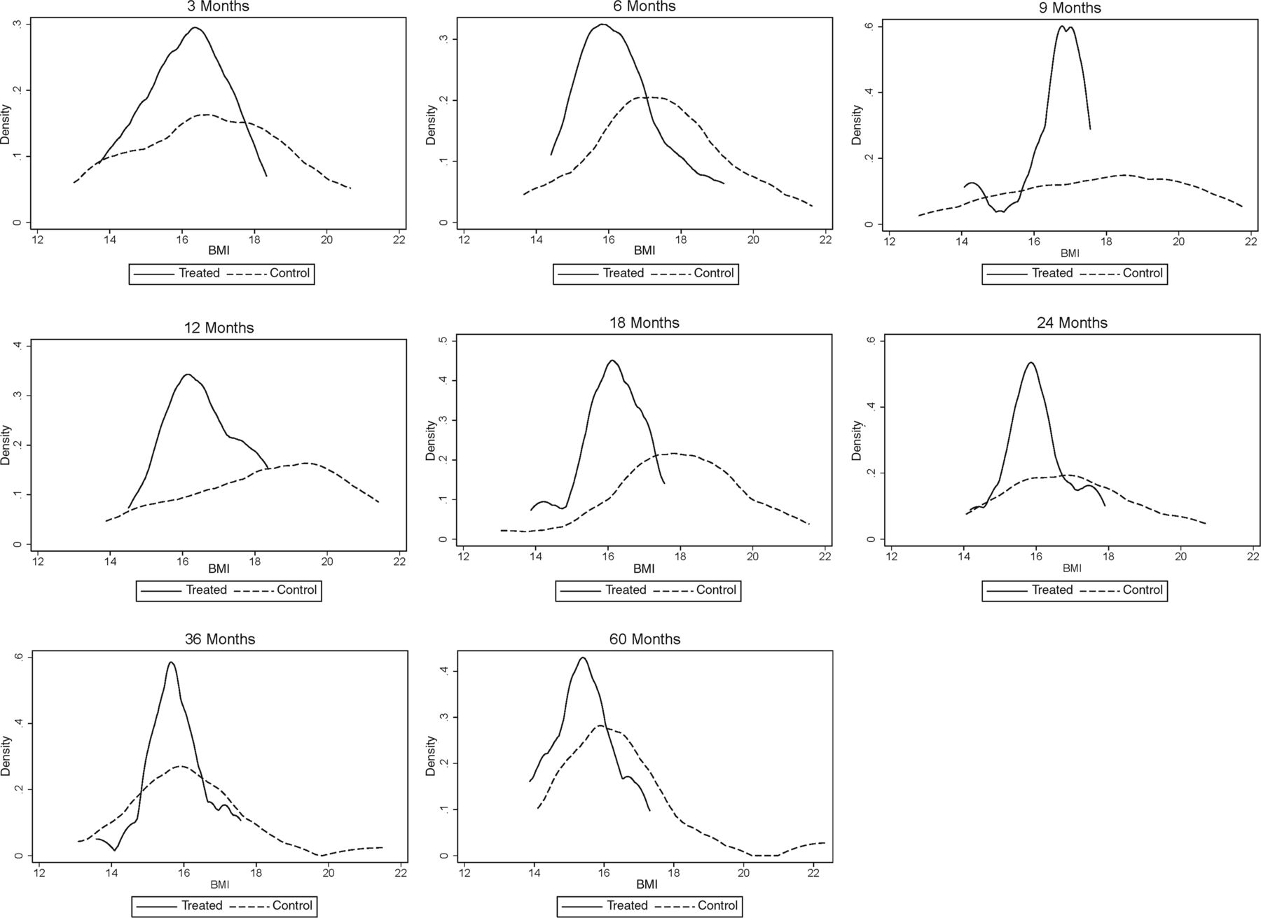
Fig. 1 BMI for males, ages 0 to 5, by treatment status.
Frances Campbell et al. Science 2014;343:1478-1485
Copyright © 2014, American Association for the Advancement of Science
Notes:
BMI for males, ages 0 to 5, by treatment status. The black solid line depicts the density for treated males; the black dashed line depicts the density for control males. The graphs display nonparametric kernel estimates of the probability density function based on the Epanechnikov kernel. The kernel K is , where is an indicator function.

Slide 3
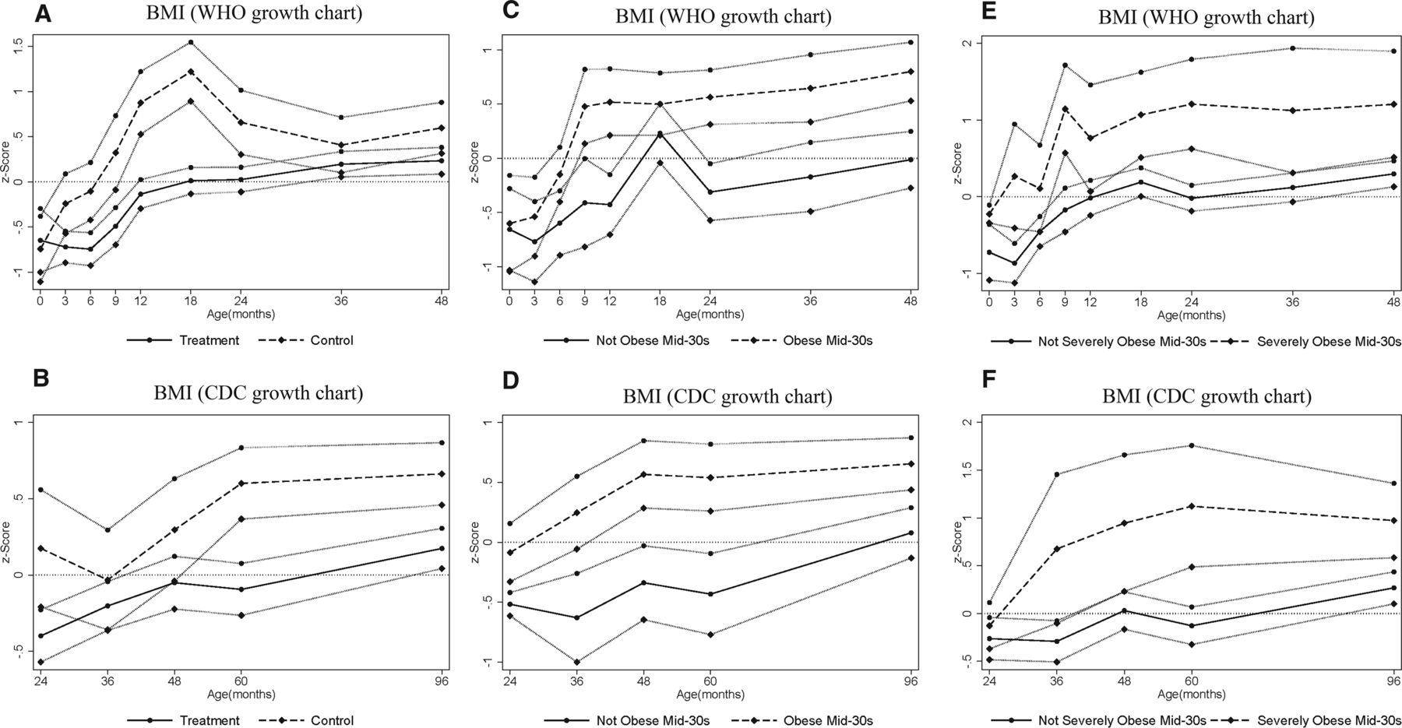
Fig. 2 BMI for males ages 0 to 4 years (A, C, and E) and 2 to 8 years (B, D, and F), by treatment and obesity status at mid-30s.
Frances Campbell et al. Science 2014;343:1478-1485
Copyright © 2014, American Association for the Advancement of Science
Notes:
BMI for males ages 0 to 4 years (A, C, and E) and 2 to 8 years (B, D, and F), by treatment and obesity status at mid-30s. The graphs show BMI z scores at different points in childhood (0, 3, 6, 9, 12, 18, 24, 36, 48, 60, and 96 months) by treatment and control status [(A) and (B)], by obesity status (BMI ≥ 30) in adulthood [(C) and (D)], and by severe obesity status (BMI ≥ 35) in adulthood [(E) and (F)]. Solid and dashed lines represent mean BMI by age for different groups, and the bands around each line represent standard errors for the corresponding means (one standard error above and below). (A), (C), and (E) use the WHO growth charts to construct the z scores; (B), (D), and (F) use the CDC growth charts. The CDC recommends the use of the WHO growth charts for less than 2 years of age (see www.cdc.gov/growthcharts/who_charts.htm).

Slide 4
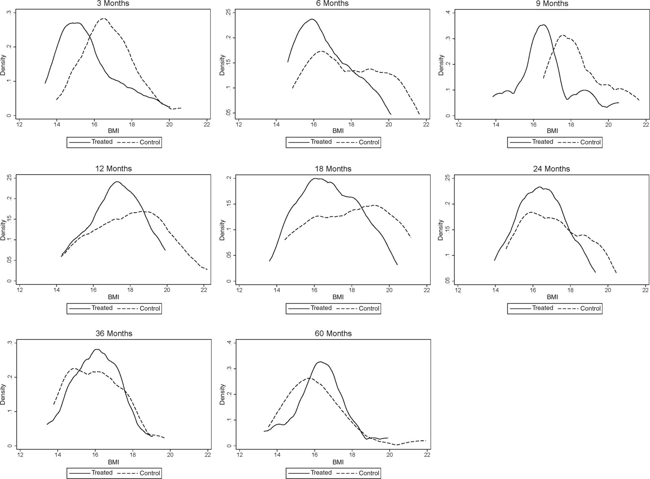
Fig. 3 BMI for females, ages 0 to 5 by treatment status.
Frances Campbell et al. Science 2014;343:1478-1485
Copyright © 2014, American Association for the Advancement of Science
Notes:
BMI for females, ages 0 to 5 by treatment status. The black solid line depicts the density for treated females; the black dashed line depicts the density for control females. The graphs display nonparametric kernel estimates of the probability density function based on the Epanechnikov kernel. The kernel K is , where is an indicator function.

Slide 5
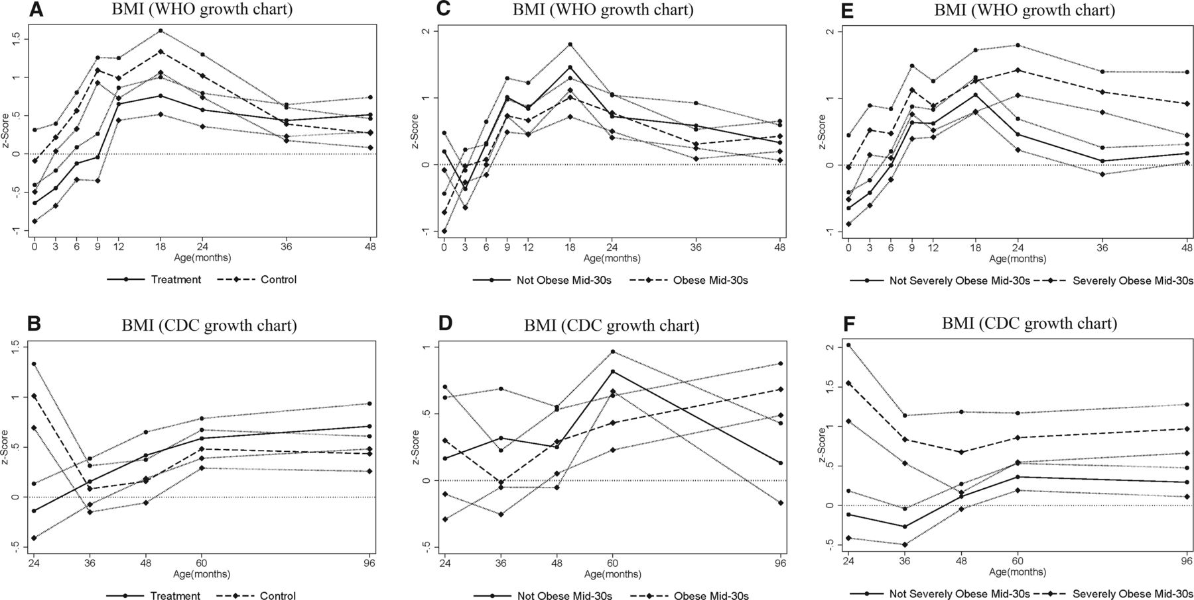
Fig. 4 BMI for females ages 0 to 4 years (A, C, and E) and 2 to 8 years (B, D, and F), by treatment and obesity status at mid-30s.
Frances Campbell et al. Science 2014;343:1478-1485
Copyright © 2014, American Association for the Advancement of Science
Notes:
BMI for females ages 0 to 4 years (A, C, and E) and 2 to 8 years (B, D, and F), by treatment and obesity status at mid-30s. The graphs show BMI z scores at different points in childhood (0, 3, 6, 9, 12, 18, 24, 36, 48, 60, and 96 months) by treatment and control status [(A) and (B)], by obesity status (BMI ≥ 30) in adulthood [(C) and (D)], and by severe obesity status (BMI ≥ 35) in adulthood [(E) and (F)]. Solid and dashed lines represent mean BMI by age for different groups, and the bands around each line represent standard errors for the corresponding means (one standard error above and below). (A), (C), and (E) use the WHO growth charts to construct the z scores; (B), (D), and (F) use the CDC growth charts. The CDC recommends the use of the WHO growth charts for less than 2 years of age. (see www.cdc.gov/growthcharts/who_charts.htm)‏

