Slide 1
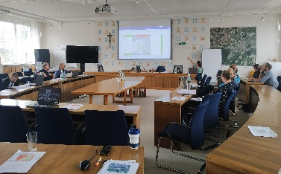

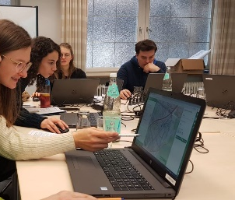



6 Application workshops
Fürstenfeldbruck, Freising, München
Kick-Off mFUND funding
Founding startup
Further application and development in research and practice
2017
…
2020
2021
Release GOAT 1.0
mFUND funding ends
1. Prototyp
Evaluation
Master Thesis
3 Testing cycles Fürstenfeldbruck

Slide 2
Kick-Off mFUND funding
Founding startup
Further application and development in research and practice
mFUND project “GOAT”
2017
…
2019
2021
Co-creative development 10 workshops with different municipalities
1. Prototyp
Release GOAT 1.0
mFUND funding ends

Slide 3
Kick-Off 1. mFUND funding
Kick-Off 2. mFUND funding
Founding startup
1. Prototyp
Co-creative development 10 workshops with different municipalities
Further development and application in research and practice
mFUND project “GOAT”
mFUND project “GOAT 3.0”
…
2017
2019
2020
2021
2022
Release GOAT 1.0
End of 1. mFUND funding

Slide 4
Kick-Off 1. mFUND funding
Founding startup
Kick-Off 2. mFUND funding
Co-creative development 10 workshops with different municipalities
Further development and application in research and practice
1. Prototyp
mFUND project “GOAT”
mFUND project “GOAT 3.0”
…
2017
2019
2020
2021
2022
Release GOAT 1.0
End of 1. mFUND funding

Slide 5
Kick-Off 1. mFUND Förderung
Ko-kreative Entwicklung 10 Workshops mit verschiedenen Kommunen
Gründung Startup
Kick-Off 2. mFUND Förderung
Fortlaufende Entwicklung und Anwendung in Wissenschaft und Praxis
1. Prototyp
mFUND Projekt „GOAT”
mFUND Projekt „GOAT 3.0”
…
2017
2019
2020
2021
2022
Release GOAT 1.0
Ende der 1. mFUND Förderung

