Slide 1
Stress Drop Reading Group
Week 1
July 15th, 2024

Slide 2
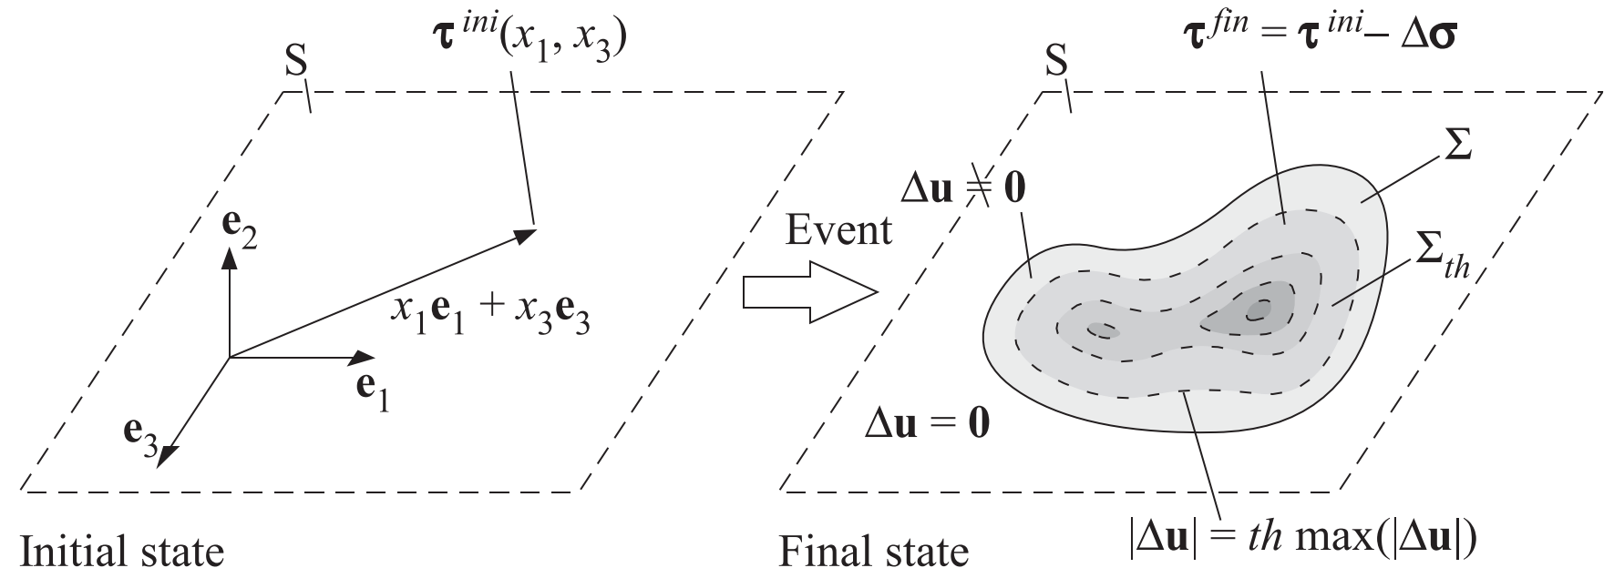

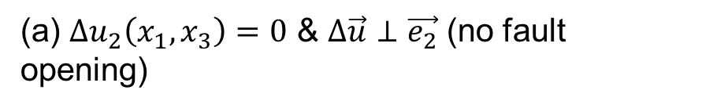
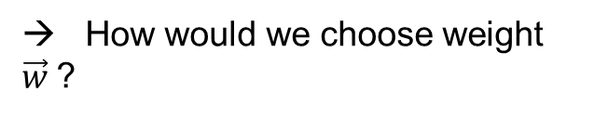
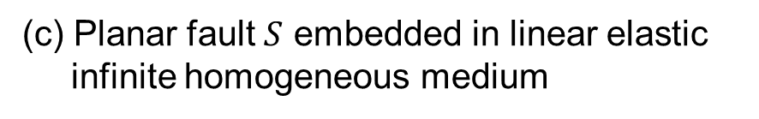
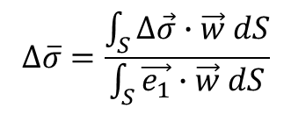

How to average stress drop?
Assumptions
(a) $∆u_{2}\left(x_{1}, x_{3}\right)=0$ & $∆\vec{u}⊥\vec{e_{2}}$ (no fault opening)
(b) Slip in single direction ($\vec{e_{1}}$) is dominant.
(c) Planar fault $S$ embedded in linear elastic
infinite homogeneous medium
Stress drop (vector): $∆\vec{σ}\left(x_{1}, x_{3}\right)=\vec{τ^{i}}\left(x_{1}, x_{3}\right)−\vec{τ^{f}}\left(x_{1}, x_{3}\right)$
It is obvious that $∆\vec{σ}$ varies spatially on the fault plane. How to average?
Rupture domain: $Σ=\left\{\vec{x}∈S : \left|∆\vec{u}\left(\vec{x}\right)\right|≠0\right\}$
Truncated domain: $Σ=\left\{\vec{x}∈S : \left|∆\vec{u}\left(\vec{x}\right)\right|>th ×\max_{S}\left(\left|∆\vec{u}\right|\right)\right\}$ (for practical purpose)
$$∆\overline{σ}=\frac{\int_{S}^{ }{∆\vec{σ}∙\vec{w} dS}}{\int_{S}^{ }{\vec{e_{1}}∙\vec{w} dS}}$$
→ How would we choose weight $\vec{w}$?

Slide 3
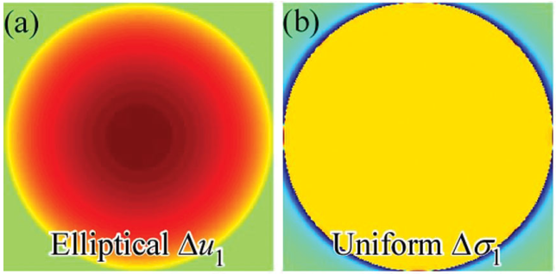
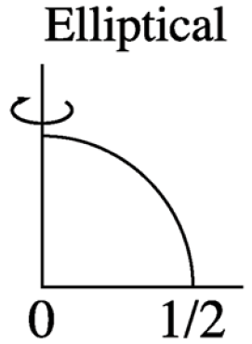
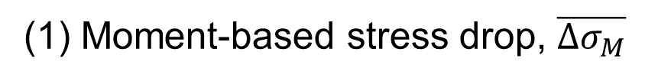
How to average stress drop?
(1) Moment-based stress drop, $\overline{{∆σ}_{M}}$
Average of stress drop weighted by the slip distribution ${\vec{E}}^{12}$ due to uniform stress drop in the overall slip direction $\vec{e_{1}}$ over the same ruptured domain ($\vec{w}={\vec{E}}^{12}$).
Equal to seismologically estimated stress drop, $\frac{M_{0}}{\int_{Σ}^{ }{E_{1}^{12}dS}}≈C\frac{M_{0}}{ρ^{3}}=C\frac{M_{0}}{A^{3/2}}$
For circular rupture, $\overline{{∆σ}_{M}}$ emphasizes stress change in the middle of the ruptured domain.

Slide 4
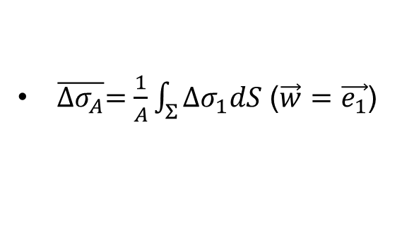

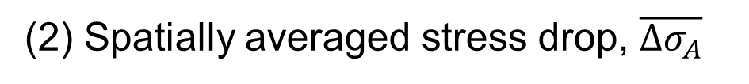
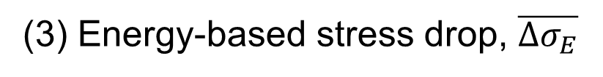
How to average stress drop?
(2) Spatially averaged stress drop, $\overline{{∆σ}_{A}}$
$\overline{{∆σ}_{A}}=\frac{1}{A}\int_{Σ}^{ }{∆σ_{1}dS}$ ($\vec{w}=\vec{e_{1}}$)
Equal to difference between average stress levels on the fault before and after earthquake.
(3) Energy-based stress drop, $\overline{{∆σ}_{E}}$
Average of stress drop weighted by the final slip $∆\vec{u}$ at each point ($\vec{w}=∆\vec{u}$).
Relevant stress drop for calculating radiation ratio, $η_{R}={E_{R}}/{∆W_{0}=\frac{2μE_{R}}{∆σM_{0}}}$
$\overline{{∆σ}_{E}} ≥\overline{{∆σ}_{M}}$

Slide 5
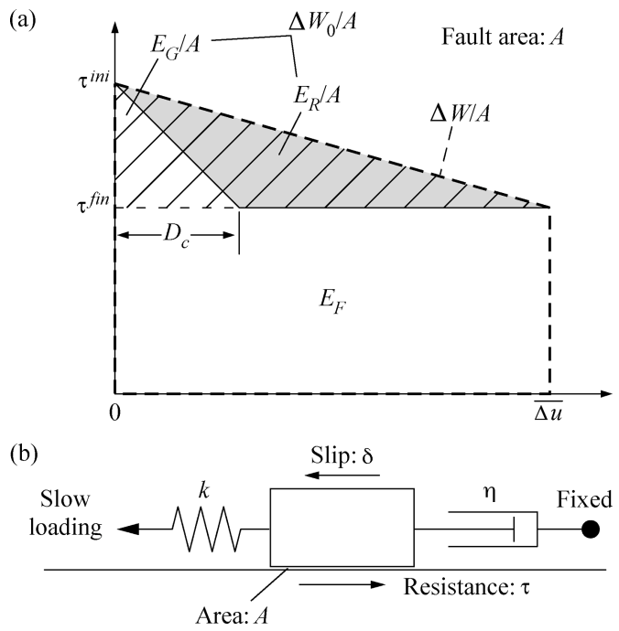

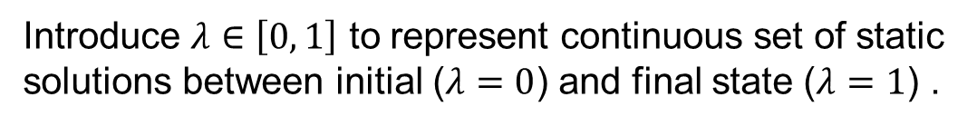
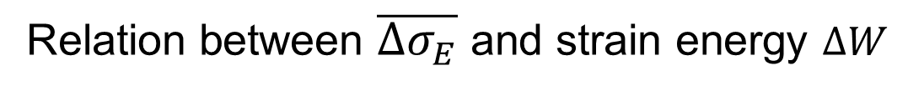

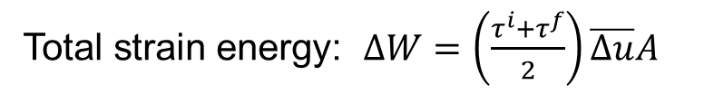
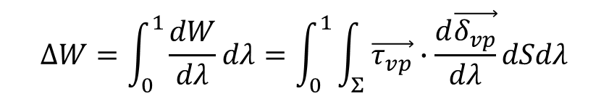
Relation between $\overline{{∆σ}_{E}}$ and strain energy $∆W$
Fracture energy
Total strain energy: $∆W=\left(\frac{τ^{i}+τ^{f}}{2}\right)\overline{∆u}A$
Radiated energy
Partial strain energy change: $∆W_{0}=E_{G}+E_{R}$
Radiation ratio (efficiency): $η_{R}={E_{R}}/{∆W_{0}=\frac{2μE_{R}}{∆σM_{0}}}$
Introduce $λ∈\left[0, 1\right]$ to represent continuous set of static solutions between initial ($λ=0$) and final state ($λ=1$) .
$\vec{δ_{vp}}\left(λ, \vec{x}\right)=λ∆\vec{u}$, $\vec{τ_{vp}}\left(λ, \vec{x}\right)=λ{\vec{τ}}^{f}+\left(1−λ\right){\vec{τ}}^{i}$
$$∆W=\int_{0}^{1}{\frac{dW}{dλ}}dλ=\int_{0}^{1}{\int_{Σ}^{ }{\vec{τ_{vp}}∙\frac{d\vec{δ_{vp}}}{dλ}dSdλ}}$$
$$∆W=\int_{Σ}^{ }{\left\{\frac{1}{2}∆\vec{σ}+{\vec{τ}}^{i}\right\}∙∆\vec{u}dS}$$

Slide 6
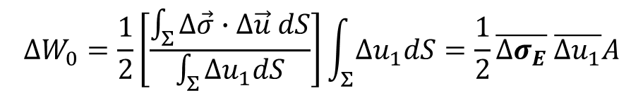
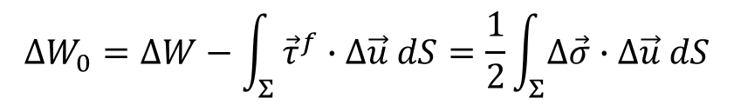
Relation between $\overline{{∆σ}_{E}}$ and strain energy $∆W$
$$∆W_{0}=∆W−\int_{Σ}^{ }{{\vec{τ}}^{f}∙∆\vec{u} dS=\frac{1}{2}\int_{Σ}^{ }{∆\vec{σ}∙∆\vec{u} dS}}$$
$$∆W_{0}=\frac{1}{2}\left[\frac{\int_{Σ}^{ }{∆\vec{σ}∙∆\vec{u} dS}}{\int_{Σ}^{ }{Δu_{1}dS}}\right]\int_{Σ}^{ }{Δu_{1}dS}=\frac{1}{2}\overline{{∆σ}_{E}} \overline{Δu_{1}}A$$

Slide 7
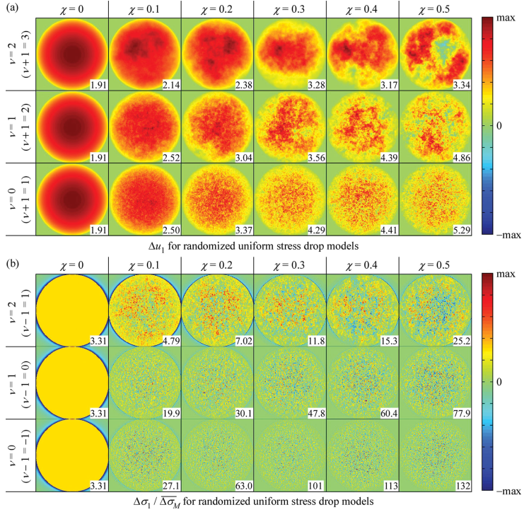
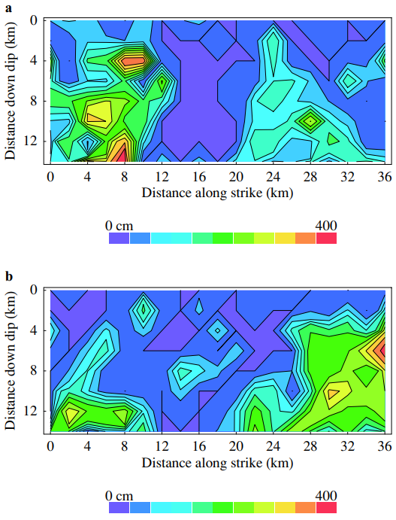
Comparison of $\overline{Δσ}$ for heterogeneous ruptures
Stochastic slip model
Lavallée et al. (2006)
Heterogeneity of prestress or friction
Realistic ground motion
Dip slip
Strike slip

Slide 8
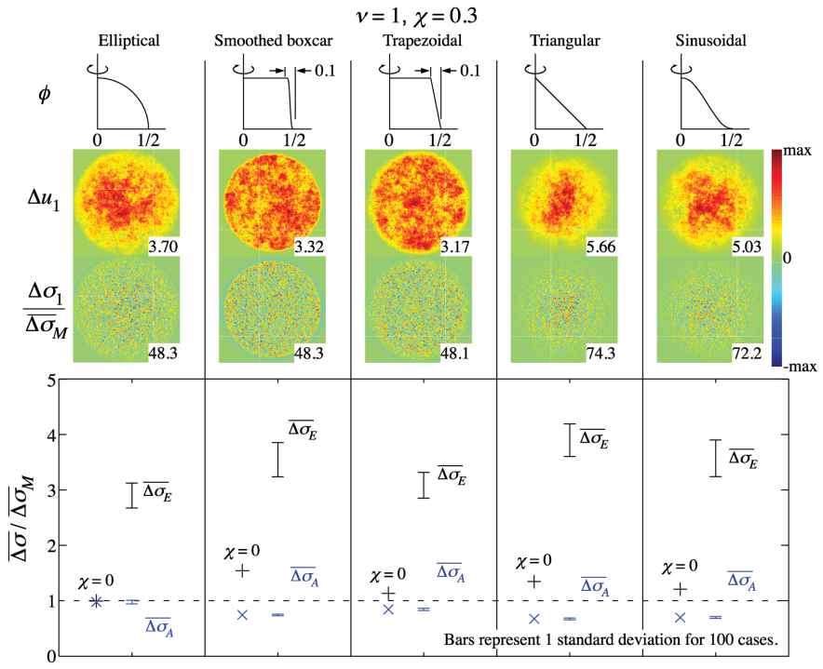
Comparison of $\overline{Δσ}$ for heterogeneous ruptures

Slide 9
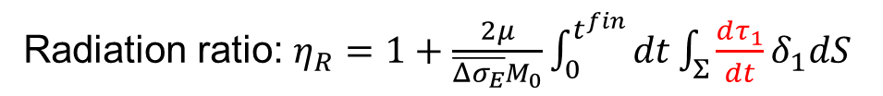
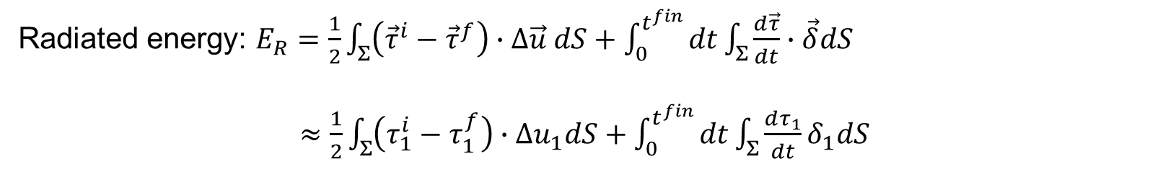
Energy partitioning and shear stress evolution
Radiated energy: $E_{R}=\frac{1}{2}\int_{Σ}^{ }{\left({\vec{τ}}^{i}−{\vec{τ}}^{f}\right)∙∆\vec{u} dS+\int_{0}^{t^{fin}}{dt}\int_{Σ}^{ }{\frac{d\vec{τ}}{dt}∙\vec{δ}dS}}$
$≈\frac{1}{2}\int_{Σ}^{ }{\left(τ_{1}^{i}−τ_{1}^{f}\right)∙∆u_{1}dS+\int_{0}^{t^{fin}}{dt}\int_{Σ}^{ }{\frac{dτ_{1}}{dt}δ_{1}dS}}$
Radiation ratio: $η_{R}=1+\frac{2μ}{\overline{Δσ_{E}}M_{0}}\int_{0}^{t^{fin}}{dt}\int_{Σ}^{ }{\frac{dτ_{1}}{dt}δ_{1}dS}$
→ Sign of $\frac{dτ_{1}}{dt}$ determines whether $η_{R}>1$ or $η_{R}<1$

Slide 10
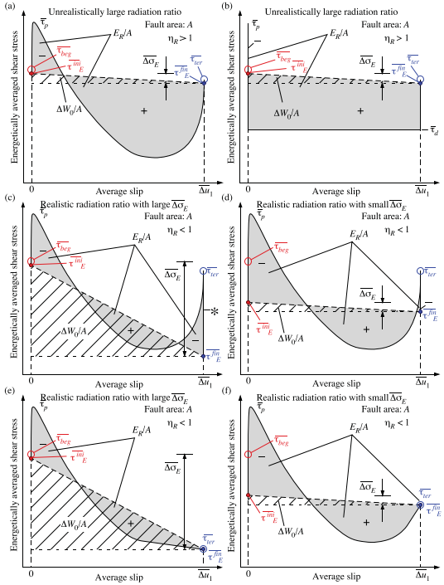
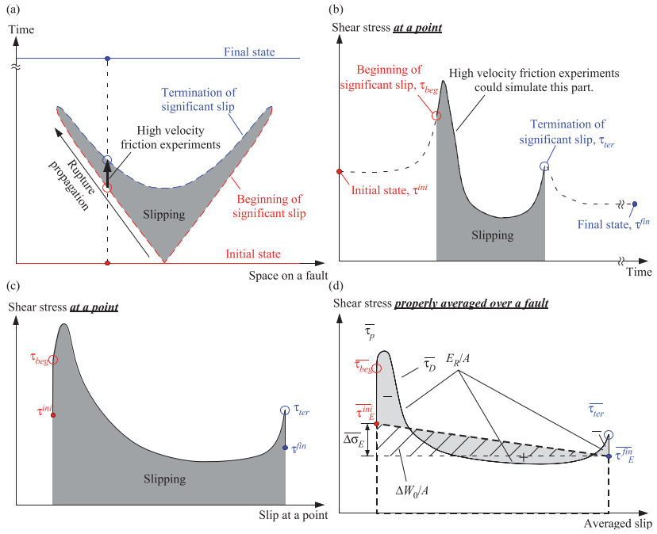


Energy partitioning and shear stress evolution
Overshoot: $τ_{d}>τ_{f}$
Undershoot: $τ_{d}<τ_{f}$

Slide 11
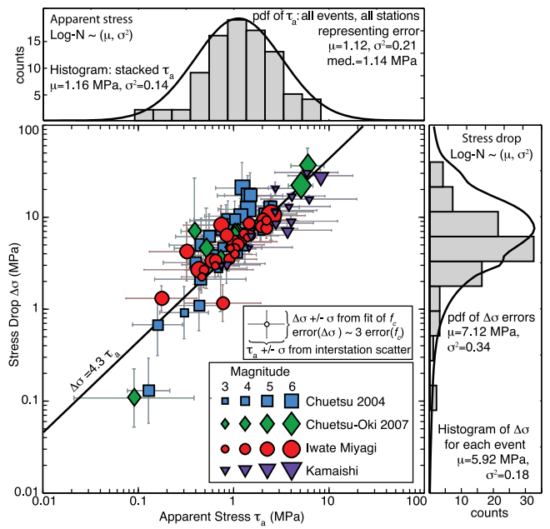


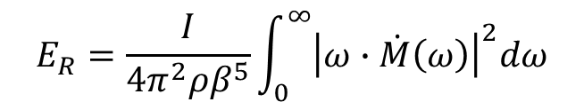
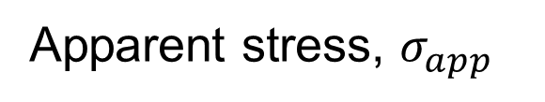
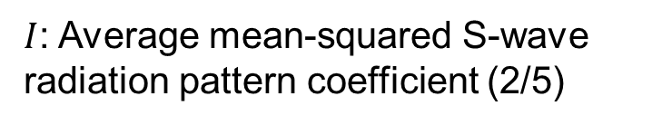
Apparent stress, $σ_{app}$
$σ_{app}=η\overline{σ}=\frac{μE_{R}}{M_{0}}$ (Madariaga, 1977)
Does not require an estimate of source dimension.
Q) Can we use $σ_{app}$ instead of $Δσ$? How much uncertainty in $E_{R}$?
Q) How does source complexity (e.g., rupture directivity) influence $E_{R}$ and $σ_{app}$?
$$E_{R}=\frac{I}{4π^{2}ρβ^{5}}\int_{0}^{∞}{{\left|ω∙\dot{M}\left(ω\right)\right|}^{2}dω}$$
$\dot{M}\left(ω\right)$: Displacement source spectra
$I$: Average mean-squared S-wave radiation pattern coefficient (2/5)
Baltay et al. (2011)

Slide 12
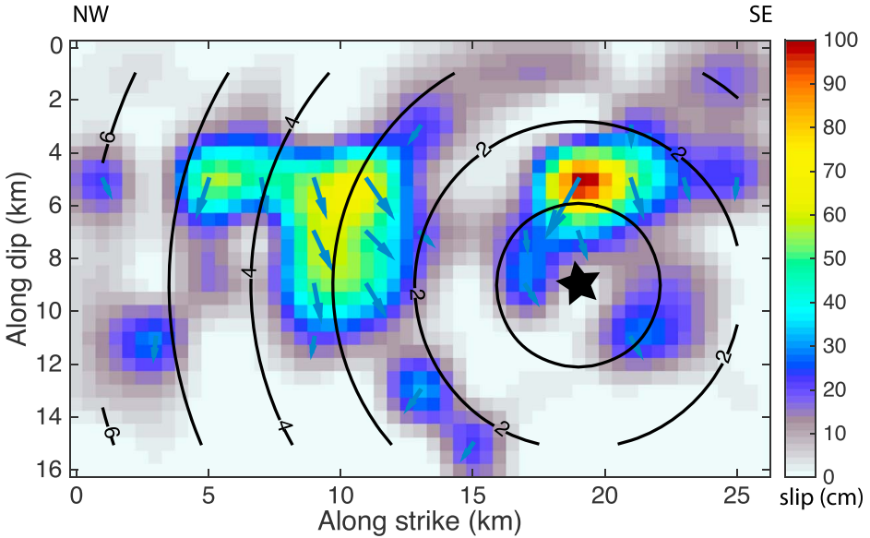
Example of earthquake with significantly varying rakes
2016 M_{w} 6.0 Amatrice, Italy, earthquake
Tinti et al. (2016)

Slide 13
Questions
1. Which stress drop average should we pursue to estimate in observational seismology?
Would it depend on specific focus of the research?
2. Heterogeneity of stress drop on the fault leads to partially very low and high parts.
Does it imply that small earthquakes that break those parts would have correspondingly
low or high stress drops? Implication for self-similarity?
3. Considering the paradigm of elastic rebound theory, does the average stress drop matter
or strong locked patch with locally high stress drop matter?

