Slide 1
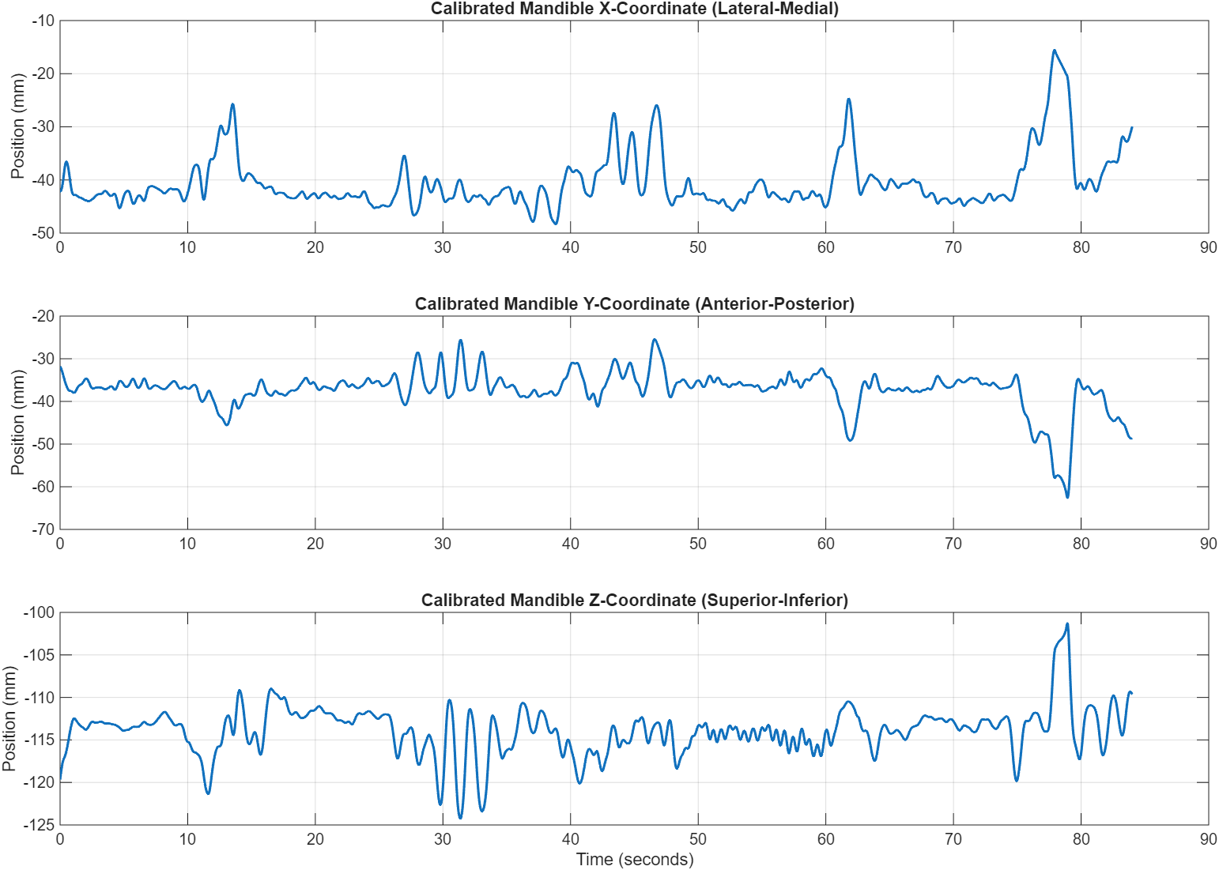
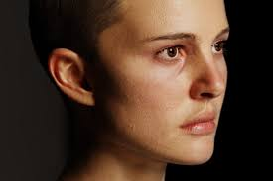
Motion data preprocessing
Facial coordinates

Slide 2
Motion features (100ms window)
Motion Time-Domain Features (for Calibrated Mandible, Calibrated Maxilla, and Calibrated ThyCart, in X, Y, and Z coordinates):
Mean
Std (Standard Deviation
RMS (Root Mean Square)
Max
Min
Range
VelMean (Mean Velocity)
VelStd (Standard Deviation of Velocity)
Skewness
Kurtosis

Slide 3
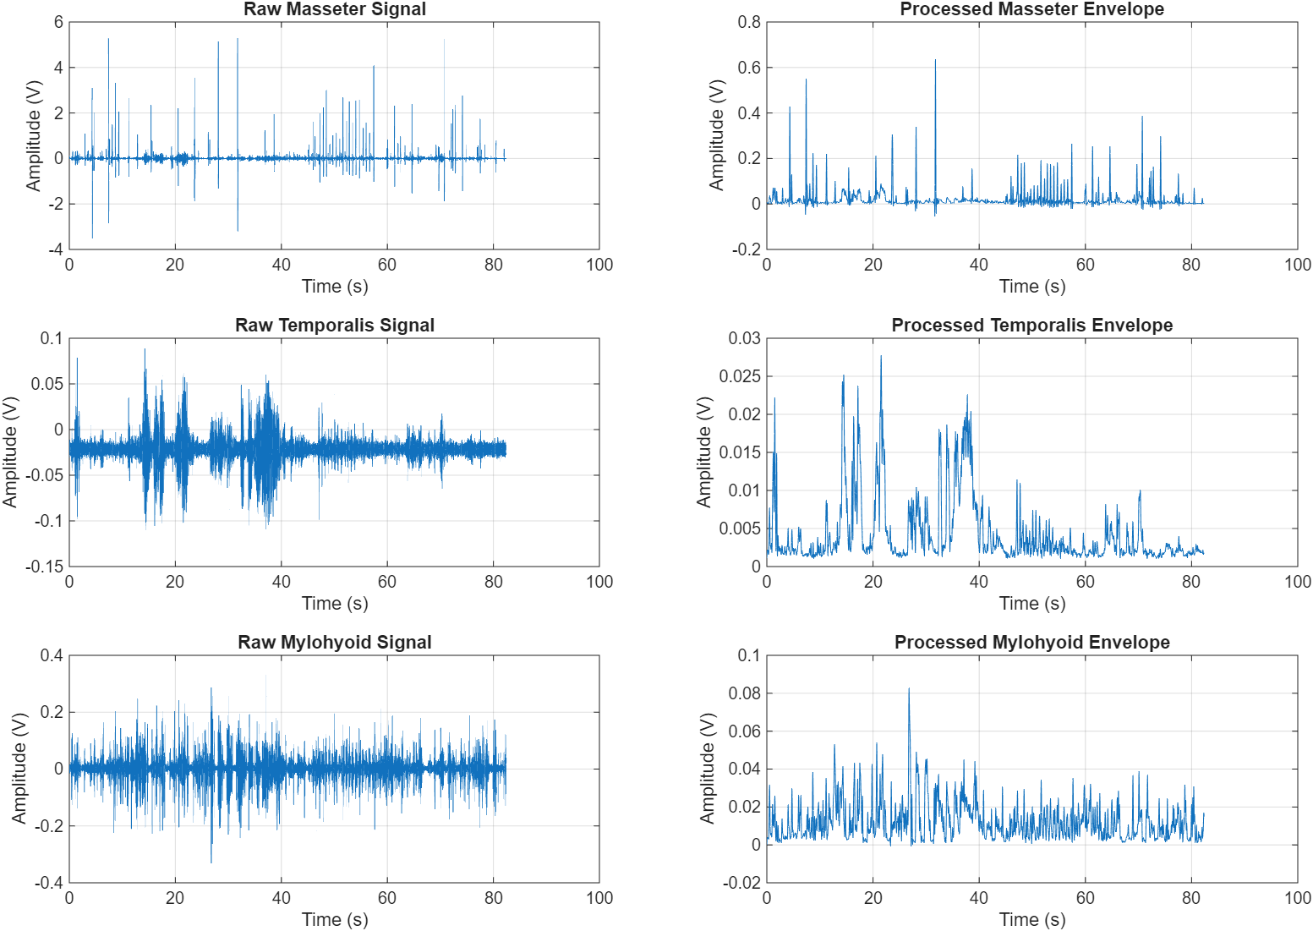
EMG preprocessing

Slide 4
EMG features (100ms window)
Macro Time-Domain Features:
MAV (Mean Absolute Value)
RMS (Root Mean Square)
WL (Waveform Length)
Micro Burst Features:
BurstCount
MeanBurstDur (Mean Burst Duration)
MeanBurstPeak (Mean Burst Peak)
MeanBurstIEMG (Mean Burst Integrated EMG)
Frequency-Domain Features:
MNF (Mean Frequency)
MDF (Median Frequency)

Slide 5
Segmentation for classification
Label 0: Masticate
Label 1: Swallow
Label 2: Others (Smile, Purse lips, Open mouth)
Continuous period of time (Not for every cycle)
Use machine learning classifiers to determine the most important features

Slide 6
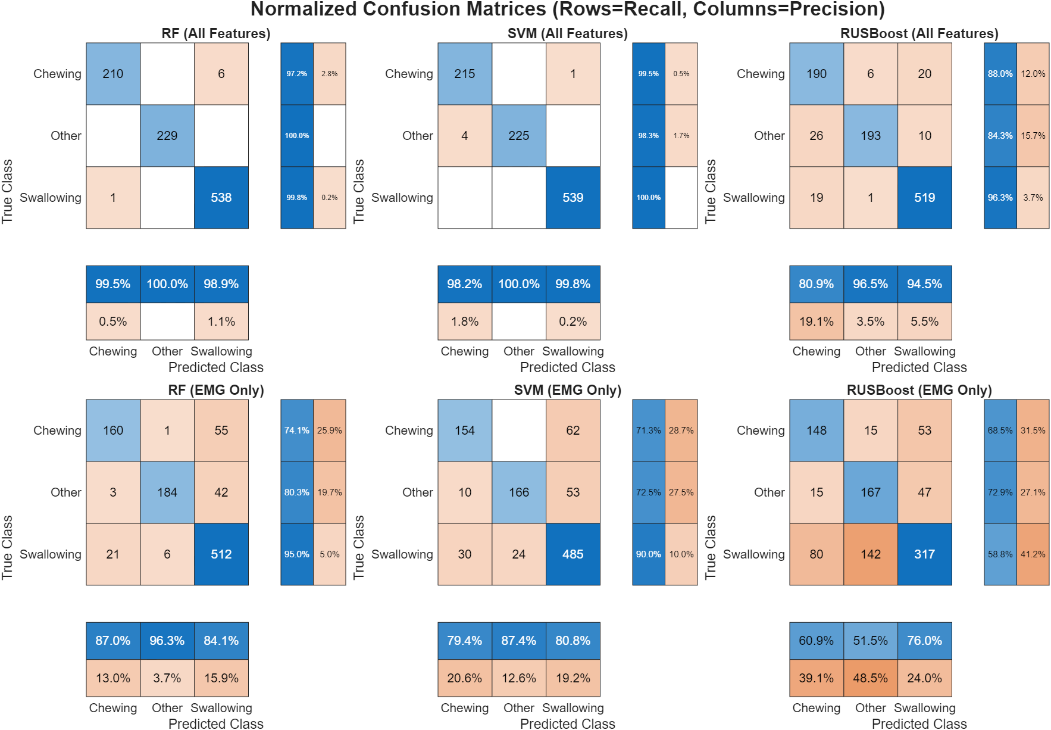
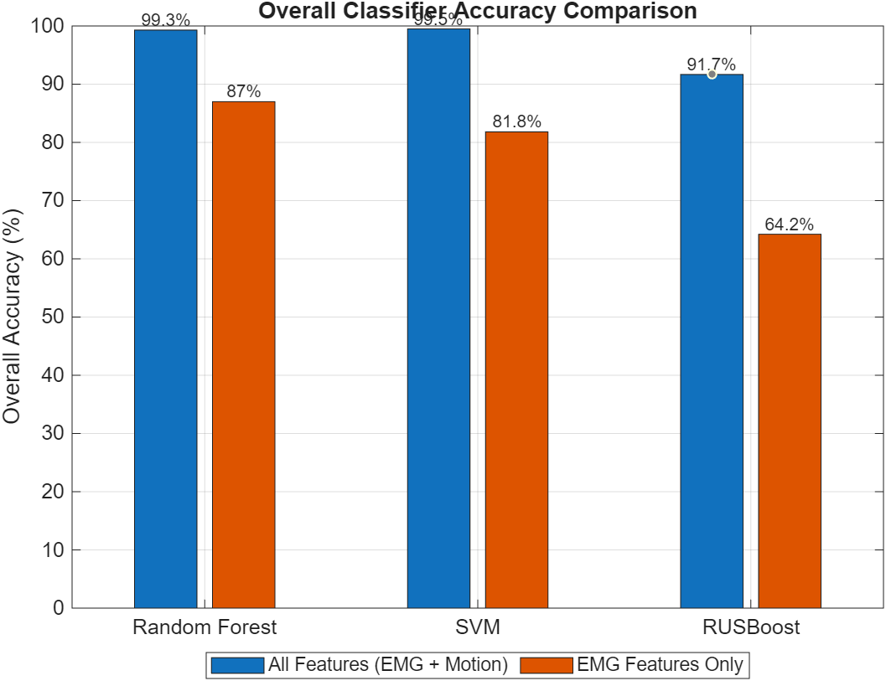
Classifier achieves high accuracy

Slide 7
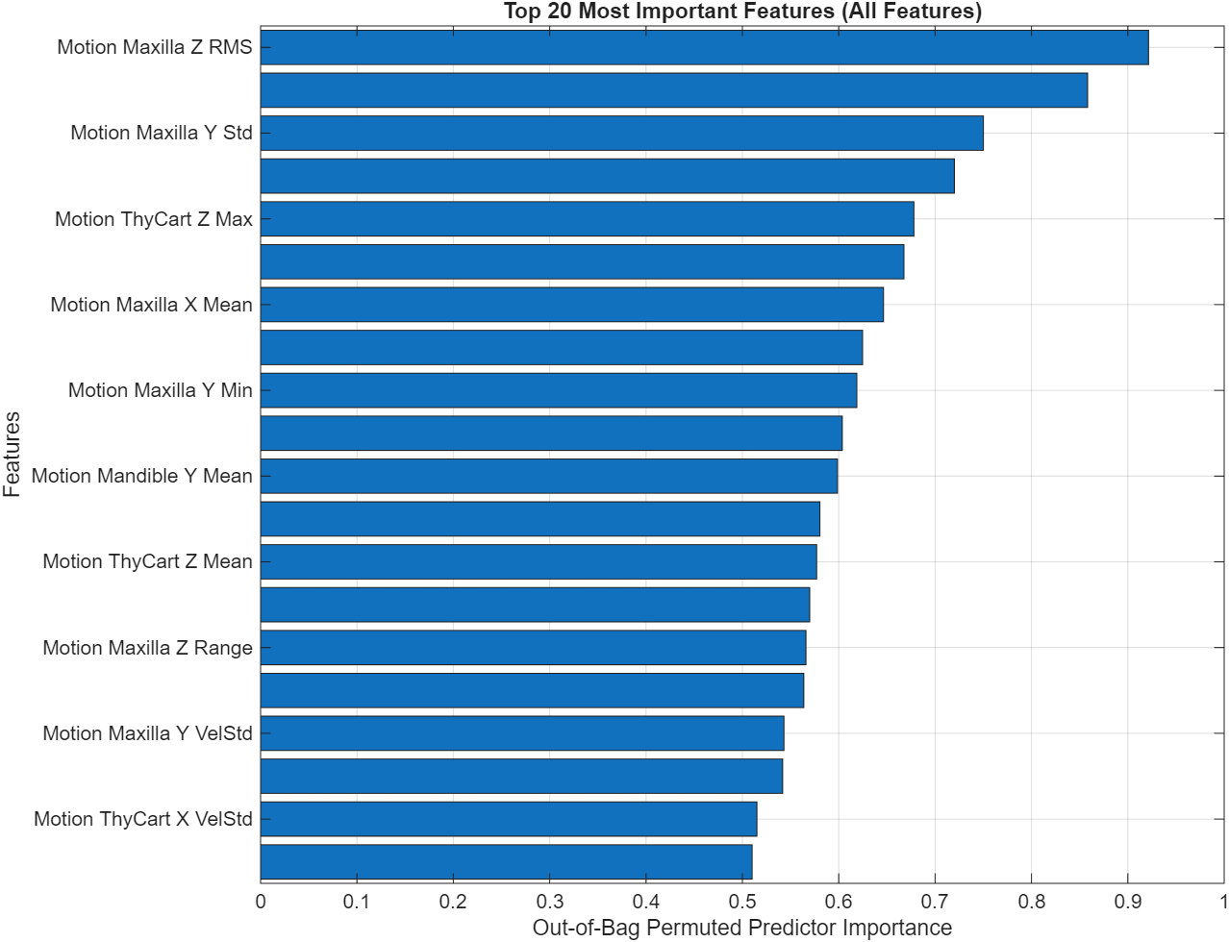
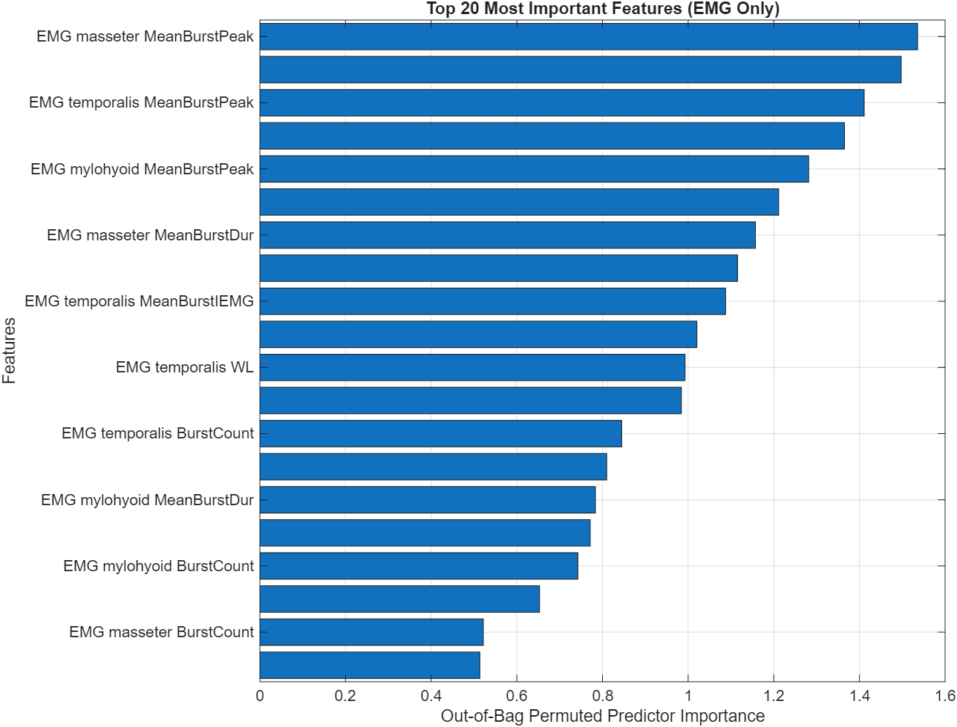
All highly important features are derived from motion data

Slide 8
Conclusion
EMG analysis indicates that the three muscles (masseter, temporalis, mylohyoid) are related to mastication and swallowing.
However, EMG may not be the most effective method for evaluating these movements when compared to motion data.

Slide 9
Future work
Collect more data from normal people
Use important features to make an evaluation model
Perform VFSS test?
What other kinematic parameters should be explored?

