Slide 1
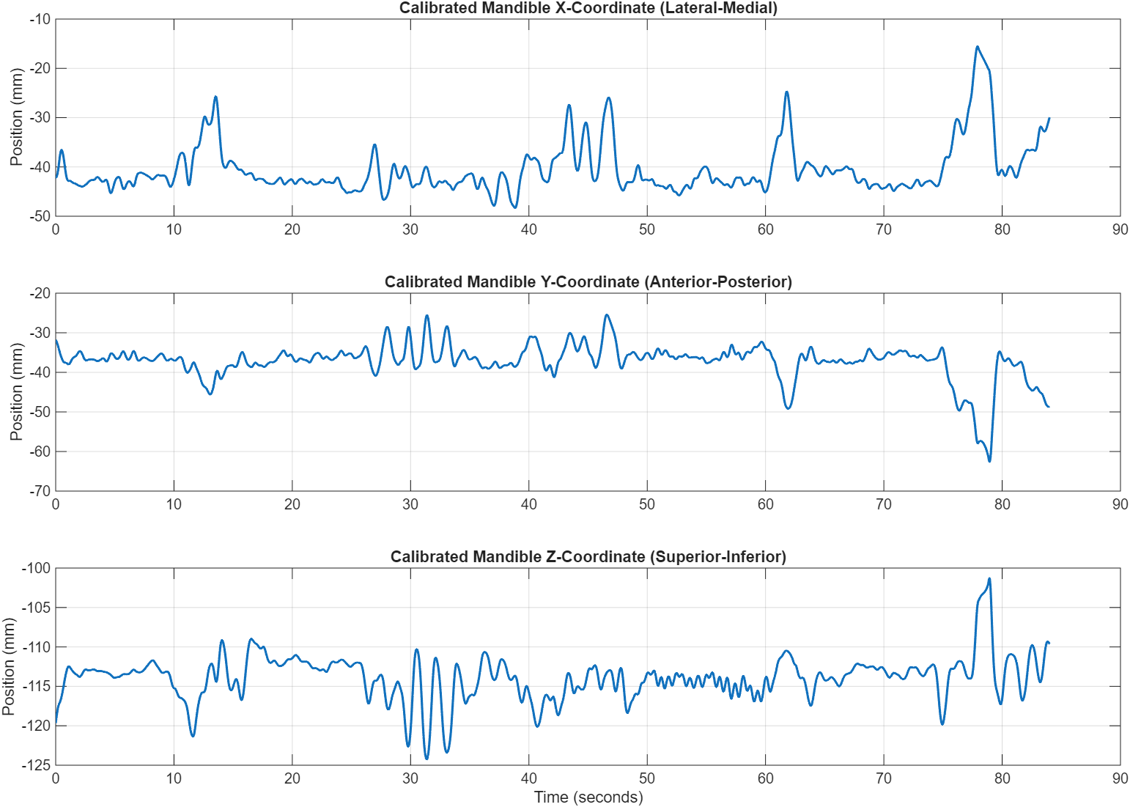
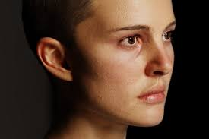
Motion data preprocessing
Facial coordinates

Slide 2
Motion features (100ms window)
Motion Time-Domain Features (for Calibrated Mandible, Calibrated Maxilla, and Calibrated ThyCart, in X, Y, and Z coordinates):
Mean
Std (Standard Deviation
RMS (Root Mean Square)
Max
Min
Range
VelMean (Mean Velocity)
VelStd (Standard Deviation of Velocity)
Skewness
Kurtosis

Slide 3
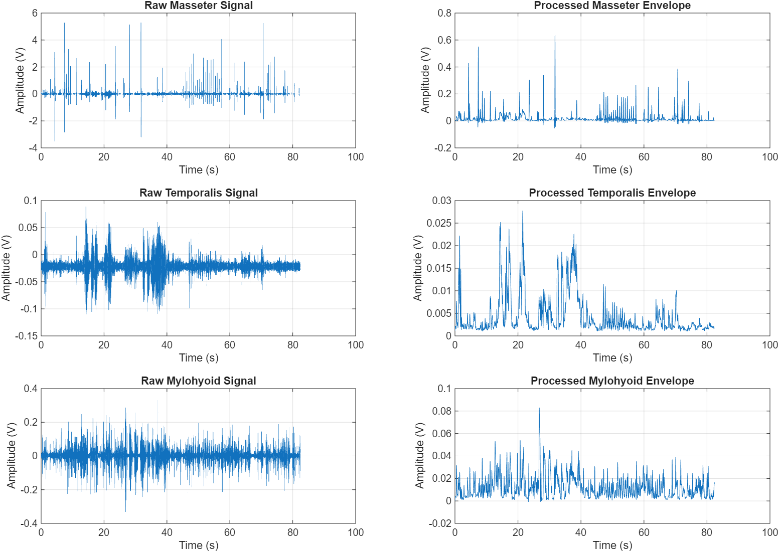
EMG preprocessing

Slide 4
EMG features (100ms window)
Macro Time-Domain Features:
MAV (Mean Absolute Value)
RMS (Root Mean Square)
WL (Waveform Length)
Micro Burst Features:
BurstCount
MeanBurstDur (Mean Burst Duration)
MeanBurstPeak (Mean Burst Peak)
MeanBurstIEMG (Mean Burst Integrated EMG)
Frequency-Domain Features:
MNF (Mean Frequency)
MDF (Median Frequency)

Slide 5
Segmentation for classification
Label 0: Masticate
Label 1: Swallow
Label 2: Others (Smile, Purse lips, Open mouth)
Continuous period of time (Not for every cycle)
Use machine learning classifiers to determine the most important features

Slide 6
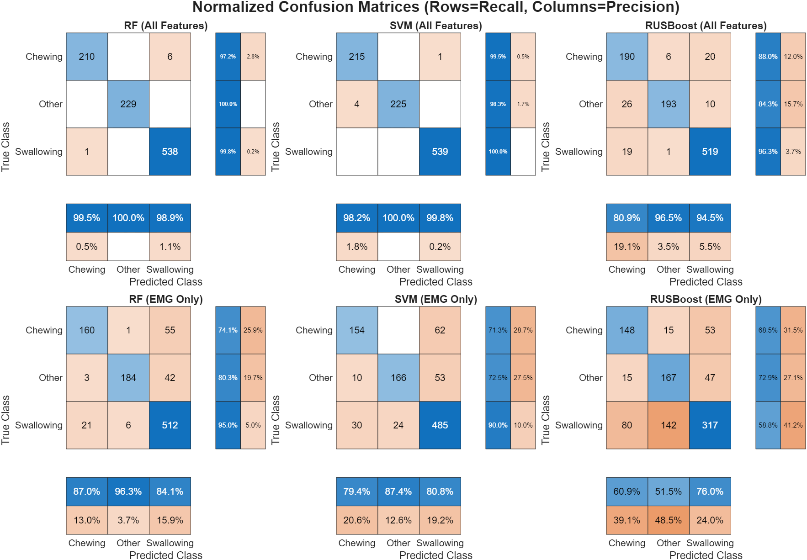
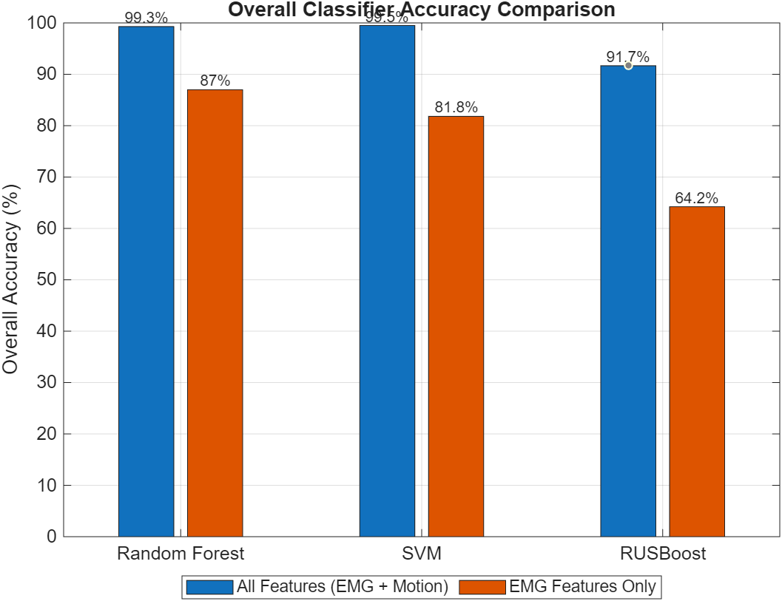
Classifier achieves high accuracy

Slide 7
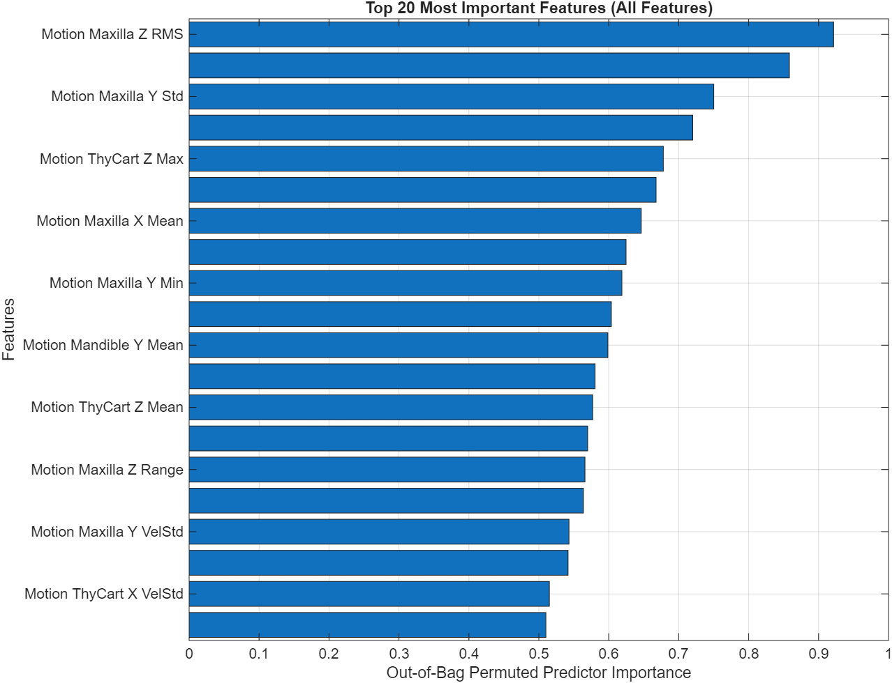
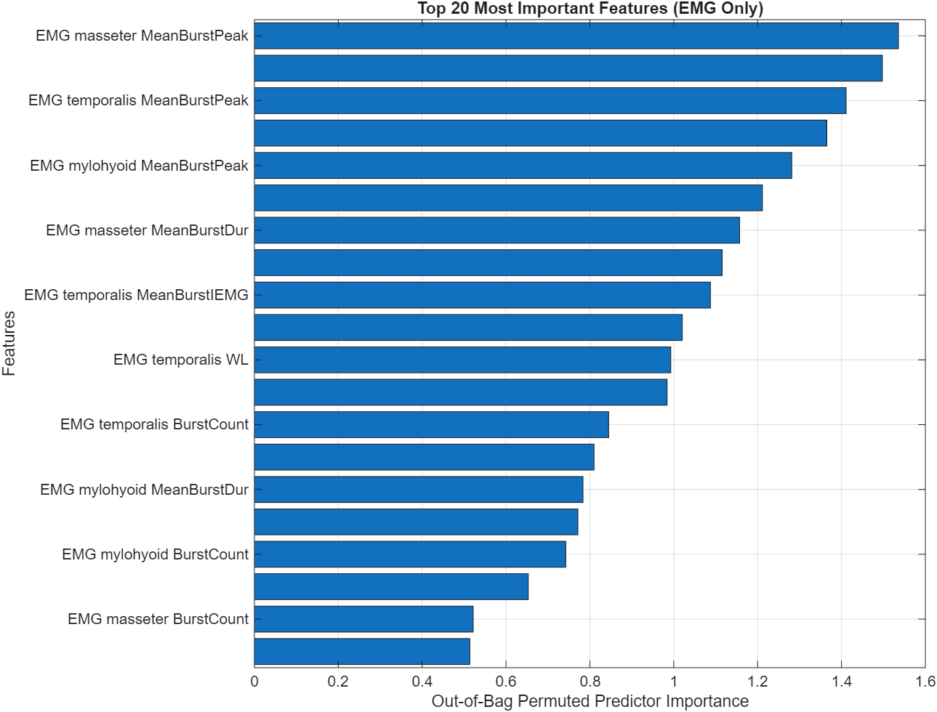
All important features are from motion

Slide 8
Conclusion
EMG shows the 3 muscles (masseter, temporalis, mylohyoid) are related to mastication and swallowing. But EMG might not be the most useful way to evaluate the movements, compared with the motion data.

Slide 9
Future work
Collect more data from normal people
Use important features to make an evaluation model
Do VFSS test?
What other ‘kinematics’ should we explore?

