Slide 1
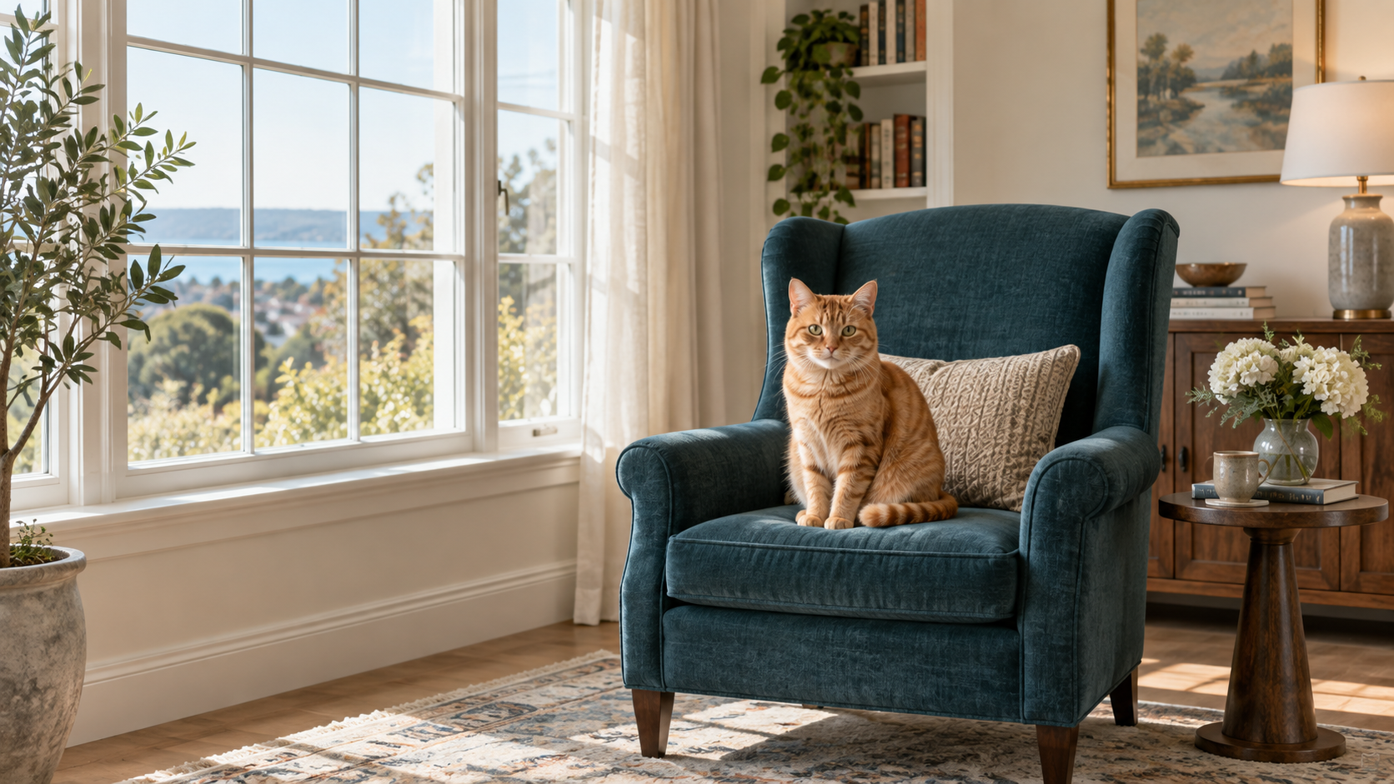

Text-to-Image
Generation
“An orange cat sits on a teal chair
beside a window.”
with AI Agents
Keeping objects and their
relations in one image
Jinjie Wei
“A red bicycle by a blue wall,
with a plant on its right.”
Notes:
Hello, I am Jinjie Wei. My topic is text-to-image generation with AI agents. The aim is to keep objects and their relations correct in the image.

Slide 2
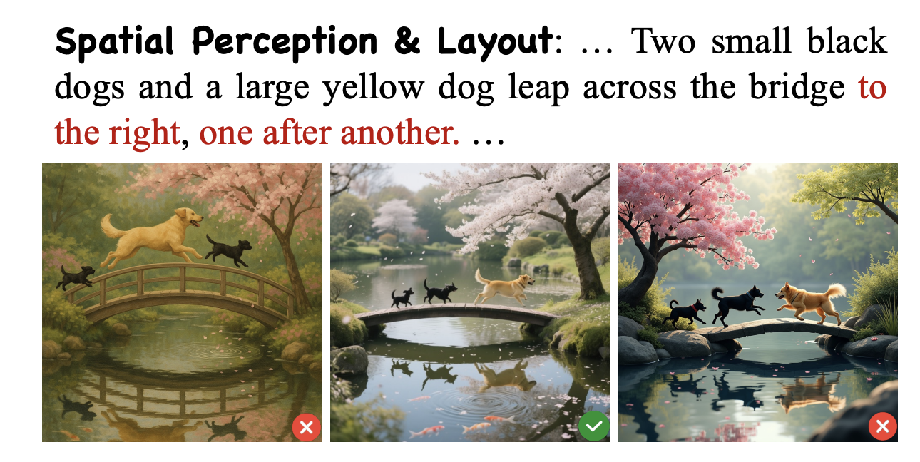
Motivation: spatial relations still fail
TEXT REQUEST (SHORTENED)
Three dogs cross a bridge.
All move right,
one after another.
WHAT WENT WRONG
In the right image,
the yellow dog faces left.
Goal: keep the right relations
between objects in the image.
Failure case, January 2026
Source: SpatialGenEval, ICLR 2026, Fig. 1. Prompt ID: 000709.
1 / 5
Notes:
Text2Image models can make clear and realistic pictures. But a good-looking picture may still miss part of the requirement in prompt. Here, all three dogs should move right,but the yellow dog faces left. I focus on how well images match the objects and relations described in the text.

Slide 3
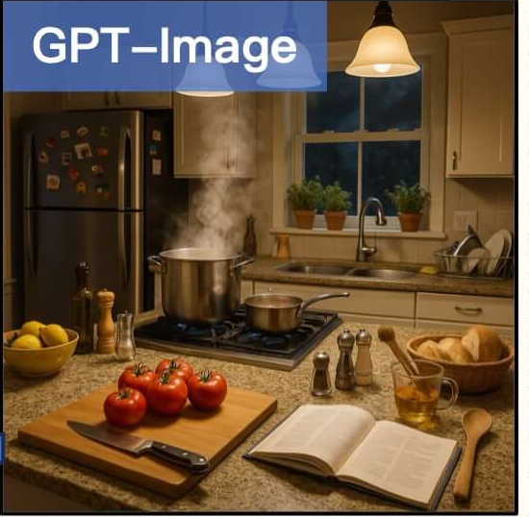
Problem: All details must fit one scene
PROMPT REQUIREMENT (SHORTENED)
A yellow bowl of lemons
sits on the windowsill
beside the plants.
WHAT WENT WRONG
The bowl is on the
kitchen counter.
Goal: keep objects and
their relations correct.
Source: T2I-CoReBench, Fig. 1(c), 2025. Prompt C-MI-001.
2 / 5
Notes:
This is an example from GPT-Image. The text asks for a yellow bowl of lemons on the windowsill, beside the plants. The picture puts the bowl on the kitchen counter. The bowl is in the wrong place. We want the image to keep all these details together。

Slide 4
Method: How the agents work together
Bar example: “Drinks sit in a line on the counter. A bartender prepares a drink.”
Original prompt
Six specialist agents
Prompt + execution
feedback
Object agent
Background agent
bartender + drinks
warm light + wood
Conductor
select
one
Evaluator
chooses the next agent
Action agent
Spatial agent
checks the plan
prepares drinks
drinks on the counter
Layout agent
Appearance agent
ready
to check
read updated
results
boxes + depth order
uniform, colorful drinks
pass
add output
Shared results
Final plan
All roles read the prompt + earlier outputs
text + boxes + depth
If wrong: the conductor traces feedback back to the agents
to the image model
3 / 5
Notes:
Six specialist agents handle objects, background, actions, positions, boxes, and appearance. A coordinator chooses the next agent. Each agent reads the prompt and earlier results, then adds its output to a shared plan.
In the bar example, one agent finds the bartender, drinks, and counter. Others find “prepares drinks” and “drinks on the counter.” The layout agent sets their boxes. The checker uses the prompt and feedback from a program to check the whole plan.

Slide 5
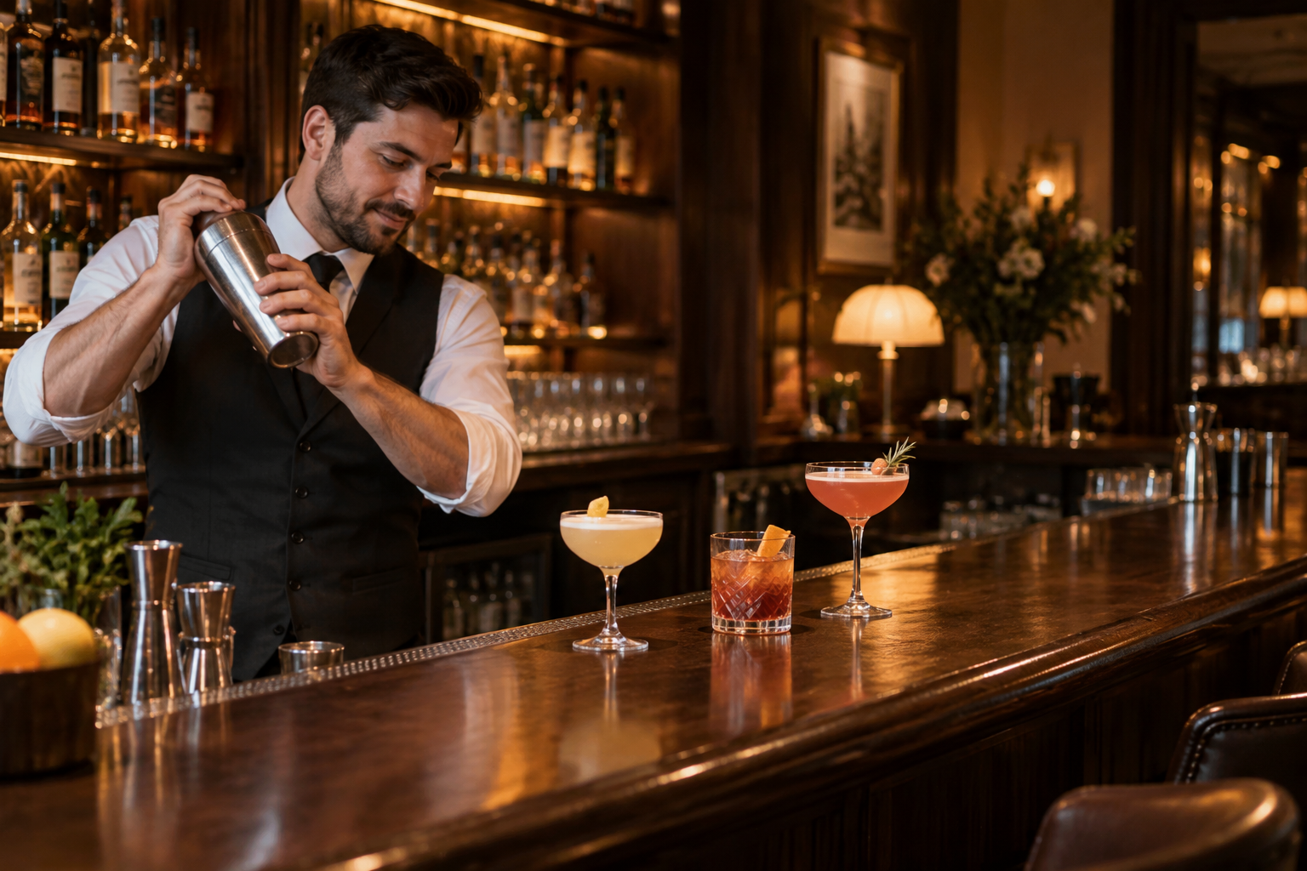
Method: A checked plan guides the image
Prompt: “Drinks stand in a line on the counter. A bartender prepares another drink.”
Generated scene illustration
Object agent
bartender, drinks, counter
Action and spatial agents
bartender prepares a drink
drinks on the counter, in a line
Checked scene plan
object text + background
positions + front/back order
4 / 5
Notes:
Here is the same idea with an image example. The object agent finds the bartender, drinks, and counter. The action agent finds “prepares a drink.” The spatial agent finds “on the counter” and “in a line.” The checker compares the plan with the text. If a detail is wrong, the right agent updates it. The image model uses the checked descriptions and positions to build the scene. This generated picture shows the target scene.

Slide 6
Data and evaluation
T2I-CompBench
What we check | Measure
Color, shape, texture | BLIP-VQA
Spatial relations | UniDet
Other relations | CLIP-Score
Complex prompts | Combined score
6 test categories
300 prompts per category
10 images per prompt
Scores measure how well the
final images follow the text.
Full system: with / without planning and region control.
Agent check: compare images after removing planning.
5 / 5
.
Notes:
We plan to use T2I-CompBench, with six groups of tasks. Each group has three hundred prompts, with ten images per prompt. We plan to use BLIP-VQA for object features, UniDet for positions, and CLIP-Score for other relations. Complex prompts use a combined score. These scores measure the full system. The paper also compares images with and without agent planning.

