Slide 1
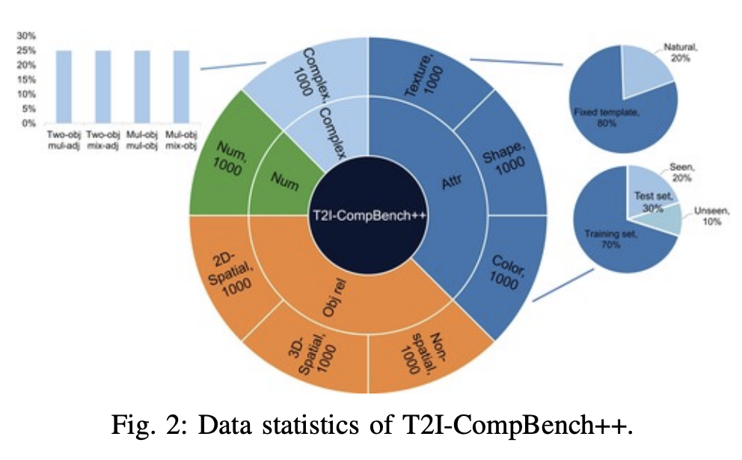
Literature review: measuring composition
PAPER 1 · BENCHMARK
WHAT IT SHOWS
T2I-CompBench
Models score well on color and texture,
but spatial relations are the weakest
category across almost all tested
Huang et al., NeurIPS 2023
The standard benchmark for compositional
text-to-image generation.
6 categories
300 prompts · 10 images each
WHAT WE TAKE FROM IT
We adopt its categories and scoring protocol
for our own evaluation.
Source: Huang et al., “T2I-CompBench: A Comprehensive Benchmark for Open-world Compositional Text-to-image Generation”, NeurIPS 2023. Figure: Fig. 2(b) of the paper.
6 / 7
Notes:
Before our method, we look at how the field measures the problem. T2I-CompBench, from Huang and colleagues at NeurIPS 2023, is the standard benchmark for compositional text-to-image generation. It defines six test categories, with three hundred prompts per category and ten images per prompt. Its key finding matters to us: models handle color, shape, and texture fairly well, but spatial relations are the weakest category across almost all models. The figure on the right is taken from the paper: it shows how the spatial score works — UniDet detects each object, and the system then checks positions and depth against the text. That is exactly the failure we saw in the motivation. We therefore adopt its protocol for our own evaluation, as shown on the data and evaluation page.

Slide 2
Literature review: plan first, then draw
PAPER 2 · LAYOUT GROUNDING
PAPER 3 · MULTI-AGENT PLANNING
LLM-grounded Diffusion
RPG: Recaption, Plan, Generate
Lian et al., NeurIPS 2023
Yang et al., ICML 2024
An LLM writes a scene layout with boxes and captions; a grounded diffusion model then paints each region.
Multimodal LLM agents recaption the prompt, split it into sub-regions, and generate the image region by region.
Limit: the plan is written once —
no check, no repair.
Limit: roles are fixed and
feedback flows one way.
GAP WE ADDRESS
Both lines plan without verification. Our system adds an evaluator and a conductor
that traces failures back to the agents — the loop shown on the method pages.
Sources: Lian et al., “LLM-grounded Diffusion”, NeurIPS 2023 · Yang et al., “Mastering Text-to-Image Diffusion: Recaptioning, Planning, and Generating with Multimodal LLMs”, ICML 2024.
7 / 7
Notes:
Two method lines are closest to our work. First, LLM-grounded Diffusion from Lian and colleagues lets a language model write a scene layout with bounding boxes and captions, and a grounded diffusion model then paints each region. It gives strong spatial control, but the layout is written once and never checked. Second, RPG from Yang and colleagues at ICML 2024 uses multimodal LLM agents to recaption the prompt, split it into sub-regions, and generate region by region. It improves composition, but the agent roles are fixed and feedback flows in one direction only. This is the gap our system fills: an evaluator checks the plan before generation, and when something is wrong, the conductor traces the failure back to the responsible agents for another round.

