Slide 1






















$$s^{r}$$
semantic cond.
$$c^{g}$$
char-class cond.
$$Z^{g}$$
noise
$$S^{r}$$
stacked style images
$$x^{w}$$
wrong real image
$$x^{r/g}$$
real / fake image
Discriminator
$$μ$$
    real/fake
Style Consistency Discriminator
    Char classification
$$x^{w}$$
$$x^{g}$$
$$x^{r}$$
    Conv.
    Char classification
    or
    or
$$x^{g}$$
    or
$$x^{r}$$
    D/C
    SCD
    correct / incorrect
    train
    Impression classification & Embedding
$s^{r}$
    train
Generator
Impression classification & Embedding
$$μ$$
    real/fake
    (b) Impression classification & embedding
word2vec
$$c^{g}$$
$$c^{g}$$
    Char
    classification
Impression label
space compressor
(ILSC)
0.29
0.92
0.01
0.09
Weighted
sum
    Conv.
output
    D/C
$$s^{r}$$
$$z^{g}$$
    G
$$x^{g}$$
    D/C
μ
    train
    fix
    Impression
    classification
minimize KL Div.
$$⨁$$
$$s^{r}$$
$$σ$$
0
1
0
1
Co-occurrence-based
missing label estimator
(CMLE)
0.3
1
0
1
$$⊗$$
target
noise

Slide 2
    (b) Impression classification & embedding
word2vec
Impression label
space compressor
(ILSC)
0.29
0.92
0.01
0.09
output
    D/C
    semantic condition s_r
Weighted sum
minimize KL Div.
0
1
0
1
0.3
1
0
1
0
1
0
1
Co-occurrence-based
missing label estimator
(CMLE)
target

Slide 3

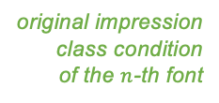





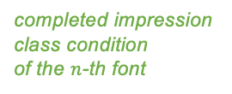
    real/fake classification
    noise
Discriminator
with Aux. Classifier
    char. class classification
    char. class condition
$$y_{n}^{Aux}$$
$$y_{n}^{ILSC}$$
Generator
real image of
the $n$-th font
0.18
0.89
0.01
0.08
Impression label
space compressor
(ILSC)
0.29
0.92
0.01
0.09
weighted
sum
    D/C
$$s_{n}$$
    G
    semantic
    condition
fake image
BCE loss
word2vec
Gaussian
Perturbation
fake image
missing
$$y_{n}$$
$$y_{n}^{CMLE}$$
    original impression
    class condition
    of the $n$-th font
0
1
0
1
Co-occurrence-based
missing label estimator
(CMLE)
0.3
1
0
1
    completed impression
    class condition
    of the $n$-th font
: impression probability
: semantic condition
: others
Impression control with missing labels

Slide 4





Impression control with missing labels
    real/fake
    noise
Discriminator
with Auxiliary Classifier
    Char class classification
word2vec
$$y_{n}^{AUX}$$
$$y_{n}^{ILSC}$$
    char class
    cond.
Generator
0.59
1.28
-0.51
-1.09
Impression label
space compressor
(ILSC)
0.29
0.92
0.01
0.09
Weighted
sum
real image
    D/C
$$s$$
    G
fake image
    Impression
    classification
    semantic cond.
Gaussian
Perturbation
minimize BCE loss
missing
$$y_{n}$$
$$y_{n}^{CMLE}$$
    Impression
    class cond.
0
1
0
1
Co-occurrence-based
missing label estimator
(CMLE)
0.3
1
0
1
    Pseudo-complete
    Impression
    class cond.

Slide 5
512×4×4
512×4×4
1430
1430
add.
classify
impression
classify
impression
classify
impression
    D/C
    D/C
baseline
（binary relevance）
Impression label space compressor
(ILSC)

Slide 6


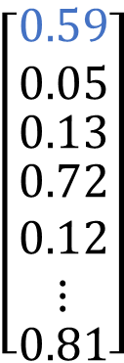
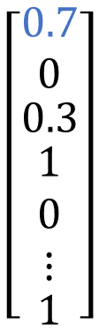
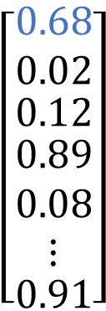

$y_{n}^{Aux}$
$$y_{n}^{ILSC}$$
$$y_{n}$$
$$\left[\begin{matrix}0.59 \\ 0.05 \\ \begin{matrix}0.13 \\ \begin{matrix}0.72 \\ 0.12 \\ ⋮\end{matrix} \\ 0.81\end{matrix}\end{matrix}\right]$$
$$\left[\begin{matrix}0.68 \\ 0.02 \\ \begin{matrix}0.12 \\ \begin{matrix}0.89 \\ 0.08 \\ ⋮\end{matrix} \\ 0.91\end{matrix}\end{matrix}\right]$$
$$\left[\begin{matrix}0.7 \\ 0 \\ \begin{matrix}0.3 \\ \begin{matrix}1 \\ 0 \\ ⋮\end{matrix} \\ 1\end{matrix}\end{matrix}\right]$$
ILSC
BCE
Encoder-Decoder
high dimension
low dimension
close
far
serif
text
shade
Notes:
具体的にCMLEで行われる欠損推定を説明します．ここで，欠損推定行列Tの各要素は印象語Iが付与されている際に，印象語ｊが付与されている事後確立を表しています．この欠損推定行列Tは事前にデータセットの印象語の分布から算出することが可能です．この行列と付与されている印象語のマルチホットベクトルを掛け合わることで，印象語が欠損している確率値を推定し補完します．[~07:18]

Slide 7
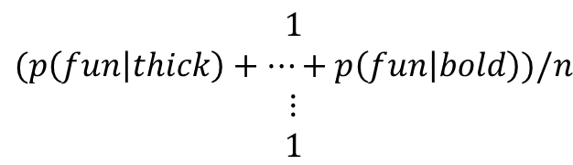



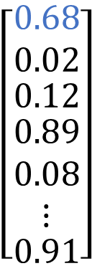
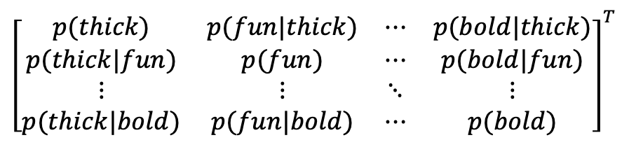
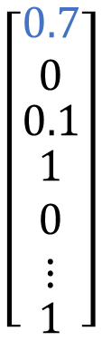






$$y_{n}^{ILSC}$$
$$y_{n}^{CMLE}$$
$$y_{n}$$
$$\left[\begin{matrix}0.68 \\ 0.02 \\ \begin{matrix}0.12 \\ \begin{matrix}0.89 \\ 0.08 \\ ⋮\end{matrix} \\ 0.91\end{matrix}\end{matrix}\right]$$
$$\left[\begin{matrix}0.7 \\ 0 \\ \begin{matrix}0.1 \\ \begin{matrix}1 \\ 0 \\ ⋮\end{matrix} \\ 1\end{matrix}\end{matrix}\right]$$
$$\left[\begin{matrix}0 \\ 0 \\ \begin{matrix}0 \\ \begin{matrix}1 \\ 0 \\ ⋮\end{matrix} \\ 1\end{matrix}\end{matrix}\right]$$
thick
fun
BCE
narrow
CMLE
fat
shade
bold
Pre-defined
Interpolate
T = p($y_{j}|y_{i}$)
$$y_{n}$$
$$y_{n}^{CMLE}$$
$${\left[\begin{matrix}p(thick) & p(fun|thick) & ⋯ & p(bold|thick) \\ p(thick|fun) & p(fun) & ⋯ & p(bold|fun) \\ ⋮ & ⋮ & ⋱ & ⋮ \\ p(thick|bold) & p(fun|bold) & ⋯ & p(bold)\end{matrix}\right]}^{T}$$
$$\begin{matrix}1/n \\ 0 \\ \begin{aligned}⋮ \\ 1/n\end{aligned}\end{matrix}$$
$$\begin{matrix}1 \\ (p\left(fun | thick\right)+…+p\left(fun | bold\right))/n \\ \begin{aligned}⋮ \\ 1\end{aligned}\end{matrix}$$
$$⨂$$
sum=1
Notes:
具体的にCMLEで行われる欠損推定を説明します．ここで，欠損推定行列Tの各要素は印象語Iが付与されている際に，印象語ｊが付与されている事後確立を表しています．この欠損推定行列Tは事前にデータセットの印象語の分布から算出することが可能です．この行列と付与されている印象語のマルチホットベクトルを掛け合わることで，印象語が欠損している確率値を推定し補完します．[~07:18]

