Slide 1




Regression
Simple Linear Regression Analysis
Presented by: Sam Lawrence Dadang & Mikko Angelo Daigdigan
Regression refers to a statistical method used to investigate the relationship between variables. It aims to understand how one or more independent variables are related to a dependent variable. Regression analysis helps in predicting the value of the dependent variable based on the values of the independent variables.

Slide 2
Regression
Regression refers to a statistical method used to investigate the relationship between variables. It aims to understand how one or more independent variables are related to a dependent variable. Regression analysis helps in predicting the value of the dependent variable based on the values of the independent variables.
Linear regression is the simplest and commonly used statistical measure for prediction studies.
It is concerned with finding an equation that uses the known values of one or more variables, called the independent or predictor variables, to estimate the unknown value of quantitative variable called the dependent or criterion.
It is a prediction when a variable (y) is dependent on the second variable (x) based on the regression equation of a given set of data.
After a scatter plot is constructed and the value of correlation coefficient is deemed to be significant, then an equation of the regression line is determined.
The regression line is the data's line to be fit.
The closer the points fit the regression line, the higher the absolute value of r and the closer it will be to + 1 or to -1.

Slide 3

Regression
Simple Linear Regression Analysis

Slide 4
Regression
Linear regression is the simplest and commonly used statistical measure for prediction studies.
It is concerned with finding an equation that uses the known values of one or more variables, called the independent or predictor variables, to estimate the unknown value of quantitative variable called the dependent or criterion.
It is a prediction when a variable (y) is dependent on the second variable (x) based on the regression equation of a given set of data.
Simple Linear Regression Analysis

Slide 5
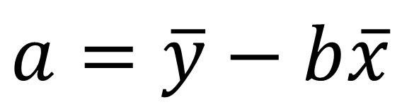
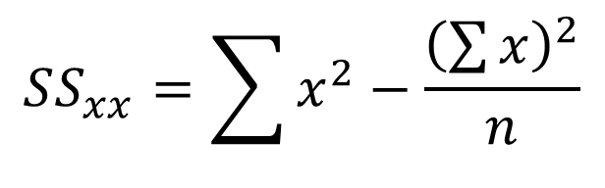

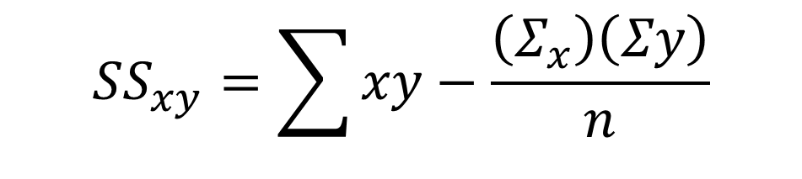
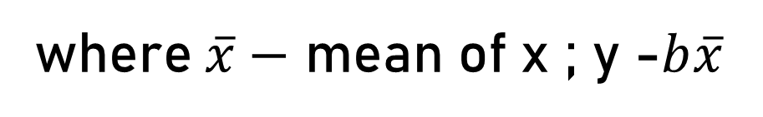

Regression
Simple Linear Regression Analysis
$$y′=a+bx$$
Formula for Regression Line
$$b=\frac{SSxy}{SSxx}$$
$$a=\overline{y}−b\overline{x}$$
and
where $\overline{x}−$ mean of x ; y -$b\overline{x}$
$$SS_{xy}=\sum{xy}−\frac{\left(Σ_{x}\right)\left(Σy\right)}{n}$$
$$SS_{xx}=\sum{x^{2}}−\frac{{\left(\sum{x}\right)}^{2}}{n}$$
Note: Round the values of a and b to three decimal places.

Slide 6
Formula for Regression Line
Regression
Simple Linear Regression Analysis
Example:
A statistics professor at a state university wants to see how strong the relationship between a students score on a test and his or her grade point average.
Test Score (x) | 98 | 105 | 100 | 100 | 106 | 95 | 116 | 112
GPA (y) | 2.1 | 2.4 | 3.2 | 2.7 | 2.2 | 2.3 | 3.8 | 3.4

Slide 7
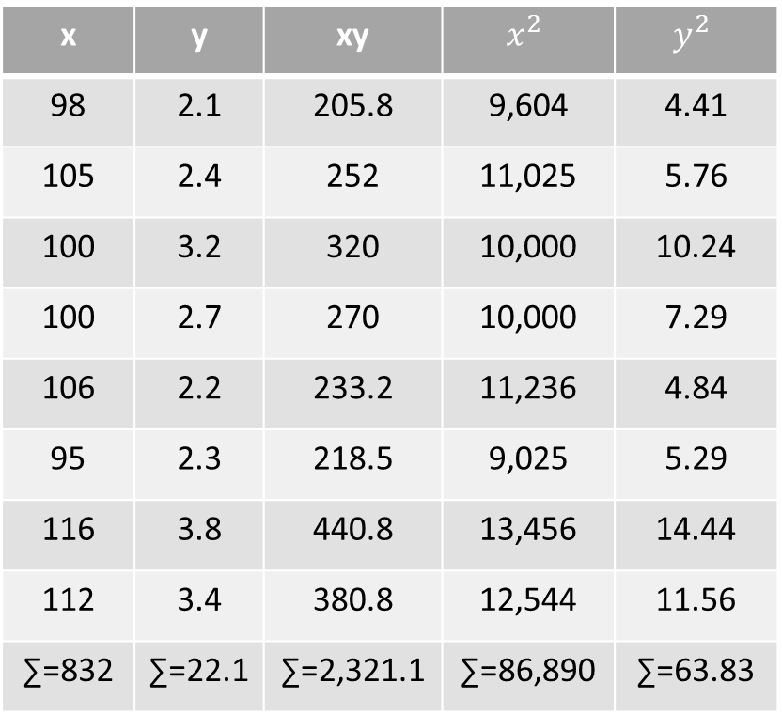

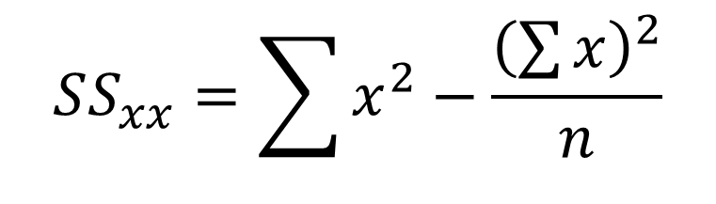
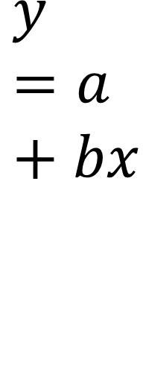
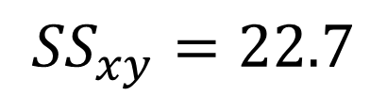
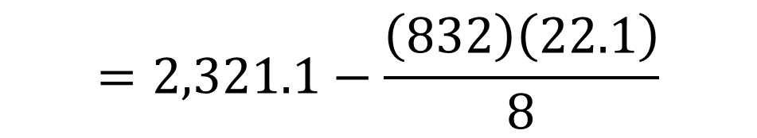
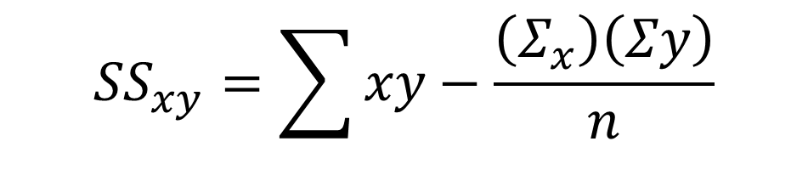

A statistics professor at a state university wants to see how strong the relationship between a students score on a test and his or her grade point average.
Formula for Regression Line
$$y=a+bx$$
Regression
Simple Linear Regression Analysis
Example:
$${SS}_{xy}=\sum{xy}−\frac{\left(Σ_{x}\right)\left(Σy\right)}{n}$$
x | y | xy | $$x^{2}$$ | $$y^{2}$$
98 | 2.1 | 205.8 | 9,604 | 4.41
105 | 2.4 | 252 | 11,025 | 5.76
100 | 3.2 | 320 | 10,000 | 10.24
100 | 2.7 | 270 | 10,000 | 7.29
106 | 2.2 | 233.2 | 11,236 | 4.84
95 | 2.3 | 218.5 | 9,025 | 5.29
116 | 3.8 | 440.8 | 13,456 | 14.44
112 | 3.4 | 380.8 | 12,544 | 11.56
∑=832 | ∑=22.1 | ∑=2,321.1 | ∑=86,890 | ∑=63.83
$$=2,321.1−\frac{\left(832\right)\left(22.1\right)}{8}$$
$${SS}_{xy}=22.7$$
$$SS_{xx}=\sum{x^{2}}−\frac{{\left(\sum{x}\right)}^{2}}{n}$$
$$=86,890−86,528$$
$$SS_{xx}=362$$

Slide 8



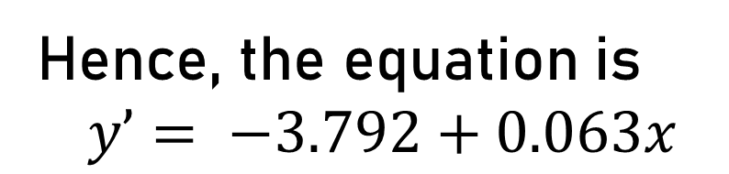
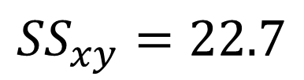


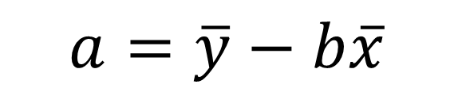
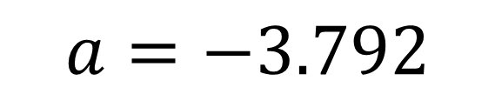



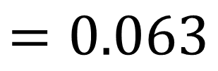

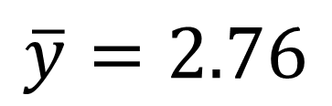
Formula for Regression Line
Regression
Simple Linear Regression Analysis
Example:
The Values we needed for the equation are
$${SS}_{xy}=22.7$$
$$SS_{xx}=362$$
$$b=\frac{SSxy}{SSxx}$$
$$=\frac{22.7}{362}$$
$$=0.063$$
$$\overline{x}=\frac{\sum{x}}{n}$$
$$\overline{y}=\frac{\sum{y}}{n}$$
$$a=\overline{y}−b\overline{x}$$
$$=\frac{832}{8}$$
$$=2.76−(0.063(104)$$
$$=\frac{22.1}{8}$$
$$a=−3.792$$
$$\overline{x}=104$$
Hence, the equation is
$$y’= −3.792+0.063x$$
$$\overline{y}=2.76$$

Slide 9



Formula for Regression Line
$$y=a+bx$$
Regression
Simple Linear Regression Analysis
Example:
A statistics professor at a state university wants to see how strong the relationship between a students score on a test and his or her grade point average.
Test Score (x) | 98 | 105 | 100 | 100 | 106 | 95 | 116 | 112
GPA (y) | 2.1 | 2.4 | 3.2 | 2.7 | 2.2 | 2.3 | 3.8 | 3.4
Estimate the GPA, given the test score. For instance, if the test score is 120 then the GPA is
$$y’= −3.792+0.063x$$
$$y’= −3.792+\left(0.063\right)(120)$$
$$y’=3.768$$

Slide 10
“Happy solving! And may the odds be ever in your favor”
Regression
Simple Linear Regression Analysis

Slide 11
“Happy solving! And may the odds be ever in your favor”
Regression
Simple Linear Regression Analysis
Presented by: Sam Lawrence Dadang & Mikko Angelo Daigdigan

Slide 12
Formula for Regression Line
$$y=a+bx$$
Regression
Simple Linear Regression Analysis
Example:
A statistics professor at a state university wants to see how strong the relationship between a students score on a test and his or her grade point average.
Test Score (x) | 98 | 105 | 100 | 100 | 106 | 95 | 116 | 112
GPA (y) | 2.1 | 2.4 | 3.2 | 2.7 | 2.2 | 2.3 | 3.8 | 3.4
Estimate the GPA, given the test score. For instance, if the test score is 120 then the GPA is
$$y’= −3.792+0.063x$$
$$y’= −3.792+\left(0.063\right)(120)$$
$$y’=3.768$$

