Slide 1
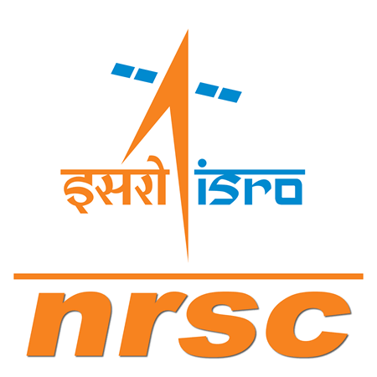



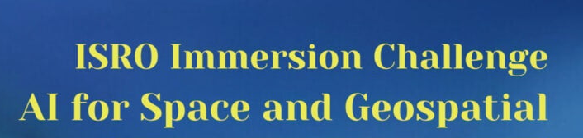

Team Name: Terra_Spatial
Solution Title : Geospatial Data Retrieval system
Track : Student Research – Spatial Informatic
Mentor : Prof. Geeta Kodabagi
Team members :
1. Raunak Jha
2. Atharva Gorale
3. Prathamesh Badgujar

Slide 2
ABSTRACT
The present solution aims to provide a easy to use interface for users to access geospatial data. The solution features Whatsapp chat window to take user query in natural language. Whatsapp API would send the query to a Natural Language Processing model hosted on cloud, which converts the natural language text into executable query.
Then the query is sent to the pretrained ML model which extracts the required result from the dataset and sends it back to NLP model. This NLP model converts the data back to natural language and it is sent to Whatsapp chat window. The user can see the result in natural language text and related image on Whatsapp.
In this way, users with low processing power devices and weak internet will be able to get context aware geospatial data. The user can input the query in natural language and get back results in easy to understand natural language text as well as images.
This solution has a wide use case in disaster management, city planning and monitoring, agriculture, land mapping and feature extraction, water management and infrastructure construction, encroachment removal and water level monitoring.
It also presents 3 unique commercialization potential with huge application.

Slide 3
BACKGROUND OF SOLUTION
ISRO was formed in 1969 to enable every Indian citizen to access space tech and exploit it’s tremendous potential of application in various fields.
Today, a lot of geospatial data is available from various sources but is not very easily and readily accessible which limits its application.
Therefore, we aim to build platform softwares that can extract, process and provide this data in easy to access and understandable form, for wide use case.
The present solution has ML models to process complex space data, NLP model to enable Natural language interface and utilizes Whatsapp as the platform to disburse this information.
Users with low processing power devices and weak internet can access sophisticated geospatial data.
Our Goal is to bring sophisticated space data to everyone’s fingertips.

Slide 4
Implementation APPROACH
Input of user query and location through Whatsapp chat.
Natural language to executable query using NLP model.
Query sent to ML model trained on geospatial datasets.
Result generated.
Result converted to Natural language.
Result displayed through Whatsapp chat window.
Whatsapp API
Ngrok webhook
Hugging Face (NLP)
Text generation
(Distilled GPT2)
Visualization
(Matplotlib)
ML model

Slide 5
METHODS & TECHNOLOGIES UTILIZED
‘Python’ programming language
Whatsapp API
‘Ngrok’ webhook
‘Flask’ web framework
‘logging’ event tracking module
‘hashlib’ hashing module
netCDF4 to process .nc
rasterio module
Matplolib visualization module.

Slide 6
A.I. UTILIZATION
NLP model : We have/aim to implement our NLP model using following tools:
1. Wikipedia API – Source of data for general NLP chat.
2. Hugging face transformer – To process user queries
3. Distilled gpt2 – To generate results
ML model: We have/aim to implement our ML model using following tools:
OpenCV
Pytorch CUDA
Scikit image
Scipy
Google Jax

Slide 7
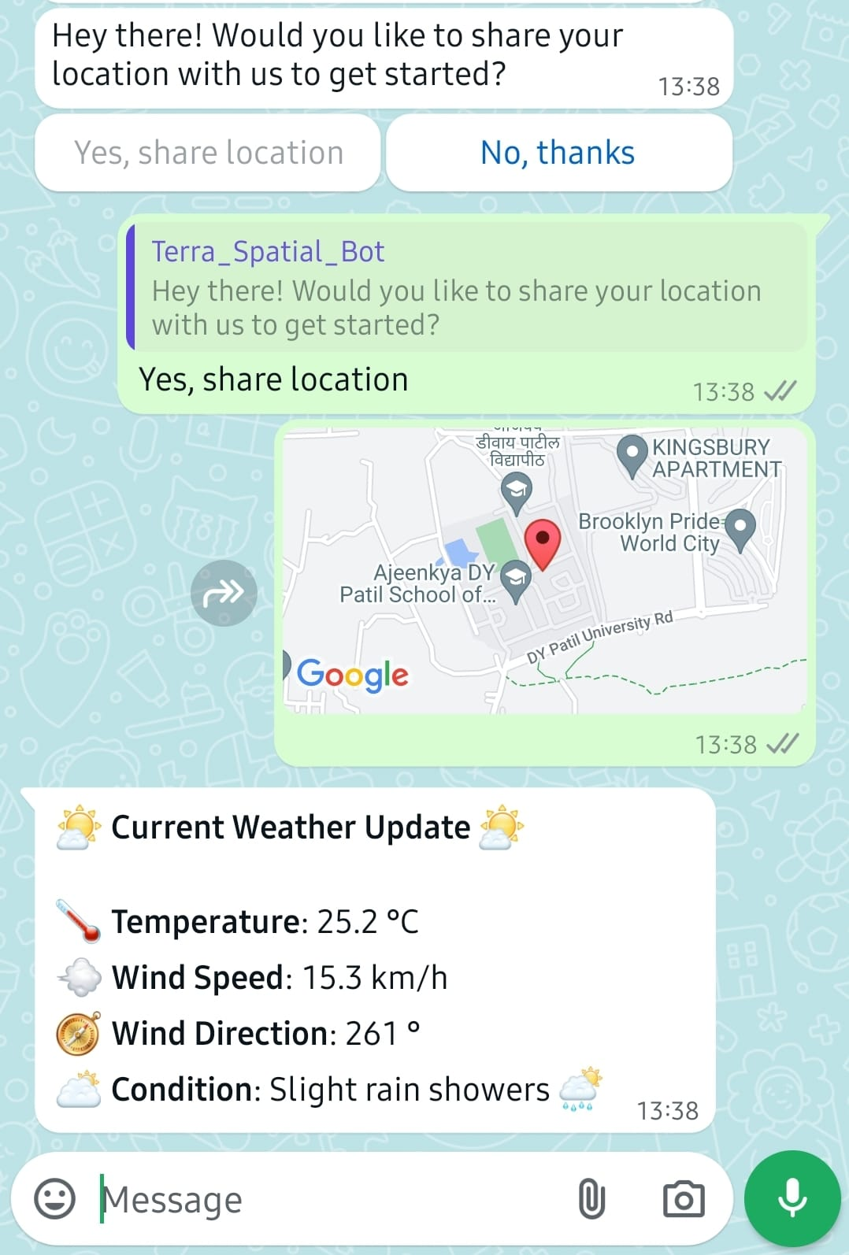
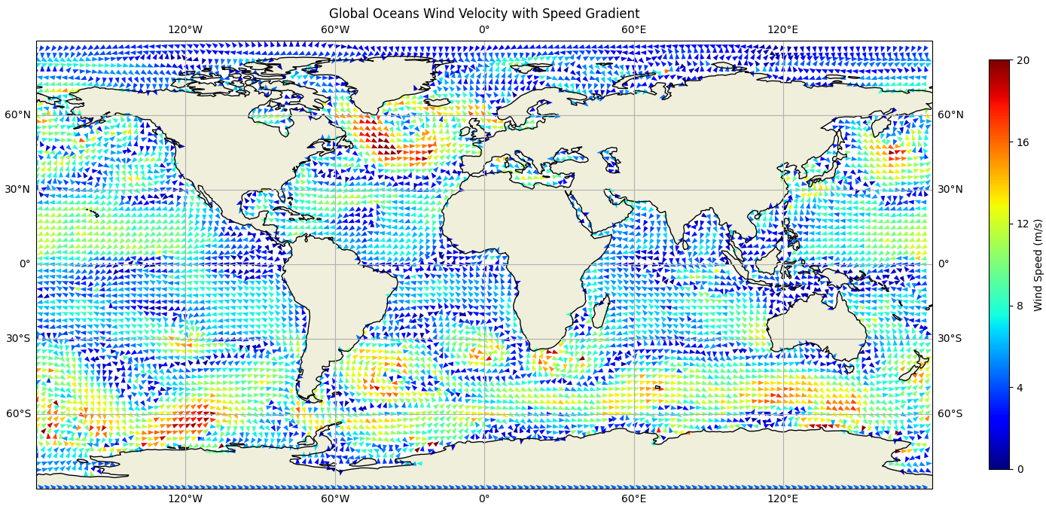
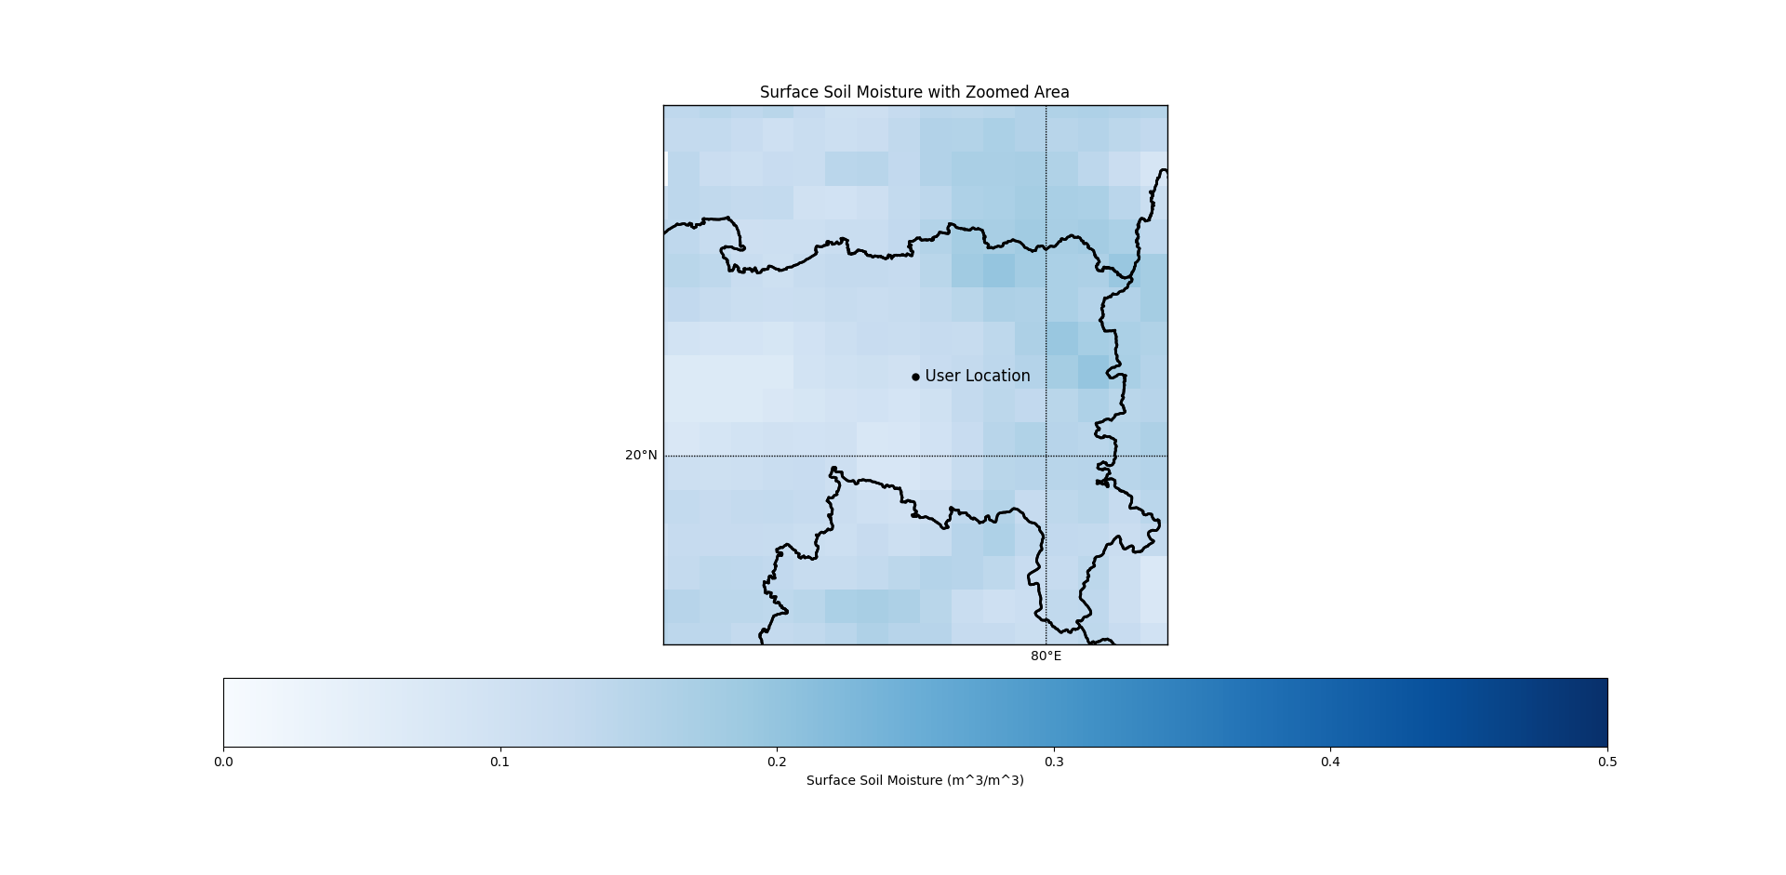
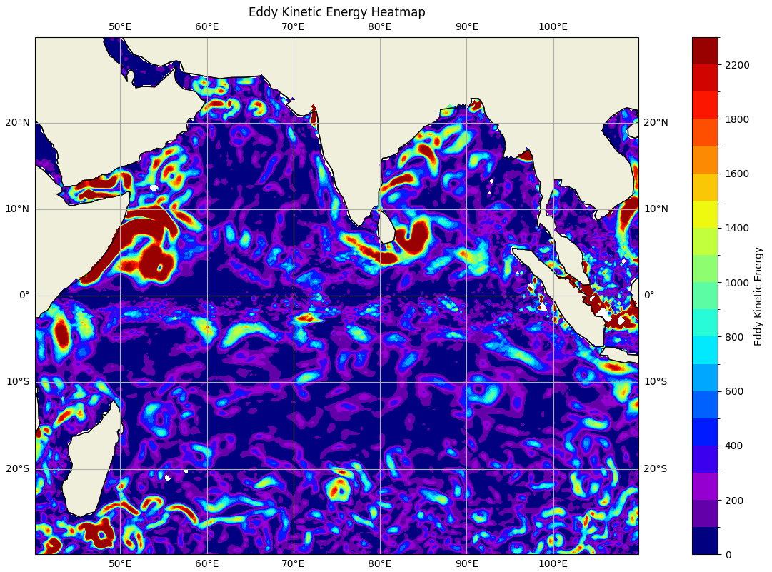
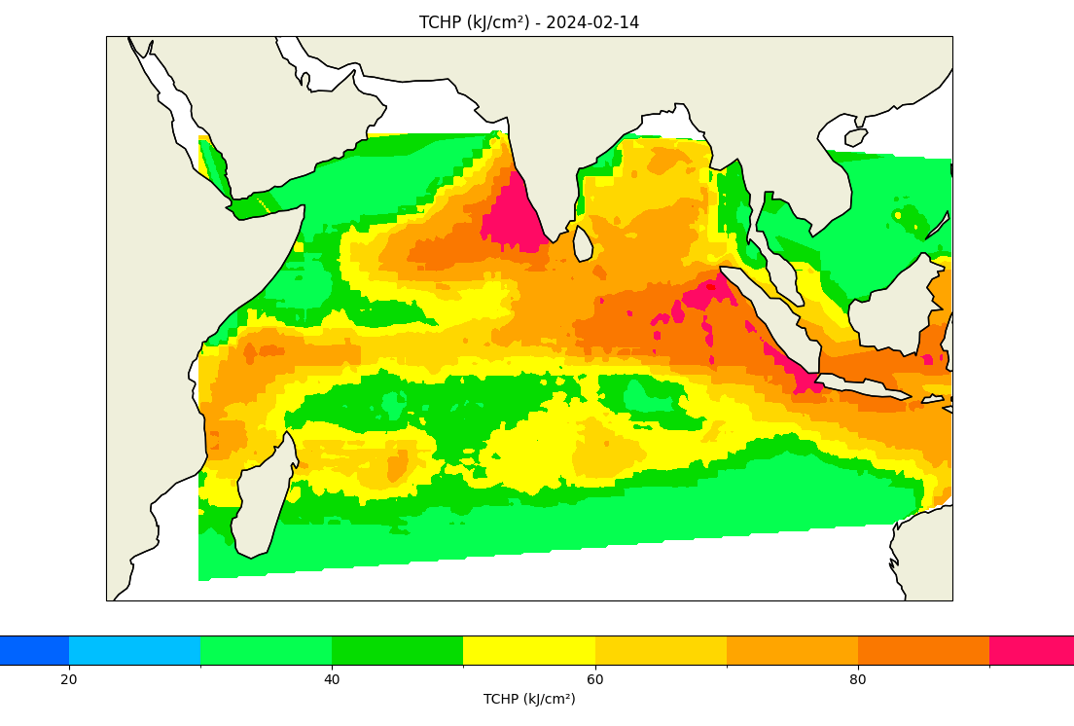
SCREENSHOTS OF IMPLEMENTATION

Slide 8
SERVICES PROVIDED
The versatility of our solution allows wide use case and we can provide an extensive variety of geospatial data to users. To begin with, we have worked on following data:
Real time weather
Soil moisture content of soil of selected region.
Ocean current.
Eddy kinetic energy heatmap.
Ocean winds magnitude and direction, among others
As the project expands, we aim to include several more geospatial data of a particular location that would serve a wide range of purposes.

Slide 9
FUTURE SCOPE
Since we aim to build platform softwares, this project holds extensive future use case.
This model can be used to extract and visualize data form other planets and moon.
An extensive network of ML models would be trained and deployed to provide multiple geospatial services.
The NLP model would be trained to handle more complex user queries and produce easier to understand results (text, image, short video).
Infrastructure constructors, farmers, government and civic bodies, disaster relief teams and ordinary citizens would be able to derive huge value from our platform.
If our platform is authorized to get real time data, it would be a game changer in real time disaster management and resource tacking.
Several aspects of this project can be tweaked to provide customized results on custom datasets.
The geospatial ML models may be used by users on their unique platforms.

Slide 10
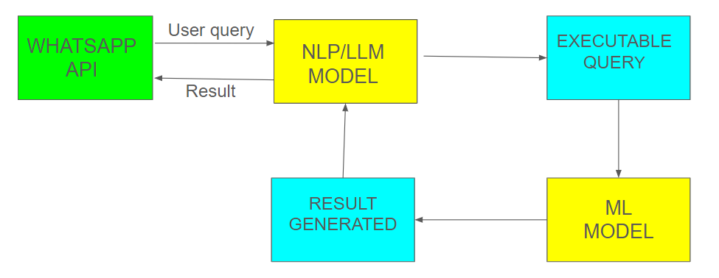
COMMERCIAL POTENTIAL
1.
FREEMIUM MODEL
Some geospatial data would be free while more sophisticated data would require a subscription.
2.
ML MODEL AS A SERVICE
Our trained ML models would provide sophisticated insights and information that other entities may use on their platform.
3.
WHATSAPP PLATFORM AS A SERVICE
Our Whatsapp platform and NLP model can be utilized by other companies to send and receive messages through whatsapp chat window in natural language.

