Slide 1
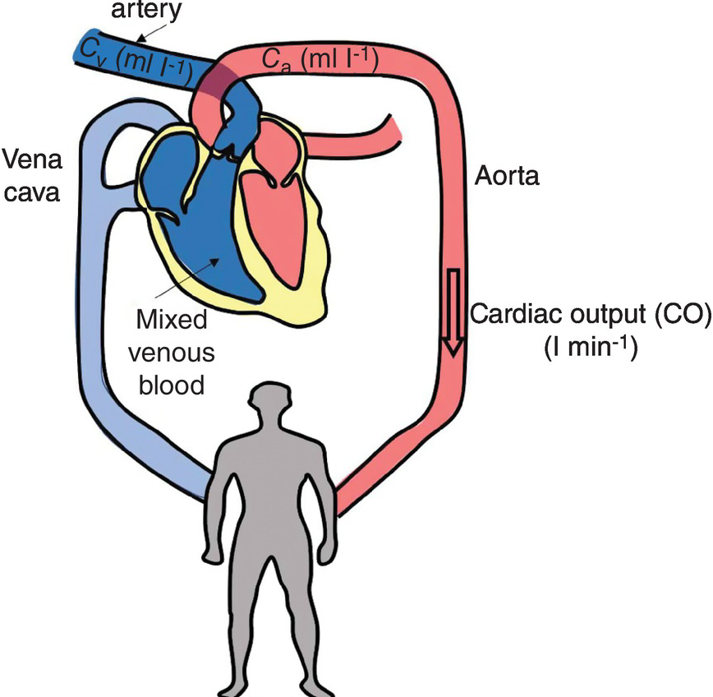
Predicting Cardiac Output
from Arterial Blood Pressure
Team 9
Sejal Ghate
Zixu Han
Yongzhi Sun

Slide 2
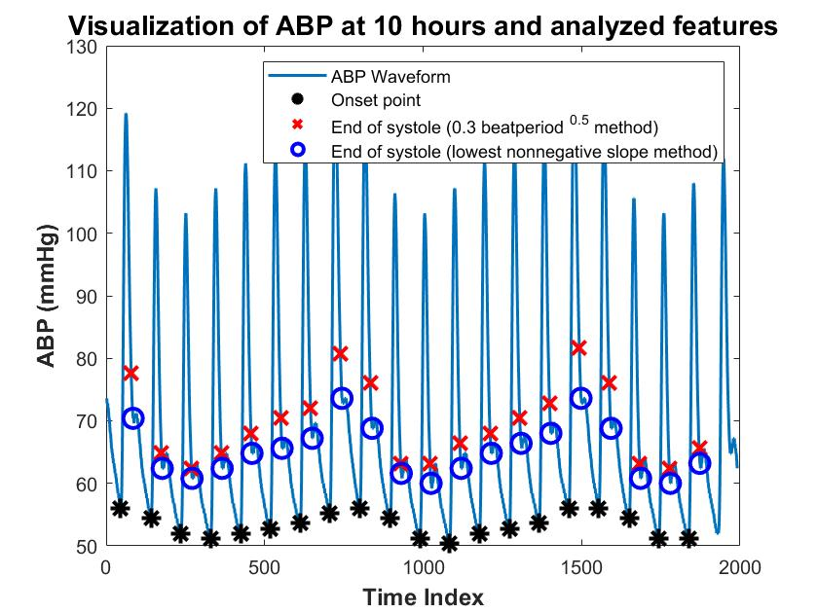
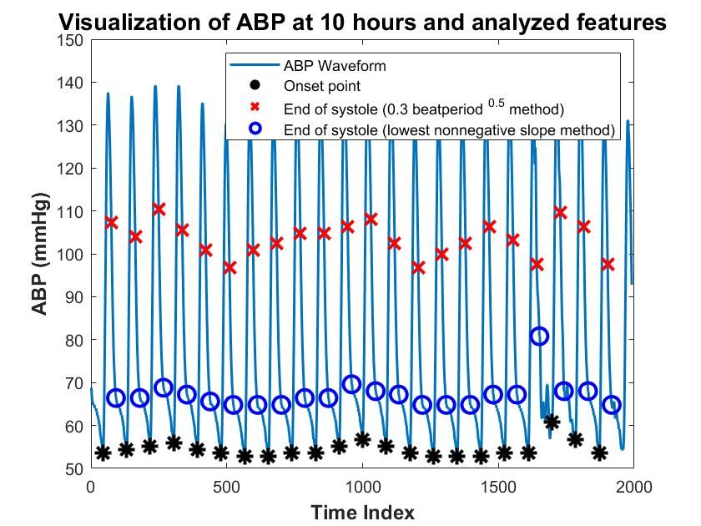
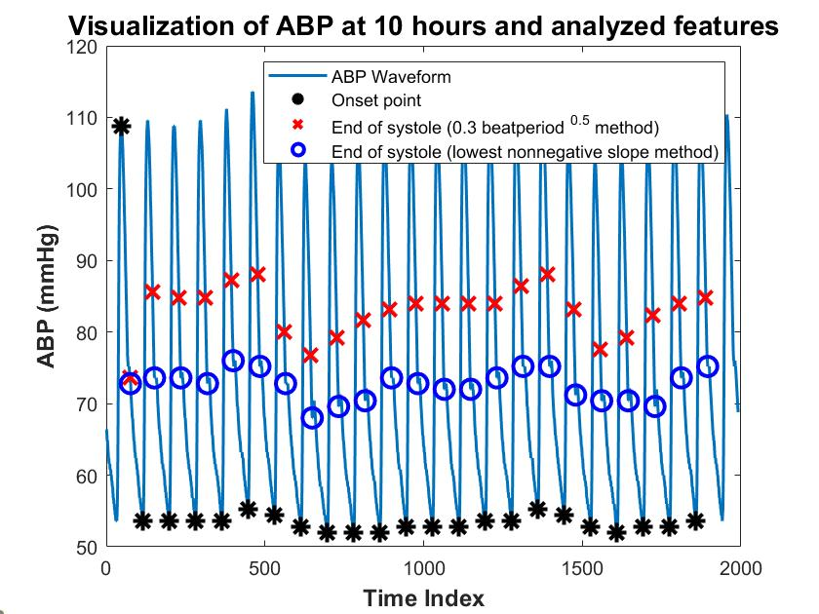
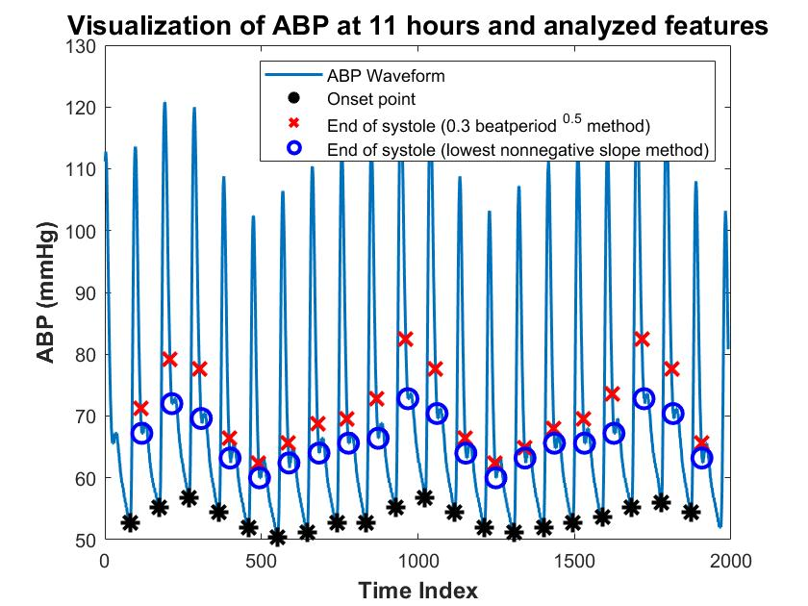
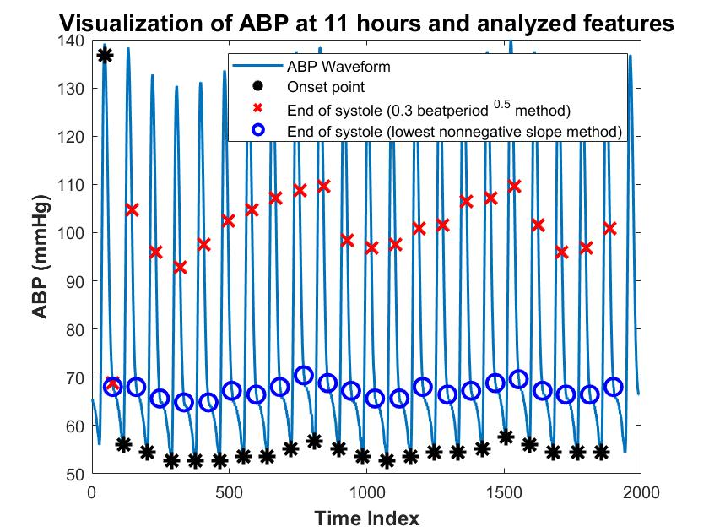
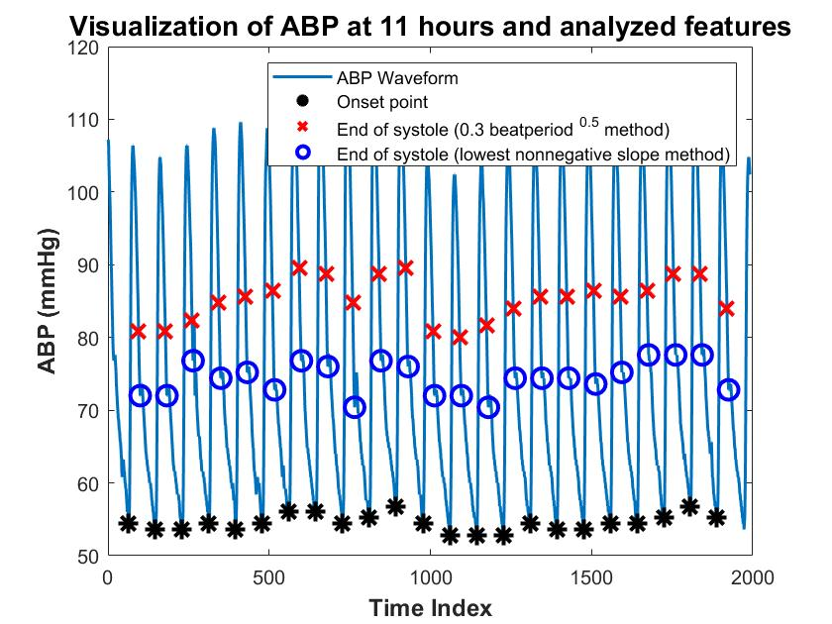
ABP and derived features from three subjects for 20 peaks
#s00020
#s00214
#s05114

Slide 3
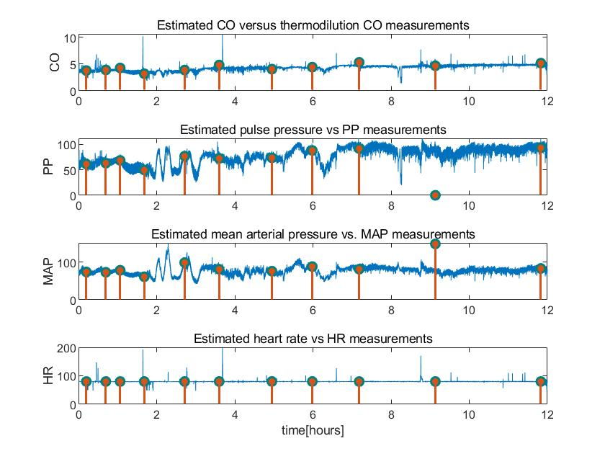
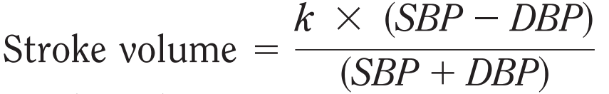
Estimated CO from Liijestrandand algorithm - #s00020
Liljestrand estimation: Estimator 5
Continuous: Estimated CO
Calibration (C2): Calibration_factor=COtd(1)/Uncalibrated_CO
Stem: COtd measurements at different times
Continuous PP, MAP and HR are derived from computed feature matrix
Stem plot: PPs, MAPs, HRs that are measured at the same time as COtd measurements

Slide 4
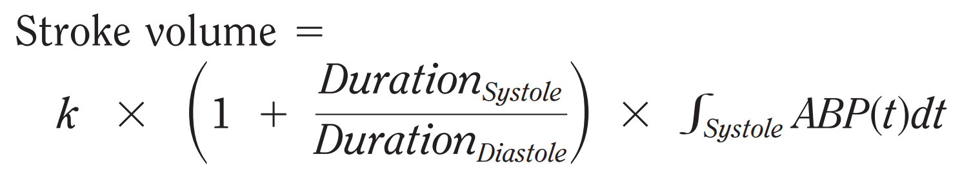

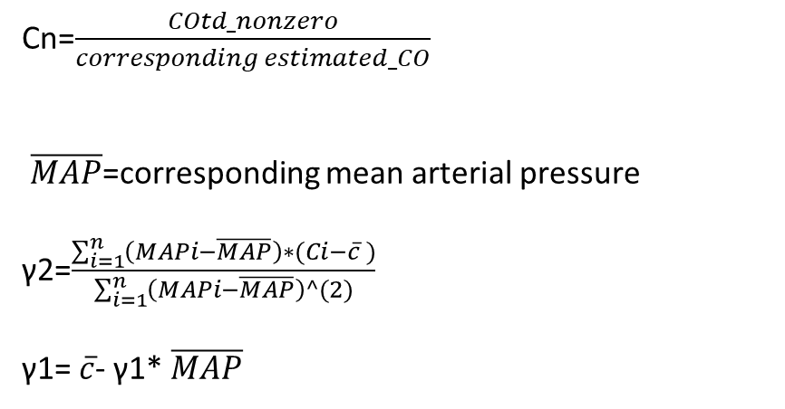
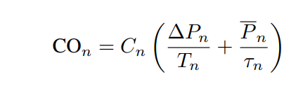
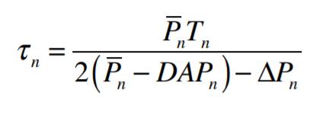
Repeat CO estimation with three other algorithms
Systolic area with Kouchoukos correction
Calibration: the same as the one used in Liljestrand algorithm (C2)
Herd
Calibration: least-square-error
Parlikar

Slide 5
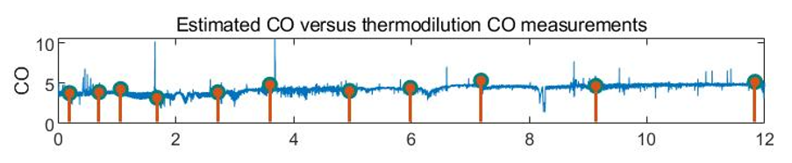
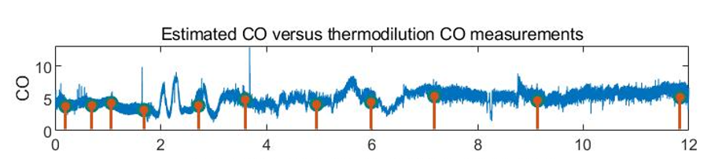
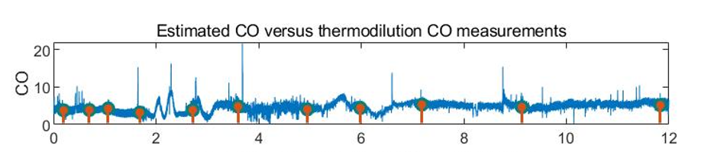
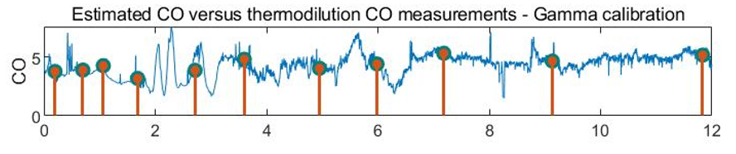
Estimated CO - #s00020 for the first 12 hours
Liljestrand
Systolic area with Kouchoukos correction
Herd
Parlikar with filt_order = 15

Slide 6
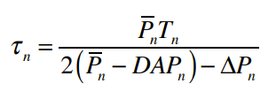
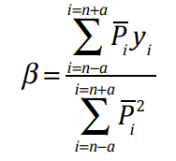
CO Calibration using Parlikar’s method:
Sliding Window approach:
Window size 21
Filtering used: filter order 15
τ calculated for each index within the window
Least squares solution used to assign the value obtained from the β equation
This value is assigned to center most index in the window
Window slides by one index
To account for indexes which cannot be mid-points for any window (left and right extreme indexes), Values interpolated to nearest non-zero value (i.e, first non-zero and last non-zero values respectively)
Calibration: C2 and least square ‘ϒ’ calibration

Slide 7
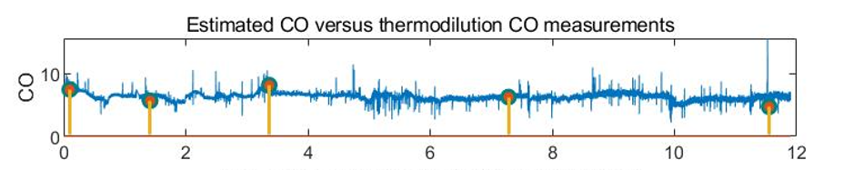
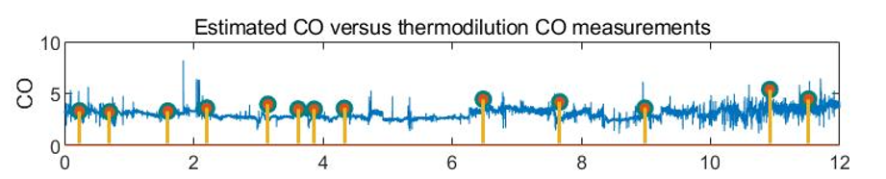
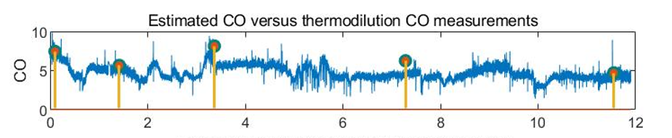
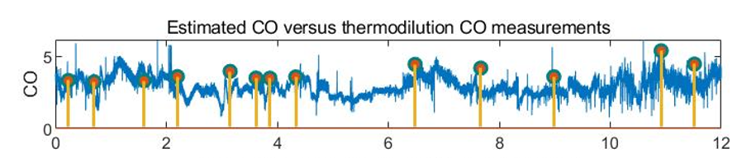
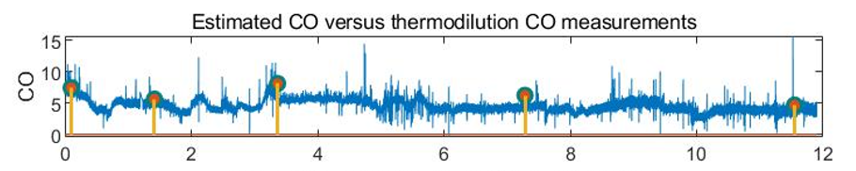
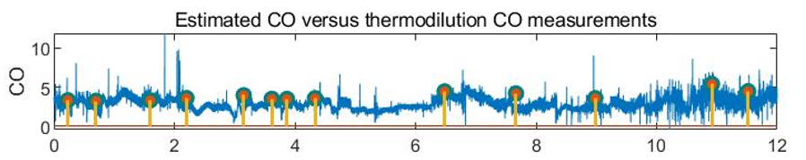
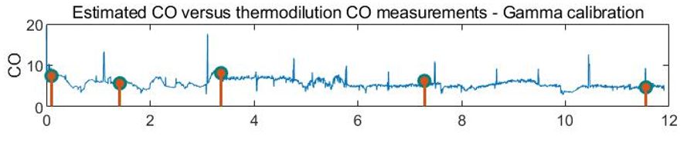
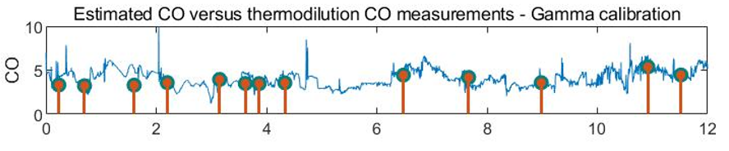
Estimated CO with two other subjects
#s00214
#s05114
Liljestrand
Systolic area with Kouchoukos correction
Herd
Parlikar

Slide 8

Total peripheral resistance calculated after Parlikar estimation
Formula used for TPR:
Feature matrix extracted from the modified estimated_co code
Calculation performed on variables of this feature matrix
Appropriate conversion applied for TPR units to mmHg/(mL/s)

Slide 9

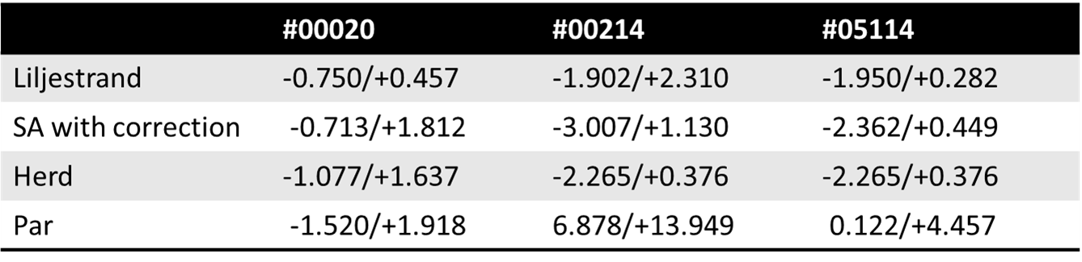
Bland-Altman Analysis for algorithm comparison based on each paired COtd-estimated_CO
Error Distributions of each paired CO-from-ABP and COtd for each algorithm
X axis-Mean value: (Estimated CO + Cotd)/2
Y axis-Difference: Estimated CO – Cotd
Mean Difference: Sum of Y /no.Cotd
95% limits of agreement: Mean Difference±1.96SD
95% limits of agreement

Slide 10
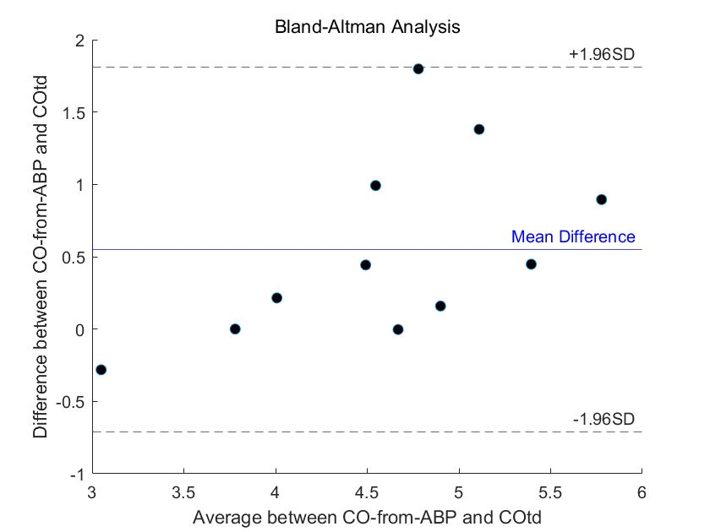
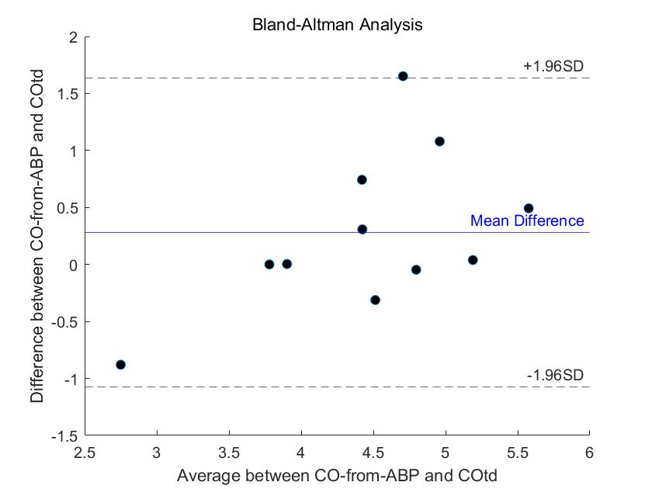
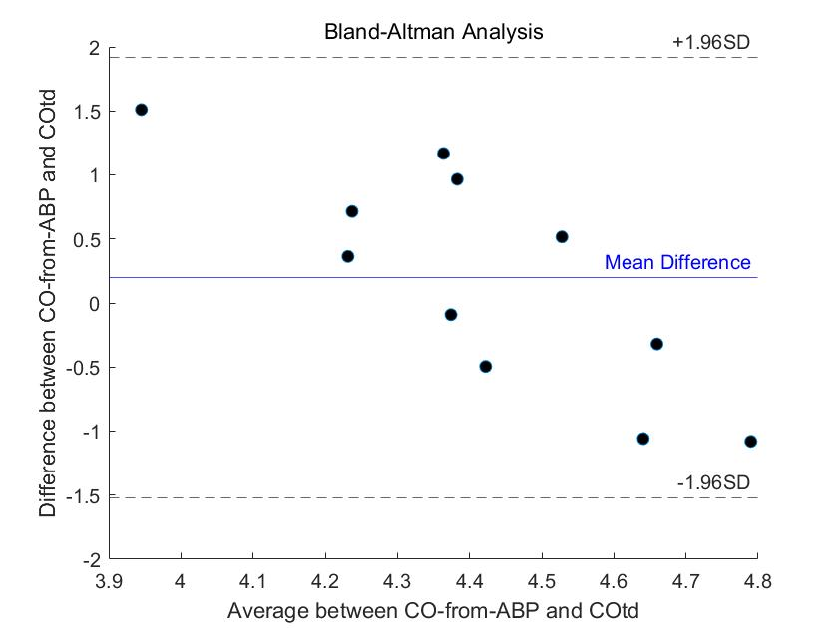
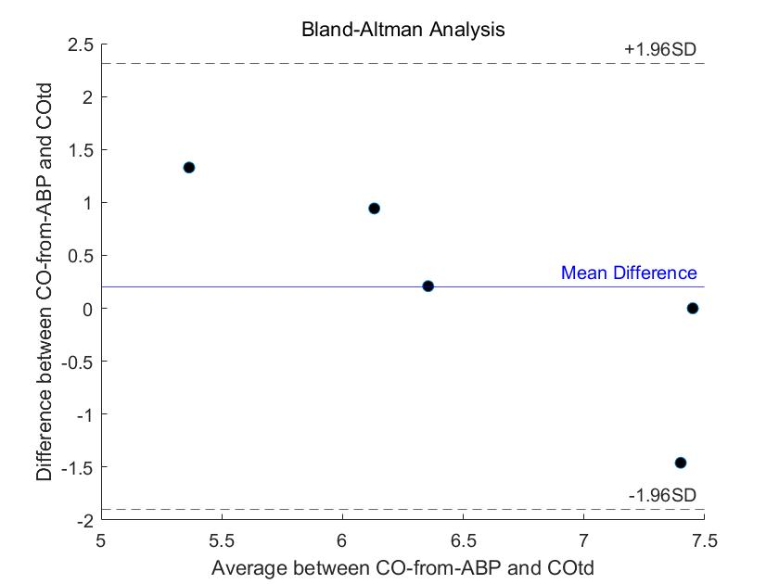
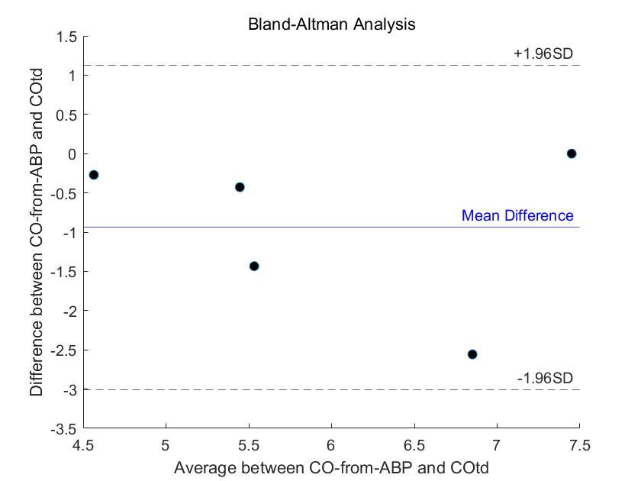
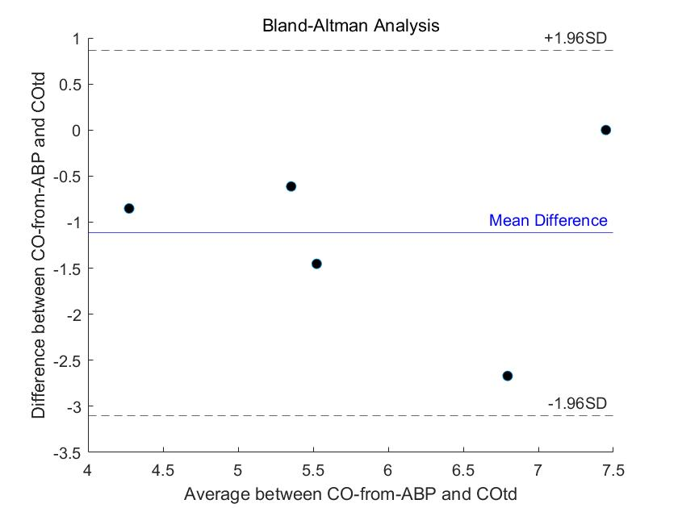
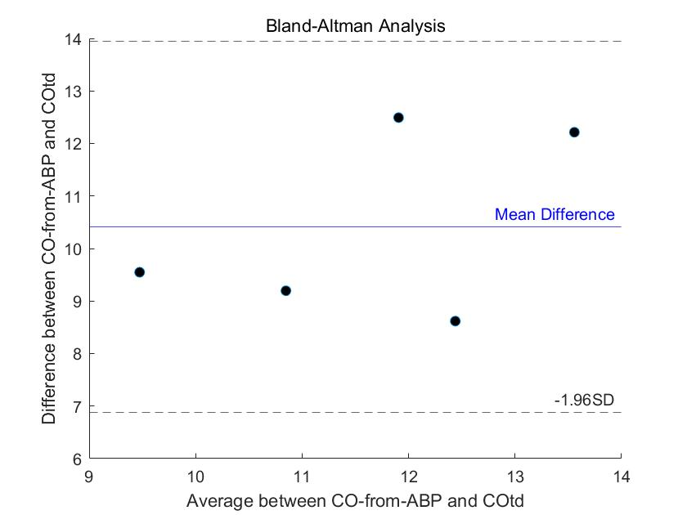
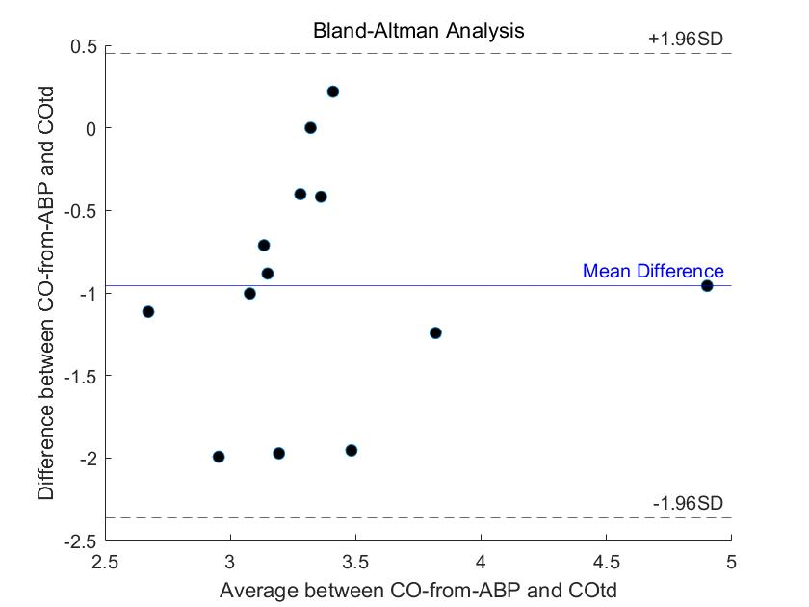
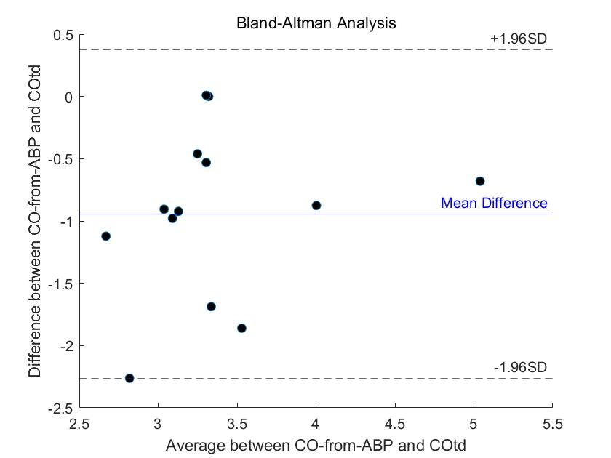
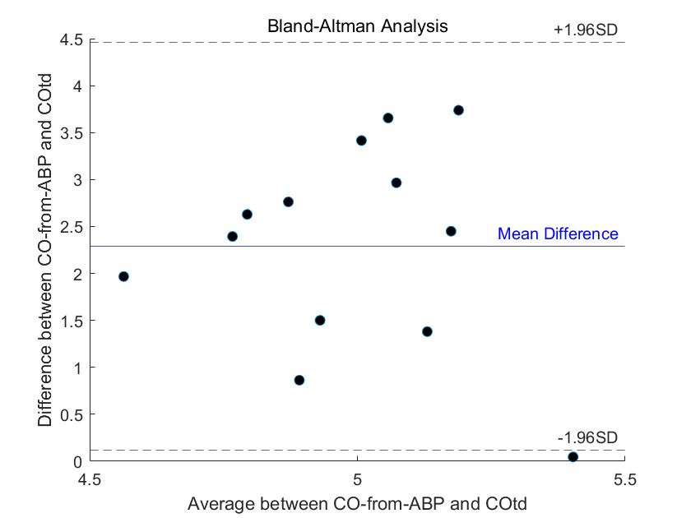
Liljestrand
Herd
Parlikar
Liljestrand
Systolic area w/ Kouchoukos correction
#s00020
#s00214
#s05114

Slide 11
Difficulties and interesting observations associated with project:
Sample selection: Unlike sample 20, the waveforms of many samples are chaotic and do not show waveforms similar to those expected, feature extraction might not always be the most accurate due to presence of ectopic beats and outliers in the signal.
Our solution: Manually screen the data and find a better waveform for analysis
There are questions about the selection of V2 and V3 algorithms
Our solution: Choose the simpler V3 algorithm among the two methods
Extreme values appear in the Parlikar estimated COs
Our solution: Increase the filter order to 15 in estimate_co_v3 function.
What’s interesting? : Higher frequency waveform data! Need not always be clean, is very noisy, and due to different instruments used needs a lot of ‘reverse engineering’ to find similarities in different data frames.

Slide 12
Individual contribution:
Sejal Ghate : Question 1,3,5,6
01
Zixu Han : Question:3,4,5
02
Yongzhi Sun: Question: 1,2,3
03

