Slide 1
Coffee Shop Sales Dashboard Analysis

Slide 2
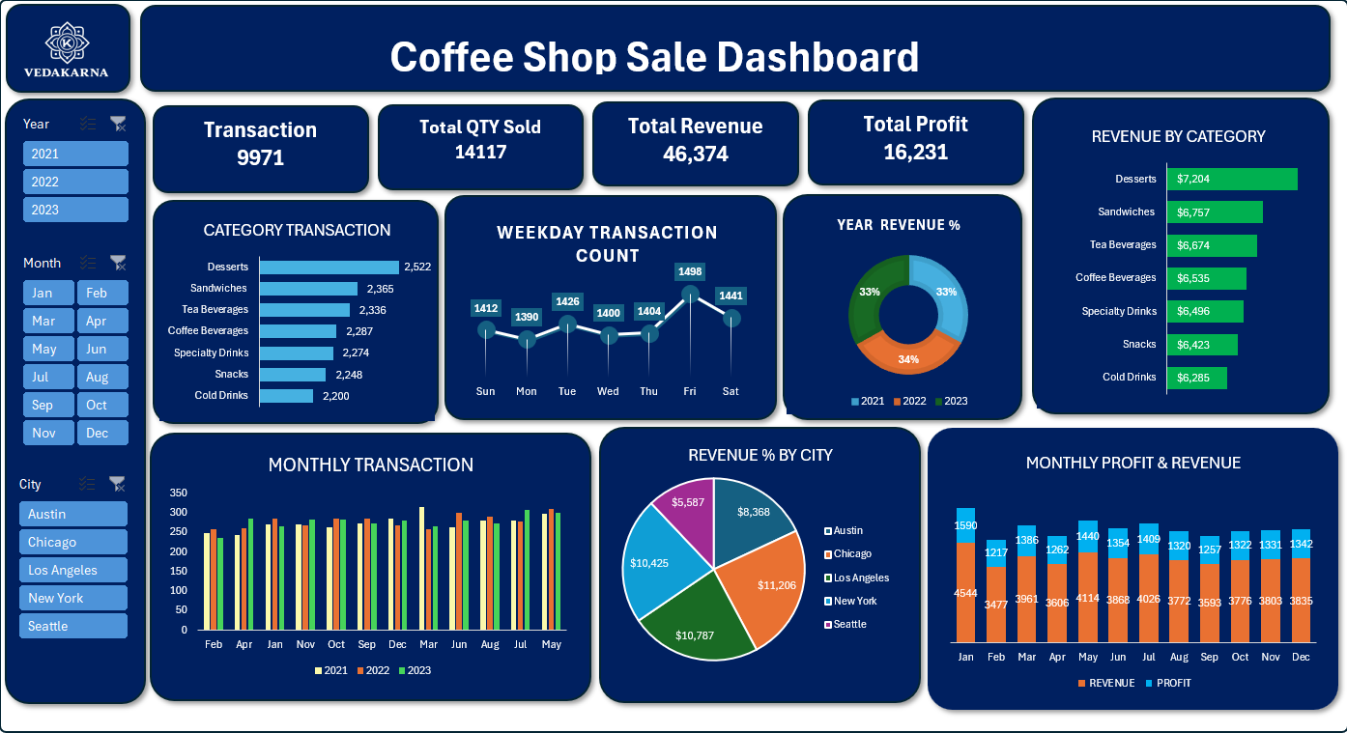
Dashboard Overview
This dashboard provides insights into coffee shop sales performance including transactions, revenue, profit, and category performance across different years, months, and cities.

Slide 3
Key Performance Indicators (KPIs)
Total Transactions: 9,971 – Total number of sales transactions recorded.
Total Quantity Sold: 14,117 – Total items sold across all product categories.
Total Revenue: $46,374 – Total income generated from sales.
Total Profit: $16,231 – Net profit earned after costs.

Slide 4
Category Transaction Chart
This bar chart shows the number of transactions by product category such as Desserts, Sandwiches, Tea Beverages, Coffee Beverages, Specialty Drinks, Snacks, and Cold Drinks.
It helps identify which product categories are most popular among customers.

Slide 5
Weekday Transaction Count
This line chart shows the number of transactions for each day of the week.
It helps analyze customer traffic patterns and identify the busiest days. For example, Friday shows the highest number of transactions.

Slide 6
Year Revenue Percentage
This donut chart compares revenue contribution across different years (2021, 2022, and 2023).
It shows that revenue distribution is relatively balanced between the years.

Slide 7
Revenue by Category
This horizontal bar chart shows the revenue generated by each product category.
It helps the business understand which products generate the most income. Desserts and sandwiches are among the highest revenue contributors.

Slide 8
Monthly Transactions
This chart shows monthly transaction counts across multiple years.
It helps track seasonal trends and understand how customer activity changes throughout the year.

Slide 9
Revenue Percentage by City
This pie chart represents the share of revenue generated from different cities such as Austin, Chicago, Los Angeles, New York, and Seattle.
It helps identify which city contributes the most to overall sales.

Slide 10
Monthly Profit and Revenue
This chart compares monthly revenue and profit.
It helps analyze financial performance over time and shows whether profit is increasing along with revenue.

Slide 11
Conclusion
The dashboard provides a complete view of coffee shop sales performance. It helps track product popularity, identify high-revenue categories, analyze customer behavior by weekday and month, and compare revenue across cities and years.

Slide 12
Thank You

