Slide 1
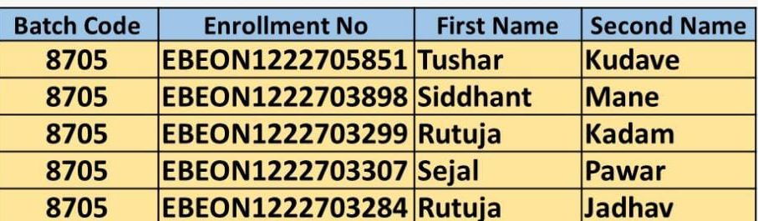
Project Title :
Laptop Shop
Team Leader : Tushar Kudave
Guided by
Varadharajan sir

Slide 2
Laptop Shop Web Application
Login Module
Admin Module
Home Page
Add to cart/ Order module
View Products module
Payment module
Stock Management Module

Slide 3
Module 1: Cart Details
Cart is bridge the gap between shopping and buying, so having the cart is extremely important on your website.
Cart details are useful to user if any product they want to buy later they can add that product to cart.
It is only useful for Users

Slide 4
Module 2: Order Details
Order details -This module stores the information regarding order to both user and admin.
1. Details Of user
2. Status of order (placed, delivered)
3. Amount
Useful for
1.Admin
2.User

Slide 5
Module 3: Payment
After cart if user want to buy any product we need complete payment procedure to place order.
Payment module supports various types of payments
Like debit card, scanner , Gpay ,…, etc.
Support only for user.

Slide 6
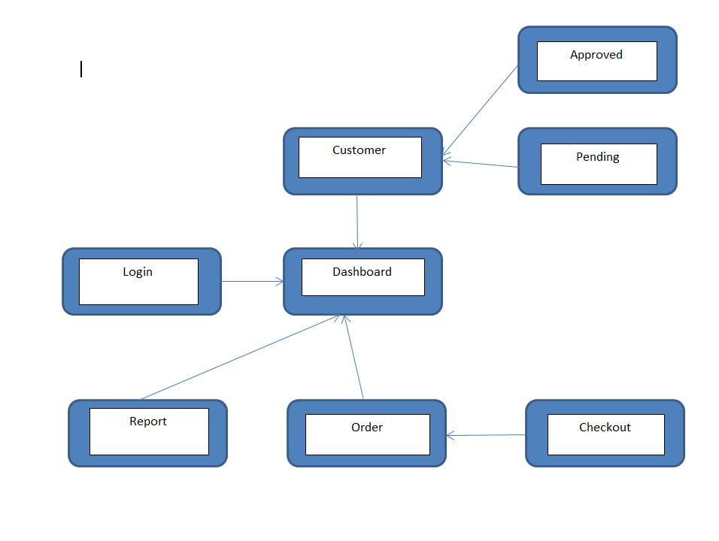
Project overview

Slide 7
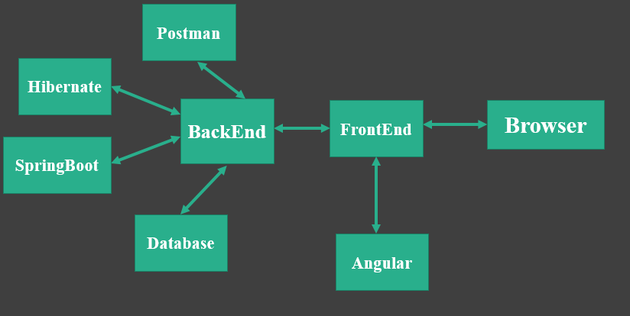
Tech architecture

Slide 8
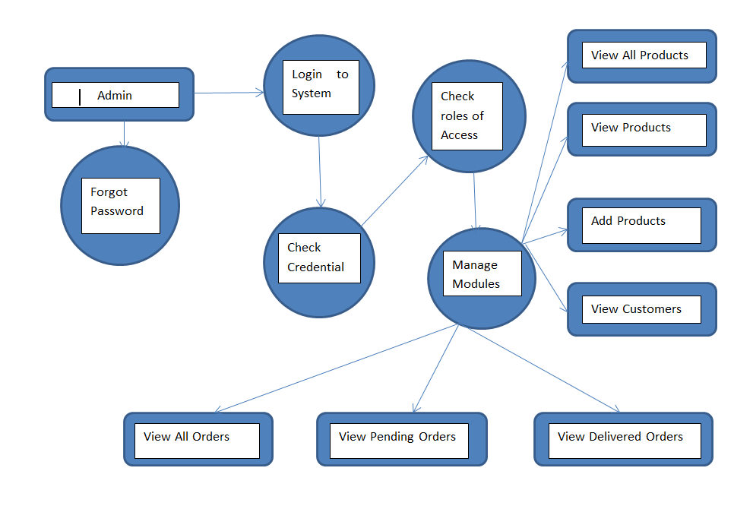
Dataflow diagram

Slide 9
Challenging issues
1) Dependencies issue
2) While creating angular project changes not reflecting in output.

Slide 10
Testing
Testing module | Expected Result | Pass/Fail
Login / create account | User able to create new account and login | Pass
Adding New Product | Admin is able to admin new product and user is able to see product | Pass
Status Of Order | User and Admin both are able to see status of order | Pass
Cart Details | User is able to add product to cart | Pass

Slide 11
Future enhancement
Integration with virtual assistants: Integrate the website with virtual assistants like Google Assistant or Amazon Alexa, enabling customers to easily place orders through voice commands.
Live customer support: Offering live chat support and personalized customer service to ensure customer satisfaction and resolve any issues that may arise.
Gps Tracker : Integrating gps tracking system of order tracking.

Slide 12
Conclusion
In this digital era Laptop Shop web application is useful for peoples. They can find all types of laptop at one place .
This project is made in such a way that it is easy to use/ handle for new users.
Project is user-friendly. Anyone can use project no need to having any technical knowledge.

