Slide 1
Insurance Management System
-By Sejal V. Narkhede

Slide 2
Index
INTRODUCTION | 3
PROJECT FEATURES | 4
SYSTEM FACILITIES | 5
SOFTWARE REQUIREMENTS | 6
HARDWARE REQUREMENTS | 7
SOFTWARE PROCESS USING AGILE METHODOLOGY | 8
DIAGRAMS | 9
SCREENSHOT | 11
CONCLUSION | 23
FUTURE SCOPE | 24
REFERENCES | 25

Slide 3

INTRODUCTION
Nowadays, insurance has been widely accepted by the public.
The users who will benefit from IMS are the insurance agent from various insurance companies such as AIA Insurance, Prudential Insurance, ING Insurance, Kurnia Insurance, and others.
For this project, AIA insurance company will be my reference organization.
The insurance packages offered by AIA will be integrated into the IMS.

Slide 4
PROJECT FEATURES
Admin finds it a very easy way to obtain the customer, supplier, and Bill information.
User-friendly.
Admin can get Timely Information from the database without any delay regarding the query.
This reduces the delay in response.
System provides Reports to admin for making quick decisions.
4

Slide 5
SYSTEM FACILITIES
Insurance Management System gives the customer a friendly Environment and facilities like :
Login / Sign up for their own account
Manage Policies for each customer
We can add/buy more types of insurance for more than one peoples and separate them for each
Update and Delete the policyholder’s records

Slide 6
SOFTWARE REQUIREMENTS
Software Requirement:
Operating System-widows 10
Apache Netbeans IDE
.JDK,
MYSQL Workbench

Slide 7
HARDWARE REQUIREMENTS
Hardware Requirement:
I3
Minimum 2GB RAM.
Maximum 500 GB HDD.
Input Devices: Keyboard, Mouse.

Slide 8
SOFTWARE PROCESS USING AGILE METHODOLOGY
When applying Agile to develop an insurance management system, you can follow the steps outlined below:
1. Project Initiation
2. Sprint Planning
3. Sprint Execution
4. Sprint Review
5. Sprint Retrospective
6. Repeat
- Repeat the sprint cycles, with each sprint resulting in a potentially shippable increment of the insurance management system.
8

Slide 9
DIAGRAMS
Data Flow Diagram
System
Customer
Login
Update
Admin
Confirmation
Confirmation
9

Slide 10
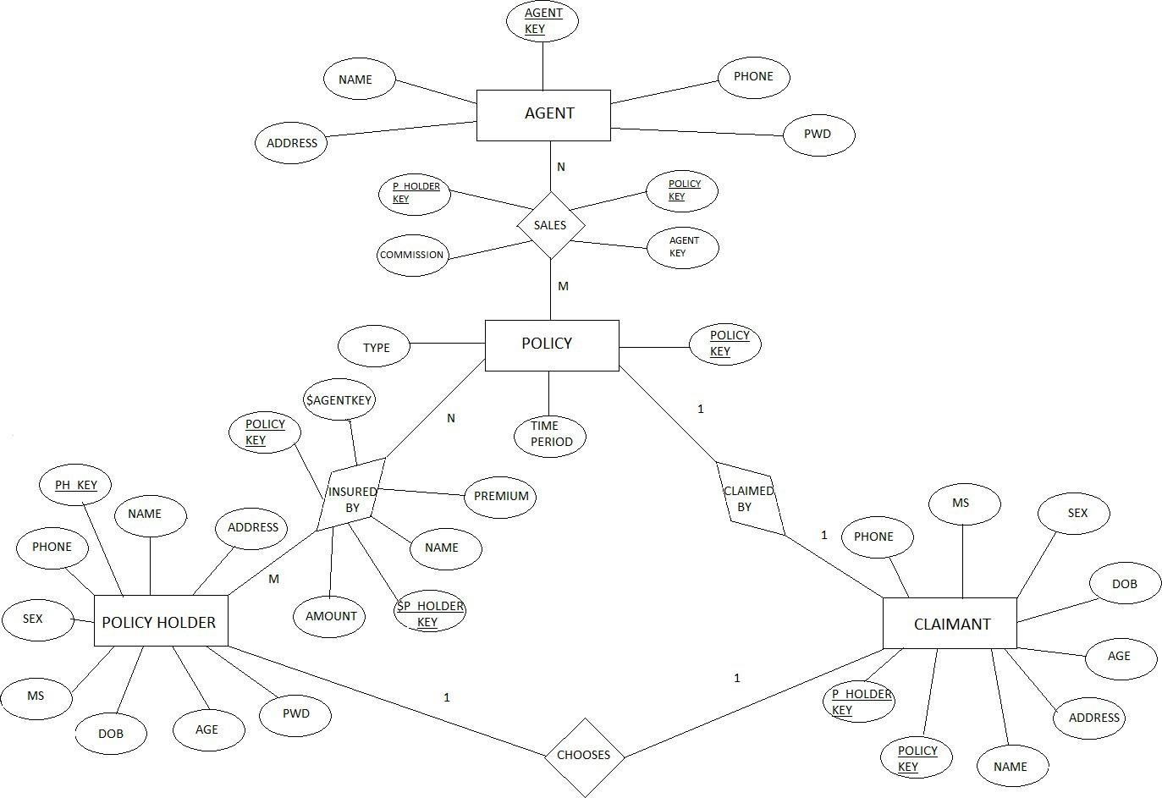
Entity Relationship Diagram
10

Slide 11
ONSCREEN VIEWS
SCREENSHOTS

Slide 12
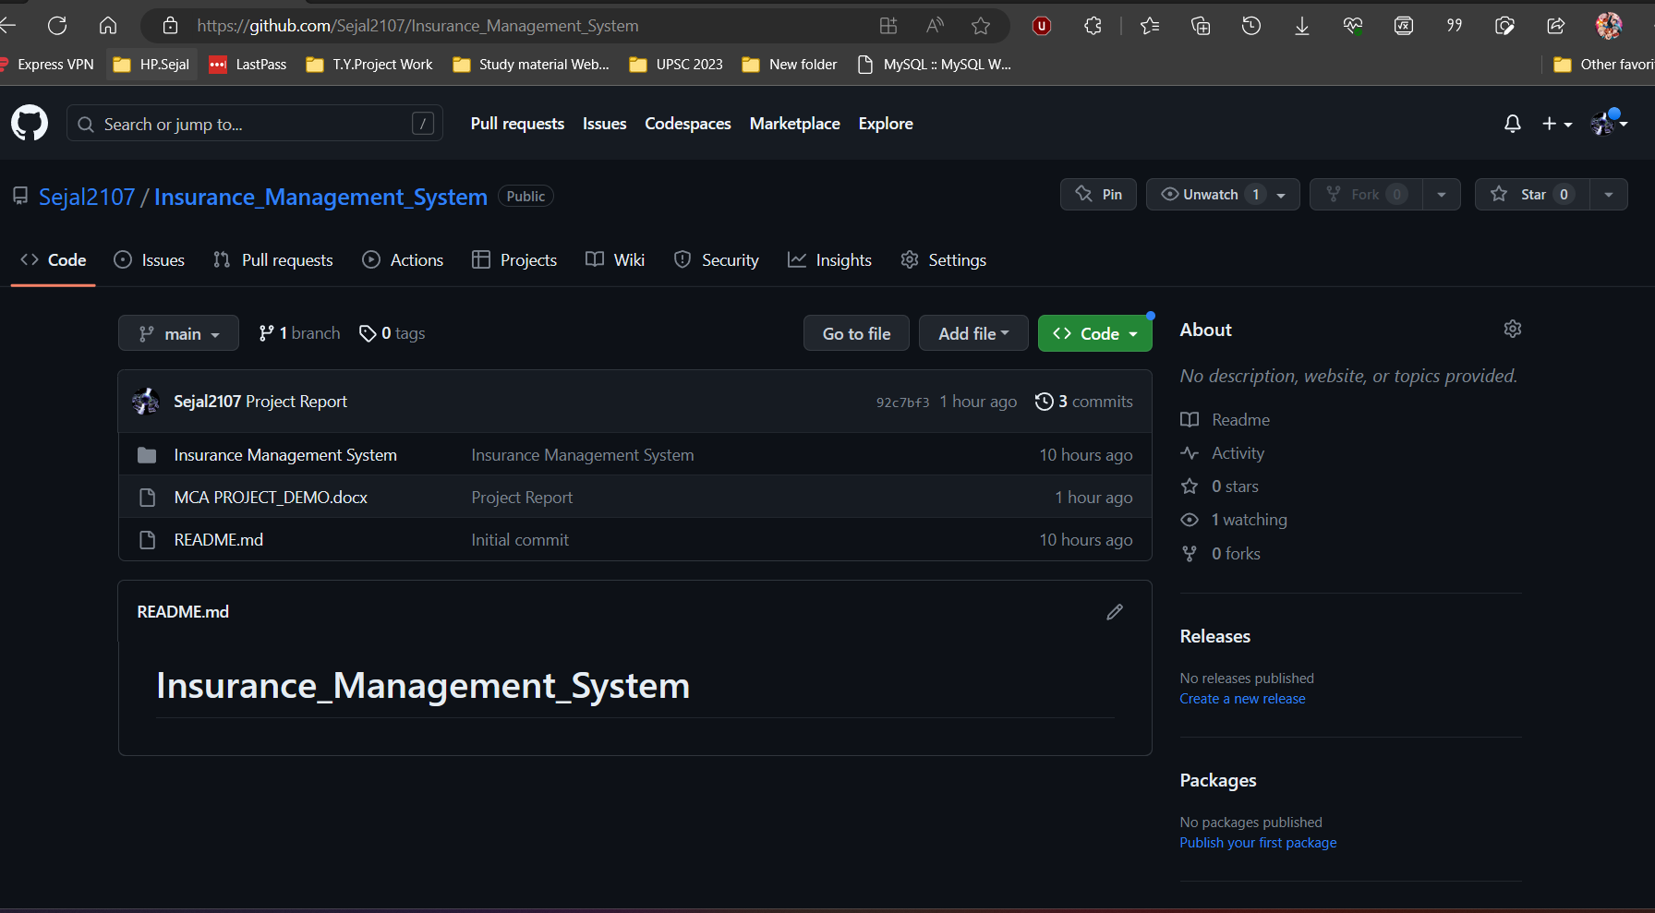
PROJECT ON GITHUB

Slide 13
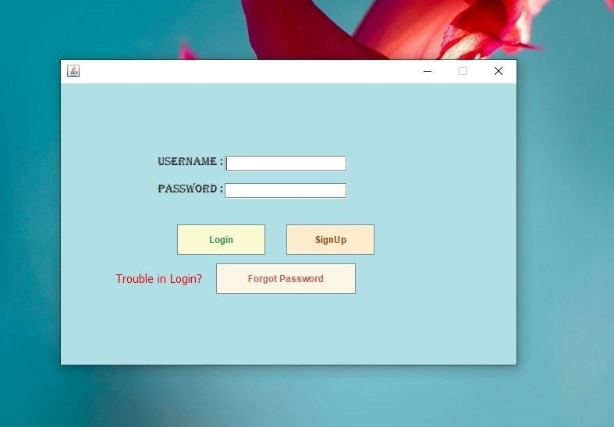
LOGIN PAGE

Slide 14
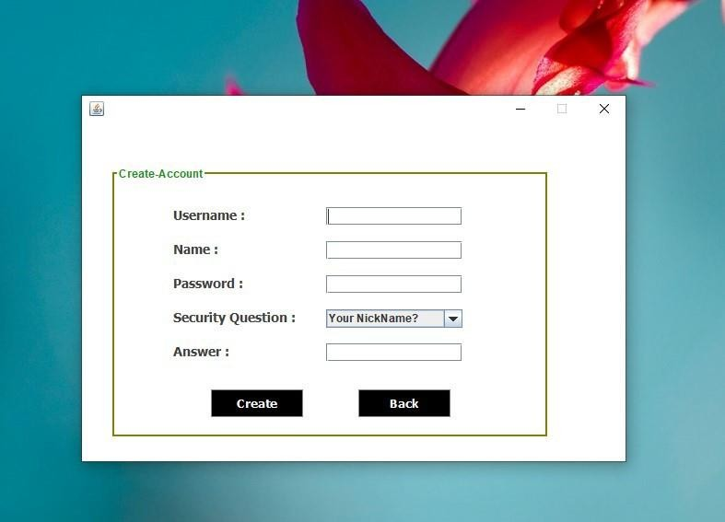
SIGN-UP PAGE

Slide 15
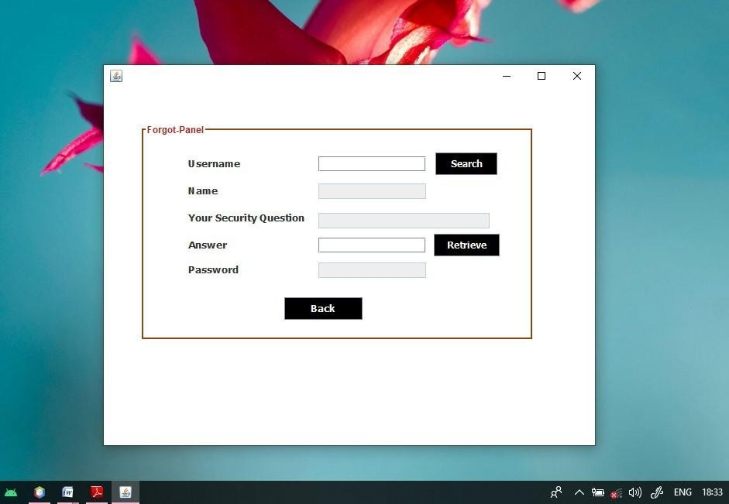
FORGOT PASSWORD PAGE

Slide 16
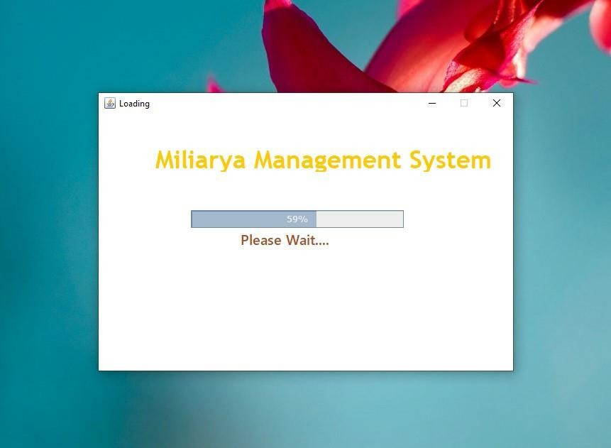
LOADING PAGE

Slide 17
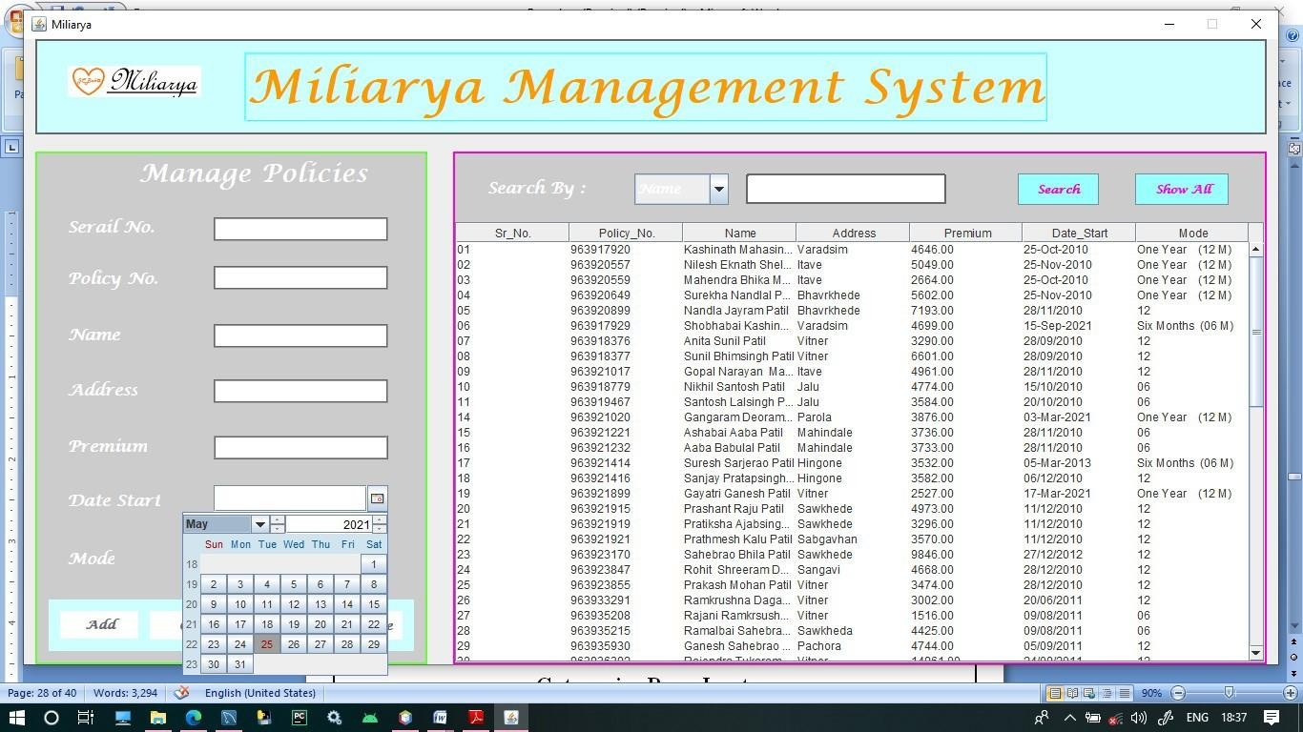
MAIN SYSTEM PAGE

Slide 18
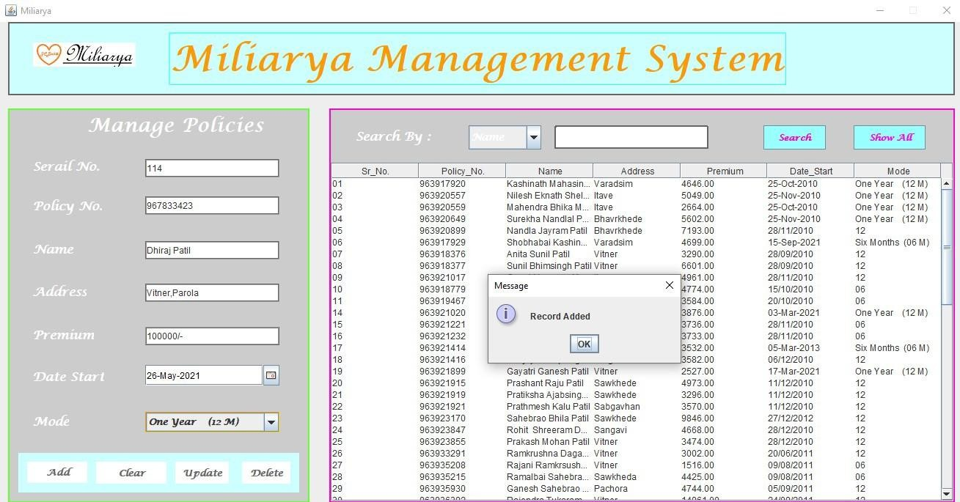
ADD Policies_holder

Slide 19
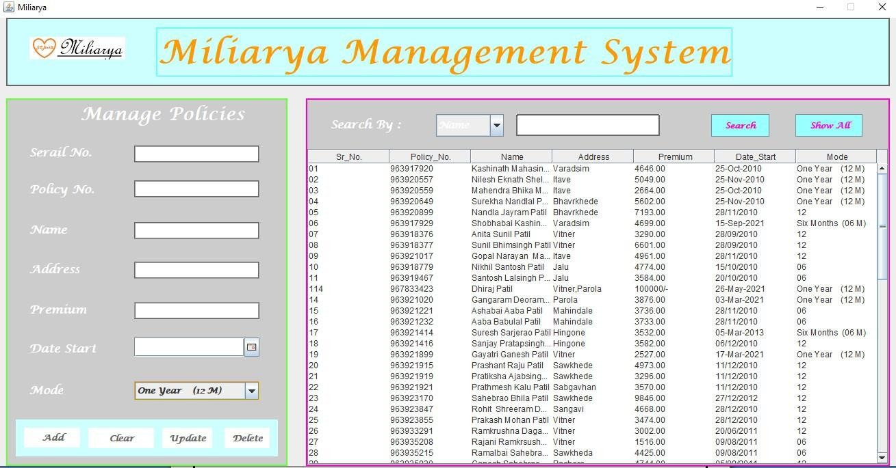
CLEAR DATA FROM TEXTFIELD

Slide 20
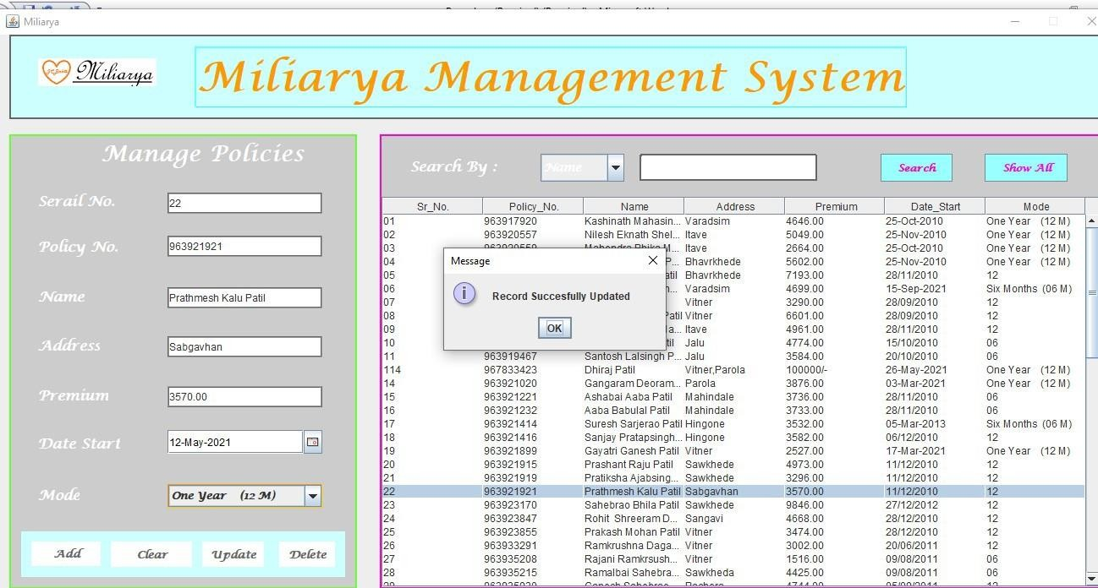
UPDATE DATA - PAGE

Slide 21
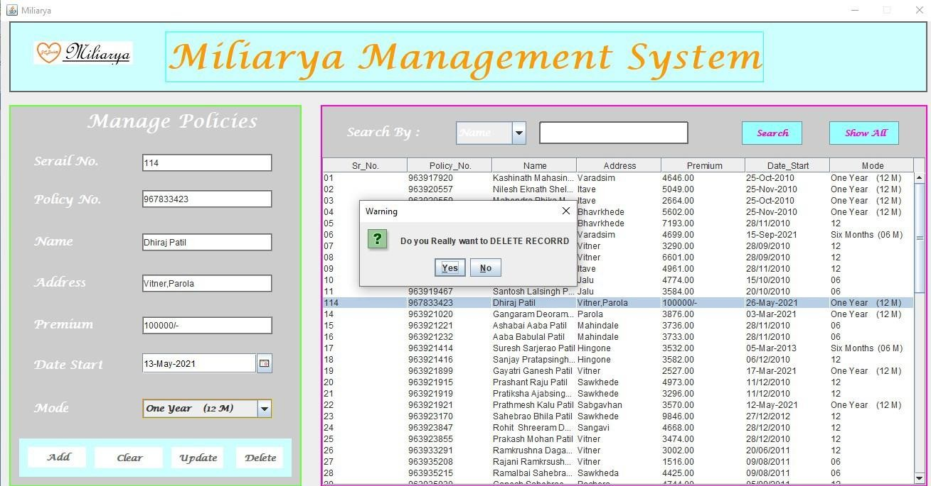
DELETE Policy_holder

Slide 22
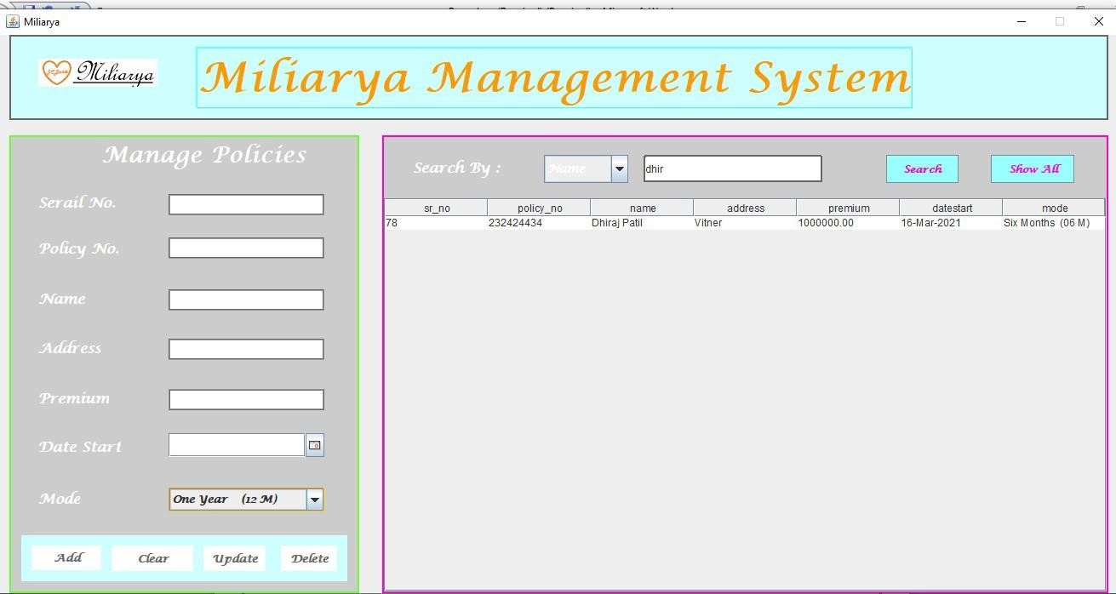
SEARCH Policy_holder

Slide 23
CONCLUSION
A computerized insurance management system has been developed and the system was tested with sample data.
The system is-
User Friendly- The system is totally user-friendly & easy to operate & understand.
Duplicity- As data is completely normalized so that no duplicate entries exist
Menu driven- This system is totally menu driven for the best result.

Slide 24
FUTURE SCOPE
The Insurance Management System project has been successfully implemented, providing an efficient platform for managing insurance policies, claims, and customer information.
Integration of AI and ML technologies for automation, fraud detection, and personalized customer experiences.
Expansion of insurance products and services to cater to diverse customer needs and market demands.
Development of a mobile application for improved accessibility

Slide 25

REFERENCES
Books:
Core Java Volume I- Fundamentals
Effective Java
Java: A Beginner’s Guide
Head First Java
Java: The Complete Reference
TDD for JAVA
Websites:
www.tutorialspoint.com
www.w3schools.com
www.dotnettricks.com
www.tutorialsteacher.com
aspnettutorials.com

Slide 26
Thank You
Sejal2107/Insurance_Management_System (github.com)

