Slide 1

Invest Saga -Your Gamified Guide to Financial Literacy
Team 5

Slide 2


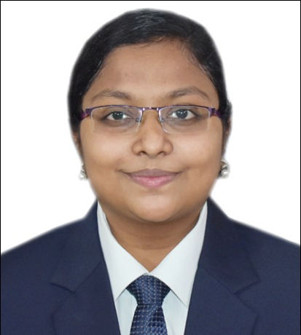


Meet the Team
Jyothi Surekha
Mitali Rajesh Chavan
Sejal Aggarwal
Veda Sai Priya Inukurthi

Slide 3
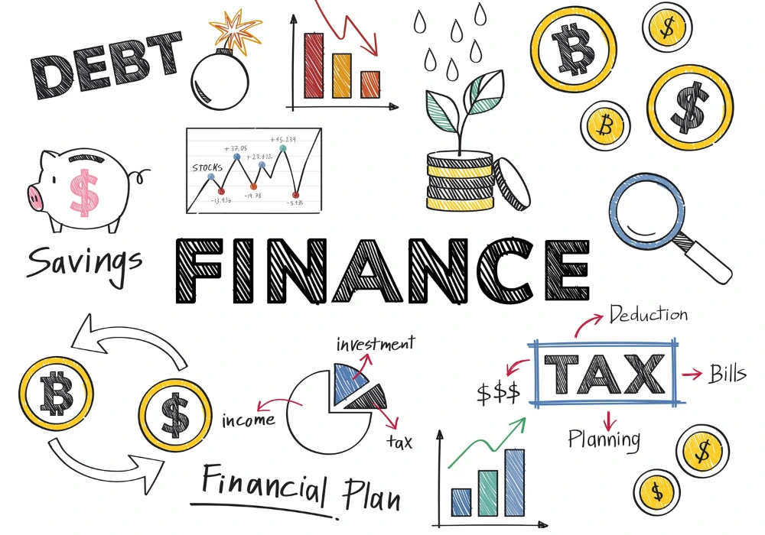
The Rise of the Financially Savvy and the Challenges of Investing Education
The financial landscape is shifting. More and more individuals, regardless of age or background, are taking an active interest in managing their personal finances.
However, traditional methods of learning are overly complex, passive and unengaging.
Need for Invest Saga
Therefore, it is of utmost importance to find new and better ways to understand and learn this subject. Methods that are simple, active and continuously engaging the audience.
One such method is that of an interactive and engaging Game.

Slide 4

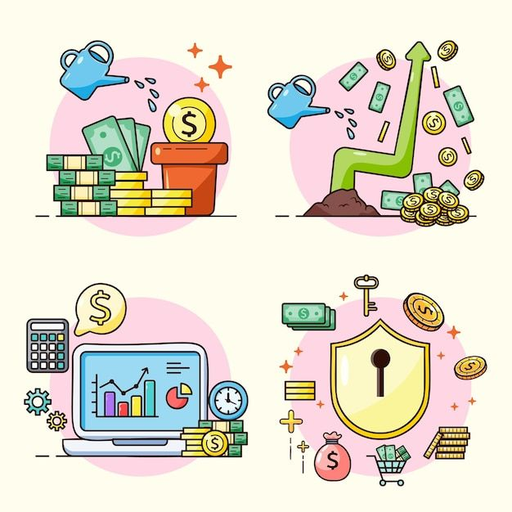

Invest Saga: Gamifying the Path to Investment Knowledge
Invest Saga steps in to bridge this gap by offering a gamified learning experience for aspiring investors.
Through engaging games and interactive content, InvestSaga transforms the often-intimidating world of finance into a fun and accessible playground.

Slide 5

Aims
Demystify Financial Concepts
Empower Individuals to make Informed Financial Decisions
Boost Engagement and Knowledge Retention

Slide 6

Our Tech Stack

Slide 7

React.js
Front - End
React empowers us to create a user interface that is both interactive and dynamic. This ensures a smooth and engaging experience for users as they navigate Invest Saga's learning modules and games.

Slide 8
Node.js & Express.js Framework
Node.js provides a fast and scalable environment, while Express.js simplifies the process of building APIs that connect the frontend and backend seamlessly.
Back - End

Slide 9
MongoDB
Invest Saga stores a variety of data. MongoDB's flexible schema allows us to store a variety of data like, including user information, learning progress, and game data.
Database

Slide 10
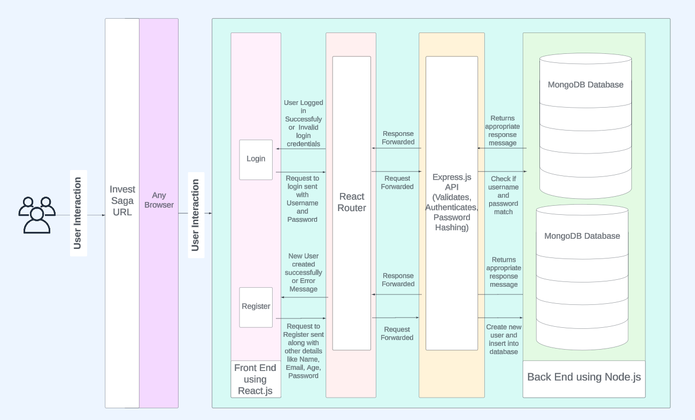
System Architecture

Slide 11

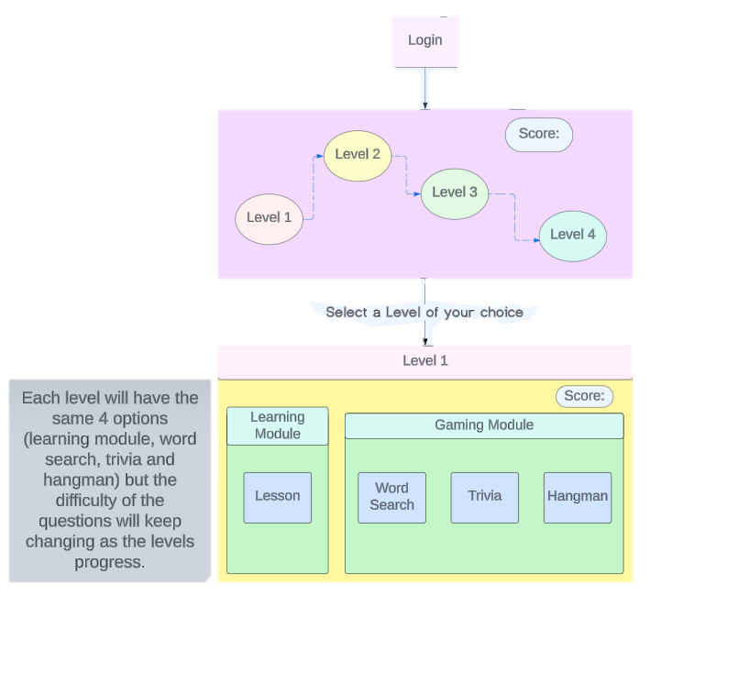
Flow Diagram

