Slide 1
PROBLEM STATEMENT
DASHBOARD 1: SUMMARY
Key Performance Indicators (KPIs) Requirements:
Total Loan Applications: We need to calculate the total number of loan applications received during a specified period.
Additionally, it is essential to monitor the Month-to-Date (MTD) Loan Applications and track changes Month-over-Month (MoM).
Total Funded Amount: Understanding the total amount of funds disbursed as loans is crucial. We also want to keep an
eye on the MTD Total Funded Amount and analyze the Month-over-Month (MoM) changes in this metric.
Total Amount Received: Tracking the total amount received from borrowers is essential for assessing the bank's cash
flow and loan repayment. We should analyze the Month-to-Date (MTD) Total Amount Received and observe the
Month-over-Month (MoM) changes.
Average Interest Rate: Calculating the average interest rate across all loans, MTD, and monitoring the
Month-over-Month (MoM) variations in interest rates will provide insights into our lending portfolio's overall cost.
Average Debt-to-Income Ratio (DTI): Evaluating the average DTI for our borrowers helps us gauge their financial health.
We need to compute the average DTI for all loans, MTD, and track Month-over-Month (MoM) fluctuations.

Slide 2
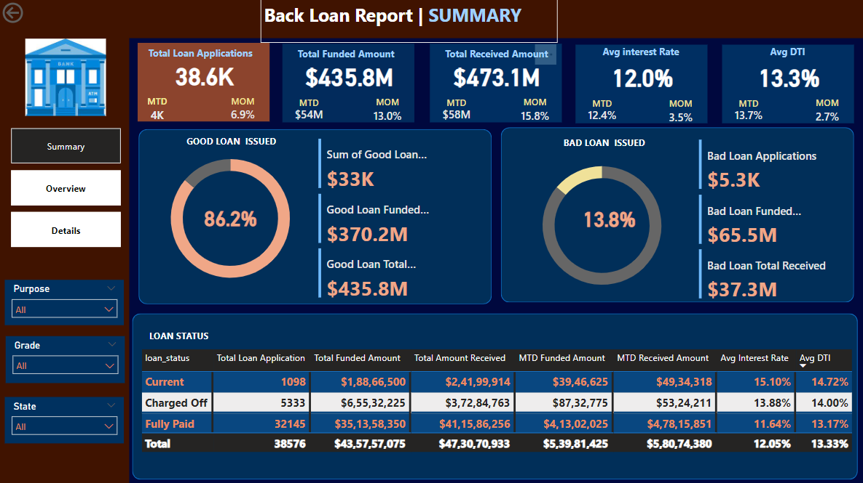

Slide 3
PROBLEM STATEMENT
DASHBOARD 2: OVERVIEW
CHARTS:
Monthly Trends by Issue Date (Line Chart):
To identify seasonality and long-term trends in lending activities
Regional Analysis by State (Filled Map):
To identify regions with significant lending activity and assess regional disparities
Loan Term Analysis (Donut Chart): To allow the client to understand the distribution of loans across various term lengths.
Employee Length Analysis (Bar Chart):
How lending metrics are distributed among borrowers with different employment lengths, helping us assess the impact of employment history on loan applications.
Loan Purpose Breakdown (Bar Chart): Will provide a visual breakdown of loan metrics based on the stated purposes of loans, aiding in the understanding of the primary reasons borrowers seek financing.
Home Ownership Analysis (Tree Map): For a hierarchical view of how home ownership impacts loan applications and disbursements.

Slide 4
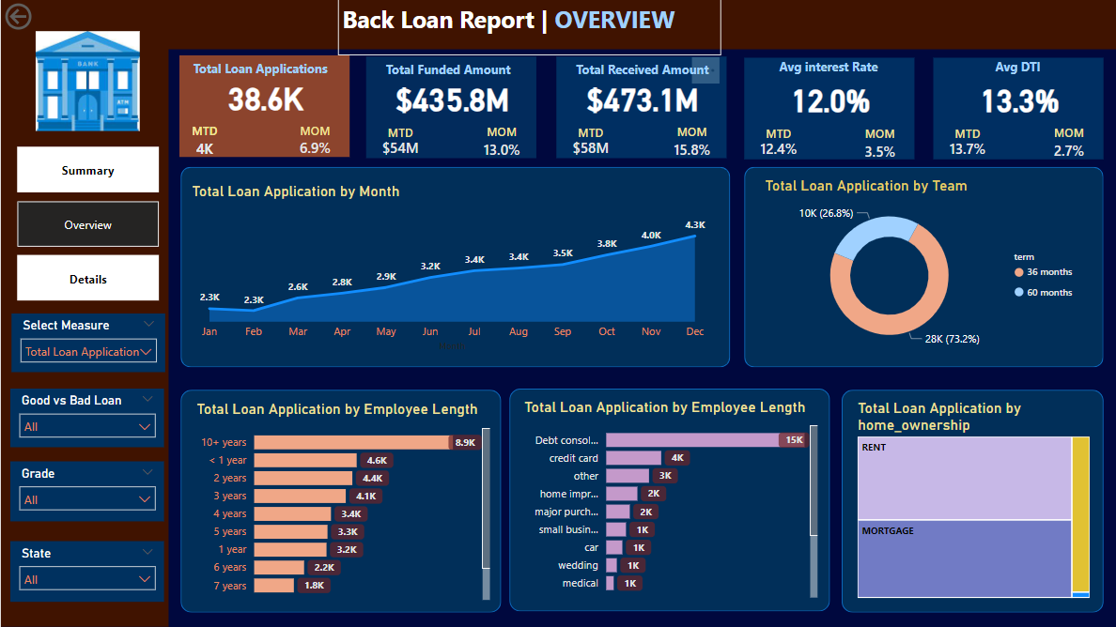

Slide 5
PROBLEM STATEMENT
DASHBOARD 3: DETAILS
GRID
Need for a comprehensive 'Details Dashboard' that provides a consolidated view of all the essential information within our loan data. This Details Dashboard aims to offer a holistic snapshot of key loan-related metrics and data points, enabling users to access critical information efficiently.
Objective:
The primary objective of the Details Dashboard is to provide a comprehensive and user-friendly interface for accessing vital loan data. It will serve as a one-stop solution for users seeking detailed insights into our loan portfolio, borrower profiles, and loan performance.

Slide 6
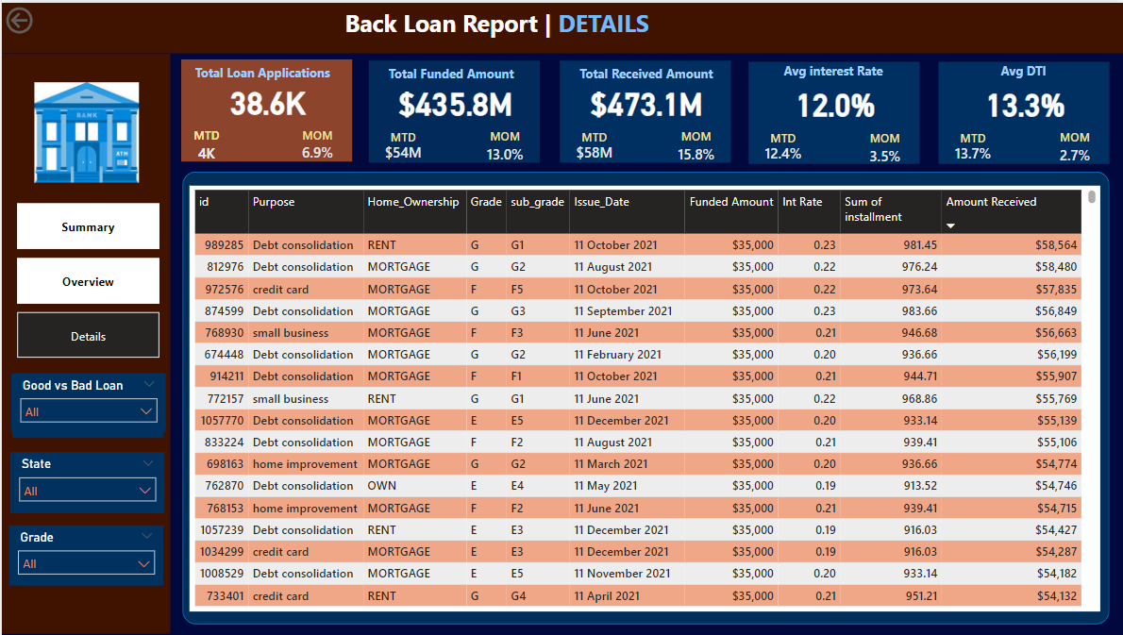

Slide 7
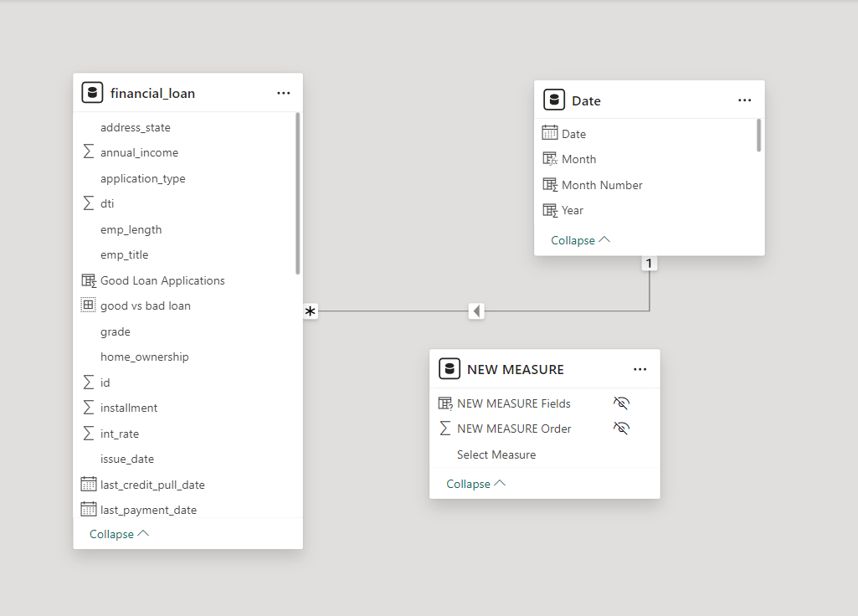
Data Modeling

