Slide 1
PROBLEM STATEMENT
KPI's REQUIREMENT
We need to analyze key indicators for our pizza sales data to gain insights into our business performance. Specifically, we want to calculate the following metrics:
1. Total Revenue: The sum of the total price of all pizza orders.
2. Average Order Value: The average amount spent per order, calculated by dividing the total revenue by the total number of orders.
3. Total Pizzas Sold: The sum of the quantities of all pizzas sold.
4. Total Orders: The total number of orders placed.
5. Average Pizzas Per Order: The average number of pizzas sold per order, calculated by dividing the total number of pizzas sold by the total
number of orders.

Slide 2
PROBLEM STATEMENT
CHARTS REQUIREMENT
We would like to visualize various aspects of our pizza sales data to gain insights and understand key trends. We have identified the following requirements for creating charts:
1.Daily Trend for Total Orders:
Create a bar chart that displays the daily trend of total orders over a specific time period. This chart will help us identify any patterns or fluctuations in order volumes on a daily basis.
2.Hourly Trend for Total Orders:
Create a line chart that illustrates the hourly trend of total orders throughout the day. This chart will allow us to identify peak hours or periods of high order activity.
3.Percentage of Sales by Pizza Category:
Create a pie chart that shows the distribution of sales across different pizza categories. This chart will provide insights into the popularity of various pizza categories and their contribution to overall sales.

Slide 3
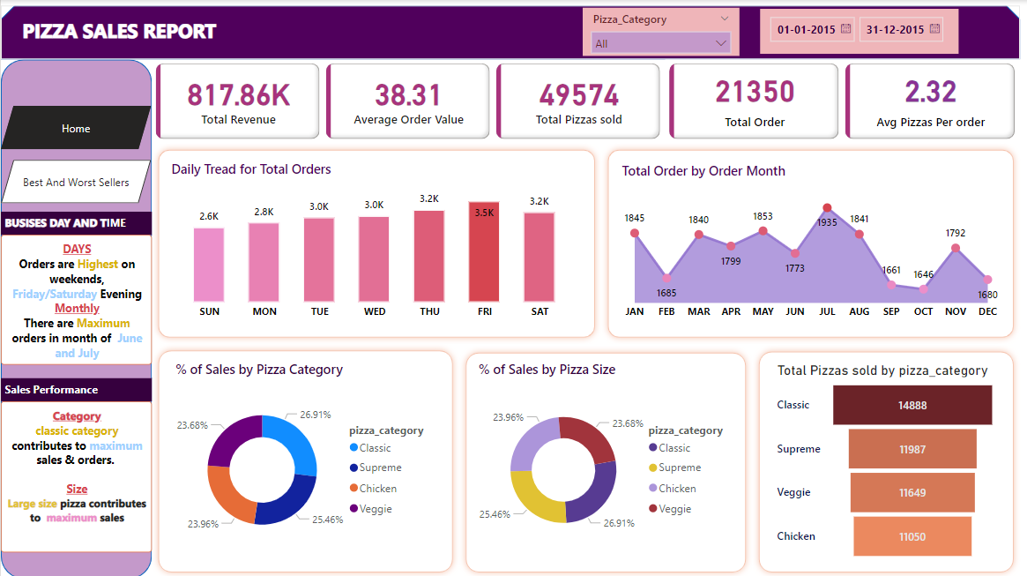

Slide 4
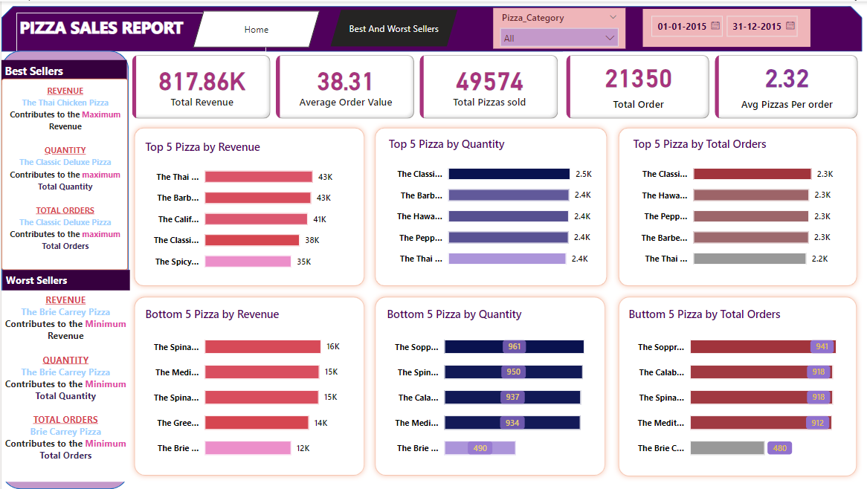

Slide 5



Sales SQL queries
A. KPI’s
1. Total Revenue:
SELECT SUM(total_price) AS Total_Revenue FROM pizza_sales;
2. Average Order Value:
SELECT (SUM(total_price) / COUNT(DISTINCT order_id)) AS Avg_order_Value FROM pizza_sales
3. Total Pizzas Sold:
SELECT SUM(quantity) AS Total_pizza_sold FROM pizza_sales

Slide 6


4. Total Orders:​
SELECT COUNT(DISTINCT order_id) AS Total_Orders FROM pizza_sales ​
​
5. Average Pizzas Per Order:
SELECT CAST(CAST(SUM(quantity) AS DECIMAL(10,2)) / CAST(COUNT(DISTINCT order_id) AS DECIMAL(10,2)) AS DECIMAL(10,2)) AS Avg_Pizzas_per_order FROM pizza_sales​

Slide 7
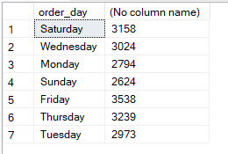
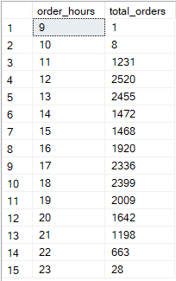
B. Daily Trend for Total Orders :
SELECT DATENAME(DW, order_date) AS order_day, COUNT(DISTINCT order_id) AS total_orders FROM pizza_sales GROUP BY DATENAME(DW, order_date)
C. Hourly Trend for Orders: In order to get data hour basis make use of DATEPART command
SELECT DATEPART(HOUR, order_time) as order_hours, COUNT(DISTINCT order_id) as total_orders from pizza_sales group by DATEPART(HOUR, order_time) order by DATEPART(HOUR, order_time)

Slide 8

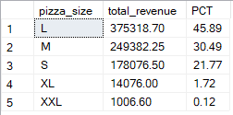
D. % of Sales by Pizza Category :
SELECT pizza_category, CAST(SUM(total_price) AS DECIMAL(10,2)) as total_revenue, CAST(SUM(total_price) * 100 / (SELECT SUM(total_price) from pizza_sales) AS DECIMAL(10,2)) AS PCT FROM pizza_sales GROUP BY pizza_category
E. % of Sales by Pizza Size:
SELECT pizza_size, CAST(SUM(total_price) AS DECIMAL(10,2)) as total_revenue, CAST(SUM(total_price) * 100 / (SELECT SUM(total_price) from pizza_sales) AS DECIMAL(10,2)) AS PCT FROM pizza_sales GROUP BY pizza_size ORDER BY pizza_size

Slide 9

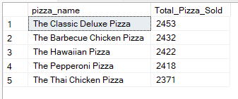
F. Total Pizzas Sold by Pizza Category:
SELECT pizza_category, SUM(quantity) as Total_Quantity_Sold FROM pizza_sales WHERE MONTH(order_date) = 2 GROUP BY pizza_category ORDER BY Total_Quantity_Sold DESC
G. Top 5 Best Sellers by Total Pizzas Sold:
SELECT Top 5 pizza_name, SUM(quantity) AS Total_Pizza_Sold FROM pizza_sales GROUP BY pizza_name ORDER BY Total_Pizza_Sold DESC

Slide 10
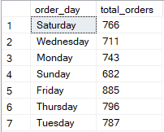
K. Get data based of quarter:
SELECT DATENAME(DW, order_date) AS order_day, COUNT(DISTINCT order_id) AS total_orders FROM pizza_sales WHERE DATEPART(QUARTER, order_date) = 1 GROUP BY DATENAME(DW, order_date)
*Here DATEPART(QUARTER, order_date) = 1 indicates that the output is for the Quarter 1. MONTH(order_date) = 3 indicates output for Quarter 3.
L. % of sales by pizza category monthly basis:
Select pizza_category, sum(total_price) as tota_price , sum(total_price) * 100/ ( select sum(total_price) from pizza_sales where month(order_date)= 1 )as percentage from pizza_sales where month(order_date) = 1 group by pizza_category

Slide 11

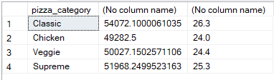
M. % of Sales by Pizza Category QUARTER BASES:​
​
Select pizza_category, sum(total_price),
CAST(sum(total_price) * 100 /( select sum(total_price) from pizza_sales where DATEPART(QUARTER, order_date) = 1) AS decimal (10,1))
from pizza_sales
where DATEPART(QUARTER, order_date) = 1
group by pizza_category

Slide 12
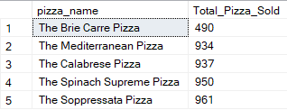
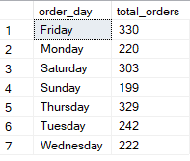
H. Bottom 5 Best Sellers by Total Pizzas Sold :
SELECT TOP 5 pizza_name, SUM(quantity) AS Total_Pizza_Sold FROM pizza_sales GROUP BY pizza_name ORDER BY Total_Pizza_Sold ASC
J. Get the data monthly bases according to week days :
SELECT DATENAME(DW, order_date) AS order_day, COUNT(DISTINCT order_id) AS total_orders FROM pizza_sales WHERE MONTH(order_date) = 1 GROUP BY DATENAME(DW, order_date)

