Slide 1
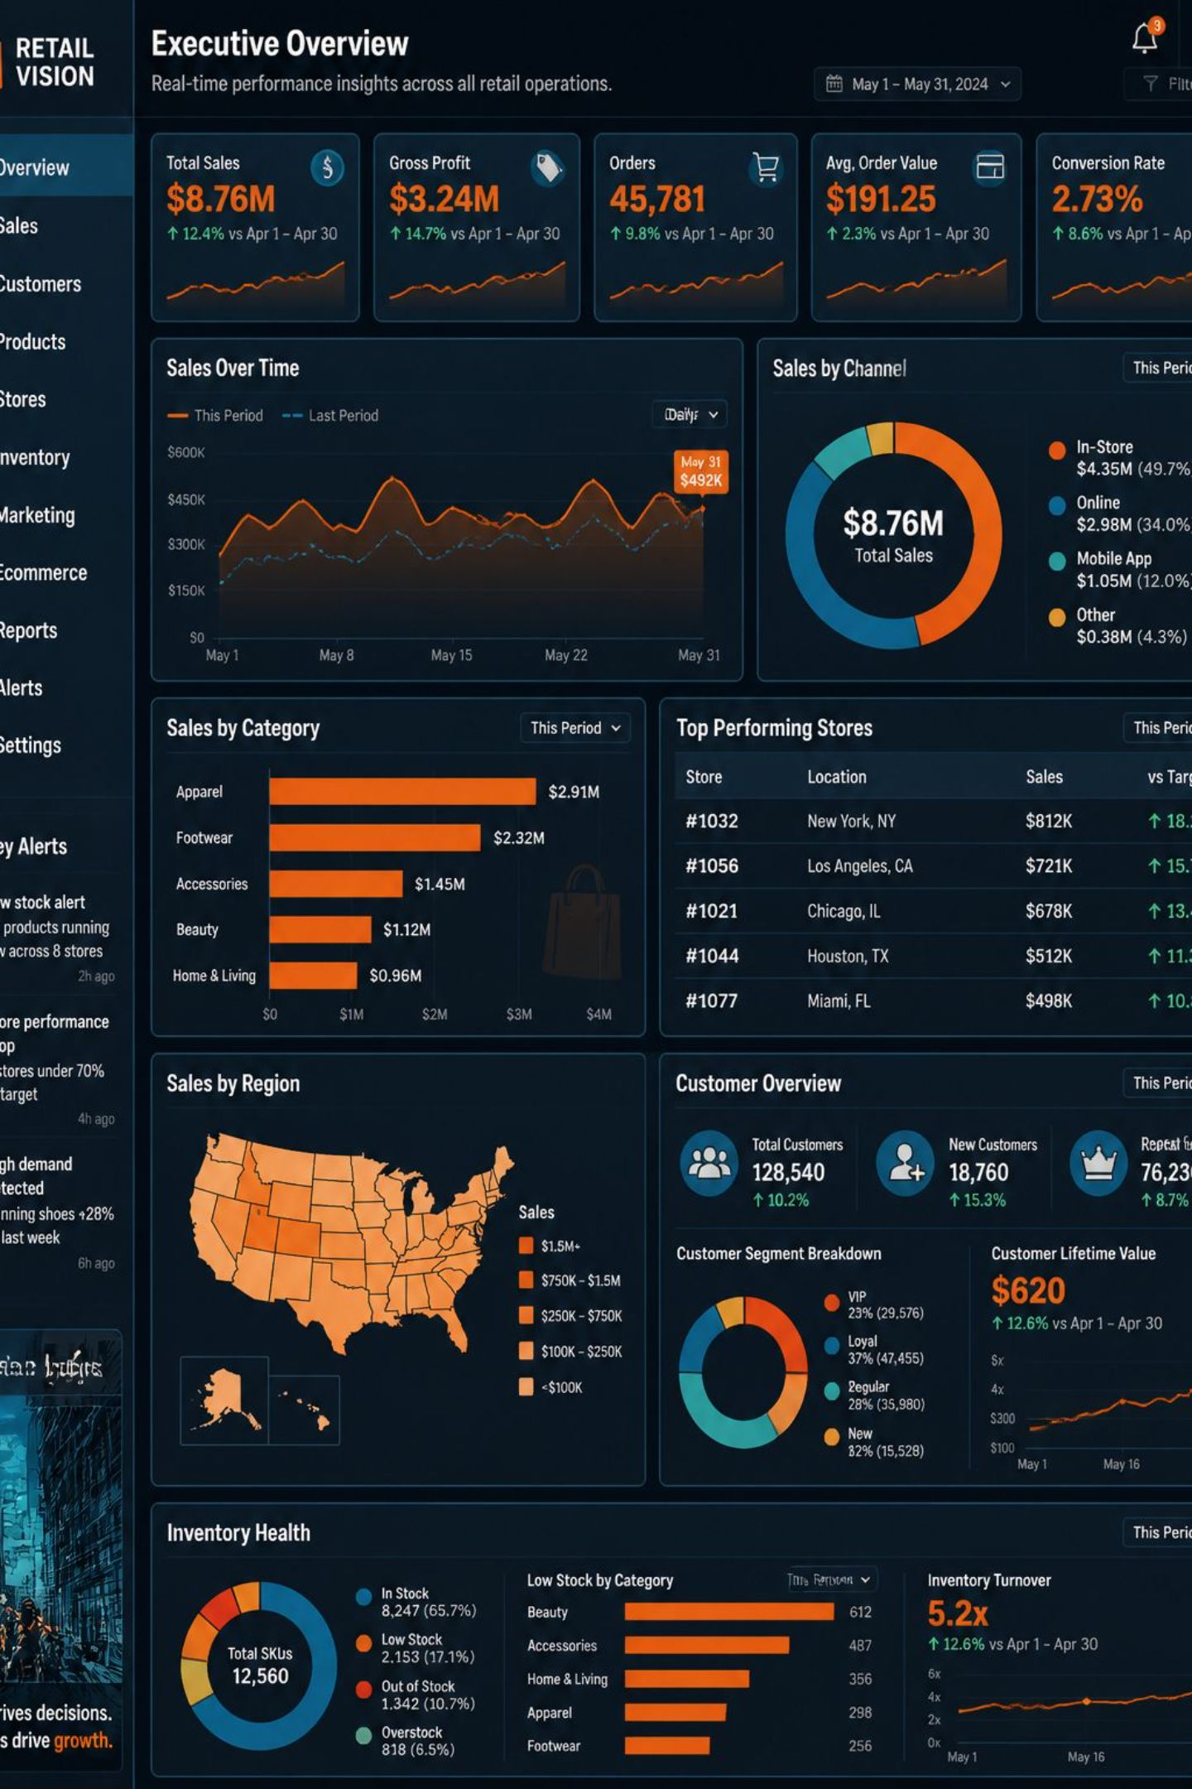
Customer Shopping Behavior Analysis
Python • SQL • Power BI — end-to-end analytics

Slide 2

Project Overview
Goal
Tech Stack
Transform raw transactions into business insights
Python, MySQL, Power BI
Audience
Executives, managers, marketing, analysts

Slide 3
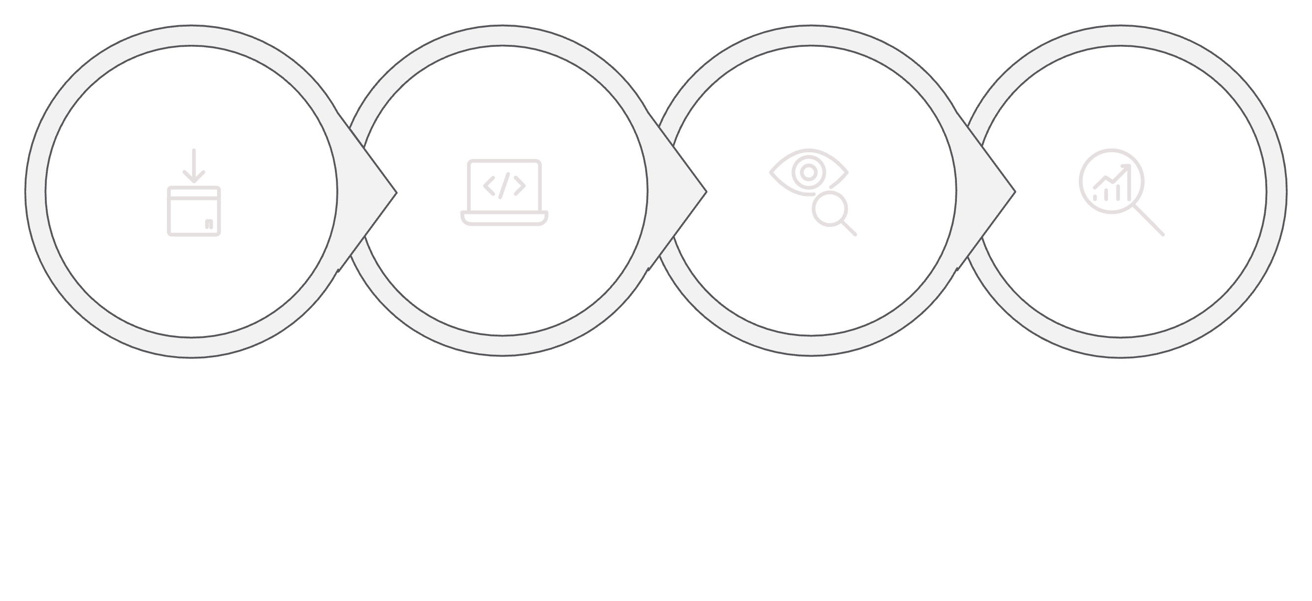
Workflow
Data Collection
Python Processing
SQL Analysis
Power BI
End-to-end: collect → clean & feature-engineer → SQL metrics → interactive dashboards

Slide 4




Data Processing (Python)
Cleaning
Missing values, duplicates removed
Feature Engineering
Customer segments, age groups, freq. metrics
Export
Clean dataset exported to MySQL

Slide 5
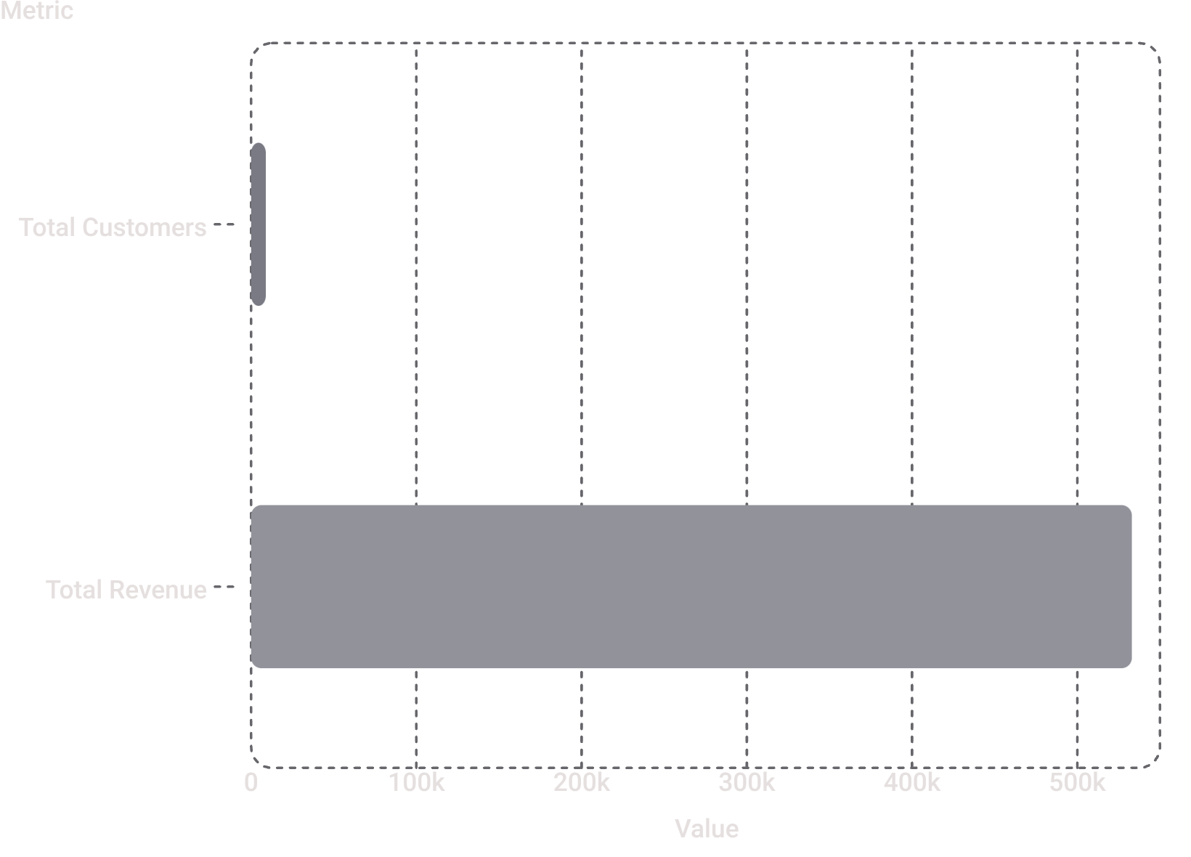

SQL Analysis — Key Metrics
SQL produced business-ready metrics used in Power BI: revenue breakdowns, loyalty, top products, shipping & discount analysis.
Metrics drive dashboard KPIs and filters

Slide 6
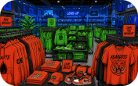

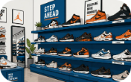
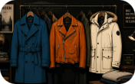
Executive Sales Overview — Highlights
Top Category
2nd Category
Footwear
Outerwear
Clothing — highest revenue (239K)
Accessories — 169K
81K
43K
Male customers: 67.61% of revenue • Young Adults top age segment

Slide 7



Customer Behavior & Loyalty
69%
26%
42%
Loyal customers
Subscribed
Discount adopters
Common frequencies: monthly, quarterly, annually. Focus on retention — repeat buyers drive revenue.

Slide 8

Product Performance, Findings & Recommendations
Top product: Blouse
Highest rated: Gloves
Standard shipping = best satisfaction
Total revenue ≈ $533K from 8.9K customers
Recommendations
Invest in Clothing & Accessories; target Young Adults; grow subscriptions; personalize retention offers; optimize Fall inventory.

