Slide 1
Mutual Fund Analytics
Capstone Project | Bluestock Fintech

Slide 2
Project Objectives
EDA, Performance Analytics, Risk Analytics, Power BI Dashboard

Slide 3
Data Sources
NAV, AUM, SIP, Portfolio Holdings, Investor Transactions

Slide 4
System Architecture
CSV → Python → SQLite → Power BI

Slide 5
EDA Insights
Growth trends, AUM leaders, SIP patterns

Slide 6
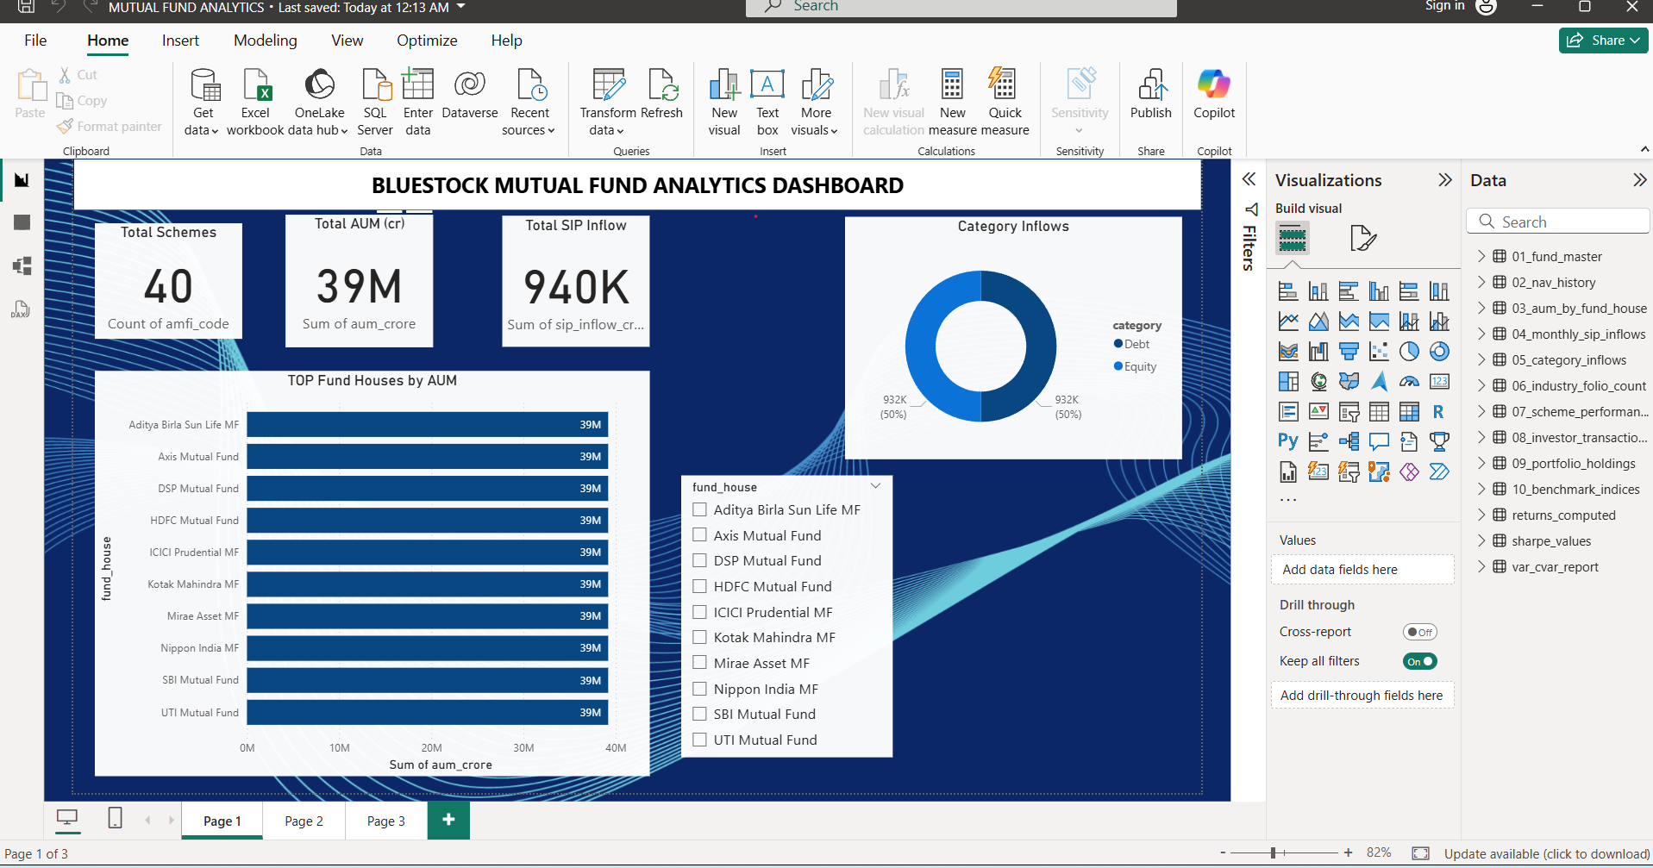
Industry Overview Dashboard

Slide 7
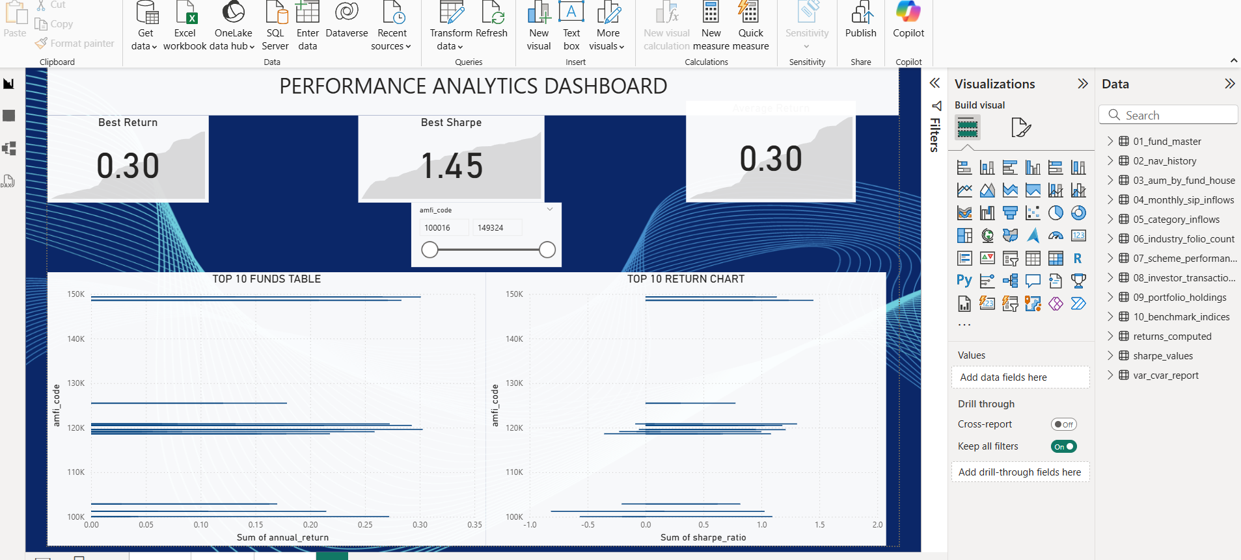
Performance Analytics

Slide 8
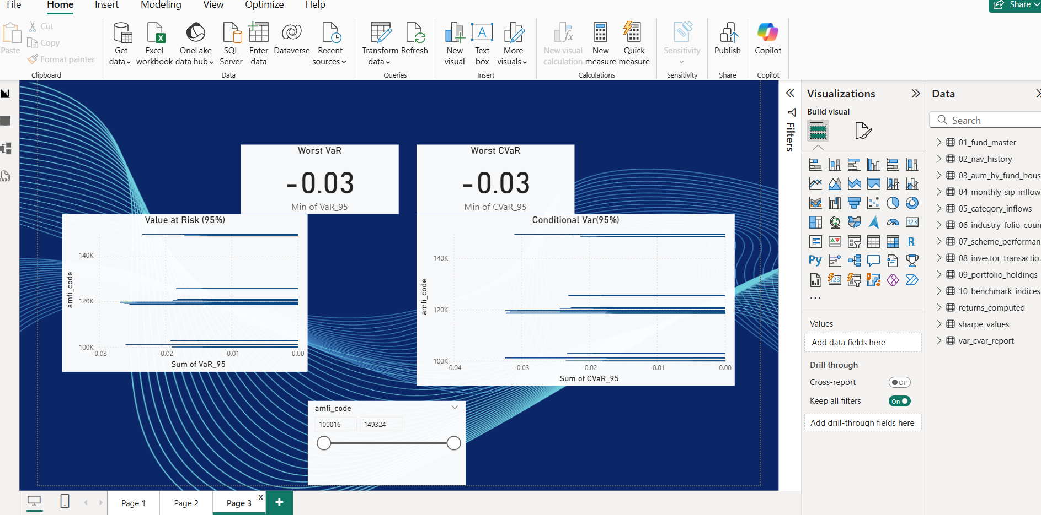
Risk Analytics

Slide 9
Fund Recommendation Engine

Slide 10
Key Business Insights

Slide 11
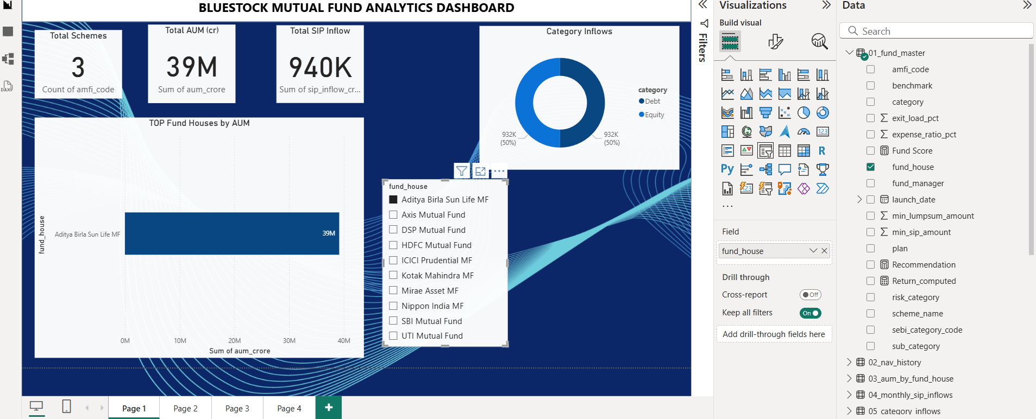
Challenges & Limitations

Slide 12
Conclusion

