Slide 1



Pre-stimulus time dimension reduction by using t-SNE to predict conscious awareness about correct or incorrect response
Sejik Park
Departments of Computer Science and Engineering
Interdisciplinary Major in Brain and Cognitive Sciences
Korea University College of Informatics

Slide 2

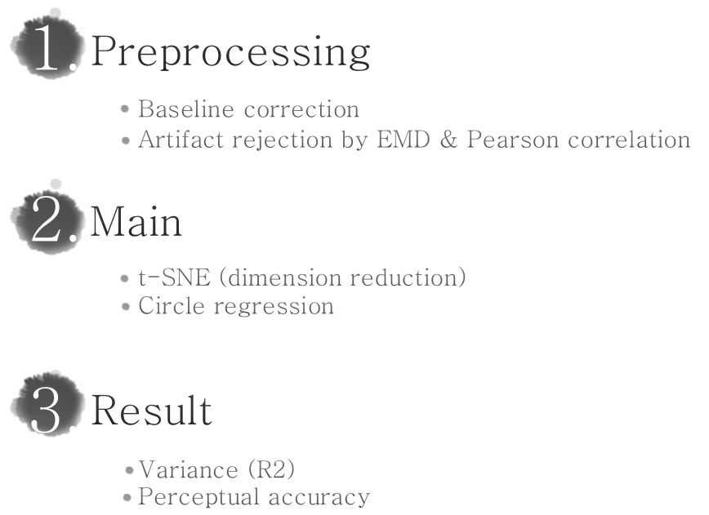

Slide 3
Preprocessing
Baseline Correction
Epoch data with given code (onset-500 to onset)
Baseline correction were performed using the 500-0 ms pre-stimulus interval
Further research
Check all channels for finding bad channel to interpolation
Artifact rejection (limit maximum amplitude & maximal gradient voltage step): remove epoch
Offline filter (e.g. 0.5-30 Hz) & ICA noise reduction (Kawakatsu 2003)
Individual averaged data analysis & Grand averaged data analysis
Frequency analysis (e.g. wavelet → Beta) (Pfurtscheller, Woertz et al. 2002)
Change time range or short range repeat analysis
Also, parallel coding with MATLAB would be better to overcome very slow computation speed

Slide 4
Preprocessing
Artifact rejection by Empirical Mode Decomposition (EMD) & Pearson correlation
Strong artifact rejection tool to remove blinking and small movement (Rosas-Cholula, Ramirez-Cortes et al. 2013)
Further research
Change EMD parameter (resolution, residual energy)
Change correlation p-value
Check EMD artifact rejection removing noise not real signal by somatosensory meg simulation data
Compare artifact rejection tool like ICA, PCA would be helpful

Slide 5
Main
t-Distributed Stochastic Neighbor Embedding (t-SNE; dimension reduction)
Dimension reduction is one way to control the complexity of electroencephalogram (Li and Lu 2009)
t-SNE is good to visualize difference among subject groups
Further research
Change t-SNE parameter (dimensionality reduction number, perplexity)
Using different input (frequency information, connectivity information by grand causality)
Check EMD artifact rejection removing noise not real signal by somatosensory meg simulation data
t-SNE with deep recurrent neural network for analysis
Lack of time-series dimension reduction knowledge

Slide 6
Main & Result
Main: Circle regression (non-linear regression)
Dimension reduction data plot looks like circular
Further research
Relation between channels to get encoded information
Result: Variance (R2)
Wrong value (because of non-linear regression): all values are over 0.90
Further research
Find way to use linear regression (way to find simple dimension reduction data)
Circle regression is not for R square value

Slide 7
Result
Perceptual accuracy
hits + correction rejection vs. false alarms + misses
Accuracy over 198 epochs: 0.6021 (Channel: 313)
t-SNE is good to visualize difference among subject groups
Result file: SejikPark_BIOMAG2016.mat
Further research
Find meaning of the 313 channel location
Test more data (epochs & subjects) with training & test analysis (e.g. 80% data for training analysis to get parameter and 20% data for test analysis to know the accuracy of method)
Find accuracy has meaning (coincidence or real meaningful result)
Limitation: analysis of only 198 epochs of first subjects because of limit of time and computational power

Slide 8



E-mail: sejik4072@korea.ac.kr
Thank you

Slide 9
Reference
Kawakatsu, M. (2003). Application of ICA to MEG noise reduction. Fourth international symposium on independent component analysis and blind signal separation (ICA2003), Nara, Japan.
Li, M. and B.-L. Lu (2009). Emotion classification based on gamma-band EEG. 2009 Annual International Conference of the IEEE Engineering in Medicine and Biology Society, IEEE.
Pfurtscheller, G., et al. (2002). "Contrasting behavior of beta event-related synchronization and somatosensory evoked potential after median nerve stimulation during finger manipulation in man." Neuroscience letters 323(2): 113-116.
Rosas-Cholula, G., et al. (2013). Head movement artifact removal in EEG signals using Empirical Mode Decomposition and Pearson Correlation. Proceedings on the International Conference on Artificial Intelligence (ICAI), The Steering Committee of The World Congress in Computer Science, Computer Engineering and Applied Computing (WorldComp).
Code (open source) reference:
(EMD) Rato, R. T., Ortigueira, M. D., & Batista, A. G. (2008). On the HHT, its problems, and some solutions. Mechanical Systems and Signal Processing, 22(6), 1374-1394.
(t-SNE) Van Der Maaten, L. (2010). Fast Optimization for t-SNE. In In Neural Information Processing Systems (NIPS) 2010 Workshop on Challenges in Data Visualization (Vol. 100).

