Slide 1
Flow Network Maximum Flow - Circulation
Y.Wang, S.Banik and B.Tran
Electrical and Computer Engineering
Oct 1, 2019

Slide 2

Content
Breadth First Search
Maximum flow – Circulation
Shortest path
Implementation
Analysis
Ford-Fulkerson method
Edmonds-Karp Algorithm
Analysis
Quality Assurance - Test
Test suit generation
Statistical analysis
Maximum flow – Circulation
Proof of correctness

Slide 3

Breadth First Search
Shortest path

Slide 4
Introduction
What is a graph?
A graph can be directed and undirected. It has vertex and edge.
How to represent a graph?
It can be represented by an adjacency list and an adjacency matrix
Which one is better for representation of a graph
A better choice for a sparse graph is adjacency list, and a dense graph is adjacency matrix.

Slide 5
Introduction
What is an vertex?
The special vertex are source and sink, in the search work, this two nodes can be chosen by ourselves.
What is an edge?
In a directed graph, the edge (u , v) is represent the flow from vertex u to vertex v, like u is parent, and v is u’s child.
What is an adjacency list representation?
For a vertex, adjacency list has all the vertices adjacent to this vertex.

Slide 6
Introduction
What is Breadth-first search:
A algorithm search the vertices by discovering all vertices at distance k from s begore discovering any vertices at distance k+1.
What is the shortest path?
Set a source and destination, the shortest path is the first discovering path from source to destination in Breadth-first search.

Slide 7
Organization
Read adjacent list text file
Get information of the Vertex
vertex name
Vertex children
Edge capacity

Slide 8
Organization
The prepare work for finding shortest path
Set source and destination
Judge source and destination belong the vertex set, if not, print out there is no source vertex or destination vertex
Set all original vertex white
A place store the edge information relating the shortest path
Whole process defined a function, if it return 1, means find the destination.
Finding the shortest path
Get the source information
Put source in queue
Change source color from white to gray

Slide 9
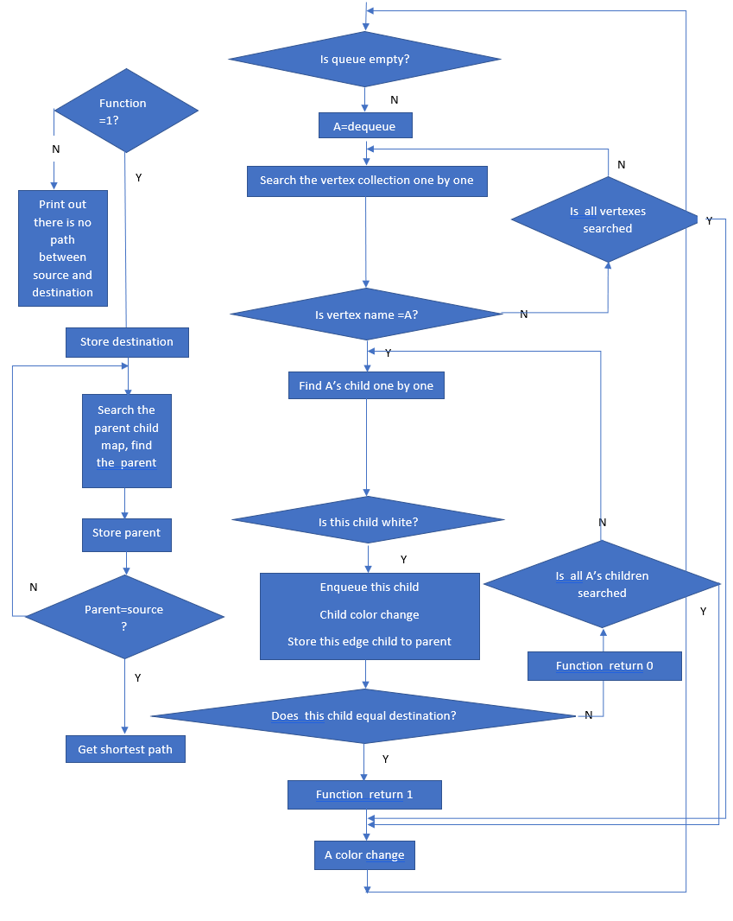
Organization

Slide 10
Example
Queue:
1
3
Vertex_number:6
Edge:6
0
5
Original color set: all white
2
4

Slide 11
Queue:
0
1
3
Enqueue:0
Color change: 0 (white → gray);
0
5
0
2
4

Slide 12
Queue:
0
1
2
Dequeue:0
Find vertex name equals 0’s class,
then find 0’s children.
Find 1:
First judge 1’s color, if it is white, and judge whether 1 is destination, if not, enqueue 1
Color change: 1 white → gray;
Get parent map:1→0
Find 2:
2 is white, and judge whether 2 is destination, if not, enqueue2
Color change: 2 white → gray;
Get parent map:2→0
Color change: 0 gray → black;
1
3
1
0
5
0
2
2
4

Slide 13
Queue:
1
2
3
1
3
Dequeue:1
Find vertex name equals 1’s class,
then find 0’s children.
Find 3:
First judge 3’s color, if it is white, and judge whether 3 is destination, if not, enqueue 3
Color change: 3 white → gray;
Get parent map:3→1
Color change:1 gray → black;
1
3
1
0
5
2
2
4

Slide 14
Queue:
2
3
4
Dequeue:2
Find vertex name equals 2’s class,
then find 2’s children.
Find 3:
First judge 3’s color, it is gray, then get out.
Find 4:
First judge 4’s color, it is white, and judge whether 4 is destination, if not, enqueue 4
Color change: 4 white → gray;
Get parent map:4→2
Color change:2 gray → black;
1
3
1
3
1
0
5
2
4
2
4
2

Slide 15
Queue:
3
4
5
Dequeue:3
Find vertex name equals 3’s class,
then find 3’s children.
Find 5:
First judge 5’s color, it is white, and 5 is destination
enqueue 5
Color change: 5 white → gray;
Get parent map:5→3
Color change:3 gray → black;
1
3
1
3
1
3
5
0
5
2
4
2
4
2

Slide 16
Queue:
4
5
1
3
Dequeue:4
Color change:4 gray → black;
Dequeue:5
Color change:5 gray → black;
1
3
1
3
5
5
0
5
2
4
2
4
2
4

Slide 17
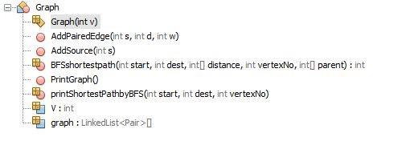
Implementation of Graph

Slide 18
Implementation for Shortest Path by Breadth First Search Algorithm
BFSshortestpath(start, dest, distance[], vertexNo, parent)
front = 0
q = ∅
for each vertex v in G(V, E)
distance[v]= 99999 parent[v]= -99999 HastheNodeBeenDiscovered[v]=White
q.add(start)
parent[start]= -99999
distance[start]=0
HastheNodeBeenDiscovered[start]=Gray
while q≠∅
front = q.poll()
for each neighbor j ∈ adjList(front)
if HastheNodeBeenDiscovered[j] == White
HastheNodeBeenDiscovered[j]=Gray distance[j]=distance[front]+1 parent[j]=front q.add(j) if(graph[j]==dest) return 1 HastheNodeBeenDiscovered[front]="Black" return 0

Slide 19
Implementation of Breadth Fast Search: Printing the Shortest Path
printShortestPathbyBFS(start, dest, vertexNo)
shortestPath= ∅
if BFSshortestpath(start,dest,distance,vertexNo,parent) == 1
d =dest;
shortestPath.add(d);
while parent[d]!=-99999
shortestPath.add(parent[d]);
d=parent[d];
for j=shortestPath.size()-1 down to 0 by -1
System.out.print(shortestPath.get(j))
else
There is no path among start and dest
return

Slide 20
Analysis of Breadth First Search Algorithm
BFSshortestpath(start, dest, distance[], vertexNo, parent)
front = 0
q = ∅
for each vertex v in G(V, E)
distance[v]= 99999 parent[v]= -99999 HastheNodeBeenDiscovered[v]=White
q.add(start)
parent[start]= -99999
distance[start]=0
HastheNodeBeenDiscovered[start]=Gray
while q≠∅
front = q.poll()
for each neighbor j ∈ adjList(front)
if HastheNodeBeenDiscovered[j] == White
HastheNodeBeenDiscovered[j]=Gray distance[j]=distance[front]+1 parent[j]=front q.add(j) if(graph[j]==dest) return 1 HastheNodeBeenDiscovered[front]="Black" return 0

Slide 21
Analysis of Breadth First Search Algorithm
BFSshortestpath(start, dest, distance[], vertexNo, parent)
front = 0
q = ∅
for each vertex v in G(V, E)
distance[v]= 99999 parent[v]= -99999 HastheNodeBeenDiscovered[v]=White
q.add(start)
parent[start]= -99999
distance[start]=0
HastheNodeBeenDiscovered[start]=Gray
while q≠∅
front = q.poll()
for each neighbor j ∈ adjList(front)
if HastheNodeBeenDiscovered[j] == White
HastheNodeBeenDiscovered[j]=Gray distance[j]=distance[front]+1 parent[j]=front q.add(j) if(graph[j]==dest) return 1 HastheNodeBeenDiscovered[front]="Black" return 0
O(V)

Slide 22
Analysis of Breadth First Search Algorithm
Will touch every vertex in Worst Case
BFSshortestpath(start, dest, distance[], vertexNo, parent)
front = 0
q = ∅
for each vertex v in G(V, E)
distance[v]= 99999 parent[v]= -99999 HastheNodeBeenDiscovered[v]=White
q.add(start)
parent[start]= -99999
distance[start]=0
HastheNodeBeenDiscovered[start]=Gray
O(V)
while q≠∅
front = q.poll()
for each neighbor j ∈ adjList(front)
if HastheNodeBeenDiscovered[j] == White
HastheNodeBeenDiscovered[j]=Gray distance[j]=distance[front]+1 parent[j]=front q.add(j) if(graph[j]==dest) return 1 HastheNodeBeenDiscovered[front]="Black" return 0
O(V)

Slide 23
Analysis of Breadth First Search Algorithm
Will touch every vertex in Worst Case
BFSshortestpath(start, dest, distance[], vertexNo, parent)
front = 0
q = ∅
for each vertex v in G(V, E)
distance[v]= 99999 parent[v]= -99999 HastheNodeBeenDiscovered[v]=White
q.add(start)
parent[start]= -99999
distance[start]=0
HastheNodeBeenDiscovered[start]=Gray
O(V)
while q≠∅
front = q.poll()
for each neighbor j ∈ adjList(front)
if HastheNodeBeenDiscovered[j] == White
HastheNodeBeenDiscovered[j]=Gray distance[j]=distance[front]+1 parent[j]=front q.add(j) if(graph[j]==dest) return 1 HastheNodeBeenDiscovered[front]="Black" return 0
Check For the children of front
O(E)
O(V)

Slide 24

Analysis of Breadth First Search Algorithm: Printing the Shortest Path
O(V+E)
printShortestPathbyBFS(start, dest, vertexNo)
shortestPath= ∅
if BFSshortestpath(start,dest,distance,vertexNo,parent) == 1
d =dest;
shortestPath.add(d);
while parent[d]!=-99999
shortestPath.add(parent[d]);
d=parent[d];
for j=shortestPath.size()-1 down to 0 by -1
System.out.print(shortestPath.get(j))
else
There is no path among start and dest
return
O(V-1)

Slide 25
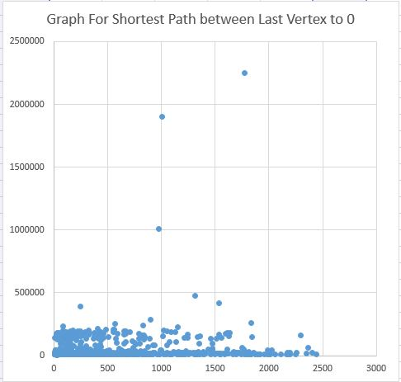
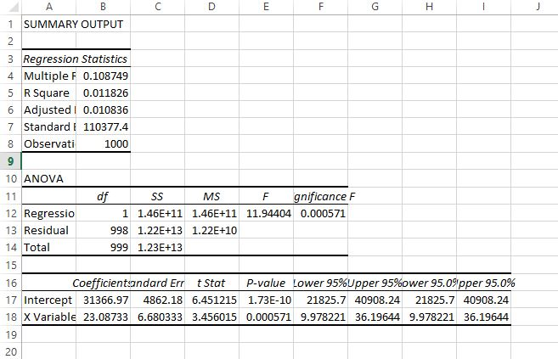
Statistical Analysis
Time vs V+E graph for Shortest path from Last vertex to 0
Regression Analysis of the Shortest Path from Last vertex to 0

Slide 26
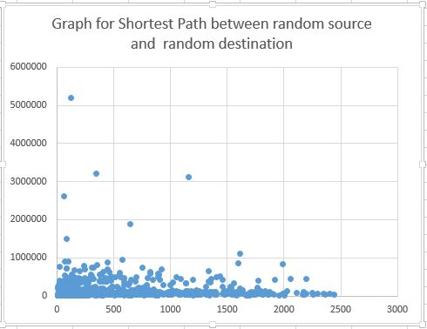
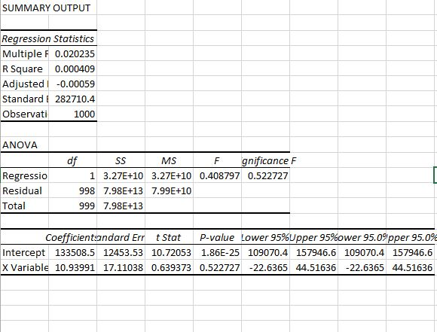
Statistical Analysis
Time vs V+E graph for Shortest path from between random source and destination
Regression Analysis for the Shortest path from between random source and destination

Slide 27
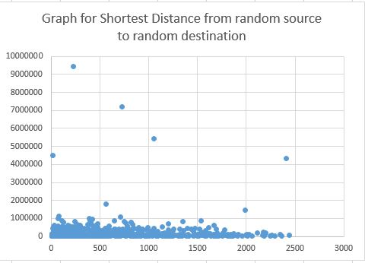
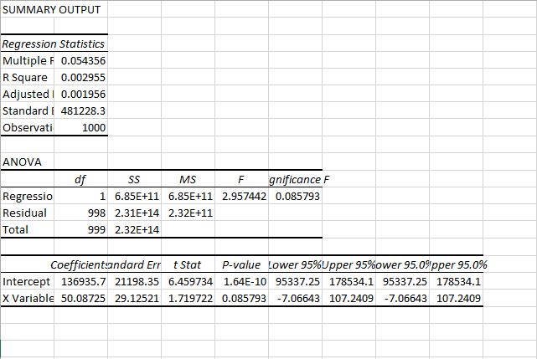
Statistical Analysis
Time vs V+E graph for Shortest path from between random source and destination
Regression Analysis for the Shortest path from between random source and destination

Slide 28
Flow Network
Maximum Flow Problem

Slide 29
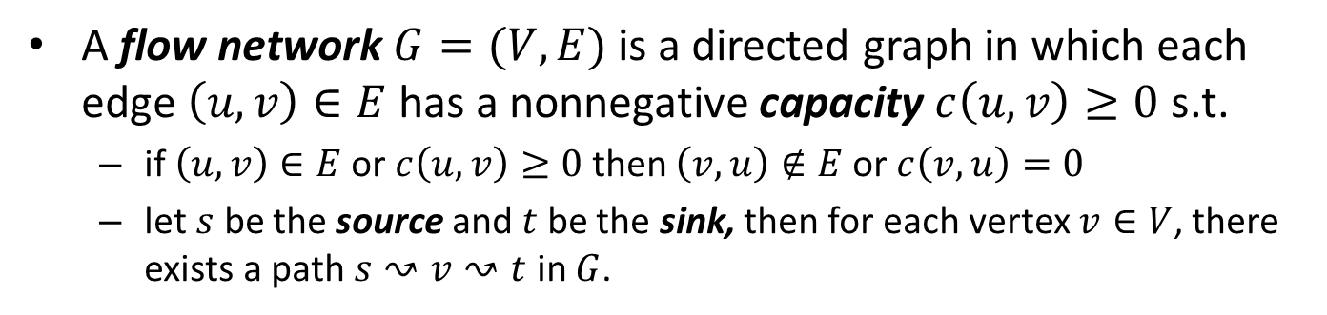
Flow network
Definition
A flow network $G=(V, E)$is a directed graph in which each edge $\left(u,v\right)∈E$has a nonnegative capacity $c\left(u,v\right)≥0$ s.t.
if $\left(u,v\right)∈E$or $c\left(u,v\right)≥0$ then $\left(v,u\right)∉E$or $c\left(v,u\right)=0$
let $s$ be the source and $t$ be the sink, then for each vertex $v∈V$, there exists a path $s↝v↝t$ in $G$.
1
23
3
1
23
3
12
5
12
s
3
10
t
s
3
10
t
5
2
8
4
16
5
2
8
4
16
is a flow network
is NOT a flow network

Slide 30


Flow
Definition
1
5/23
3
A flow in $G$ is a real-valued function $f:V×V→ℝ$that satisfies the following two properties:
Capacity constraint: $∀ u,v∈V$,
$0≤f\left(u,v\right)≤c\left(u,v\right)$
$f\left(u,v\right)=0⟺(u,v)∉E$
Flow conservation: $∀ u∈V−\{s,t\}$
$$\sum_{v∈V}{f(u,v)}=\sum_{v∈V}{f(v,u)}$$
3/12
5/5
s
1/3
1/10
t
3/5
2
2/8
4
1/16
is a valid flow
1
5/23
3
6/12
5/5
s
1/3
1/10
t
3/5
2
2/8
4
1/16
$$\max_{f∈F}\left|f\right|=\sum_{v∈V}{f(s,v)}$$
is NOT a valid flow

Slide 31
Flow Network
Ford-Fulkerson Method

Slide 32



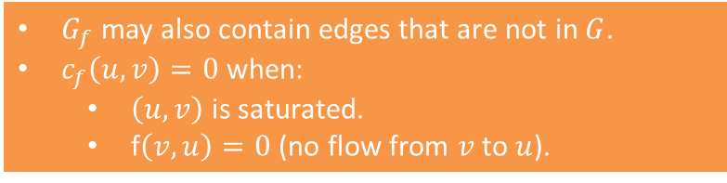
Residual network
Definition
Given a flow network $G=(V, E)$ with source $s$ and sink $t$, let $f$ be a flow in $G$, the residual network of $G$ induced by $f$ is
$G_{f}=(V,E_{f})$
where
$$E_{f}=\{(u,v)∈ V×V:c_{f}(u,v)>0\}$$
$$c_{f}(u,v)=\left\{\begin{aligned}c\left(u,v\right)−f\left(u,v\right), \left(u,v\right)∈E \\ f\left(v,u\right), \left(u,v\right)∉E \\ 0 otherwise\end{aligned}\right.$$
1
5/23
3
3/12
5/5
s
1/3
1/10
t
3/5
2
2/8
4
1/16
$$G$$
18/23
1
3
3/12
5/23
5/5
Properties
s
9/12
1/3
2/3
1/10
t
2/5
9/10
15/16
$G_{f}$ may also contain edges that are not in $G$.
$c_{f}\left(u,v\right)=0$ when:
$\left(u,v\right)$ is saturated.
f$\left(v,u\right)=0$ (no flow from $v$ to $u$).
3/5
2
6/8
4
1/16
2/8
$$G_{f}$$

Slide 33
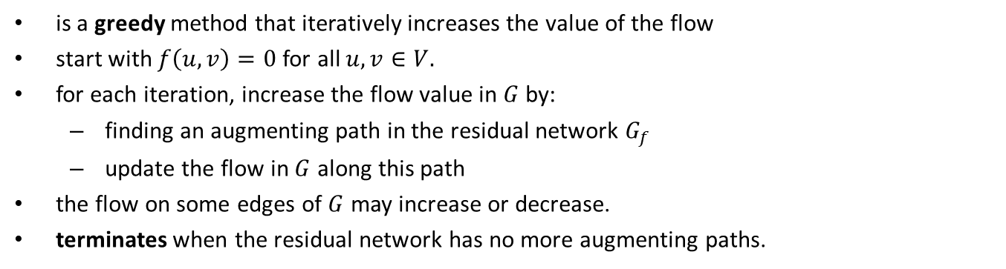
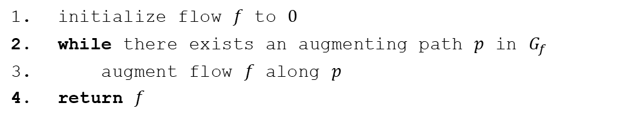
Ford-Fulkerson method
Ford-Fulkerson method
initialize flow $f$ to $0$
while there exists an augmenting path $p$ in $G_{f}$
augment flow $f$ along $p$
return $f$
upon termination, returns a maximum flow
Intuition
is a greedy method that iteratively increases the value of the flow
start with $f\left(u,v\right)=0$for all $u,v∈V.$
for each iteration, increase the flow value in $G$ by:
finding an augmenting path in the residual network $G_{f}$
update the flow in $G$ along this path
the flow on some edges of $G$ may increase or decrease.
terminates when the residual network has no more augmenting paths.
how to find this path?

Slide 34
Flow Network
Edmonds-Karp Algorithm

Slide 35

Edmonds-Karp Algorithm
Intuition
is an implementation of the Ford-Fulkerson method.
the augmenting path must be a shortest path in $G_{f}$ that has available capacity
Breadth First Search

Slide 36

Edmonds-Karp Algorithm
Implementation
for each edge $\left(u,v\right)∈ G.E$
$f(u,v)=0$
$p = SHORTEST_PATH(G,s,t)$
while $p$ exists
$c_{f}\left(p\right)=min\left\{c_{f}\left(u,v\right):\left(u,v\right)∈p\right\}$
for each edge $\left(u,v\right)∈p$
if $(u,v) ∈ G.E$
$f\left(u,v\right)=f\left(u,v\right)+c_{f}\left(p\right)$
else
$f\left(v,u\right)=f\left(v,u\right)−c_{f}\left(p\right)$
$G_{f}=RESIDUAL_GRAPH(G)$
$p = SHORTEST_PATH(G_{f},s,t)$
return $f$
initialization
termination condition
/* residual capacity */
update the edges along the augmenting path

Slide 37



Edmonds-Karp Algorithm
Example: iteration 0
for each edge $\left(u,v\right)∈ G.E$
$f(u,v)=0$
$p = SHORTEST_PATH(G,s,t)$
while $p$ exists
$c_{f}\left(p\right)=min\left\{c_{f}\left(u,v\right):\left(u,v\right)∈p\right\}$
for each edge $\left(u,v\right)∈p$
if $(u,v) ∈ G.E$
$f\left(u,v\right)=f\left(u,v\right)+c_{f}\left(p\right)$
else
$f\left(v,u\right)=f\left(v,u\right)−c_{f}\left(p\right)$
$G_{f}=RESIDUAL_GRAPH(G)$
$p = SHORTEST_PATH(G_{f},s,t)$
return $f$
$$G$$
s
0/2
0/1
5
0/2
1
0/2
3
0/1
6
0/2
2
0/2
0/1
4
0/2
t
$$p=\left[\left(s,1\right),\left(1,2\right),\left(2,t\right)\right]$$

Slide 38


Edmonds-Karp Algorithm
Example: iteration 1
$$G$$
for each edge $\left(u,v\right)∈ G.E$
$f(u,v)=0$
$p = SHORTEST_PATH(G,s,t)$
while $p$ exists
$c_{f}\left(p\right)=min\left\{c_{f}\left(u,v\right):\left(u,v\right)∈p\right\}$
for each edge $\left(u,v\right)∈p$
if $(u,v) ∈ G.E$
$f\left(u,v\right)=f\left(u,v\right)+c_{f}\left(p\right)$
else
$f\left(v,u\right)=f\left(v,u\right)−c_{f}\left(p\right)$
$G_{f}=RESIDUAL_GRAPH(G)$
$p = SHORTEST_PATH(G_{f},s,t)$
return $f$
s
0/2
1/1
5
0/2
1
0/2
3
1/1
6
0/2
2
0/2
1/1
4
0/2
t
$$p=\left[\left(s,1\right),\left(1,2\right),\left(2,t\right)\right]$$
$$c_{f}\left(p\right)=1$$
$$f\left(s,1\right)=0+1=1$$
$$f\left(1,2\right)=0+1=1$$
$$f\left(2,t\right)=0+1=1$$

Slide 39


Edmonds-Karp Algorithm
Example: iteration 1
for each edge $\left(u,v\right)∈ G.E$
$f(u,v)=0$
$p = SHORTEST_PATH(G,s,t)$
while $p$ exists
$c_{f}\left(p\right)=min\left\{c_{f}\left(u,v\right):\left(u,v\right)∈p\right\}$
for each edge $\left(u,v\right)∈p$
if $(u,v) ∈ G.E$
$f\left(u,v\right)=f\left(u,v\right)+c_{f}\left(p\right)$
else
$f\left(v,u\right)=f\left(v,u\right)−c_{f}\left(p\right)$
$G_{f}=RESIDUAL_GRAPH(G)$
$p = SHORTEST_PATH(G_{f},s,t)$
return $f$
$$G_{f}$$
s
0/2
0/1
5
0/2
1
0/2
3
0/1
6
0/2
2
0/2
0/1
4
0/2
t
$$p=\left[\left(s,5\right),\left(5,6\right),\left(6,2\right),\left(2,1\right),\left(1,3\right),\left(3,4\right),(4,t)\right]$$

Slide 40
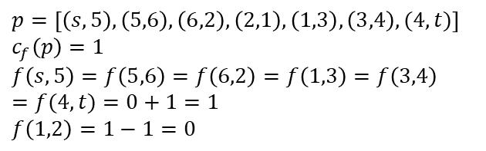
Edmonds-Karp Algorithm
Example: iteration 2
$$G$$
for each edge $\left(u,v\right)∈ G.E$
$f(u,v)=0$
$p = SHORTEST_PATH(G,s,t)$
while $p$ exists
$c_{f}\left(p\right)=min\left\{c_{f}\left(u,v\right):\left(u,v\right)∈p\right\}$
for each edge $\left(u,v\right)∈p$
if $(u,v) ∈ G.E$
$f\left(u,v\right)=f\left(u,v\right)+c_{f}\left(p\right)$
else
$f\left(v,u\right)=f\left(v,u\right)−c_{f}\left(p\right)$
$G_{f}=RESIDUAL_GRAPH(G)$
$p = SHORTEST_PATH(G_{f},s,t)$
return $f$
s
1/2
1/1
5
1/2
1
1/2
3
0/1
6
1/2
2
1/2
1/1
4
1/2
t
$$p=\left[\left(s,5\right),\left(5,6\right),\left(6,2\right),\left(2,1\right),\left(1,3\right),\left(3,4\right),(4,t)\right]$$
$$c_{f}\left(p\right)=1$$
$$f\left(s,5\right)=f\left(5,6\right)=f\left(6,2\right)=f\left(1,3\right)=f\left(3,4\right)=f(4,t)=0+1=1$$
$$f\left(1,2\right)=1−1=0$$

Slide 41
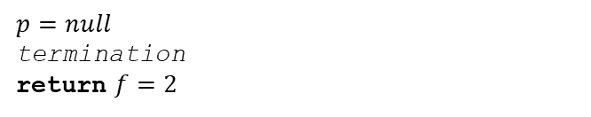
Edmonds-Karp Algorithm
Example
for each edge $\left(u,v\right)∈ G.E$
$f(u,v)=0$
$p = SHORTEST_PATH(G,s,t)$
while $p$ exists
$c_{f}\left(p\right)=min\left\{c_{f}\left(u,v\right):\left(u,v\right)∈p\right\}$
for each edge $\left(u,v\right)∈p$
if $(u,v) ∈ G.E$
$f\left(u,v\right)=f\left(u,v\right)+c_{f}\left(p\right)$
else
$f\left(v,u\right)=f\left(v,u\right)−c_{f}\left(p\right)$
$G_{f}=RESIDUAL_GRAPH(G)$
$p = SHORTEST_PATH(G_{f},s,t)$
return $f$
$$G_{f}$$
s
1/2
0/1
0/1
5
1/2
1
0/1
1/2
3
0/1
0/1
6
1/2
2
0/1
0/1
1/2
0/1
4
1/2
0/1
t
$$p=null$$
termination
return $f=2$

Slide 42





Edmonds-Karp Algorithm
Analysis
for each edge $\left(u,v\right)∈ G.E$
$f(u,v)=0$
$p = SHORTEST_PATH(G,s,t)$
while $p$ exists
$c_{f}\left(p\right)=min\left\{c_{f}\left(u,v\right):\left(u,v\right)∈p\right\}$
for each edge $\left(u,v\right)∈p$
if $(u,v) ∈ G.E$
$f\left(u,v\right)=f\left(u,v\right)+c_{f}\left(p\right)$
else
$f\left(v,u\right)=f\left(v,u\right)−c_{f}\left(p\right)$
$G_{f}=RESIDUAL_GRAPH(G)$
$p = SHORTEST_PATH(G_{f},s,t)$
return $f$
$$O(|E|)$$
$O(|V|∗|E|)$
Theorem 26.8 textbook
$O(|E|)$as $p.length<|V|$
$O(|V|+|E|)$by BFS
$$O\left(\left|V\right|∗\left|E\right|\right)∗O\left(\left|V\right|+\left|E\right|\right)=O(\left|V\right|{|E|}^{2})$$

Slide 43
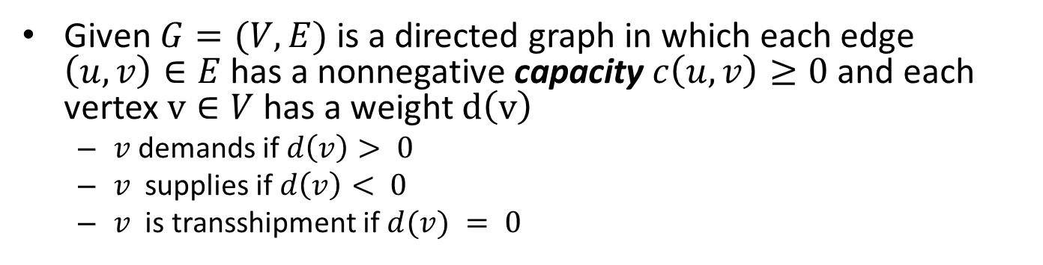
Circulation
Definition
Given $G=(V, E)$is a directed graph in which each edge $\left(u,v\right)∈E$has a nonnegative capacity $c\left(u,v\right)≥0$ and each vertex $v∈V$ has a weight $d\left(v\right)$
$v$ demands if $d\left(v\right)> 0$
$v$ supplies if $d\left(v\right)< 0$
$v$ is transshipment if $d(v) = 0$
7
1
23
3
12
5
4
supply
-15
0
3
10
5
demand
5
2
8
4
16
5

Slide 44


Circulation
Definition
A circulation in $G$ is a real-valued function $f:V×V→ℝ$that satisfies the following two properties:
Capacity constraint: $∀ u,v∈V$,
$0≤f\left(u,v\right)≤c\left(u,v\right)$
$f\left(u,v\right)=0⟺(u,v)∉E$
conservation: $∀ u∈V−\{s,t\}$
$$\sum_{v∈V}{f(v,u)}−\sum_{v∈V}{f\left(u,v\right)=d(v)}$$
$\text{does} \text{there} \text{exist} \text{a} \text{circulation}$?

Slide 45
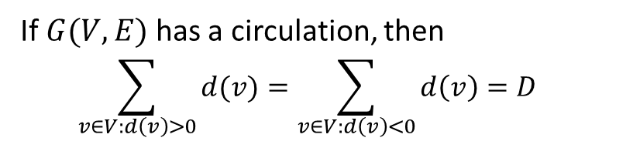
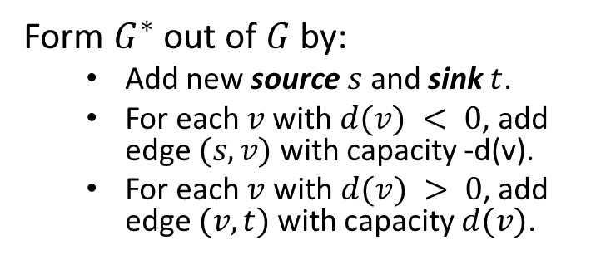
Circulation
Necessary condition
If $G(V,E)$ has a circulation, then
$$\sum_{v∈V:d\left(v\right)>0}{d(v)}=\sum_{v∈V:d\left(v\right)<0}{d\left(v\right)=D}$$
Maximum flow formulation
Form $G^{∗}$ out of $G$ by:
Add new source $s$ and sink $t$.
For each $v$with $d(v) < 0$, add edge $(s, v)$with capacity -d(v).
For each $v$ with $d(v) > 0$, add edge $(v, t)$with capacity $d(v)$.
s
7
1
23
3
15
12
7
0
3
5
4
4
-15
10
5
t
16
5
2
8
4
5
5

Slide 46
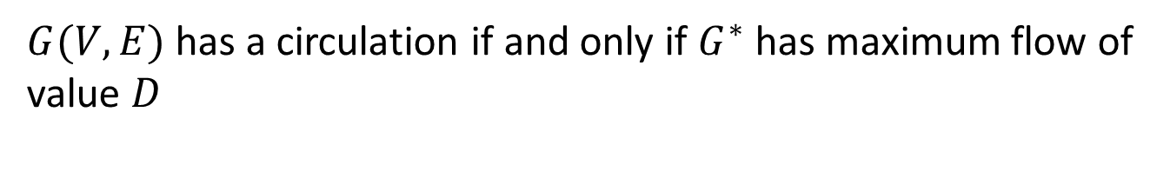
Circulation
Sufficient condition
$G(V,E)$ has a circulation if and only if $G^{∗}$ has maximum flow of value $D$

Slide 47
Flow Network
Test

Slide 48

Test suit
Extreme test case
$$G$$
s
0/2
Simple, trackable
There is an iteration where the flow of an edge decreases (iteration 2, edge (1,2))
0/1
5
0/2
1
0/2
3
0/1
6
0/2
2
0/2
0/1
4
0/2
t
Test cases from textbook

Slide 49


Test suit
Random test cases – Questions
What the requirements?
$∀v∈V$, $∃$ a path $s↝v↝t$ in $G$.
How to generate a graph that satisfies the requirement?
Random walk from $s$ to $t$
How to assert the correctness of our implementation?
Compare to commercial tools (MATLAB)

Slide 50

Test case generation
Random walk from s to t
input V,E
count = 0
$S = MAKE_VERTICES(V)$/*generate vertex $v_{i, }i=1,…V−2)$and save to set S*/
while $S≠∅$
Q = RAND_SUBSET(S) /*take a random subset from S*/
p = RAND_PATH(Q) /*make a simple path from Q*/
ADD_SOURSE(p,s) /*make s the start vertex of p*/
ADD_SINK(p,t) /*make t the end vertex of p*/
S = S - Q
count = count + LENGTH(p)
while count < E
RAND_EDGE(1,V-2) /*make edge between two random vertices*/
count = count + 1

Slide 51
Assert correctness
DEMO

Slide 52
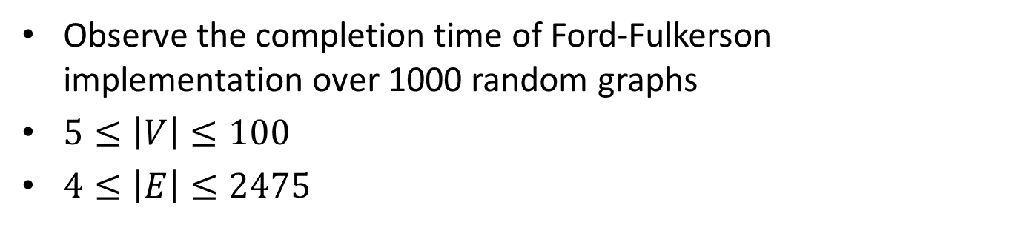
Statistical Analysis
Objective
Observe the completion time of Ford-Fulkerson implementation over 1000 random graphs
$5≤\left|V\right|≤100$
$4≤\left|E\right|≤2475$
Expecting result
Correlation between completion time and $\left|V\right|∗{|E|}^{2}$

Slide 53
Statistical Analysis
Scatter plot

Slide 54
Statistical Analysis
Regression
SUMMARY OUTPUT
Regression Statistics
Multiple R | 0.743018093
R Square | 0.552075887
Adjusted R Square | 0.551627065
Standard Error | 15561386.64
Observations | 1000
ANOVA
 | df | SS | MS | F | Significance F
Regression | 1 | 2.98E+17 | 2.98E+17 | 1230.056 | 3E-176
Residual | 998 | 2.42E+17 | 2.42E+14
Total | 999 | 5.4E+17
 | Coefficients | Standard Error | t Stat | P-value | Lower 95% | Upper 95% | Lower 95.0% | Upper 95.0%
Intercept | 9813348.558 | 543864.1 | 18.04375 | 3.3E-63 | 8746100 | 10880597 | 8746100 | 10880597
X Variable 1 | 0.2119017 | 0.006042 | 35.07215 | 3E-176 | 0.200045 | 0.223758 | 0.200045 | 0.223758

Slide 55

Conclusion
Breadth First Search to find shortest path
$O\left(\left|V\right|+\left|E\right|\right)$ in worst case
lower in practice
Ford-Fulkerson method
Edmonds-Karp algorithm
$O\left(\left|V\right|∗{|E|}^{2}\right)$ in worst case
lower in practice
Random walk for flow network generation
Statistical analysis for time complexity

Slide 56
Thank you.
Q&A

