Slide 1


Life Science
Hack 2025
SEMANTIC SEARCH (PUBMED)
PubMed Semantic Bot: AI-Powered RAG Assistance
TEAM NAME: CODE RIDERS
TEAM NO : 11
RMKCET

Slide 2
Life Science
Hack 2025
Team Members Name | Mail Id | Team Faculty Mentors | Faculty Mentor Id | Cognizant Mentor Name
LATHEEF AHMED A | lathad046@rmkcet.ac.in | Ms. Mary Selvan | maryselvanads@rmkcet.ac.in | Mr. Babu Perumal
JAGATH ABHIJIT K | jagaad039@rmkcet.ac.in |  |  | Mr. Tamil Vanan
MORIBOYINA DEEKSHITH KUMAR | moriad055@rmkcet.ac.in
GURU SHANKAR P | guruad029@rmkcet.ac.in
K BHARATH | kbhaad110@rmkcet.ac.in
VALLAMSETTY VENKATA SAI PHANENDRA | vallad095@rmkcet.ac.in
KOLLURU SEKHAR | koll22ad302@rmkcet.ac.in
METTUKURU VENKATA SAI NIKHILESH REDDY | mettad053@rmkcet.ac.in
TEAM NAME: CODE RIDERS
TEAM NO : 11
RMKCET

Slide 3
Problem Statement
PubMed is a widely used online database maintained by the National Center for Biotechnology Information (NCBI). It provides access to a vast collection of biomedical literature, including research articles, clinical studies, reviews, and more. Researchers, clinicians, and students rely on PubMed to find relevant scientific information across various disciplines.
Given a specific query (e.g., an article title, keywords, or a combination), design an approach to retrieve relevant PubMed records that match the query semantically.
The goal is to enhance search precision by considering semantic relationships between terms rather than relying solely on exact keyword matches. Given a specific query (e.g., an article title, keywords, or a combination), design an approach to retrieve relevant PubMed records that match the query semantically.
CANVA
POWERPOINT

Slide 4
MAJOR ISSUES ADDRESSED
BY PUBMED-RAG SYSTEM
Keyword Overload
Boolean Operator Challenges
Truncation Issues
MeSH Term Complexity
Poor Retrieval for Complex Clinical Queries
Lack of Semantic Search
Ineffective Handling of Multiple Queries

Slide 5
SOLUTION
SEMANTIC SEARCH (PUBMED)
Natural Language Processing (NLP) and Retrieval-Augmented Generation (RAG) based approach has been applied to improve document retrieval beyond keyword matching.
Sentence embeddings (S-PubMedBERT-MS-MARCO Sentence-BERT variant, trained on MSMARCO passage ranking) are generated for both the query and documents to capture the contextual meaning.
A similarity measure (such as cosine similarity) is applied to rank documents based on semantic closeness rather than just keyword overlap.
To enhance usability, the search system is integrated with a Hybrid approach (semantic + lexical search) for better accuracy and diversity(MMR) in results.
An interactive interface or chatbot can be connected to explain retrieved results, making the search process more intuitive and user friendly.

Slide 6
PICO FRAME WORK
P – Population / Problem: Who are the patients, or what is the problem being addressed? This includes the main condition and key patient characteristics.
I – Intervention: What is the main treatment, test, or strategy you are considering? This is the "action" part of the question.
C – Comparator / Comparison: What is the main alternative to the intervention? Is it being compared to a placebo, the current standard of care, or another treatment?
O – Outcome: What is the desired effect or result? What are you hoping to achieve or measure
C – Context: In what setting or situation is this occurring?

Slide 7
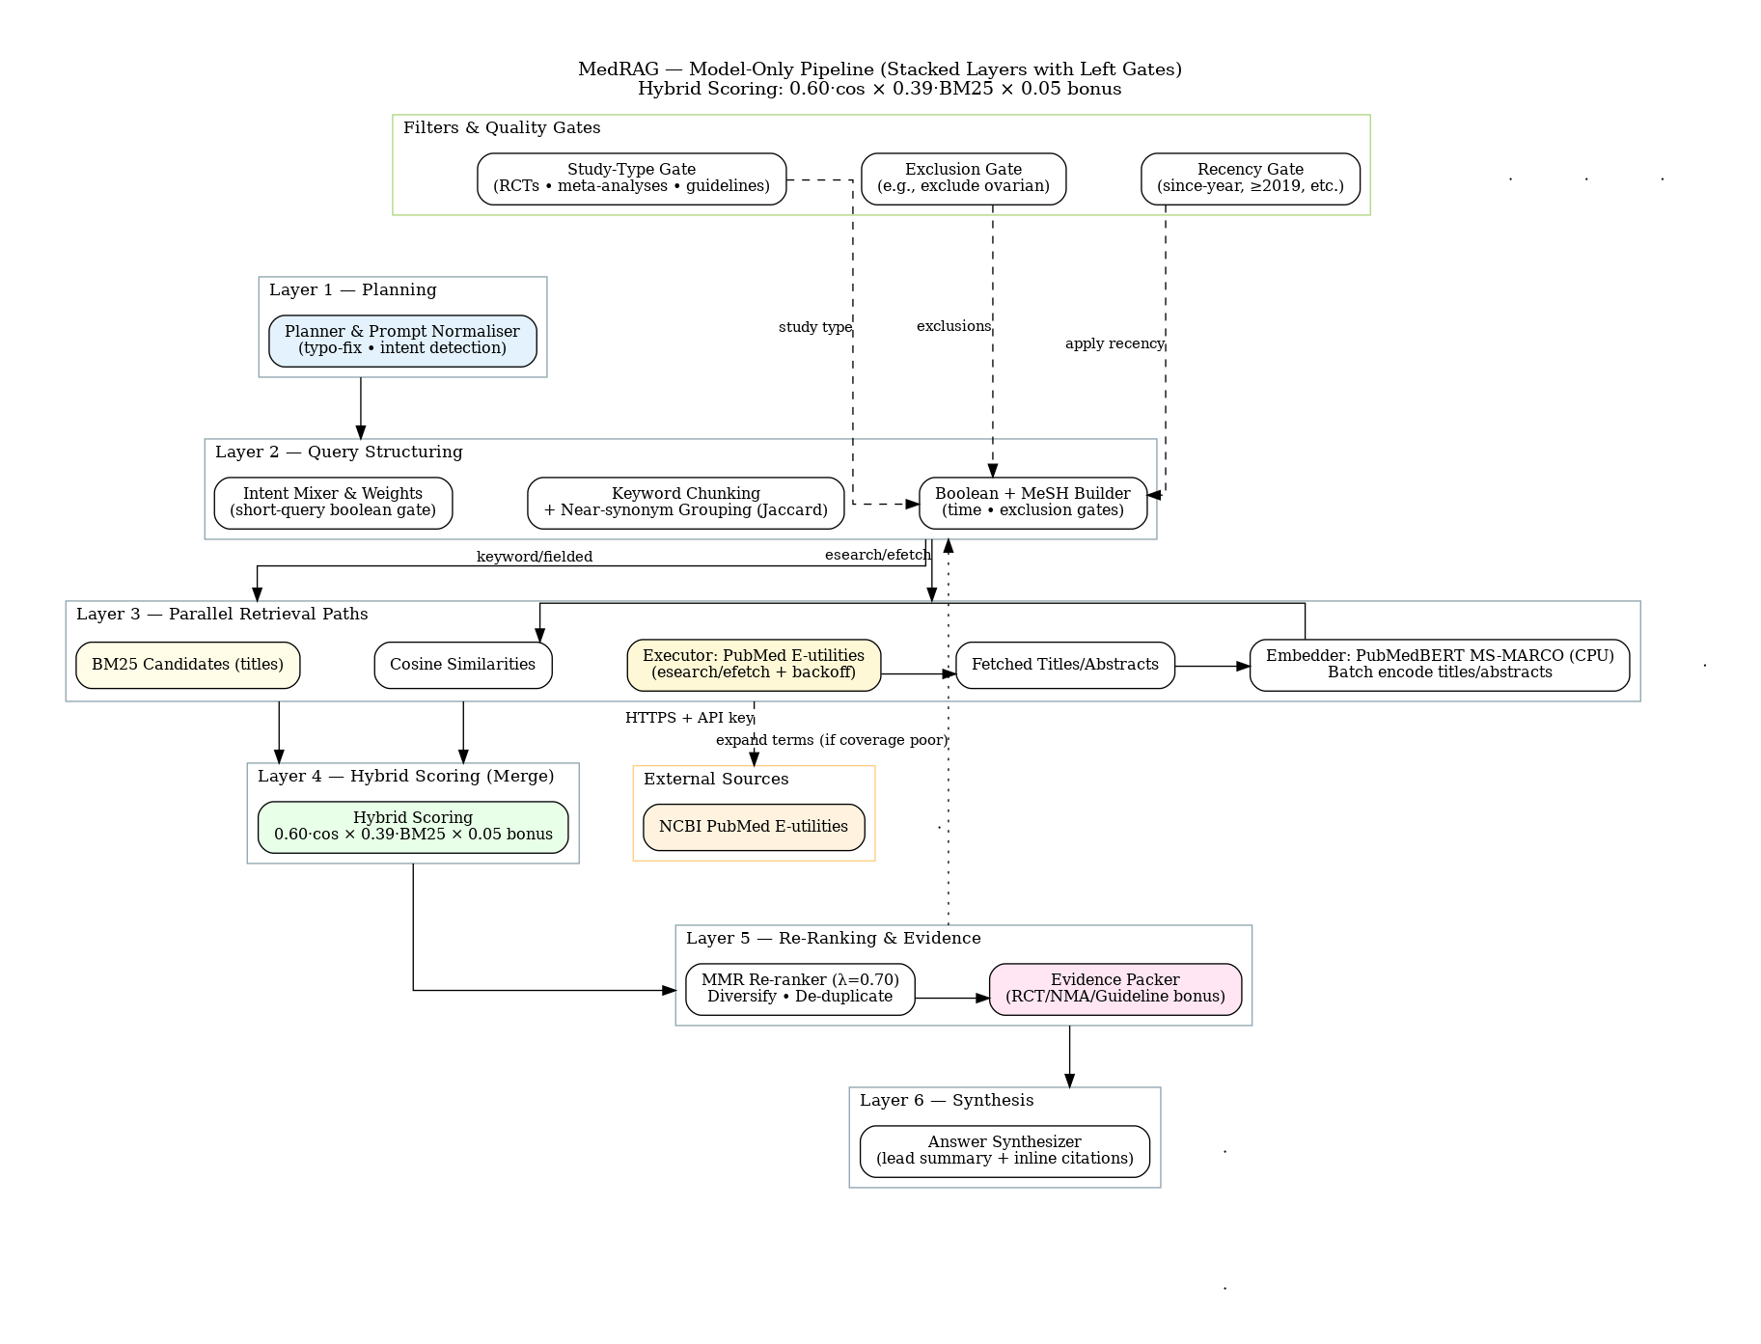
Algorithm Flow

Slide 8
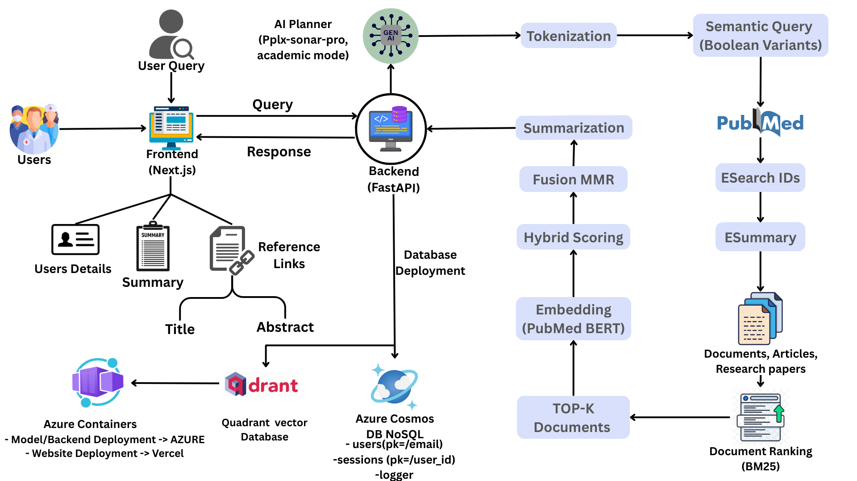
Architecture
diagram

Slide 9
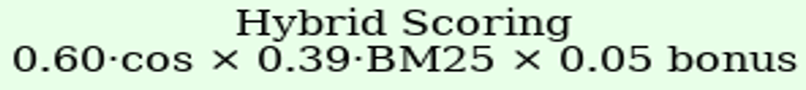
Hybrid Models
AI Agent
The code integrates with a Perplexity API, which is an advanced Large Language Model (LLM).
Instead of directly searching PubMed with the raw user question, the LLM breaks down the input into Short tokens, Concept buckets ,Synonyms and related terms
The AI Agent uses prompt engineering to guide the LLM, ensuring it outputs structured tokens instead of long text.
It works as a semantic planner, converting queries into meaningful tokens and concepts that improve PubMed search accuracy.
Hybrid Model (BM25 + Embeddings)
Since BM25 is strong for exact matches and embeddings are strong for semantic matches, the system combines both.
A weighted score is calculated for each document based on:
This hybrid approach balances precision (exact matches) and recall (semantic matches).

Slide 10
Hybrid Models
BM25 (Lexical Retrieval Model)
BM25 is a classical Information Retrieval model used in the system.
It retrieves documents by looking at exact keyword matches between the query and PubMed abstracts.
It scores documents based on:
- How many times the keywords appear in the document.
- The importance of each keyword (inverse document frequency).
PubMedBERT MS-MARCO(Semantic search)
PubMedBERT (MS-MARCO fine-tuned) creates embeddings for both query with PubMed documents.
These embeddings are compared using cosine similarity to find semantically closest matches.
The hybrid model (BM25 + PubMedBERT embeddings) ensures both keyword precision and semantic understanding.

Slide 11
Hybrid Models
MMR (Maximal Marginal Relevance)
After retrieving top documents, the system applies MMR reranking.
Purpose: To ensure results are diverse and non-redundant.
Without MMR, many retrieved results may be almost identical.
MMR selects documents that are both:
Highly relevant to the query.
Different from each other.
This helps the final set of results cover a broader evidence base.

Slide 12
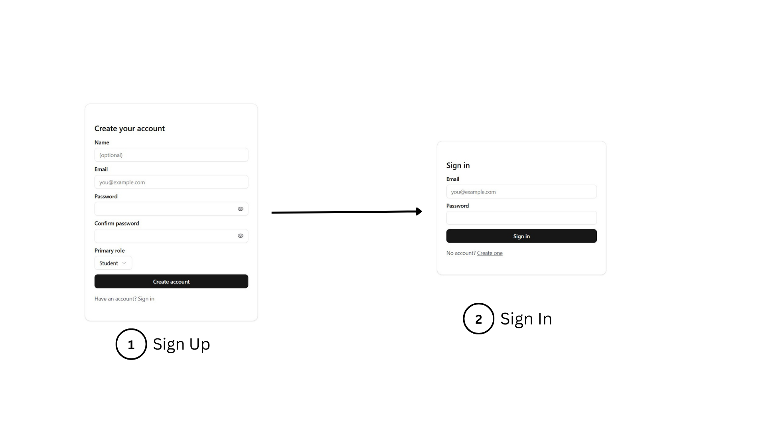
UI WORK FLOW
Semantic search (PUBMED)

Slide 13
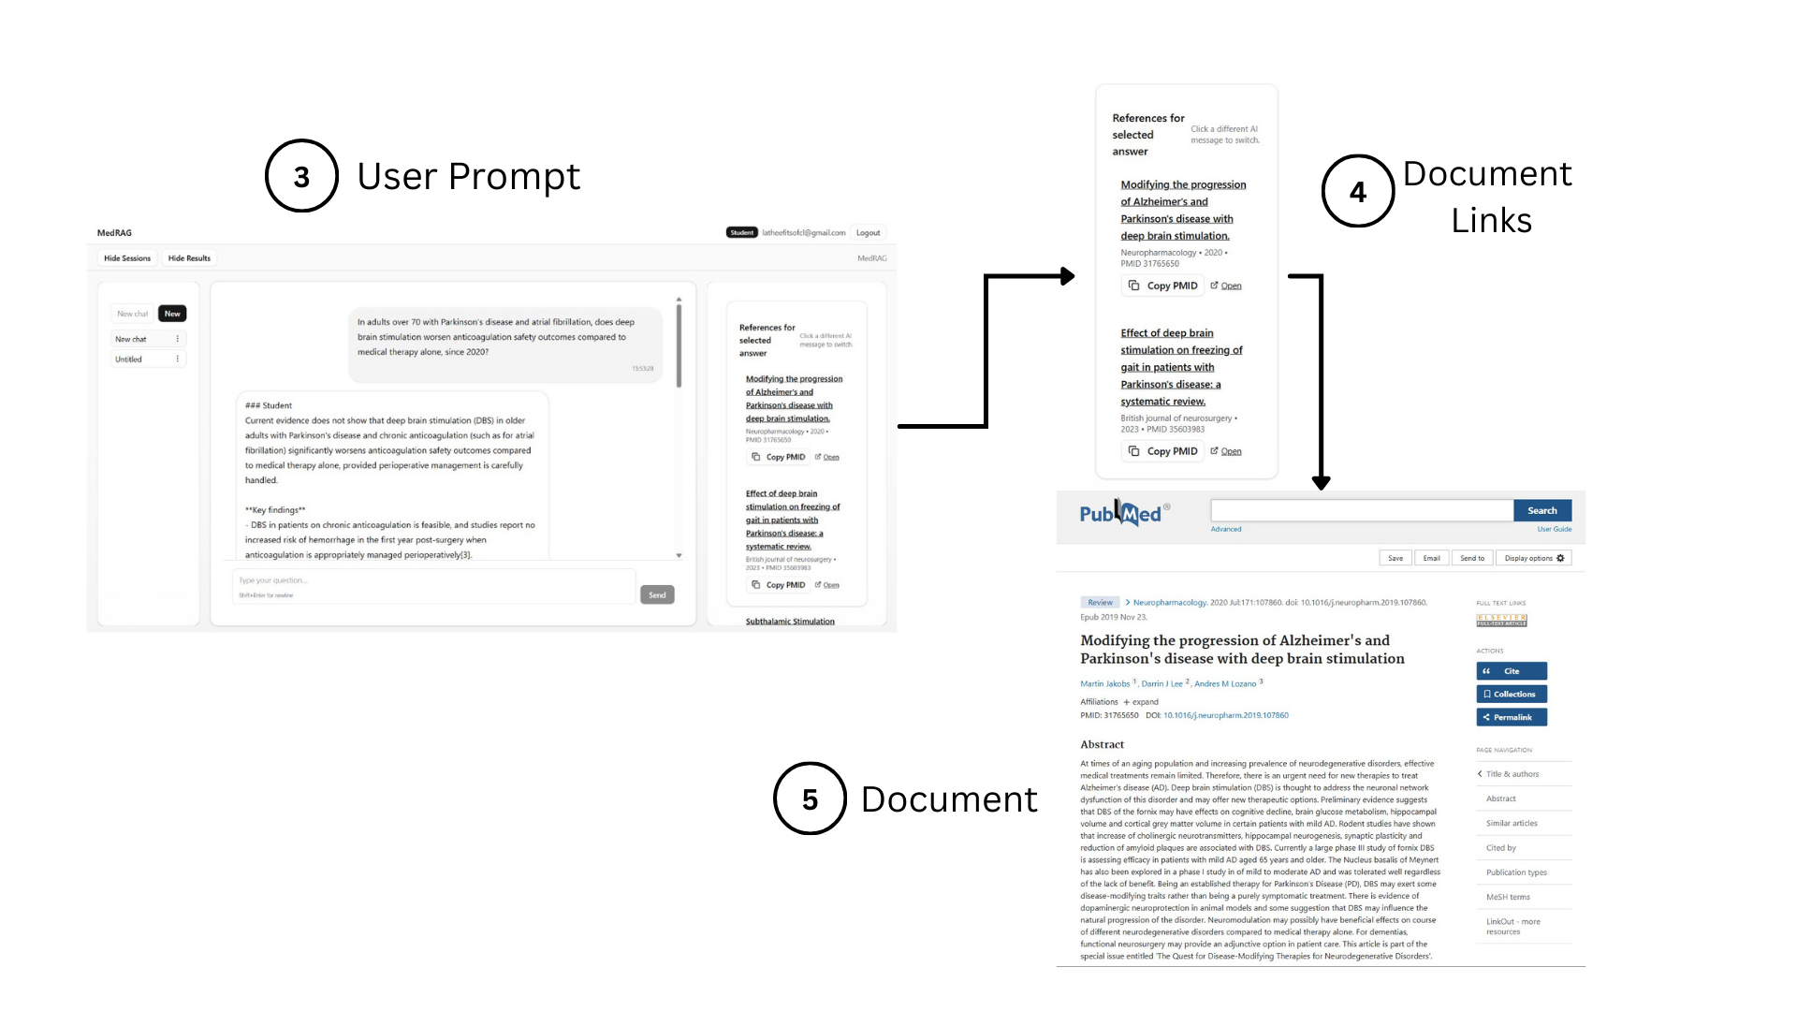
UI WORK FLOW

Slide 14
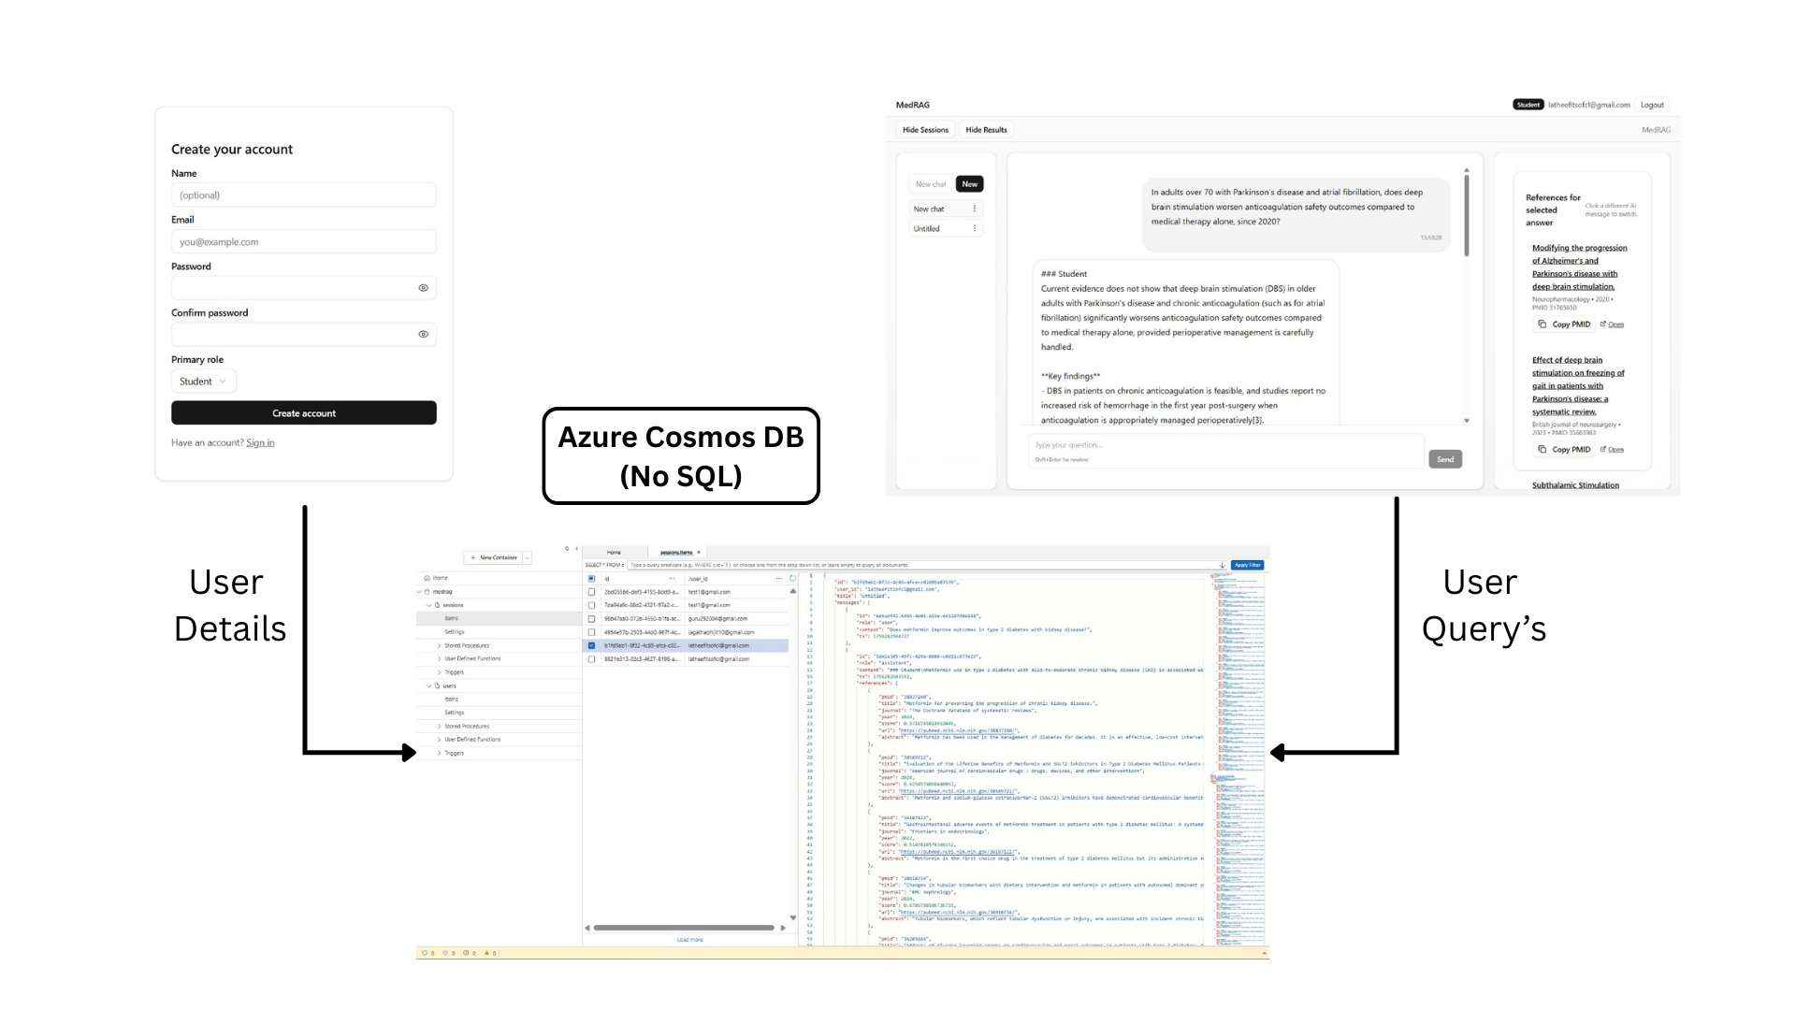
UI WORK FLOW

Slide 15
Performance Metrics
Metric Category | Metric | Value (Demo Run) | What It Shows
Retrieval Quality | Precision@10 | 0.87 | 87% of top-10 results were relevant
 | Recall@10 | 0.95 | Most relevant docs were retrieved in top-10
Summarization Quality | ROUGE-1 F1 | 0.45 | Good lexical overlap with reference
 | BERTScore (F1) | 0.72 | Strong semantic similarity to gold summary
System Latency | End-to-End Query Time | 25.19 sec | Retrieval + embeddings + summarization runtime

Slide 16
Methodology Variants
MODEL
Approach-1 | Approach-2 | Approach-3
ncbi/MedCPT-Query-Encoder (embedding) + facebook/bart-large-cnn (summarization). | Pegasus, BART, T5 with spaCy, Gensim. | Uses PubMedBERT (MS-MARCO), BM25 , and PPLX LLM (Sonar) for planning and summarization.
APPROACH
Maps query to MeSH, retrieves articles, re-ranks semantically, and summarizes | MeSH expansion + PubMed retrieval + role-based summarization. | Plans queries, maps to MeSH, retrieves PubMed docs, re-ranks with hybrid BM25+embeddings, and summarizes evidence.
ISSUES
Heavy dependencies, manual similarity, general summarizer, rate limit delays. | API limits, hallucinations, weak error handling.. | API/rate limits and high resource usage.
DESCRIPTION
MeSH-based recall, MedCPT ranking, and summaries for PubMed insights. | Retrieves and summarizes PubMed articles by role. | A hybrid RAG pipeline integrating PubMed API, embeddings, boolean queries, and LLM-based reasoning.
CONCLUSION
Good for biomedical relevance, resource-intensive, needs specialized summarizer | Enhances biomedical search but needs more robustness. | Provides precise PubMed evidence synthesis and domain-specific summarizers for scalability.

Slide 17
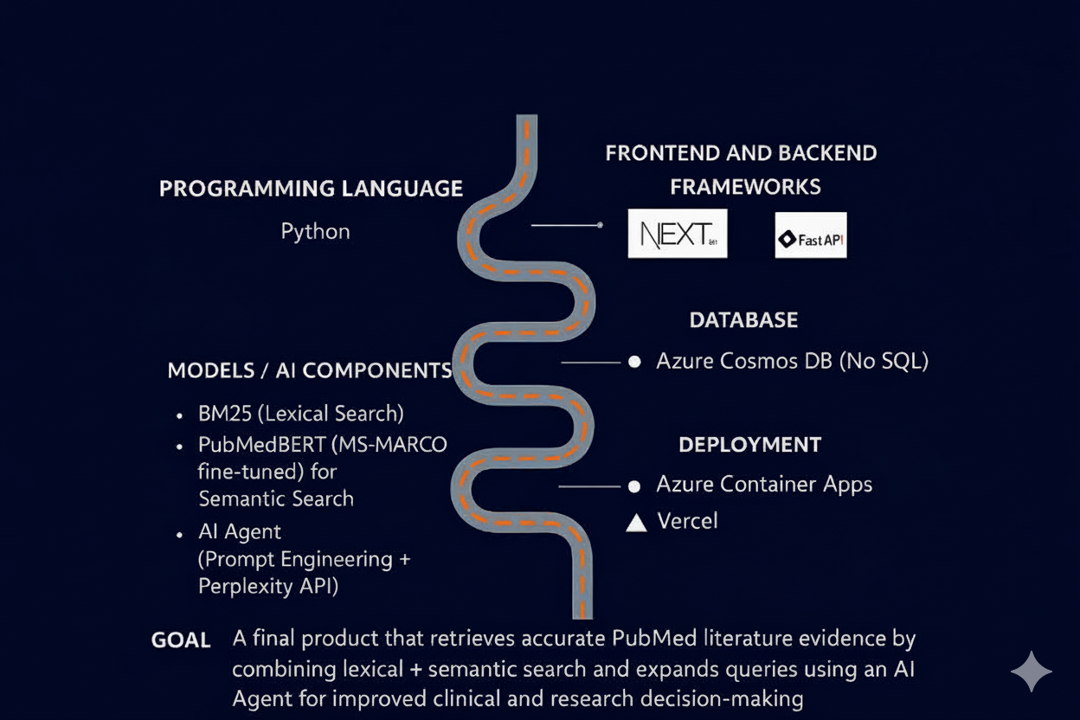
Technology stack

Slide 18
RESEARCH AND CASE STUDIES
On collecting evidence from biomedical research workflows, we found that traditional PubMed keyword searches often miss relevant articles due to synonym mismatches and long, unstructured queries along with weak Boolean pairing.
Studies show that semantic models like PubMedBERT trained on biomedical text can capture deeper context and retrieve relevant documents beyond exact keyword matching.
Our system combines BM25 (lexical search) and PubMedBERT embeddings (semantic search), ensuring both precision and recall in literature retrieval.
Additionally, the AI Agent with Prompt Engineering expands queries into tokens, concept buckets, and synonyms, helping align user questions with PubMed metadata such as publication dates and MeSH terms.
Conclusively, this hybrid approach supports clinicians, students, and researchers by improving access to the latest and most relevant biomedical evidence.

Slide 19
LITERATURE SURVEY
The development of the semantic search model for PubMed has been done with reference to the following research papers and case studies.
1.Demystifying the Search Button
Explains robust strategies for effective PubMed searches using Boolean operators, truncation, and MeSH terms.
🔗 https://pmc.ncbi.nlm.nih.gov/articles/PMC4513072/
2.Research Trend Visualization by MeSH Terms from PubMed
Proposes a MeSH-based visualization system (MeSH Net) to reduce keyword overload and improve semantic understanding.
🔗https://www.mdpi.com/1660-4601/15/6/1113
3.MedGraph: Semantic Information Retrieval Using Knowledge Graph Embeddings
Presents a graph-based embedding method to enhance semantic search precision in PubMed.
🔗 https://arxiv.org/abs/2112.06348
API Details:
https://www.ncbi.nlm.nih.gov/home/develop/api/

Slide 20
ROAD MAP
Name | Contribution
LATHEEF AHMED A | A Led retrieval pipeline and tested endpoints; containerized the backend with an optimized Dockerfile; integrated /ask and right-pane references.
JAGATH ABHIJIT K | Ensured API connectivity/tokens; tuned hybrid retrieval & embeddings; implemented auth/sessions with token storage; added session hooks and state management.
MORIBOYINA DEEKSHITH KUMAR | Verified PubMed API access; debugged backend errors and summary evaluation; strengthened API robustness/evaluator; built evidence rendering with citation links.
GURU SHANKAR P | Documented early tests/baselines; evaluated backend failure cases; set up CI/CD with tests; refined chat UI bubble and composer.
K BHARATH | Ran initial trials and abstract tests; validated boolean + fallback pipeline; set up Azure environment & secrets; built login/signup and maintenance flow.
VALLAMSETTY VENKATA SAI PHANENDRA | Collected edge-case queries; evaluated ranking scores and MM-Reranker; created smoke tests & healthcheck endpoints; fixed Vercel config/routing.
KOLLURU SEKHAR | Normalized abstracts and token checks; validated evidence packs & summaries; added scaling configs and redeploy validation; handled frontend deploy + UI fixes.
METTUKURU VENKATA SAI NIKHILESH REDDY | Recorded test runs and query variants; ensured embedding consistency and eval support; analyzed logs with redeploy validation; prepared final docs and demo polish.

Slide 21
Mentor connect details
Date of connect
22/08/25
Time | Platform | Agenda of the meet
11:30 AM | Google Meet | Rework on the algorithm along the lines of enhanced RAG Piplines with advanced AI Tools
26/08/25
12:30 PM | Google Meet | The project has a well-designed architecture but needs improved modularity with LLaMA integration, better annotations, and enhanced error handling.
28/08/25
3:15 PM | Google Meet | Improve app latency, refine context-based summaries, add chat logging, remove unnecessary slides, update workflow, and ensure consistent slide alignment.

Slide 22

Source Code & Demo Link
Source code for Frontend https://github.com/latheefahmed/medrag-frontend
Hosting : Vercel
Framework: Next.js (React + TypeScript)
Source code for Backend https://github.com/latheefahmed/medrag_api
Azure Container Apps : Containerization & Images Using Docker
Data Storage : Azure Cosmos DB NoSQL
Demo Link: https://drive.google.com/file/d/1x7UYlHZy3r_EEDfQ_z4La_jVI2-85SuV/view?usp=sharing
Host Link: https://medrag-frontend.vercel.app/login

Slide 23
THANK YOU!

