Slide 1
SCHOOL MANAGEMENT SYSTEM
Presented by: C.GANESH KUMAR
Enrollment No: EBEON03251076560
Batch : 2024-14789

Slide 2
Objective
• To apply object-oriented programming concepts (like classes, inheritance, encapsulation) and use Java Collections (like ArrayList) for managing real-world data in a simple and organized manner.
• Simulate: To provide a structured system to manage student records, teacher details, and track school finances (income from student fees and expenses like teacher salaries) using core Java OOP principles.

Slide 3
System Architecture
[Main.java] -> [School.java] -> [Student.java] -> [Teacher.java]
• MainApp handles user input and flow
• SchoolApp tracks total money earned/spent
• StudentApp holds ID, name, grade, fees paid, and handles paying fees to the school.
TeacherApp holds ID, name, salary, and handles receiving salary from the school.

Slide 4
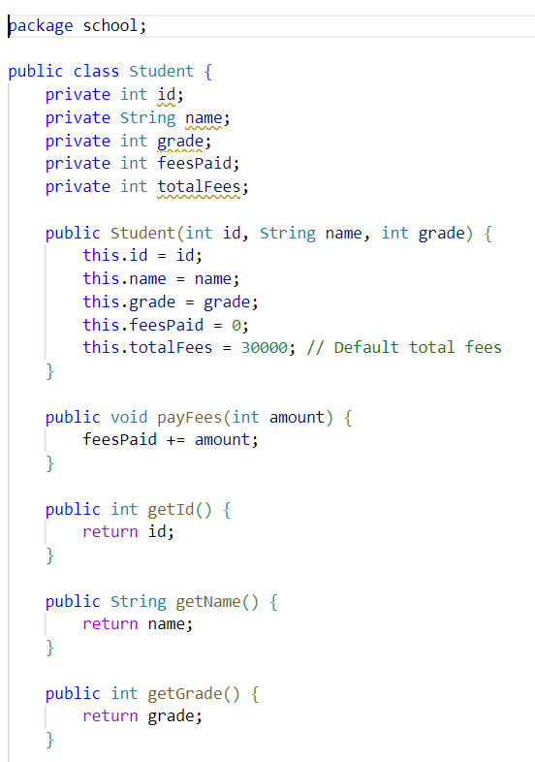
Class - Student.java
Attributes: name, studentId, courses, balance
Methods: enroll(), payFees(), showStatus()

Slide 5
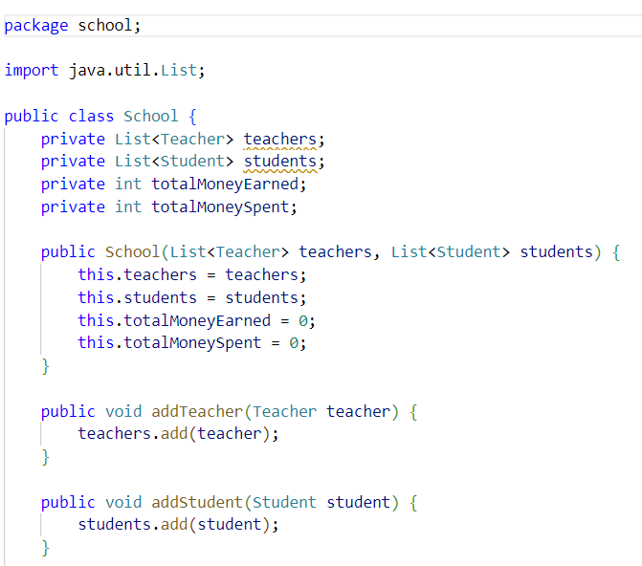
Class - School.java
Manages teachers and students list and IDs
Finds and adds total Money Earned and Spend

Slide 6
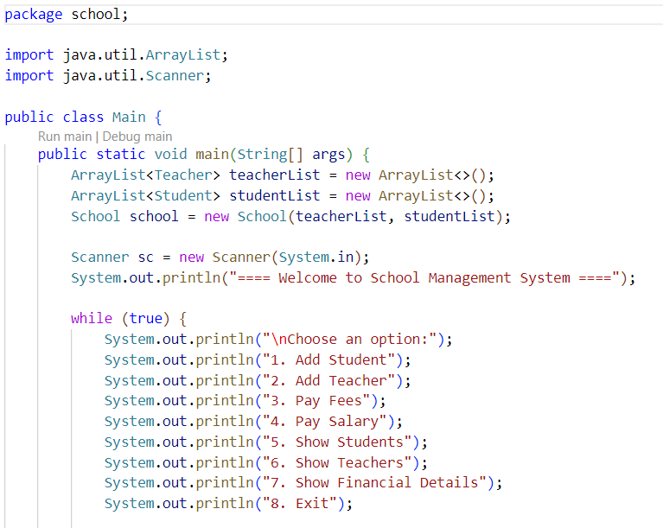
MainApp.java – User Interaction
Menu with options using switch-case
Handles user input and delegates actions

Slide 7
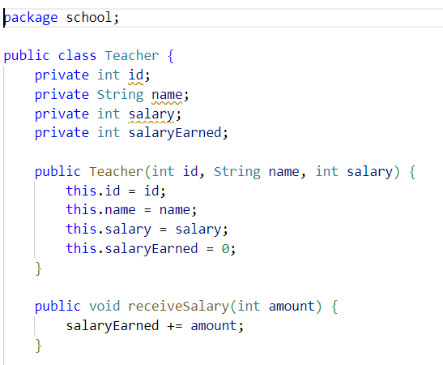
Class – Teacher.java
Stores teacher information such as ID, name, and salary using encapsulation principles.
Handles salary transactions, allowing the teacher to receive a salary and updating the school’s total expenditure accordingly.

Slide 8
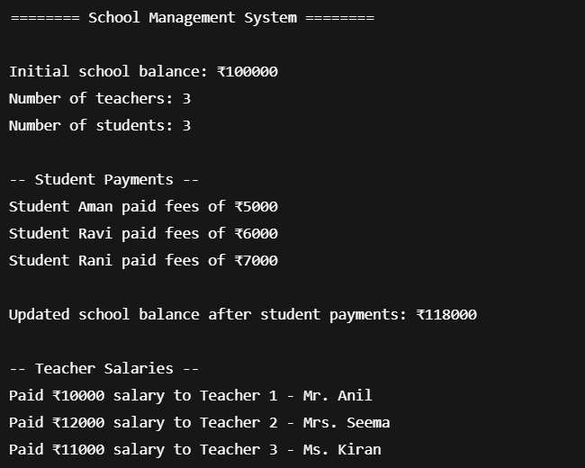
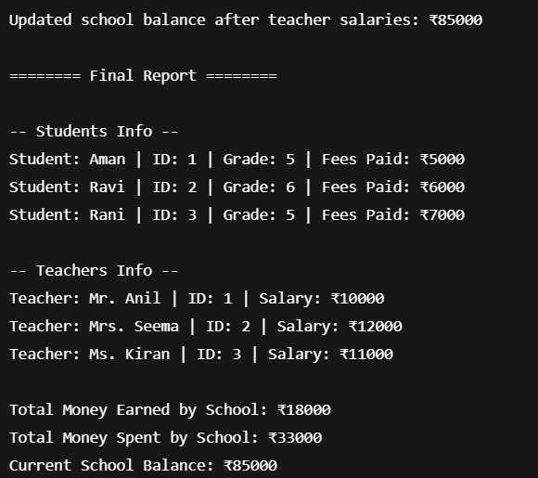
Output

Slide 9
Features
Student Fee Management
Teacher Salary Payment
School Fund Tracking
Object-Oriented Structure
Report Generation

Slide 10
OOP Concepts Used
Encapsulation: private fields, public getters/setters to protect data.
Objects: School instances
Reusability: logic separation
ArrayList: dynamic data

Slide 11
Conclusion
• Built a working console-based school Management system
• Applied Java fundamentals effectively

Slide 12
Future Enhancements:
• Add database, GUI
• Admin/instructor roles
• Course scheduling, notifications

