Slide 1
Predictive models on Tesla stock
S. Sekarski
Supervisor: M. Gholam

Slide 2
Plan
Introduction and expectations
Tesla stock
Variables and preprocessing
Time Series approach
Machine Learning approach
Conclusion

Slide 3
Tesla Stock

Slide 4
Tesla Stock

Slide 5
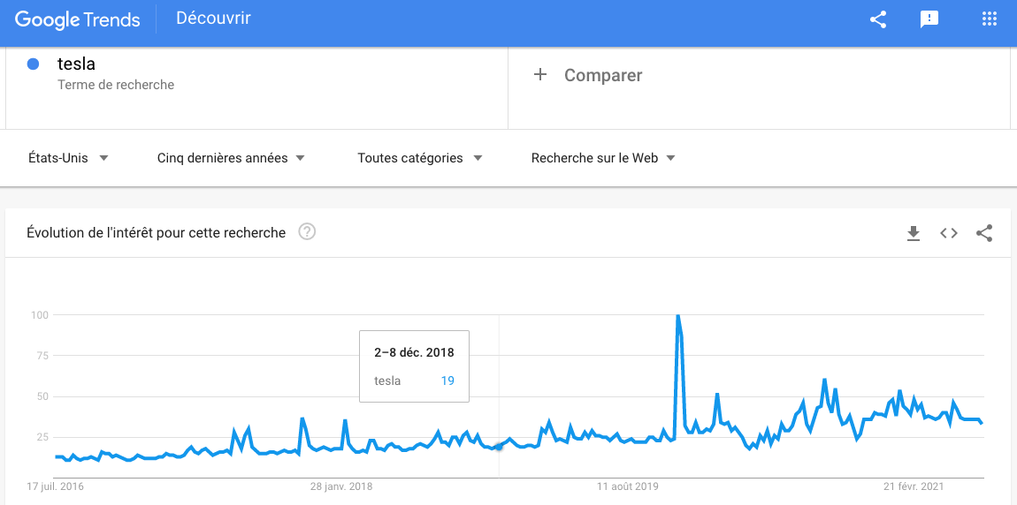
Google Trends

Slide 6
Search Terms
„Tesla“
„TSLA“
„Musk“
„Tesla stock“

Slide 7
„tesla“ preprocessing

Slide 8
„tesla“ preprocessing

Slide 9
„tesla“ preprocessing

Slide 10
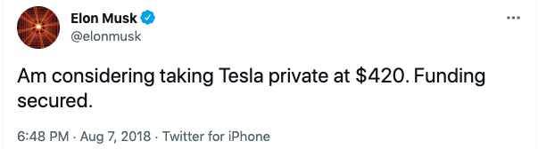
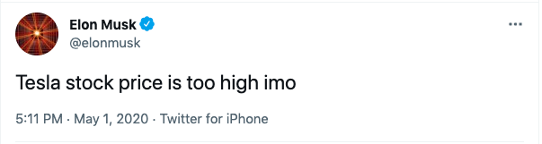
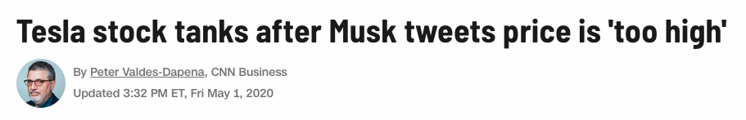
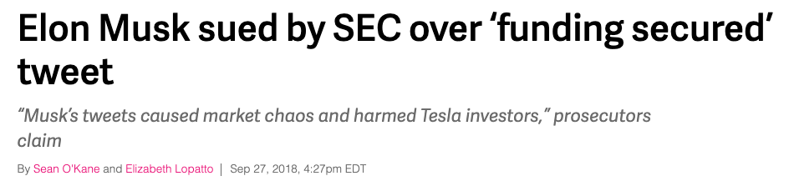
Twitter

Slide 11
Twitter metrics
Likes
Retweets
Replies
(Quotes)

Slide 12
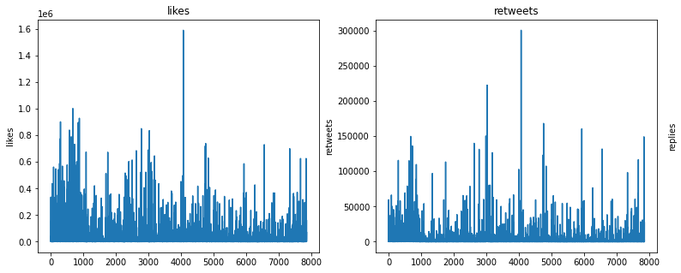
Raw Twitter Data

Slide 13
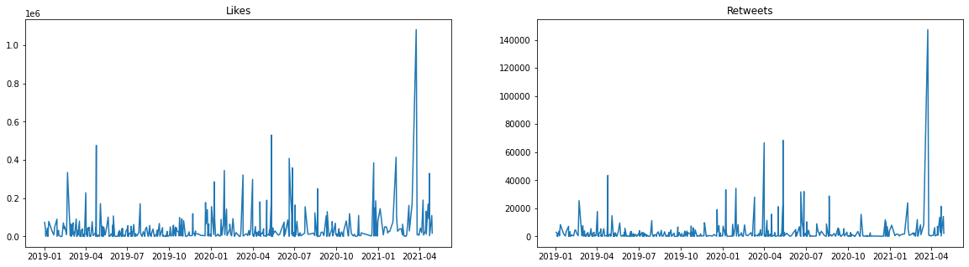
Processed Twitter Data

Slide 14
Likes vs Retweets

Slide 15
Time Series Exploration

Slide 16
Time Series Exploration

Slide 17
Time Series Exploration

Slide 18
Time Series Exploration

Slide 19
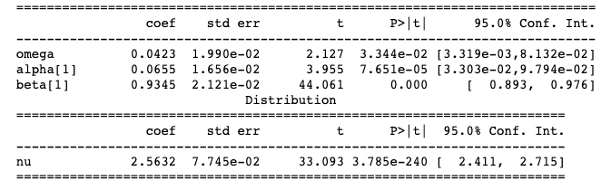
GARCH(1,1)-t_{nu}

Slide 20
Residuals and Volatility

Slide 21
Fit Diagnostic

Slide 22
TSLA Volatility

Slide 23
Time Series Prediction

Slide 24
Machine Learning
Linear Model
KNN
Decision Tree
Random Forest
Extremely Randomized Tree
Atrificial Neural Network

Slide 25
Machine Learning v1

Slide 28
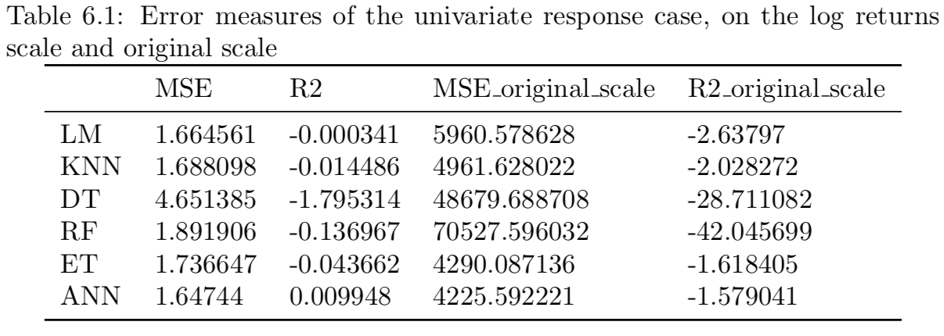

Slide 29
Machine Learning v2

Slide 32
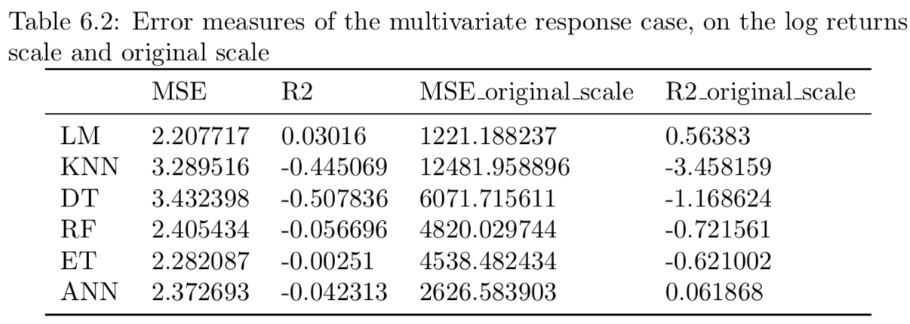

Slide 33
Conclusion
Preprocessing
Confidence intervals

