Slide 1
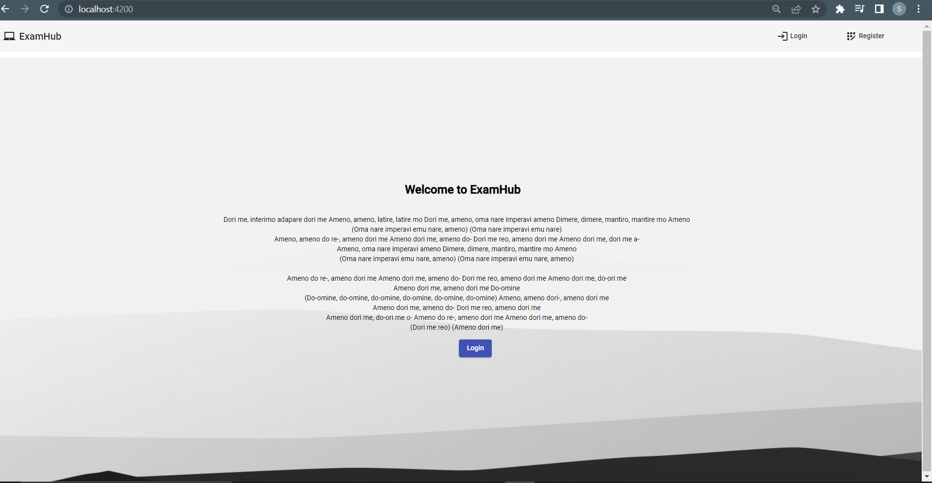
Welcome page
Notes:
The first page the user will view on entering the app

Slide 2
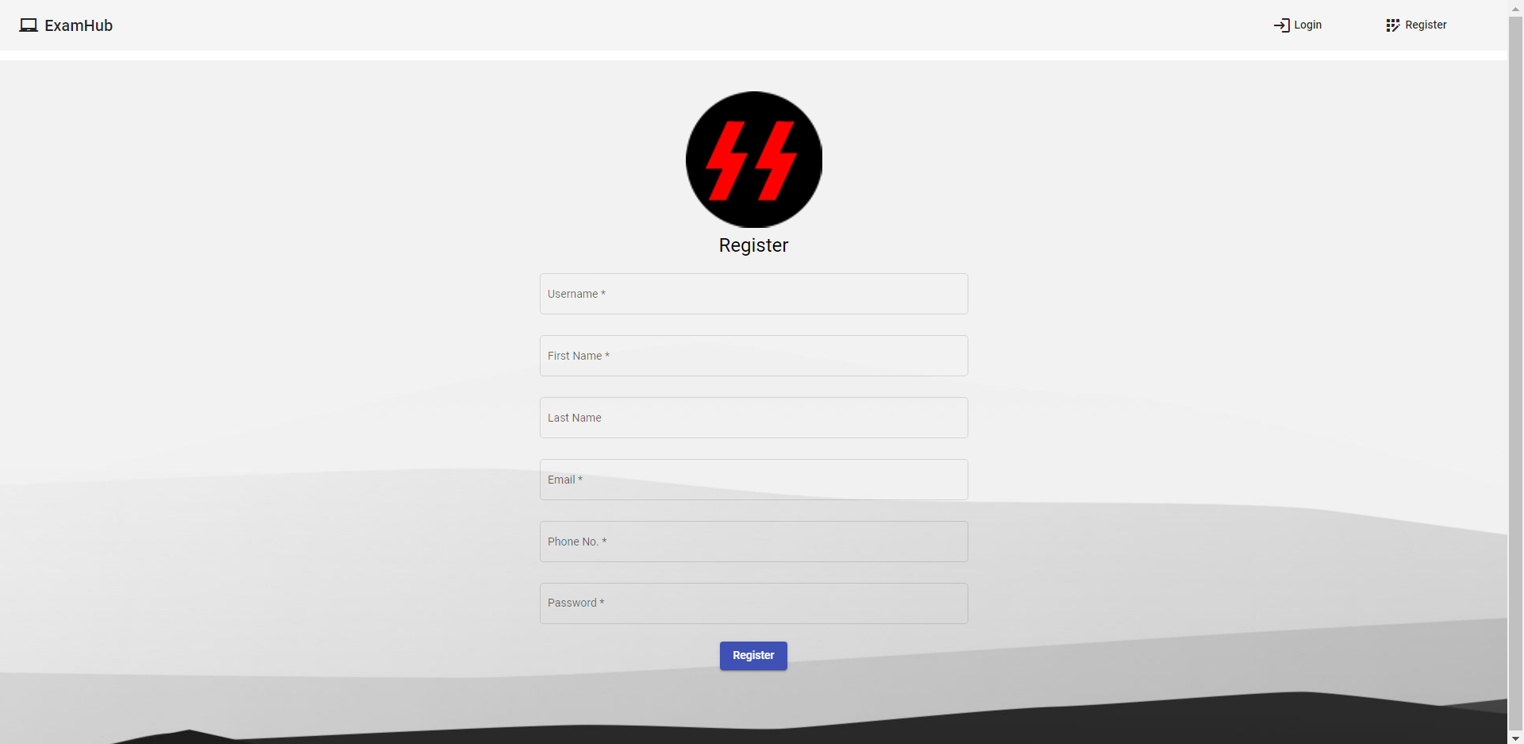
Sign up page
Notes:
If the user hasn’t registered, then he can register by filling the requested details and click on register. As of now all users trying to register via this page will automatically be registered as a normal user, and not an admin user. The option to register as an admin from the signup page can be added in the future.

Slide 3
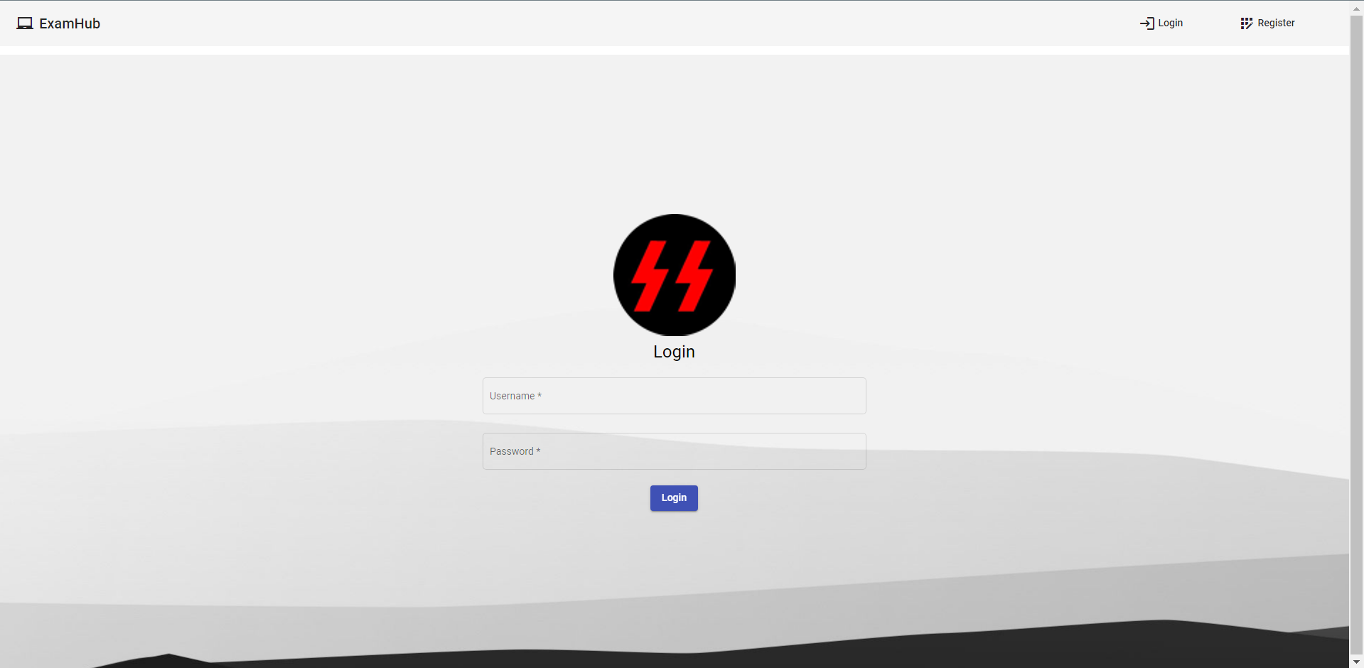
Login page
Notes:
After registering, the user can login from the login page by giving his username and password

Slide 4
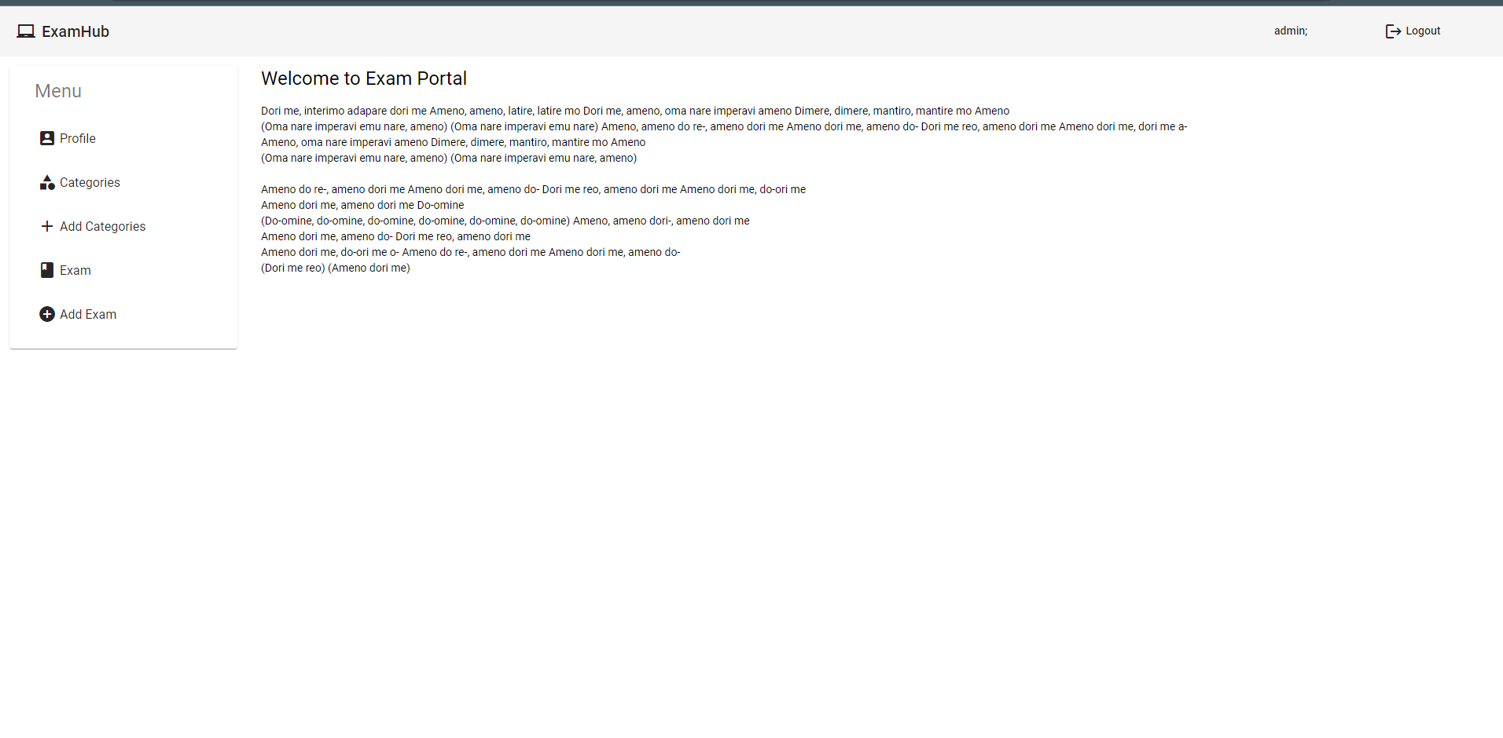
Admin UI
Notes:
This is the first page the user will see if he logged in as an admin.
NOTE: After login, the user can view a logout option in the navbar, clicking which they can logout any time. This option didn’t exist for non logged in users.

Slide 5
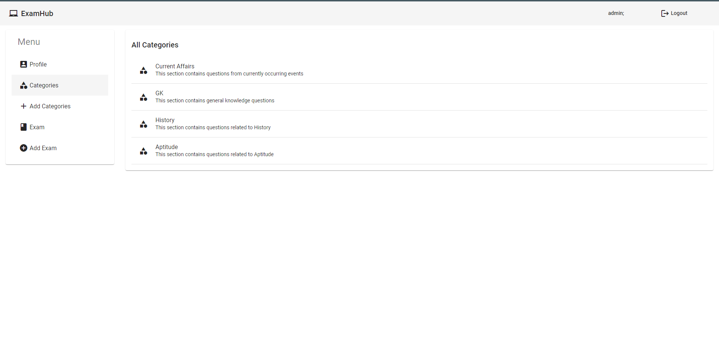
All available categories view
Notes:
The admin has got many powers. He can add/delete/modify the exam topics, the questions, and their answers

Slide 6
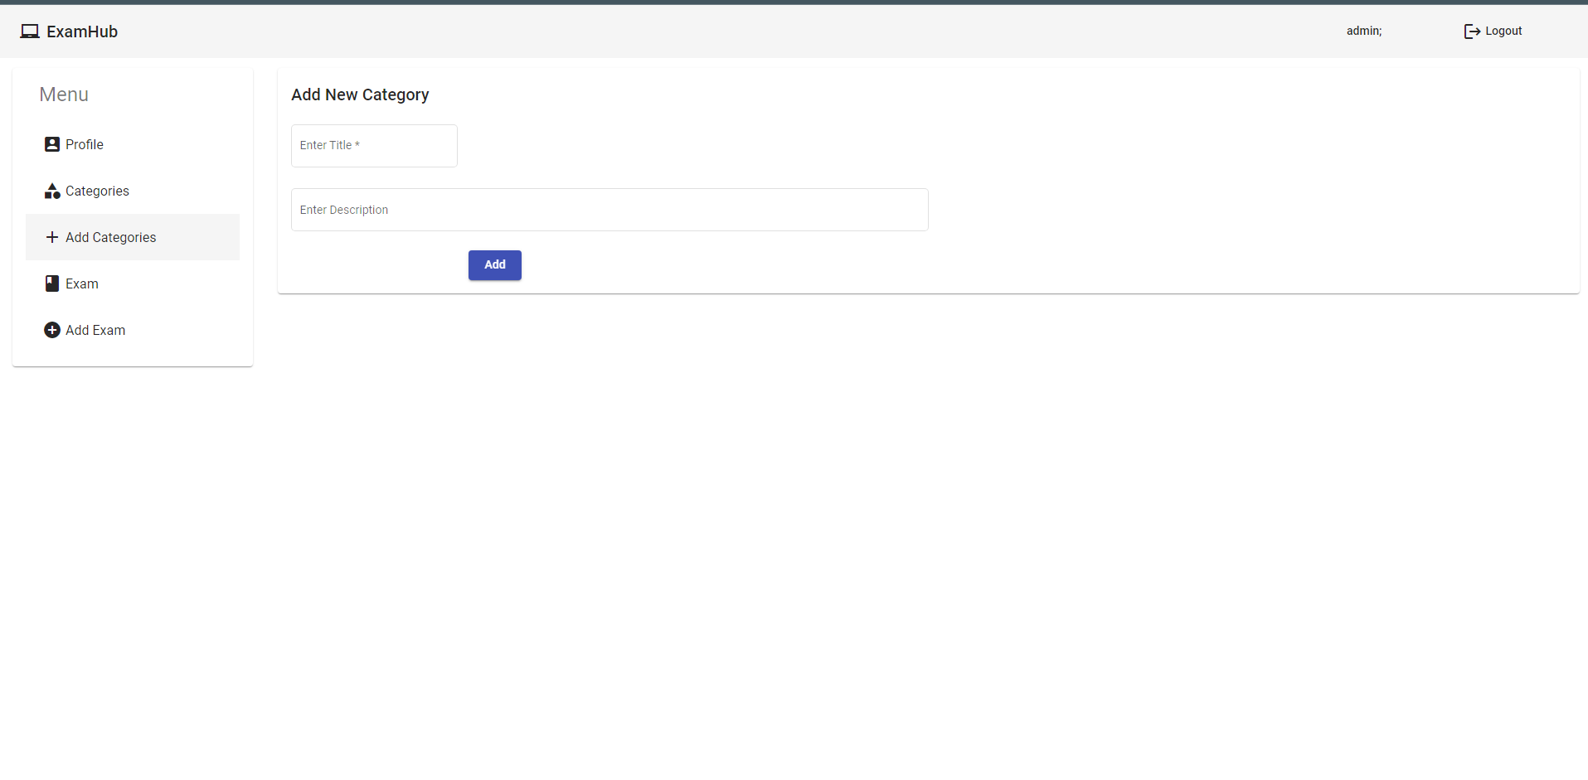
Add new category
Notes:
The admin can add a new category of the exam.

Slide 7
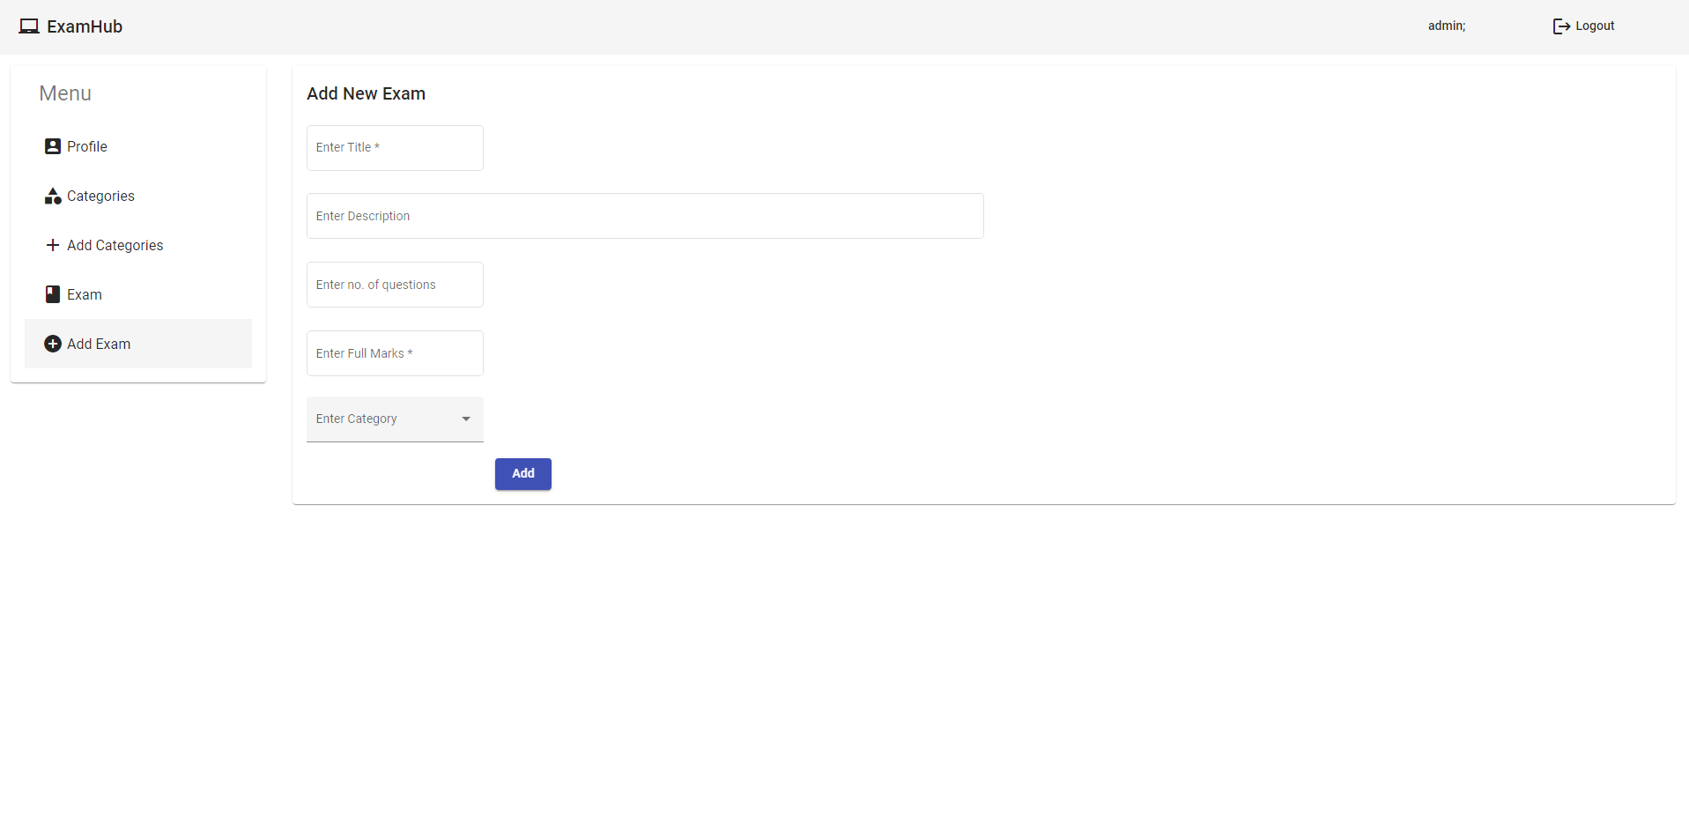
Add new exam
Notes:
The admin can add new exam under any desired category. Exam is a subset of category. Category can be correlated to subject, and Exam can be correlated to chapter.

Slide 8
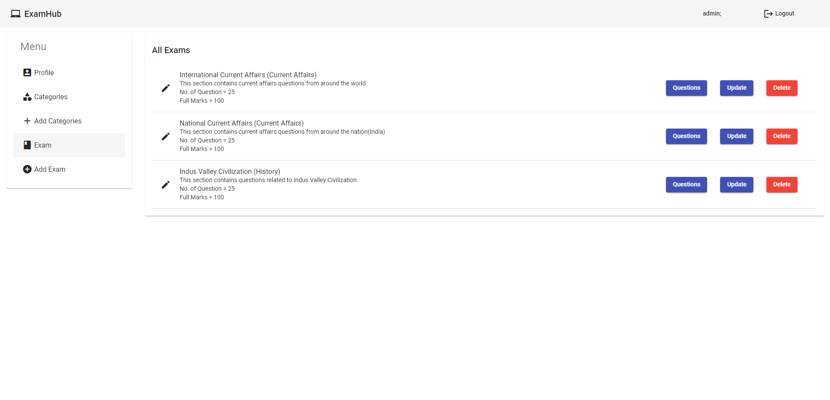
View exams
Notes:
The admin can view all existing exams, and view each of their questions, update them, or even delete them

Slide 9
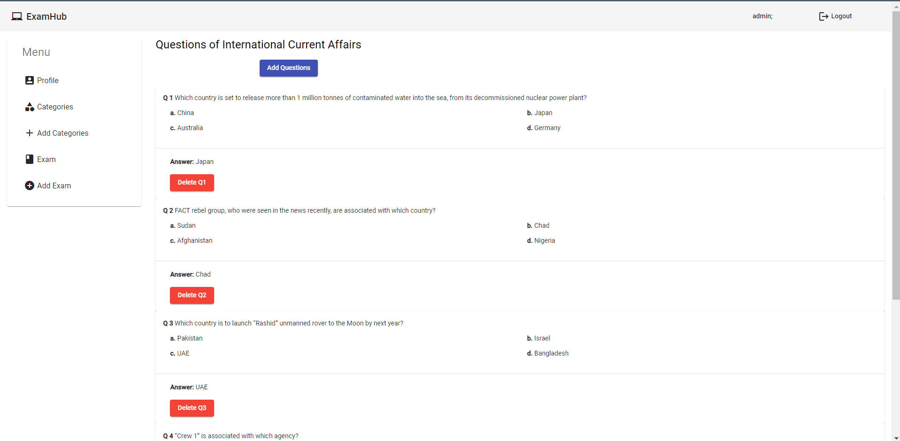
Modify questions
Notes:
The admin can view all questions and their answers, and also delete any question as well.

Slide 10
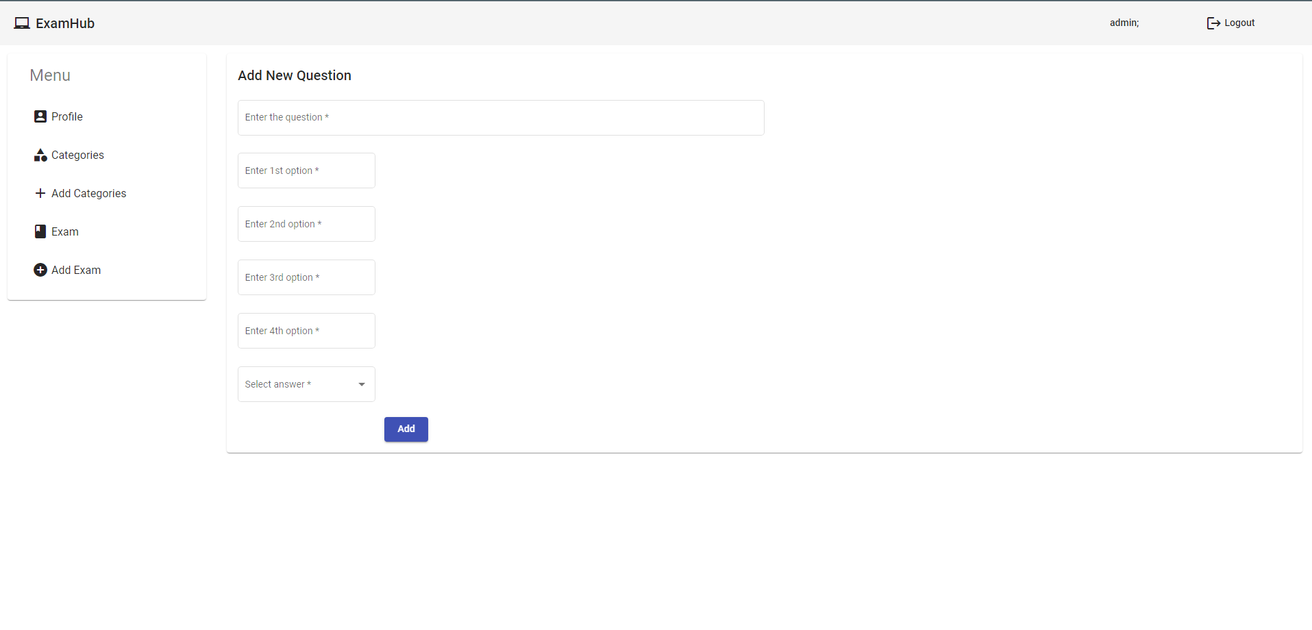
Add new question
Notes:
The admin can add a new question, provide their options, and provide the correct option as well

Slide 11
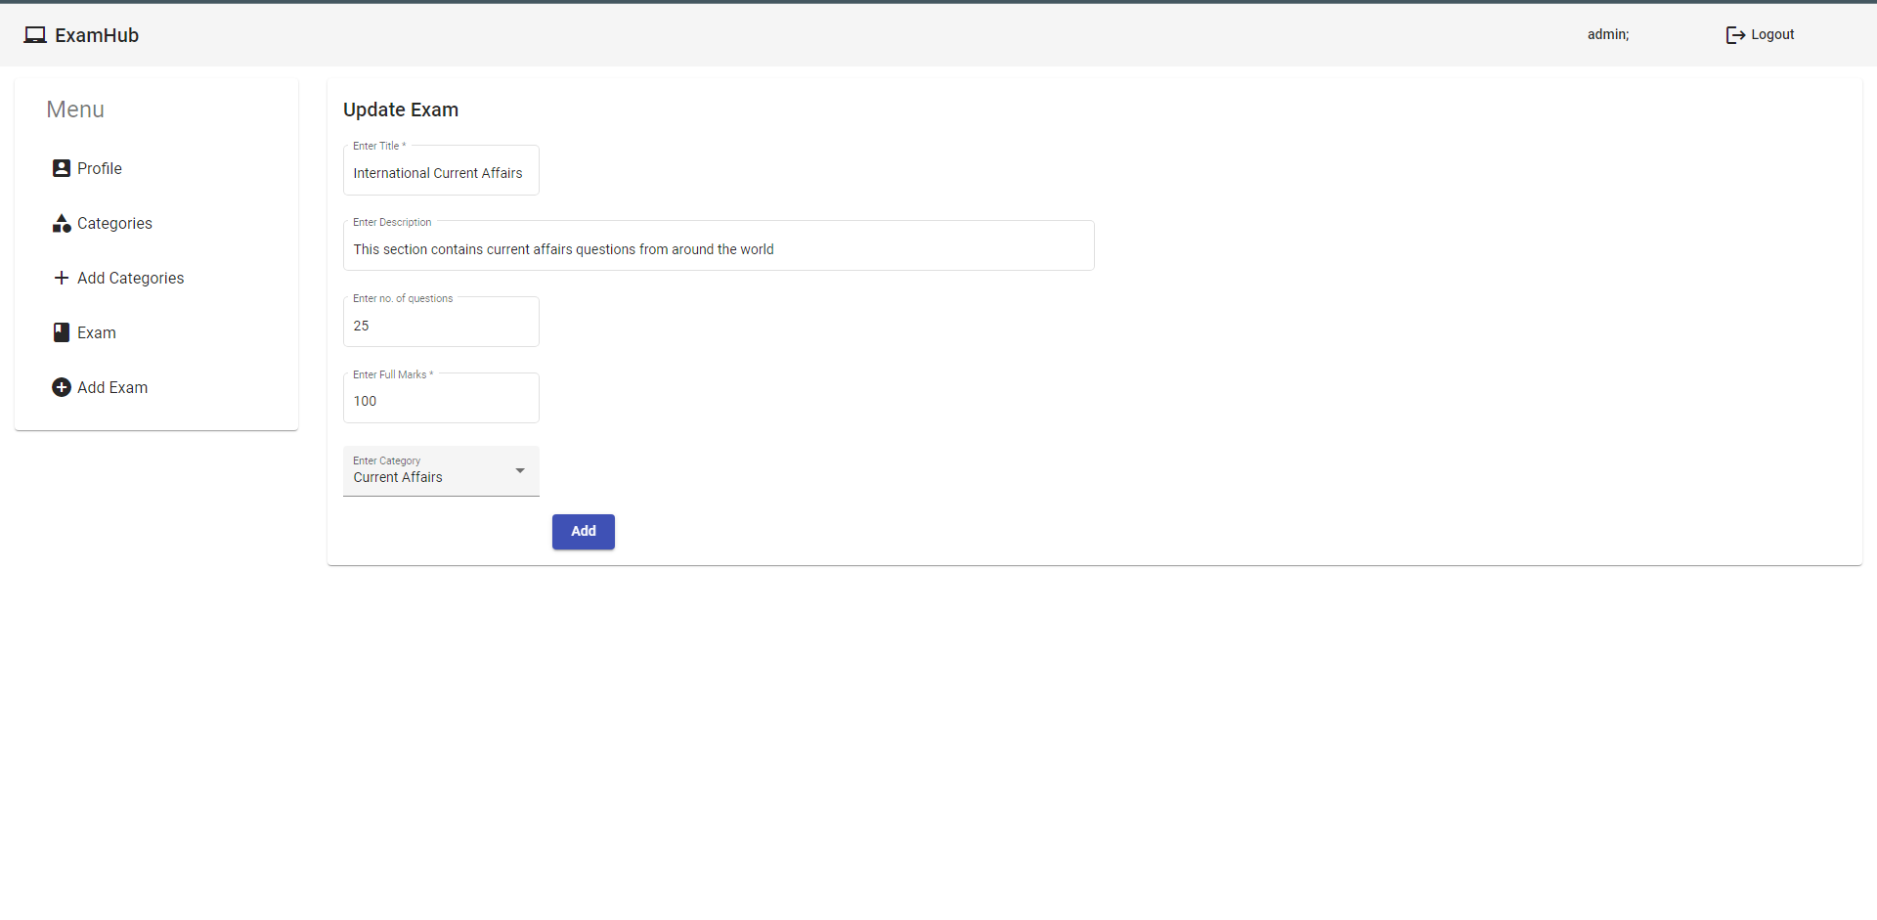
Update Exam
Notes:
The admin can edit the existing features of the exam.

Slide 12
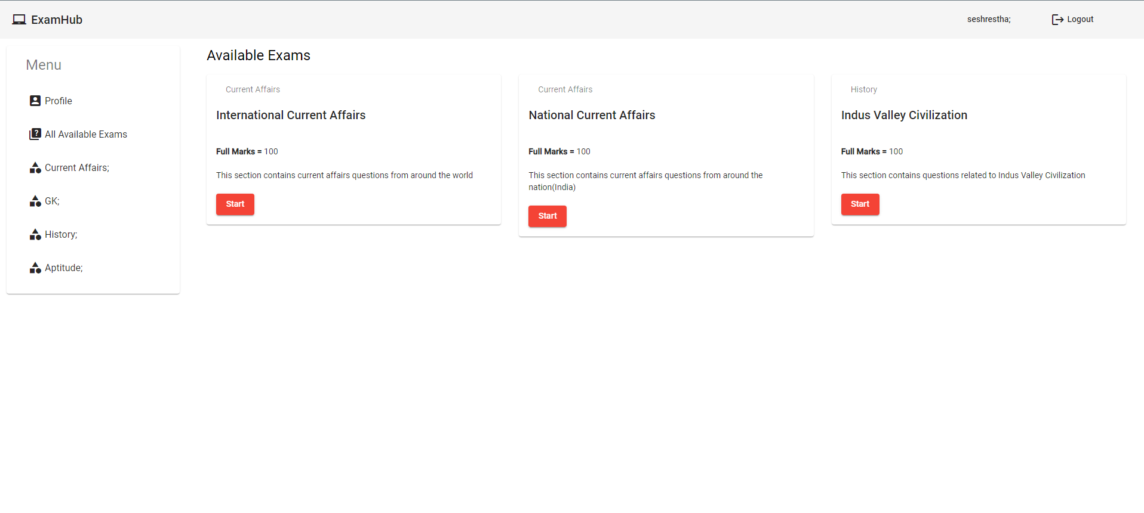
Normal user UI
Notes:
The first page a normal user would view on logging in.
NOTE: Normal user can’t enter admin ui and vice versa. If they try, they’ll be redirected to the login page.

Slide 13
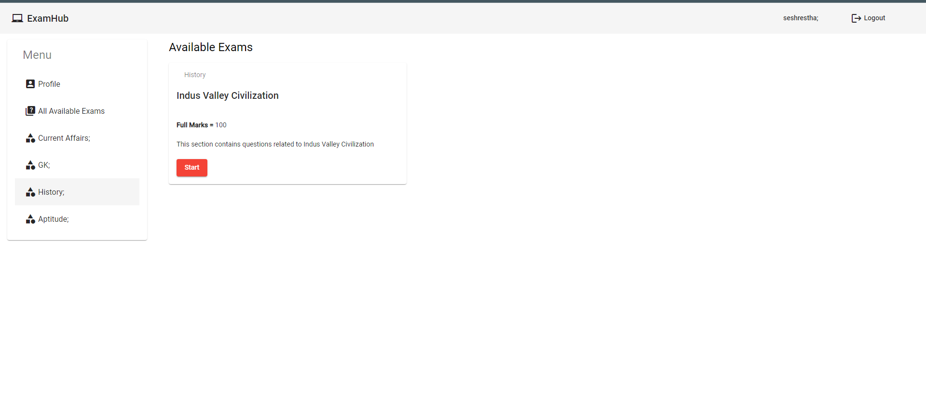
Category-wise view
Notes:
Users can view exams based on its category

Slide 14
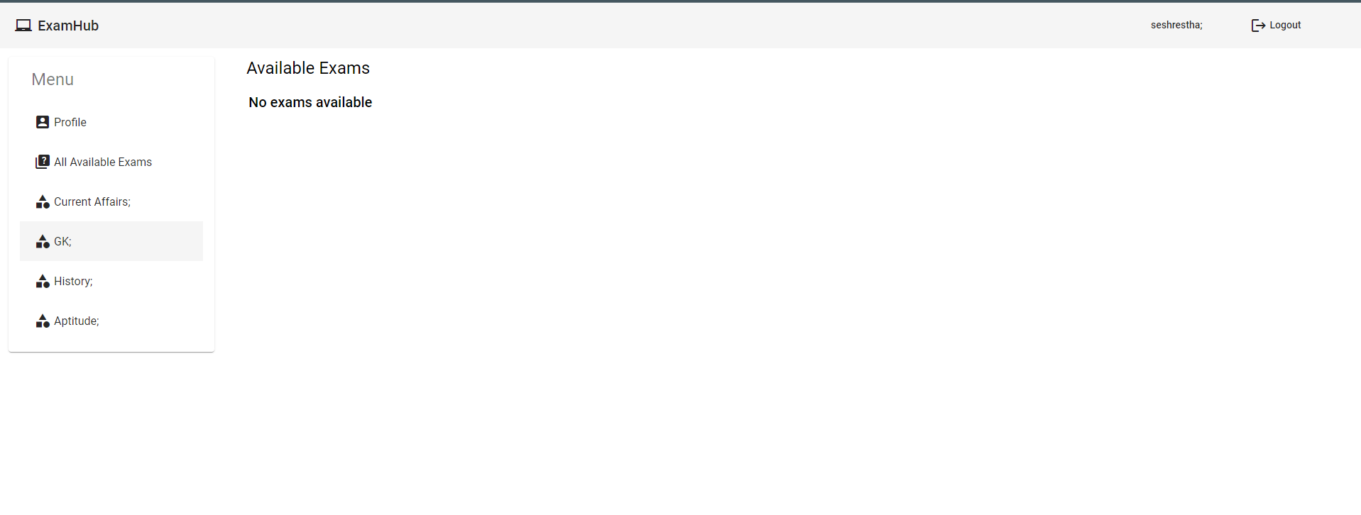
Category-wise view when no exam available
Notes:
View when there’s no exam available for a particular category

Slide 15
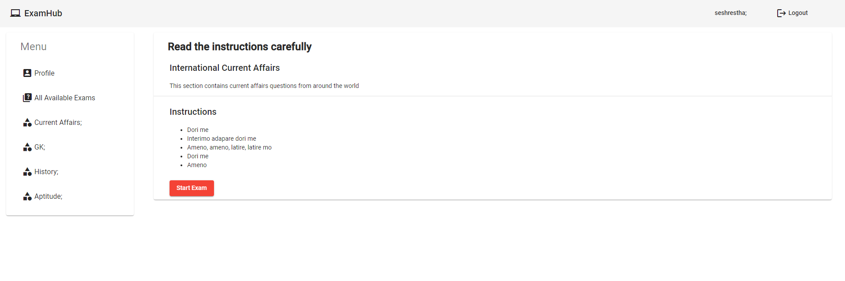
Exam instructions
Notes:
On clicking start for any exam, the user will be directed to the instructions page

Slide 16
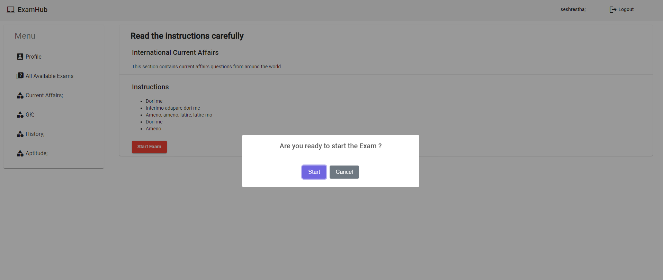
Confirmation before finally starting the exam

Slide 17
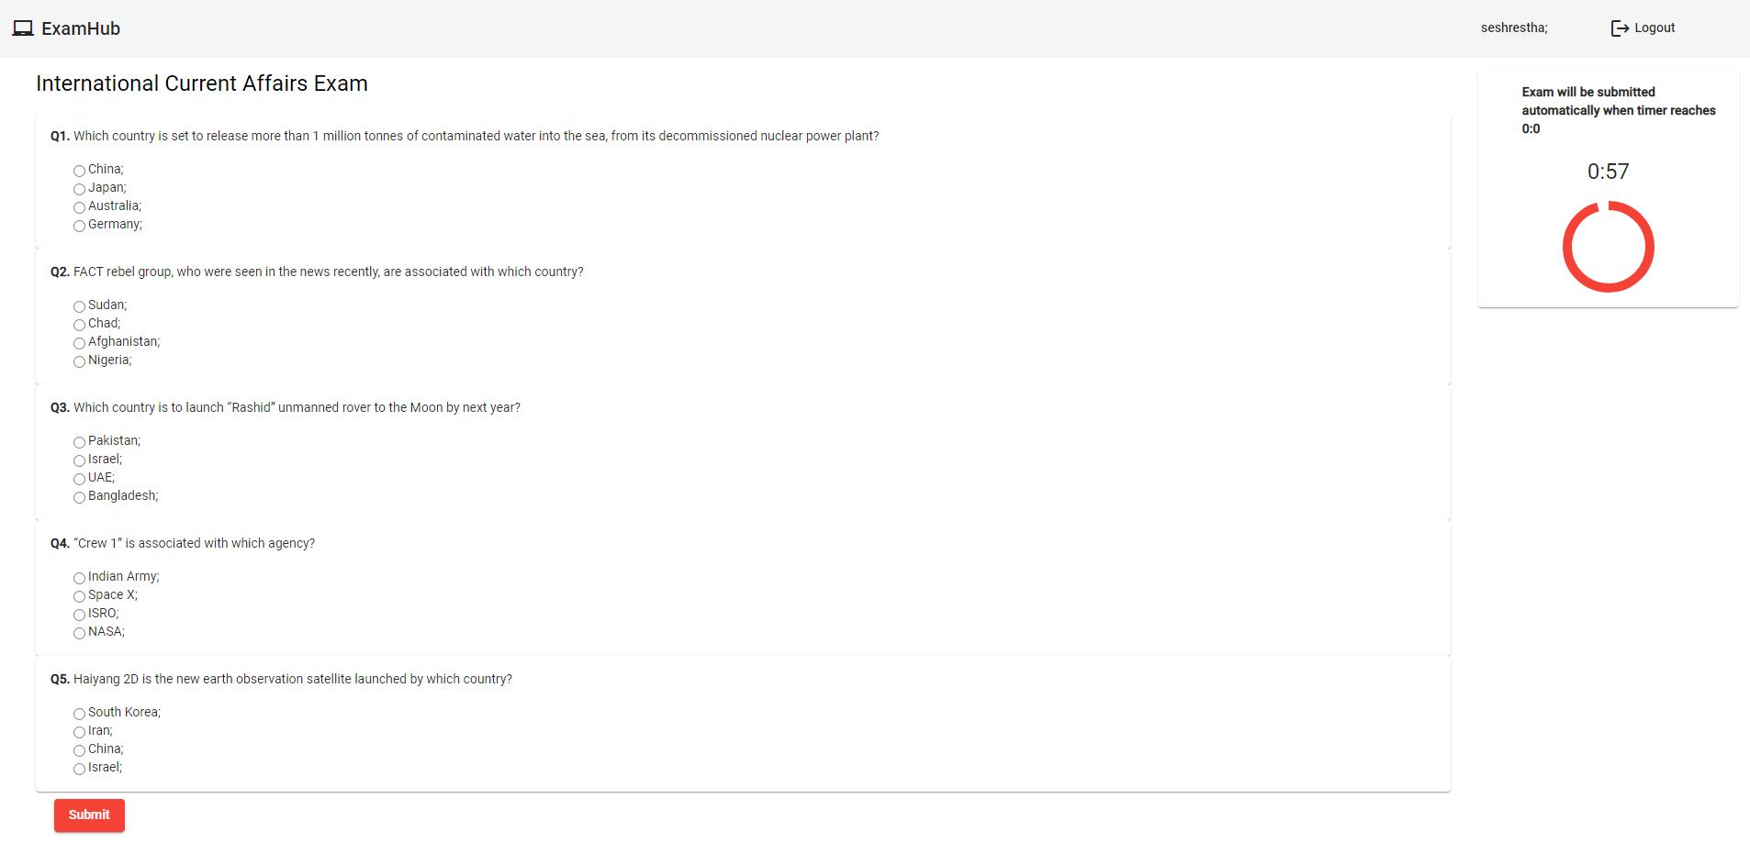
Exam page
Notes:
User can submit the exam by himself. If he fails to do so before the time ends, then the exam will be submitted automatically.

Slide 18
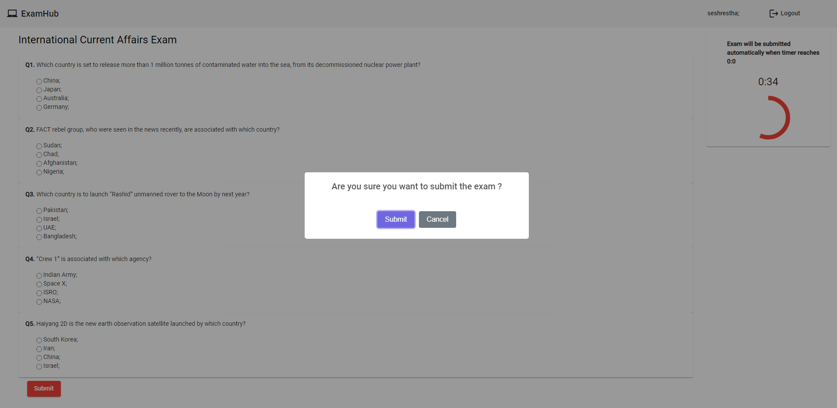
Submit

Slide 19
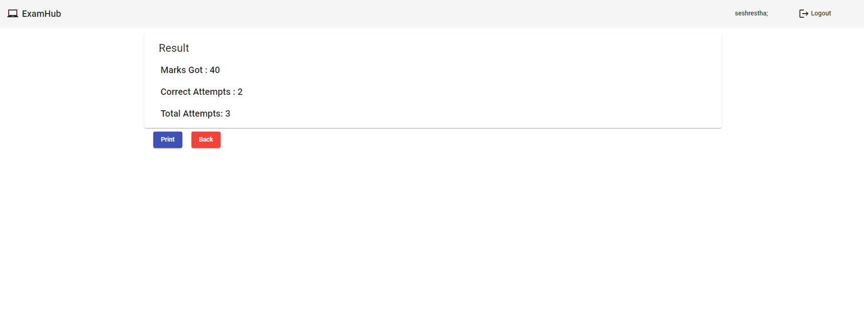
Exam result
Notes:
User can take a printout of the result as well. Clicking back will redirect user to all available exams page

