Slide 1
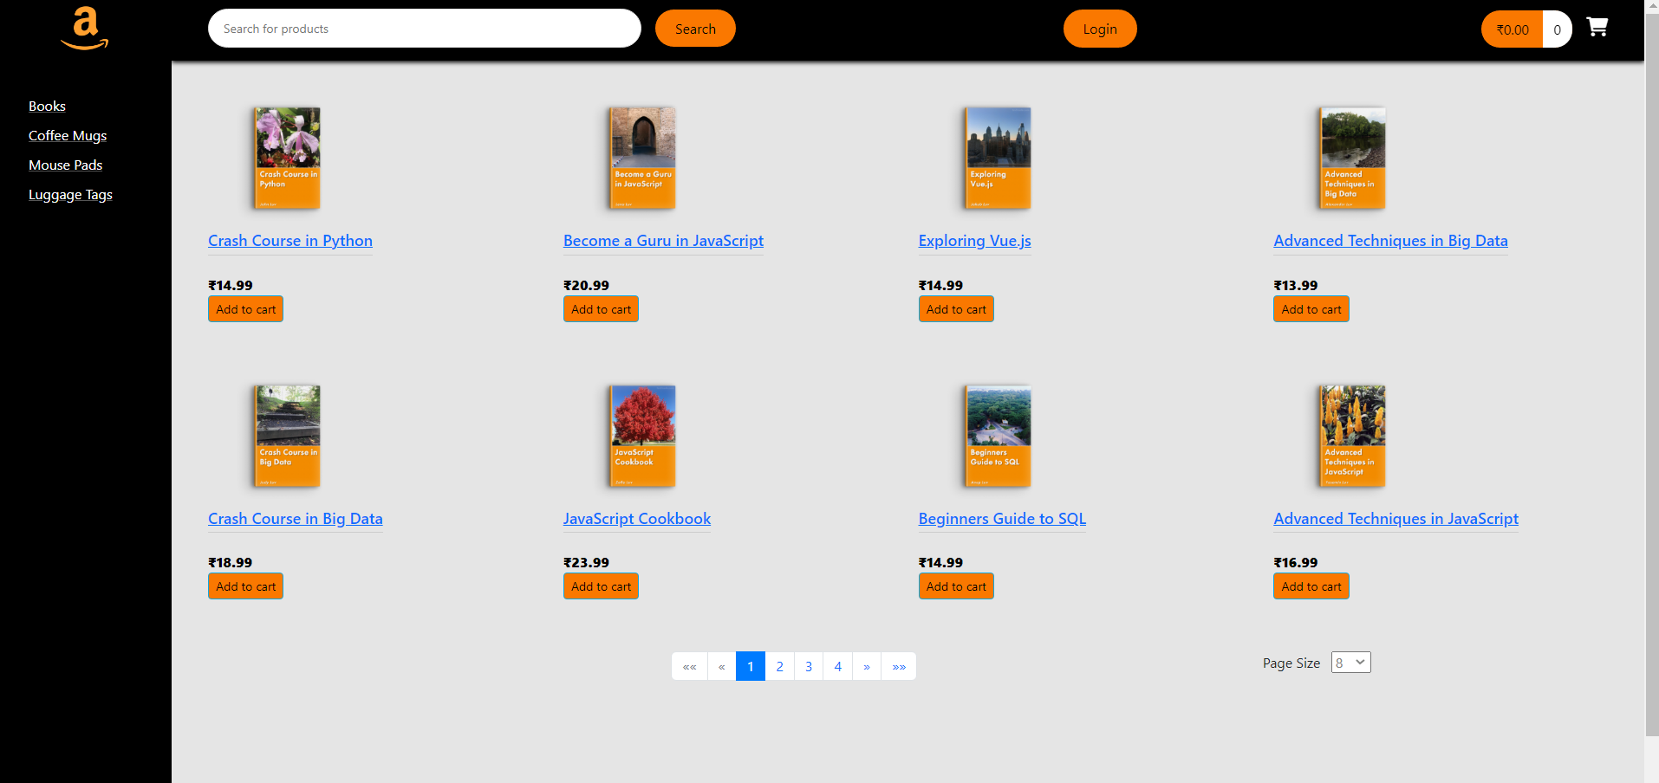
Home page
Notes:
First page any user views when he enters the app

Slide 2
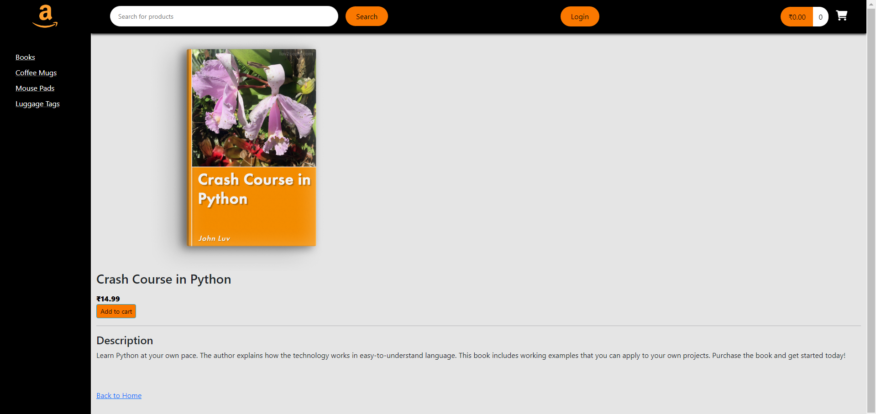
Detailed view of product
Notes:
User can see details of any products by clicking on it

Slide 3
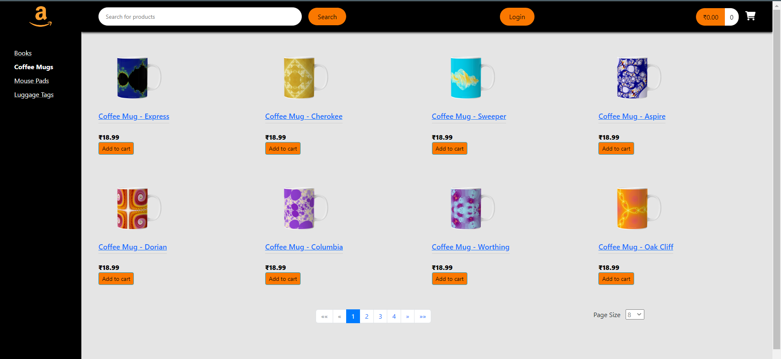
Category-wise view
Notes:
User can click on any category(left menu bar) and view its products.

Slide 4
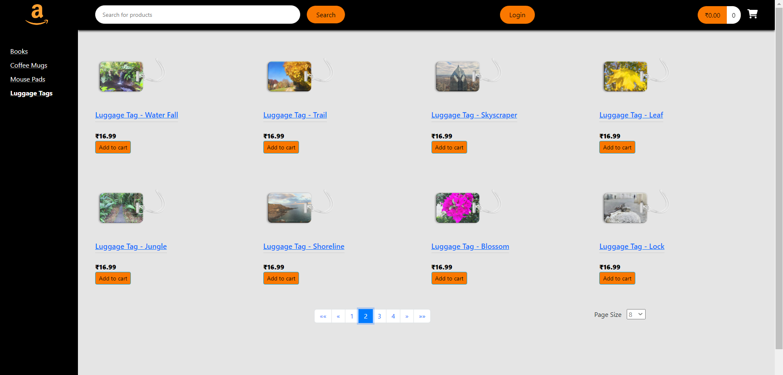
Pagination
Notes:
Pagination implemented for entire page

Slide 5
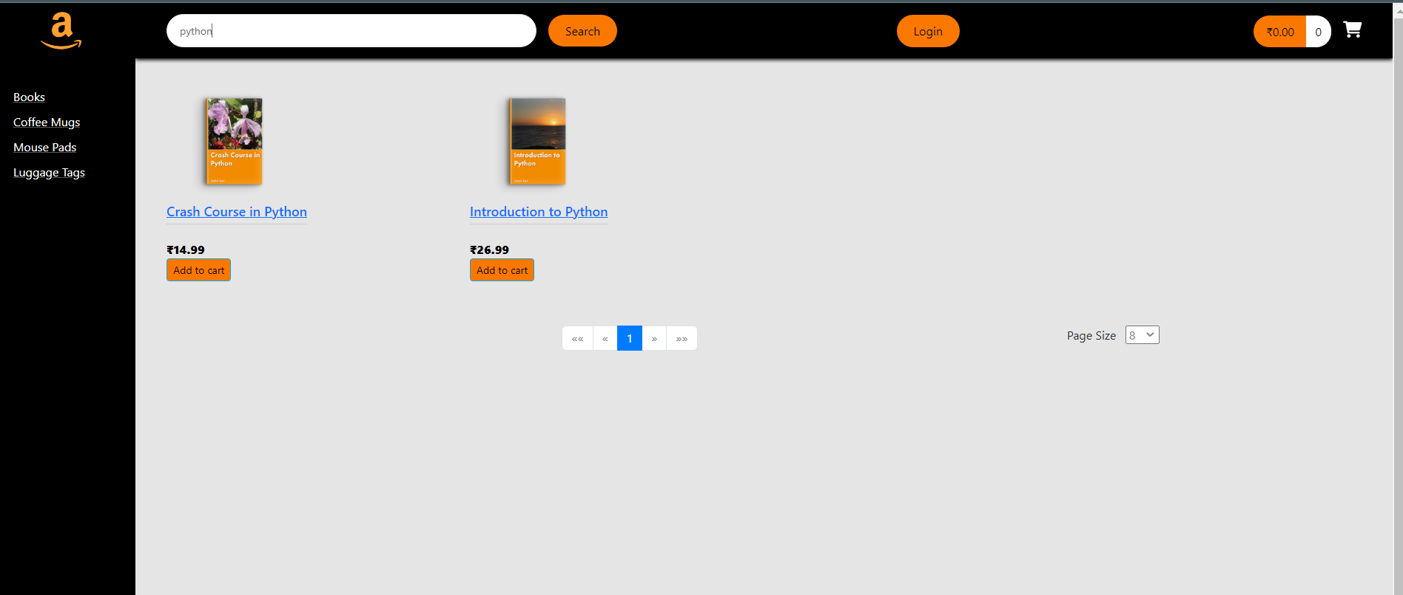
Search
Notes:
User can search any keyword and view all products having that keyword

Slide 6
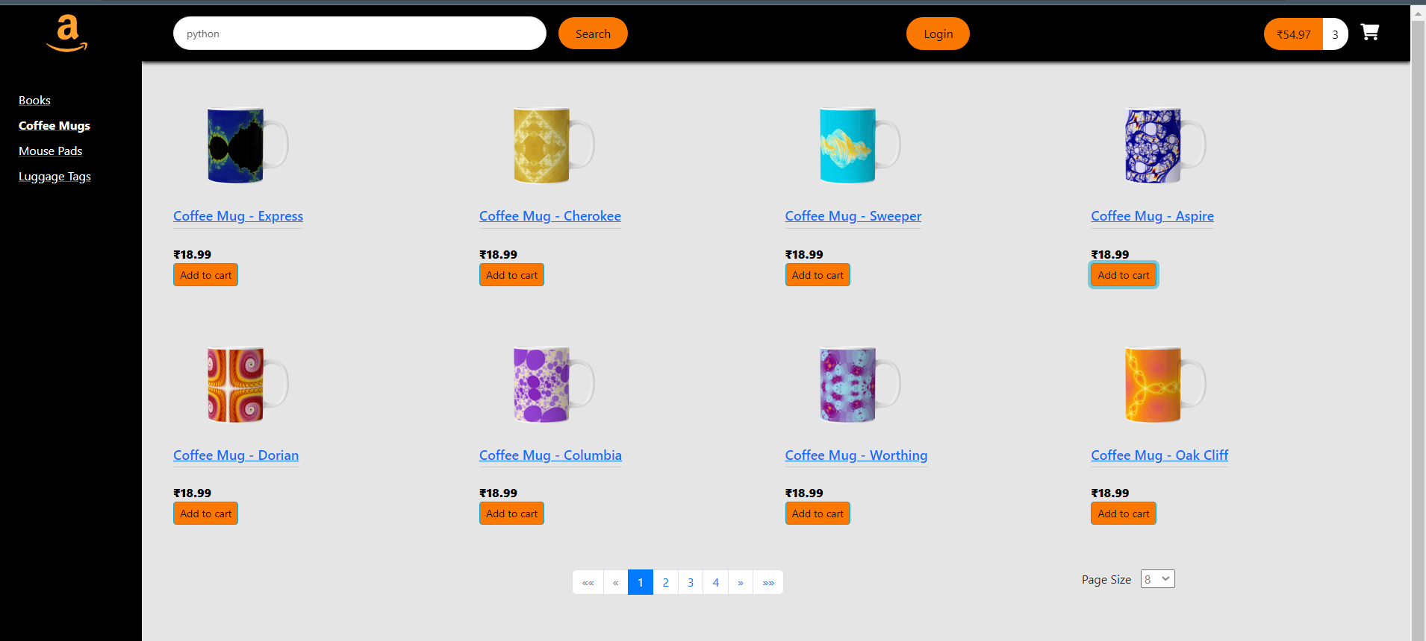
Add to cart
Notes:
User can click and add any items to cart.

Slide 7
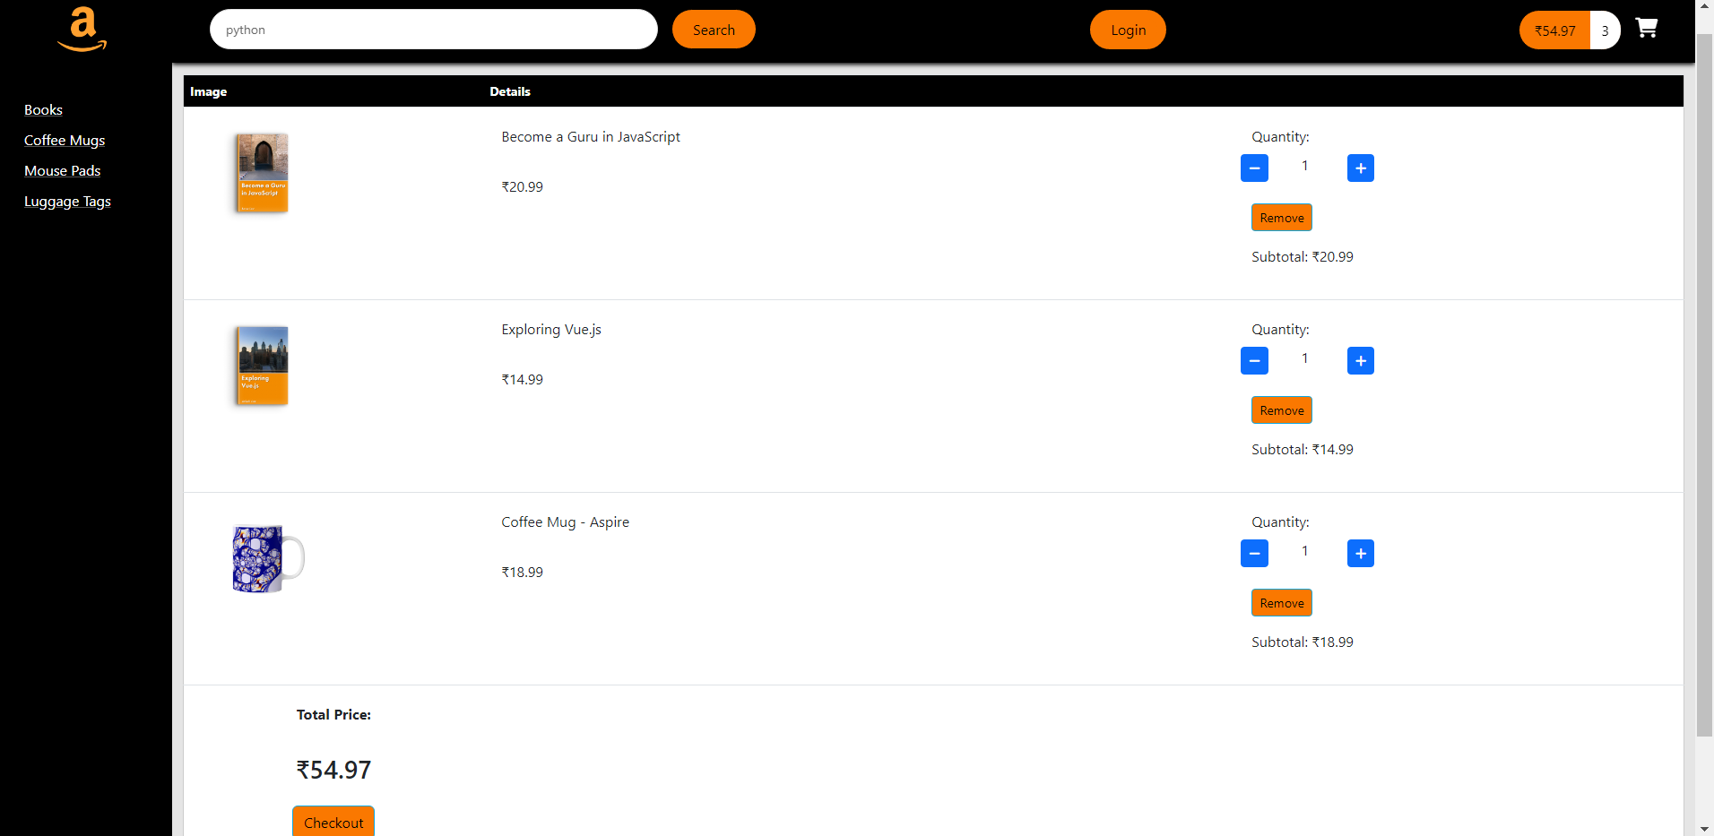
Inside cart
Notes:
All added items displayed in cart. User can add or remove any existing item in the cart.

Slide 8
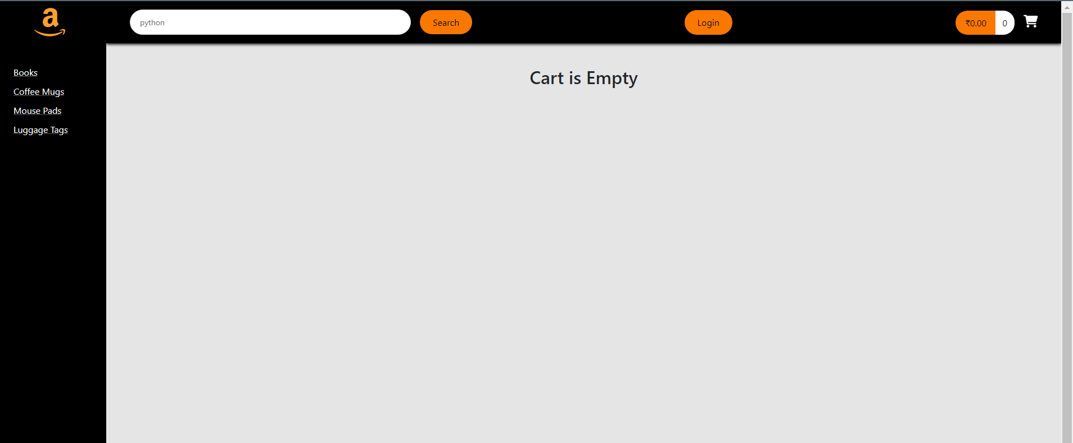
No items in cart
Notes:
View after all items in cart removed by user

Slide 9
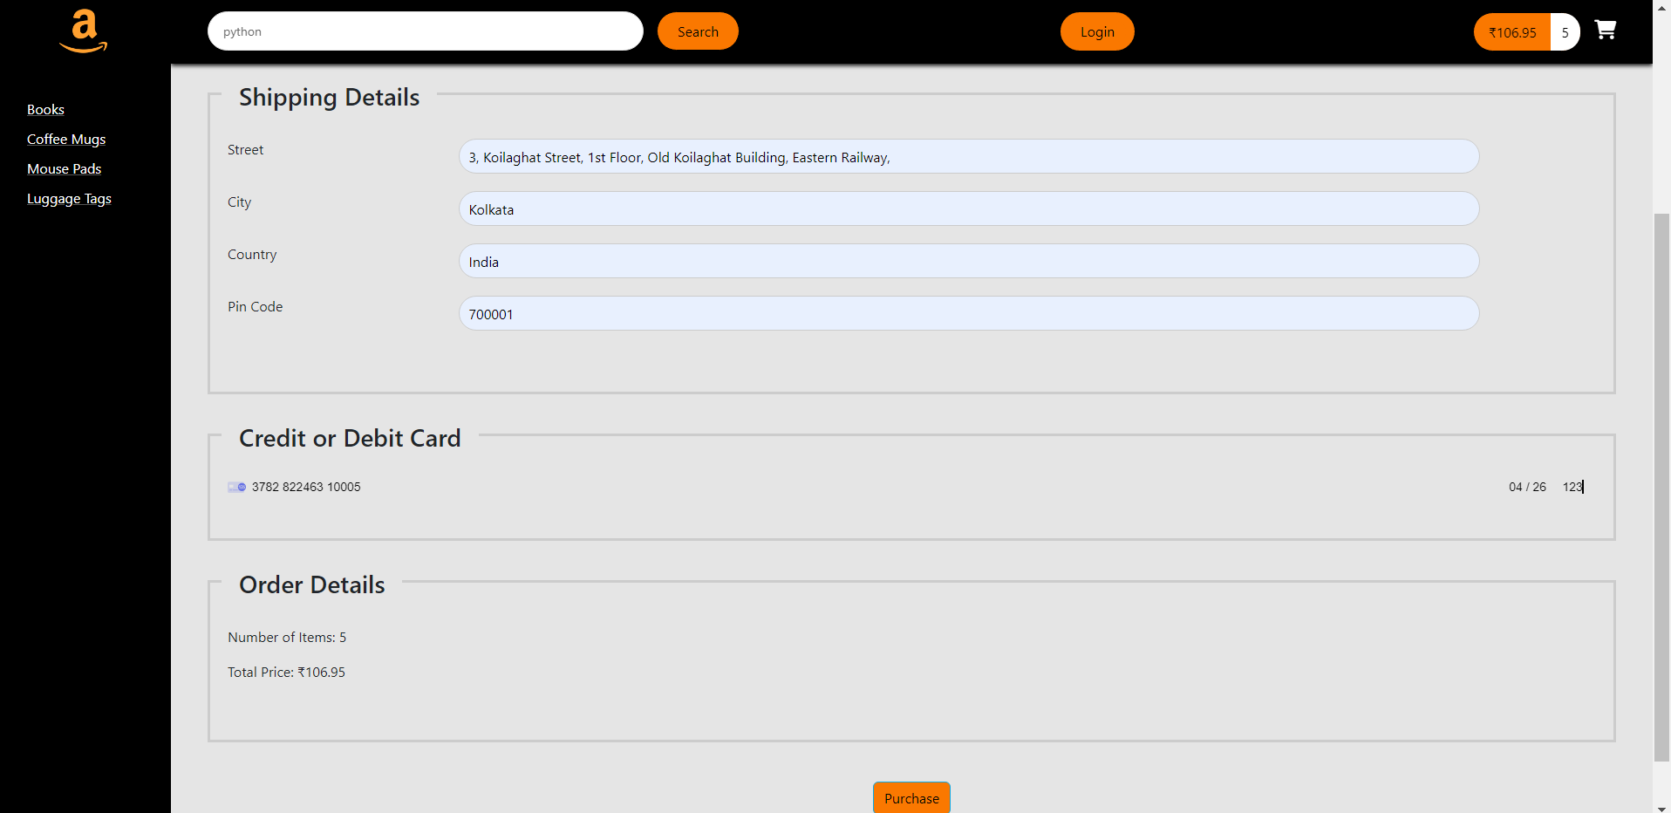
Checkout page

Slide 10
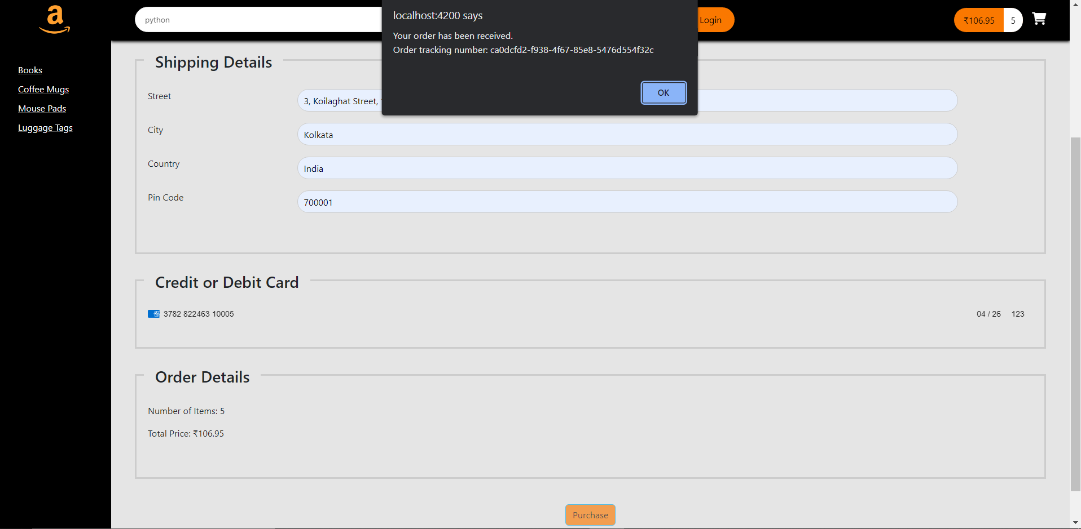
Items purchased
Notes:
NOTE: As visible user can not click purchase button multiple times, to avoid multiple requests to the server

Slide 11
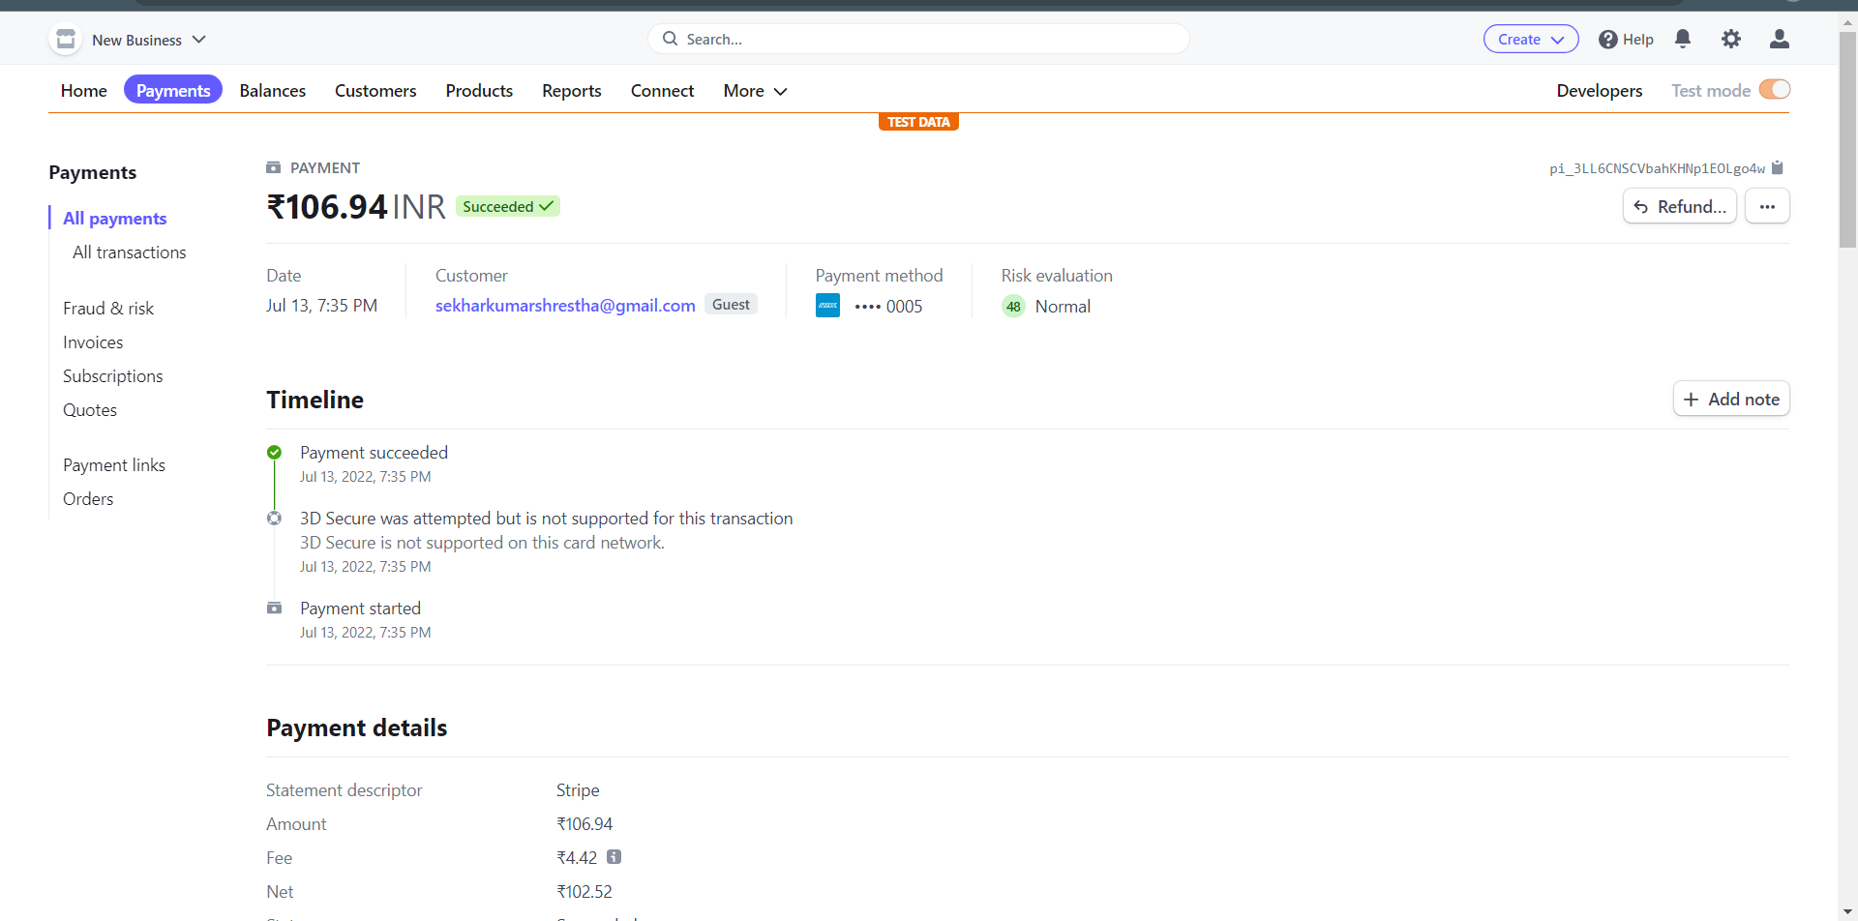
Stripe page
Notes:
The stripe test page shows login successful

Slide 12
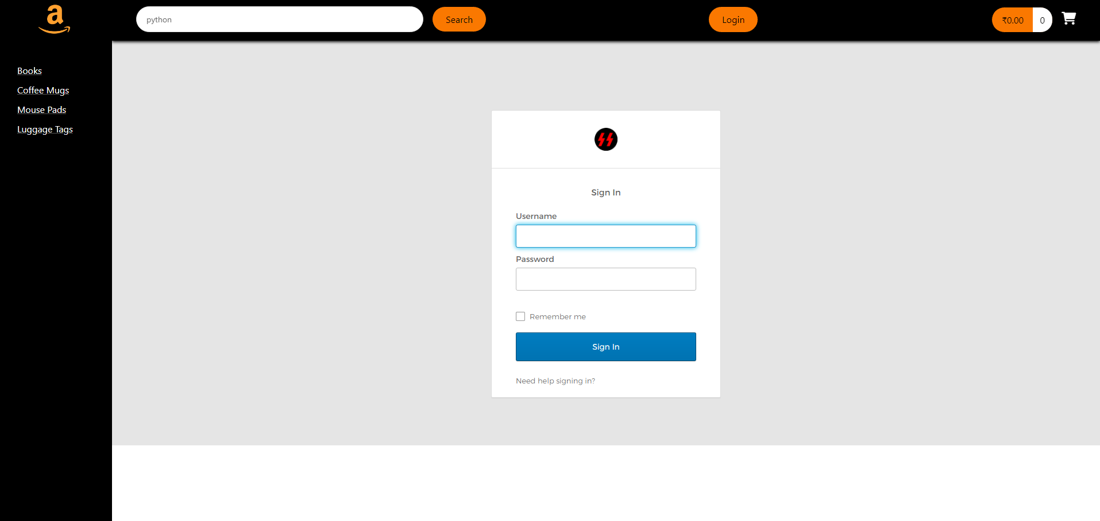
Login page
Notes:
Users can login and access more features too

Slide 13
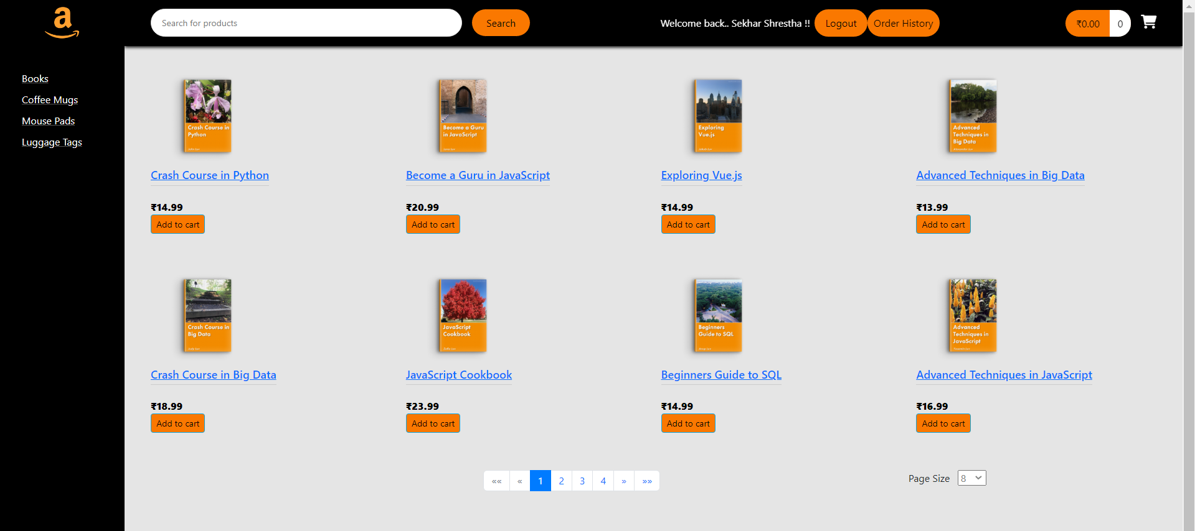
Logged in user
Notes:
Note the navbar

Slide 14
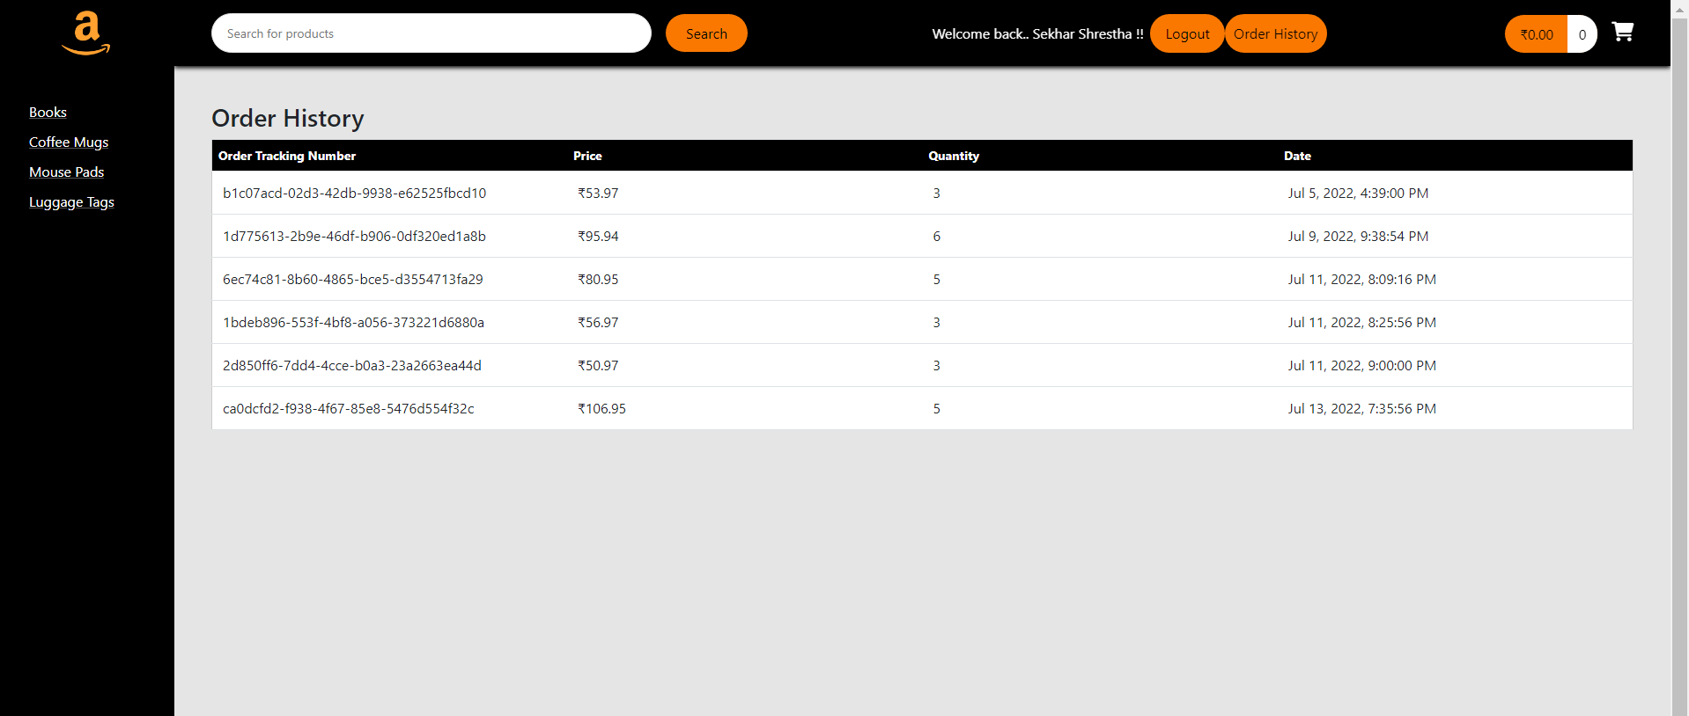
Order history
Notes:
On clicking order history, user can view all the orders he has done for the mail id with which he logged in

