Slide 1

Crime Data Analysis and Prediction Using Machine Learning A comprehensive analysis of crime data to predict high and low crime zones Sonal Sekhda& Wilmer Cifuentes December 06, 2024

Slide 2
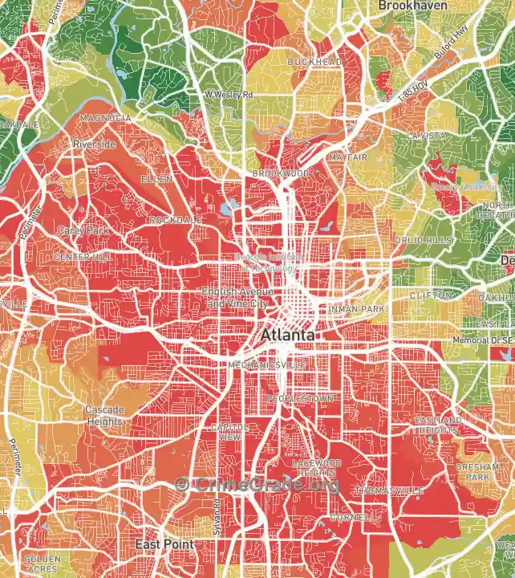
Introduction
Cities are facing increasing crime rates, and predicting crime trends can help with urban planning and resource allocation.
The goal is to predict whether a crime zone is high-crime or low-crime based on historical data.
Problem Statement:
"We aimed to predict whether a crime zone in Atlanta is high-crime or low-crime using historical crime data. This prediction could help in law enforcement and urban safety strategies."

Slide 3
Dataset Overview
Dataset:
Historical crime data from Atlanta.
Key features: Day of the Week, Crime Category, Zone, Beat, Victim Count, Location, Longitude, Latitude, etc.
Data Size: 153,591 records, 25 columns.
Challenges: Handling missing data and removing irrelevant columns.

Slide 4
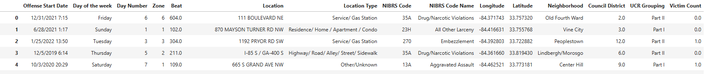
Preprocessing & Data Cleaning
Missing Data Handling:
Filled missing values for Victim Count with 0.
Forward-filling for other columns.
Irrelevant Columns Removed: Columns like Report Number, GlobalID, and OffID were discarded.
Categorical Encoding: Converted categorical columns (like Day of the Week, Location, etc.) into numerical values using Label Encoding.

Slide 5
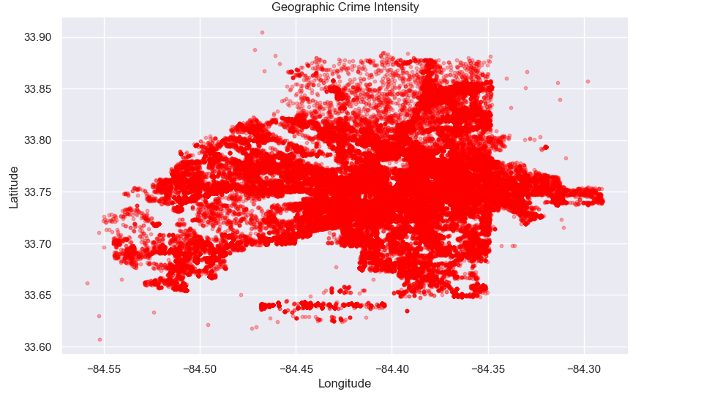
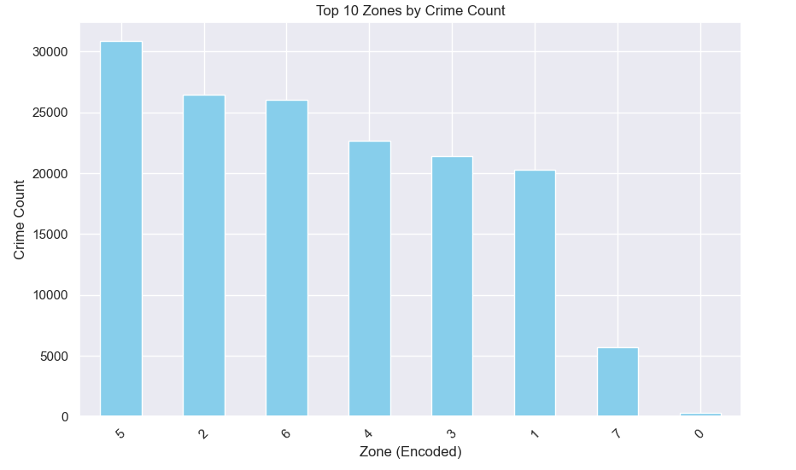
Feature Engineering
Temporal Features: Extracted the month from Offense Start Date.
Geospatial Features: Kept Longitude and Latitude for geospatial analysis.
Target Variable Creation: Created a binary target variable (Crime Label) based on whether crime in a zone exceeds the median crime count.

Slide 6

Training Data Set
The model learns from the historical data of crimes to make predictions based on features like Longitude, Latitude, Location, and other descriptors.
The dataset was split into a training set (80%) and a test set (20%) using the train_test_split function from scikit-learn
The training set has 122,871 samples and 15 features.

Slide 7
Models Used
Neural Network:
Architecture: Input layer, 4 hidden layers with 512 neurons each, dropout for regularization, output layer with sigmoid activation.
Model complied with optimizer ‘adam’, loss function binary crossentropy, and accuracy score.
XGBoost:
Powerful ensemble method for handling large datasets with grid search for hyperparameter tuning.

Slide 8
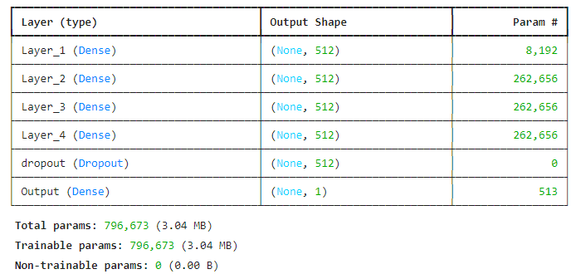
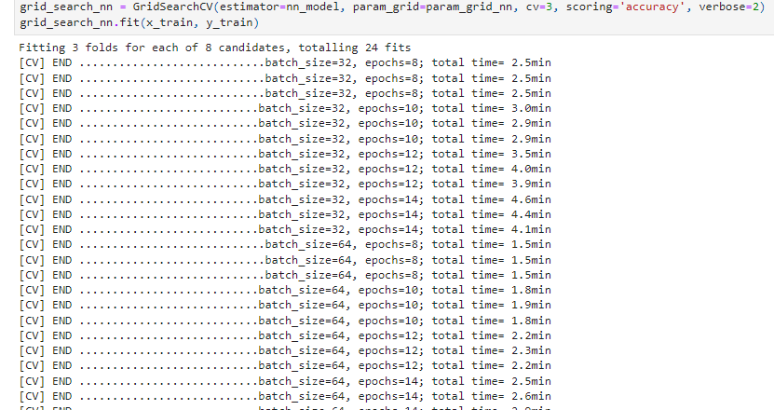
Neural Network
Model Summary:
Hyperparameter tuning for Neural Network using GridSearch

Slide 9
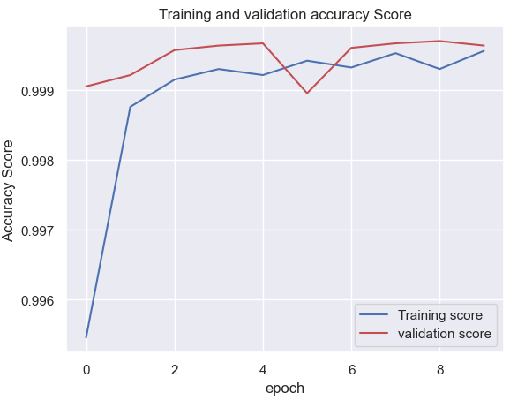
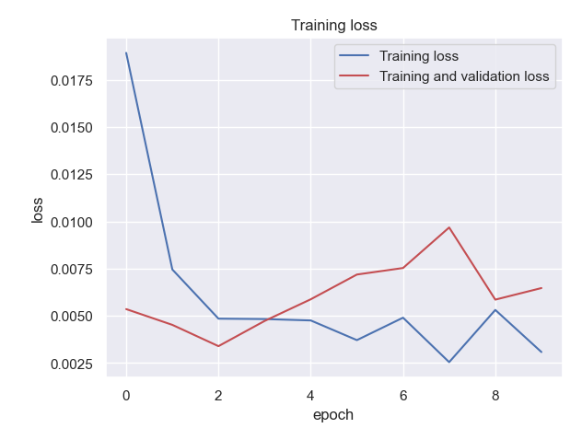
Neural Network continued
Using accuracy score and loss, plotted the graph.

Slide 10
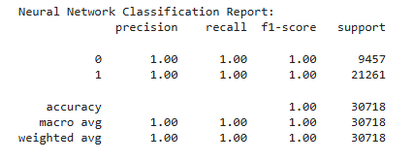
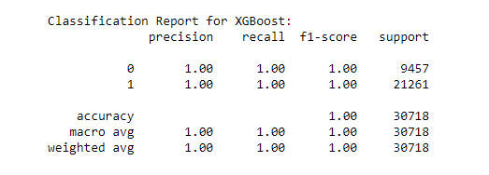
Model Evaluation & Results
Metrics:
Accuracy, Precision, Recall, and F1-score to evaluate model performance.
Results:
Neural Network: 99.99% accuracy, but overfitting observed.
XGBoost: 99.99% accuracy, faster training, and better precision/recall.

Slide 11
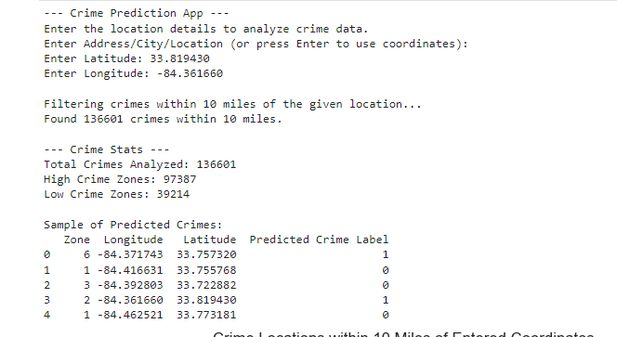
User Input for crime prediction
Using Geopy library: tried to allow the user to input an address and predict the crime statistics.

Slide 12
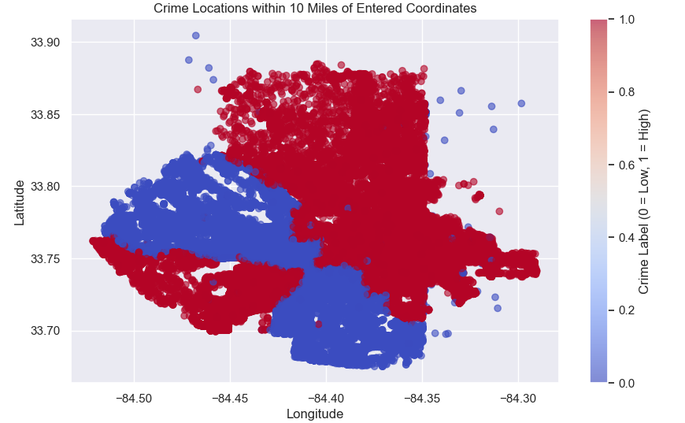
Insights & Analysis
Crime Trends:
Higher crime rates in months (seasonal trends).
Central Atlanta and residential areas show concentrated crime zones.
Top Crime Zones: Highlight zones like Old Fourth Ward and Vine City with higher crime rates.

Slide 13
Challenges & Limitations
Data Quality:
Missing values, particularly in victim count and Neighborhood.
Overfitting:
Neural network showed signs of overfitting.
Geospatial Variability:
Potential improvements by incorporating additional data such as neighborhood demographics

Slide 14
Conclusion & Future Work
Conclusion: Both models work well for predicting high and low-crime zones, with XGBoost showing better performance.
High-accuracy classification models.
A dynamic real-time crime analysis tool.
Actionable insights for urban planners and law enforcement agencies.
Future Work:
Incorporate more features (crime type, time of day).
Further model optimization with more complex algorithms (e.g., time-series models).
Integrate real-time crime data feeds for live predictions.
Expand feature engineering to include socioeconomic and environmental data.
Deploy the tool as a public-facing web application.

Slide 15

THANK YOU

