Slide 1

TEAM MEMBERS
SEKINAT
SUSANA
AYISHATU
CYNTHIA
REJOICE
FAAVIEL
PORTIA

Slide 2


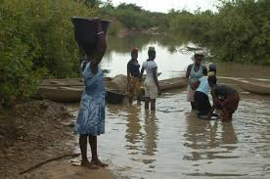
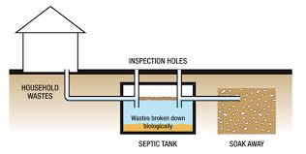
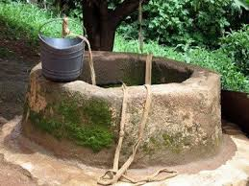
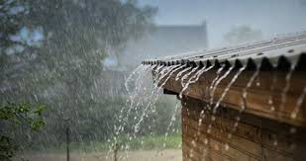
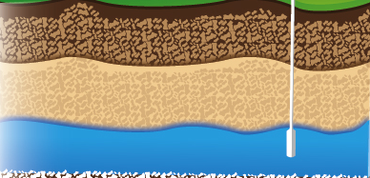
What is life if there are no humans?
All water sources are prone to pollution
They should be tested before drinking
according to cdc.gov ‘You should have your water and your system tested regularly and maintain the system properly’

Slide 3
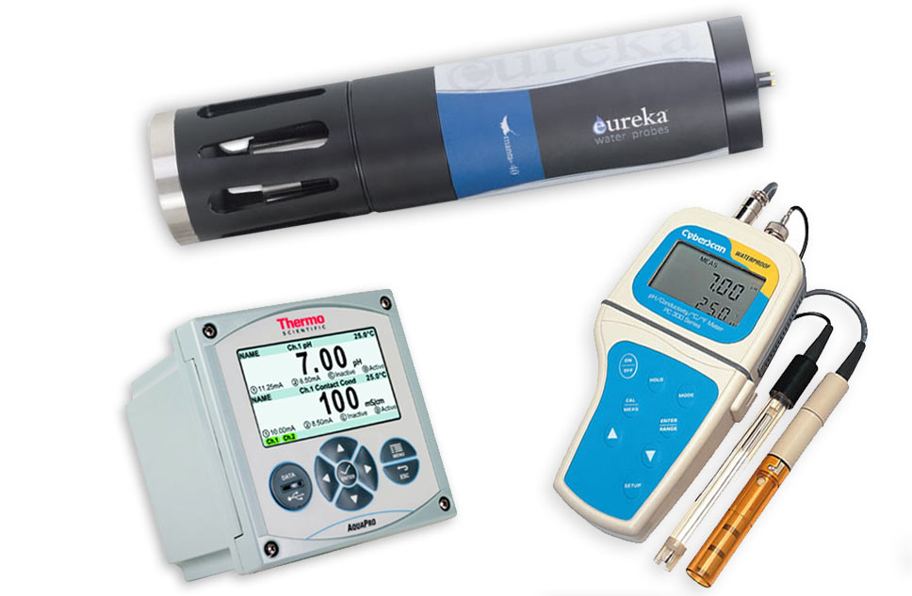
Why SDG 6
Globally, diarrhoeal diseases and malaria accounted, respectively, for 4 percent and 3 percent of DALYs lost and 1.8 and 1.3 million deaths in the year 2002. This burden is almost entirely concentrated in the
group under 5 years of age
water quality monitoring devices are not readily available. they are analog
It is estimated that, on average, each child under 5
years of age in a developing country suffers from three episodes of diarrhoea per year, with little change over the years (Kosek et al., 2003)

Slide 4
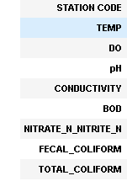
Our Solution
we have created a water quality prediction device, to make individuals aware of their water quality
Input features are physico-chemical properties
IOT
MACHINE LEARNING
Water Quality Prediction Device

Slide 5
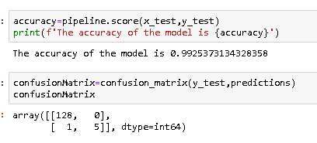
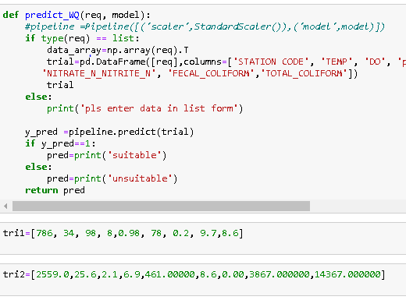
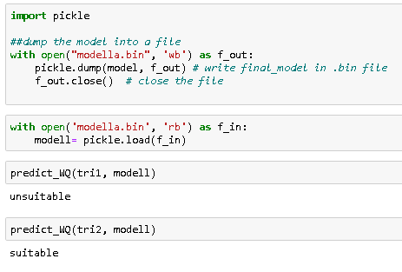
Our Solution
99% Accuracy!!

Slide 6

OUR DEVICE
IOT SENSORS SENDS DATA
(IoT) sensor collects and exchange data using embedded sensors.
[786, 34, 98, 8,0.98, 78, 0.2, 9.7,8.6]
SENSOR
DATA
UNSUITTABLE

Slide 7
Conclusion
Tell people to boil water before use
Segregate drinking water from household water
Inform the government to provide safe water source for rural areas
know your water!!!

Slide 8

THANK
YOU

