Slide 1
Spam Detection with Neural Networks
Ludvig Sundström
John Shaw

Slide 2
Project Goals
Study machine learning techniques for spam detection
Implement a well-performing spam filter using artificial neural networks

Slide 3

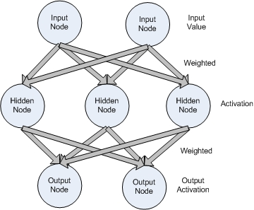

About spam
87-90% of emails
$200 million business
Anti-Spam companies
Spamming techniques vs spam filters
Notes:
Should mention the importance of classification of the word context instead of words meaning.

Slide 4



About spam
Expensive
Annoying
Dangerous(?)

Slide 5
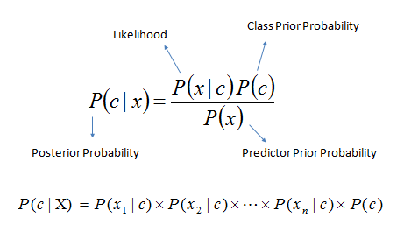
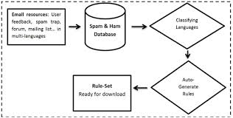
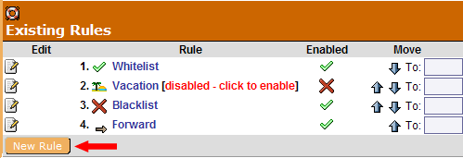
Anti Spam
Naive Bayes Classifiers
SVM
ANN
Rule Based

Slide 6

Preprocessing and feature extraction
How do decide the important parts of a message
Transforming a String into a Numeric vector

Slide 7
Implementation
Deciding initial set of features
Finding optimal network parameters
Removing redundant features, deciding most important features for training

Slide 8
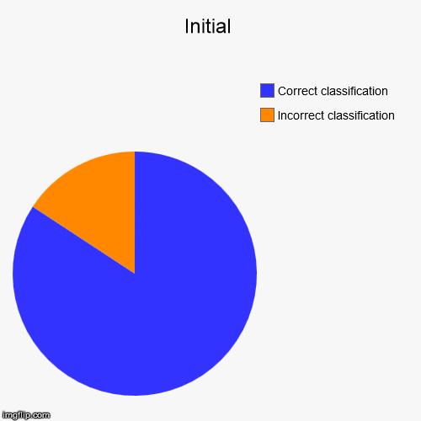
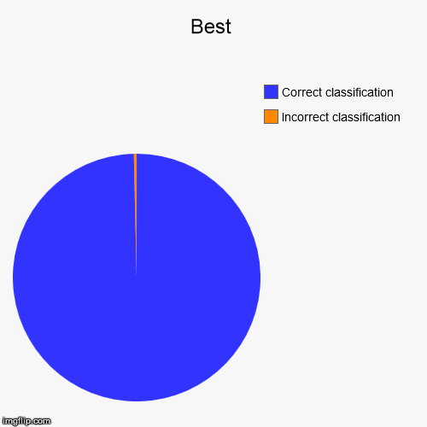
Results
Best result, initial set of features: 84.24%
Best result, reworked features: 99.63%

Slide 9
Results
Most important parameters:
Average word length.
Average sentence length.
Word diversity.
Measure of “short” words.

Slide 10
Conclusions
Neural networks can classify spam messages without operating on the individual words
Mapping each individual feature value to the output range helped a lot
The network needs really little information about a message in order to classify it

Slide 11
Conclusions
Future work:
Generalisation to more datasets.

Slide 12

Questions

