Slide 1
TITLE
Final presentation
Comprehensive Design
SUNGKYUL UNIVERSITY
Information Communication Engineering
Speaker : Kim WonJung

Slide 2
CONTENT
01
Team Introduction
02
Project Overview
03
Project Introduction
04
Achievement status

Slide 3
01
Team Introduction
TeamName Introduction
Member
2019.6.19 Comprehensive Design final

Slide 4

01
Team Introduction
Teamname Introduction
“We Are Yasimzak.”
2019.6.19 Comprehensive Design final

Slide 5
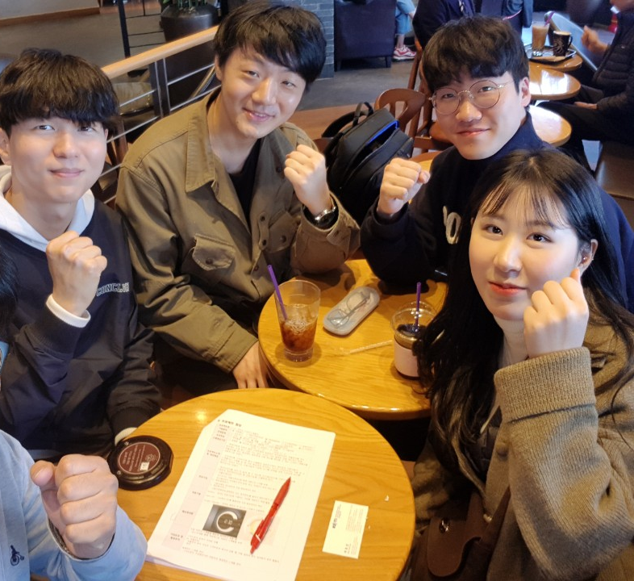
01
Team Introduction
Member
Kim Wonjung (leader)
Hardware
-
Arduino
Kim donguk
Software
-
Android
Sin sekyu
Chief of Development
-
Software(Server)
Lim yeji
Hardware
- 3D print & Design

Slide 6
CONTENT
01
Team Introduction
02
Project Overview
03
Project Introduction
04
Achievement status

Slide 7
02
Project Overview
Why Smart-Scheduler?
The Goal of Project
2019.6.19 Comprehensive Design final

Slide 8
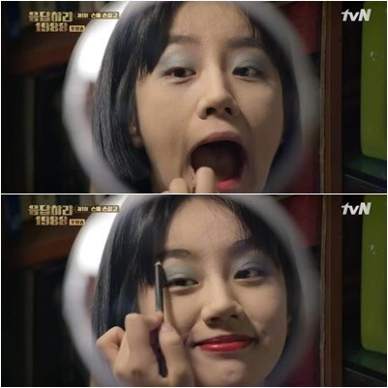

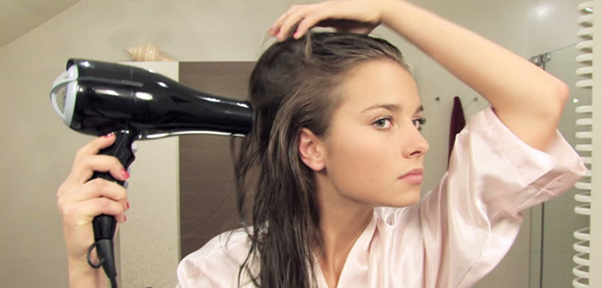
02
Project Overview
Why Smart-Scheduler?
2019.6.19 Comprehensive Design final

Slide 9
02
Project Overview
The Goal of Project
Attractive
Essential
Practical
Reasonable
2019.6.19 Comprehensive Design final

Slide 10
CONTENT
01
Team Introduction
02
Project Overview
03
Project Introduction
04
Achievement status

Slide 11
03
Project Introduction
Introduction
Details
2019.6.19 Comprehensive Design final

Slide 12




03
Project Introduction
Introduction
A
Introduce one line
It is a smart scheduler that manages time by intuitively looking at the daily schedule that combines the stored Android watch with the existing living room clock.
B
Development Environment and language
Server : Node. JS
IDE : Android studio
Development language : C , JAVA(Android studio) ,
JAVA SCRIPT(Node JS)
2019.6.19 Comprehensive Design final

Slide 13


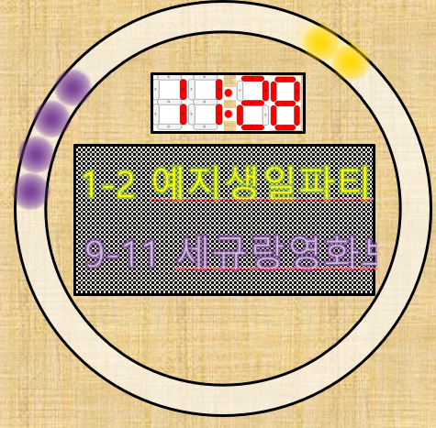







03
Project Introduction
Introduction
▼ Overall operation process
[User]
“Show my schedule.”
[Smart Scheduler]
[Android]
[Server]
<Google calendar>
<Open-API>
2019.6.19 Comprehensive Design final

Slide 14

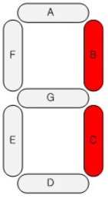
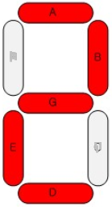
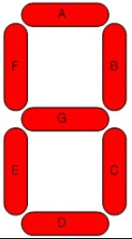
03
Project Introduction
Details
9-11 watching movie with sekyu
2019.6.19 Comprehensive Design final

Slide 15
03
Project Introduction
Details
o o o o
o o
o o o
o o
-3’(-3/-12)
2019.6.19 Comprehensive Design final

Slide 16

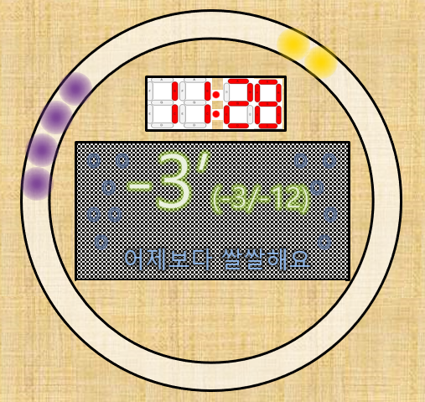
03
Project Introduction
Details
“Bring me, Schedule.”
“Bring me, Weather.”
2019.6.19 Comprehensive Design final

Slide 17
CONTENT
01
Team Introduction
02
Project Overview
03
Project Introduction
04
Achievement status

Slide 18
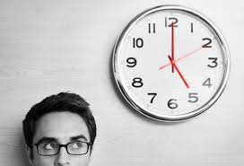

03
Achievement status
Attractive
Essential
Practical
Reasonable
2019.6.19 Comprehensive Design final

Slide 19
Q n a?
WE ARE YASIMZAK
2019.6.19 Comprehensive Design final

Slide 20
THANKS YOU
WE ARE YASIMZAK
SUNGKYUL UNIVERSITY
information communication engineering department
2019.6.19 Comprehensive Design final

