Slide 2
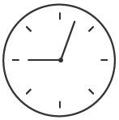
종합회로도 - 완성
clk_50M
clk_1K
seg_com
clk_50m_1k
clock
seg_data
Sw_reset
push
Lcd_display
e
alarm
rs
rw
alarm_decision
led_data(2)
uart_msg(128)
clk_50m_100k
clk_100K
piezo
bell
uart_alarmTime(32)
uart_presentTime(32)
현재시간
uart_test
일정(문자)
rs232
일정(시간)
~
받아온현재시간
Bluetooth
~
android
~

Slide 3
D_7seg
clk_50M
seg_com,sec_out
SmartClock
Sw_reset
e,rs,rw,lcd_data
LcdText
push
bell
piezo
RX
TX
UART

Slide 4
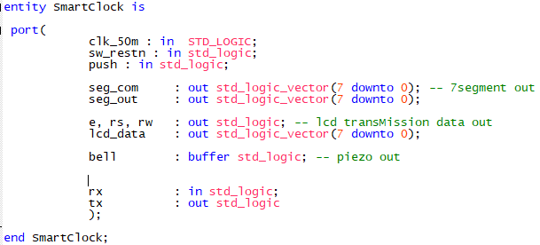

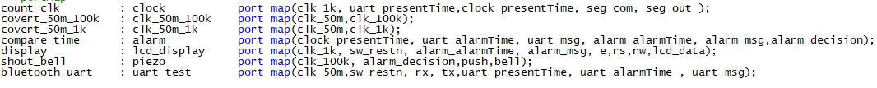

Slide 5
분주기
clk_50M
clk_50m_1k
clk_1k
clk_50M
clk_50m_100k
clk_100k

Slide 6


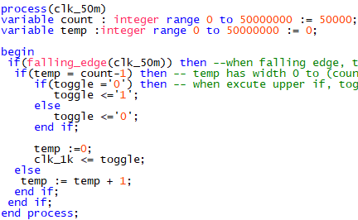
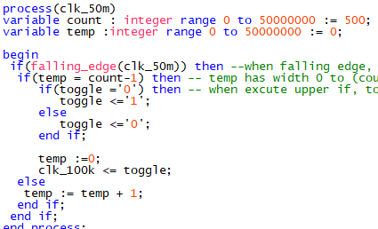
clk_50m_1k
clk_50m_100k

Slide 7
clock
clk1k
D_watch
D_7seg
Seg_com
Uart_presentTime
val
Seg_out
Clock_presentTime

Slide 8
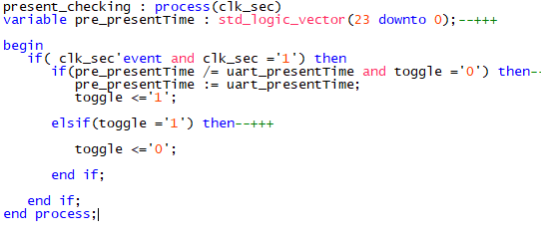

d_Watch

