Slide 1
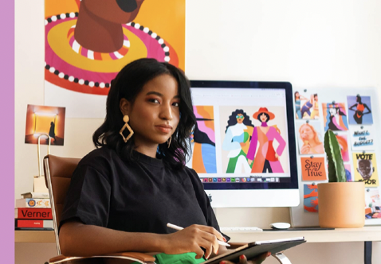
User Persona
Short Description
Key Attribute
Tia works as a retail analyst for a Kiehls skincare company and is responsible for monitoring market trends, competitor analysis, and sales performance.
Age 19
Occupation: retail analyst
About: cat lover, crotchet enthusiast, fashionista, and philanthropist
Tia
Needs
Sarah frequently experiences creative blocks, making it challenging to come up with innovative advertising campaigns, product ideas
Tia face difficulty understanding the preferences, needs, and behaviors of Kiehl's target audience, leading to ineffective targeting and messaging in skincare product development and marketing efforts.
Tia needs to conduct comprehensive competitive analysis in the skincare industry, making it difficult for Kiehl's to stay ahead of competitors, identify market gaps, and capitalize on emerging trends.
Challenges
Wants to increase visibility of her content to target demographics to increase customer engagement
Compare products based on marketable attributes
Advertise her product effectively
Opportunities
Using skincare data to deliver targeted and personalized marketing campaigns, promotions, and product recommendations can improve customer satisfaction, retention, and loyalty, ultimately driving sales and revenue growth. It also gives her the opportunity to see changes of customer interaction when putting out certain marketing for Kiehls products and monitor competitors for certain products that are marked with the same benefits.

Slide 2
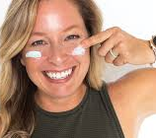
User Persona
Key Attribute
Short Description
Age 20
Occupation: Skincare and beauty blogger and Sephora Ambassador
Alex is a beauty blogger who shares reviews and recommendations on skincare products through their blog and social media channels. With a passion for skincare and a keen eye for trends, Alex strives to provide their audience with valuable insights and recommendations that are backed by data-driven analysis.
Alex
Needs
Staying updated on the latest skincare trends and incorporate them into their content to maintain relevance and engagement with their audience.
Finding dupes that are marketed the same as luxury skincare brands
Challenges
Wants to review content that is original and try dupes for luxury brands
Alex can create engaging content that resonates with their followers and helps them stay informed about the latest developments in the skincare industry.
Alex aims to provide their audience with timely and relevant content that enhances their skincare knowledge and purchasing decisions.
Opportunities
Alex gains valuable insights into consumer preferences, emerging trends, and brand performance. Armed with this data, Alex can tailor their content strategy to feature popular and well-reviewed products, stay ahead of industry trends, and provide personalized recommendations to their audience. Additionally, the dashboard opens doors for brand partnerships and collaborations, as Alex can identify high-performing brands and initiate discussions for sponsored content and ambassadorship opportunities.

