Slide 1
Tshepo Makgoba Data Scientist|Developer 10 March 2021
distinguish between different types of fruits

Slide 2
MEETING OBJECTIVES
Project background and Overview
Exploratory Data Analysis
Modeling & Results
More Exploration to consider
Solution & Production architecture
Summary

Slide 3
Background & Problem statement
Can machine learning distinguish or classify different types of fruits ?
What is the purpose ?
This is a supervised classification problem.
The fruits dataset was created by Dr. Iain Murray from University of Edinburgh. He bought a few dozen oranges, lemons and apples of different varieties, and recorded their measurements in a table. And then the professors at University of Michigan formatted the fruits data slightly.

Slide 4
Background & Problem statement
Data set & Key features overview
Dataset characteristics | Associated task | Number of instances | Number of attributes | Area | Missing values
Multivariate | Classification | 59 | 7 | Research | N/A
WHEN | WHAT | WHO | WHERE | HOW
 | Fruit_name
 | Fruit_label
 | Height
 | Fruit_subtype
 | mass
 | width
 | Color_score

Slide 5
Background & Problem statement
Try to show a scatter plot for fruits classification

Slide 6
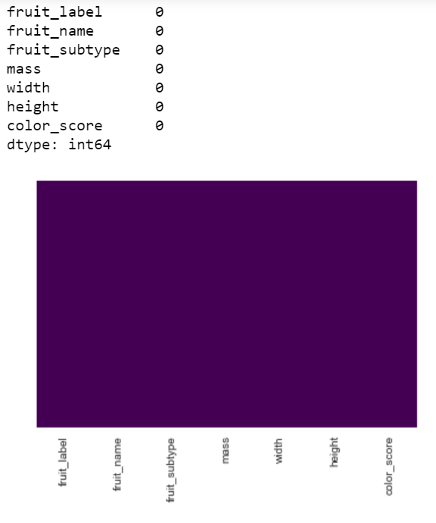
Missing values
Exploratory Data Analysis
Data wrangling
Data was very clean, No missing values, in tidy format
Preprocessing preparing the data for modeling
Approach to impute for future reference
Categorical base imputer
Mean imputer
Median imputer
Drop columns or rows with NA’s

Slide 7
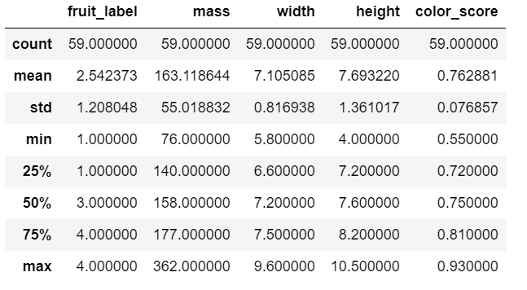
Exploratory Data Analysis
Descriptive Statistics (Numerical)
The numerical values do not have the same scale. Scaling is required for this dataset. There are no data points that immediately appear as anomalous and no zeros in any of the measurement columns.

Slide 8
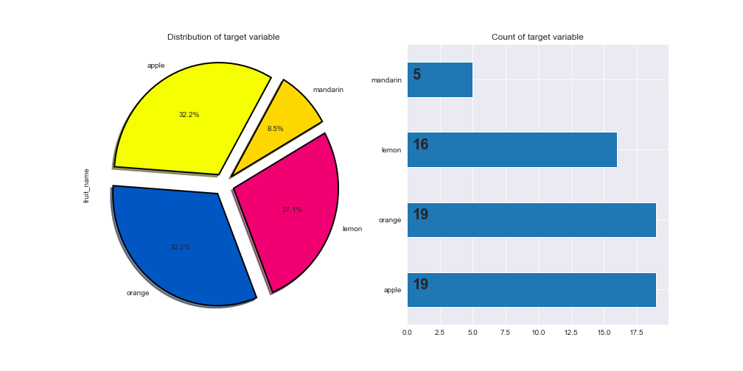
Exploratory Data Analysis
Balance or Imbalance dataset
The data is pretty much balanced except mandarin

Slide 9
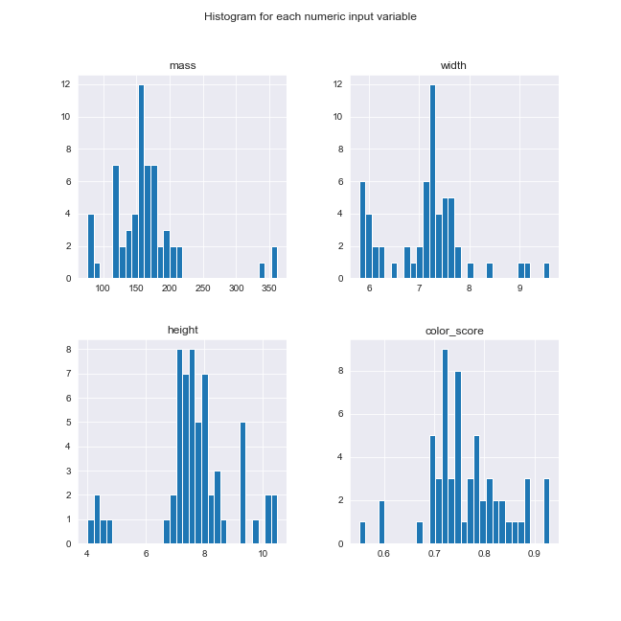
Exploratory Data Analysis
Numerical Feature distribution
Some pairs of attributes are correlated (mass and width). This suggests a high correlation and a predictable relationship. Thus a presence of multicollinearity

Slide 10
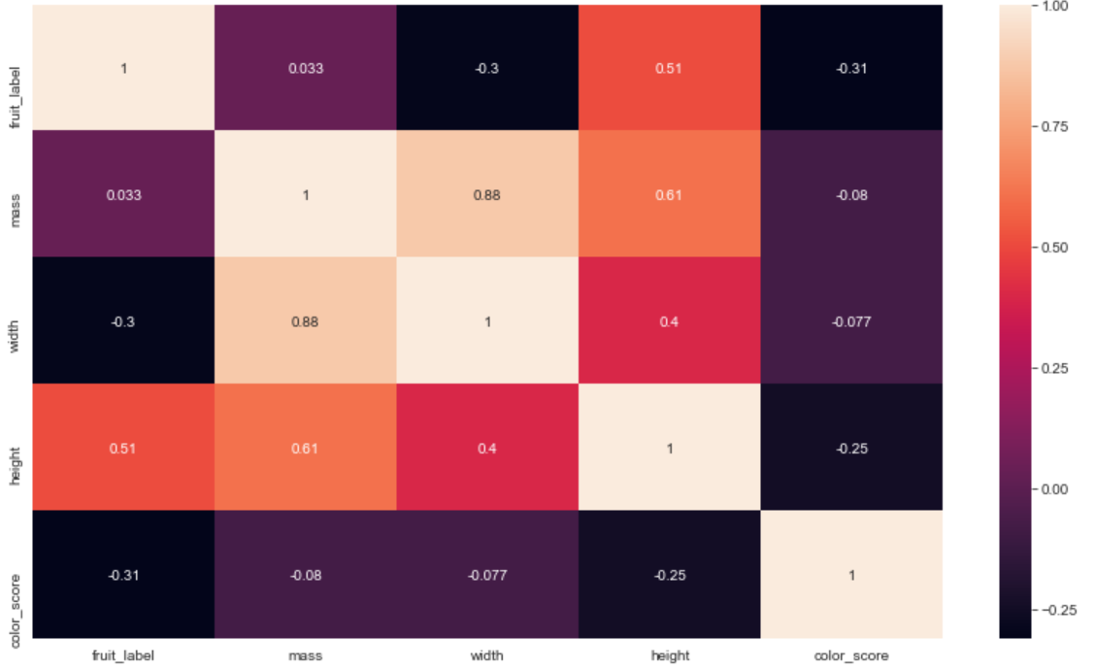
Exploratory Data Analysis
Feature correlation

Slide 11
Exploratory Data Analysis Pre processing
One hot encoder to convert categorical variables so I can model with full variables for my baseline model
Data is not that large
Only two categorical variables
Scaling

Slide 12
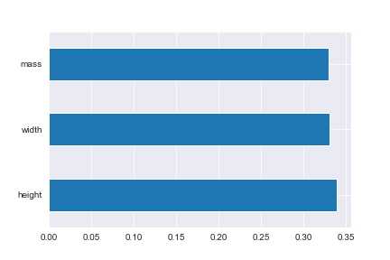
Modeling
Feature importance
Mass, Width and Height were the relevant features to be selected to use in the model to obtain more accurate results.

Slide 13
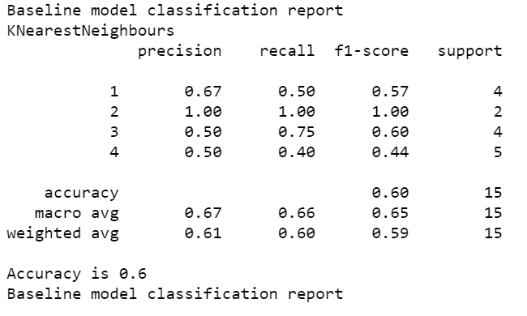
Modeling
Baseline Classifier
The baseline model accuracy is 60%. Which will act as a baseline to all models

Slide 14
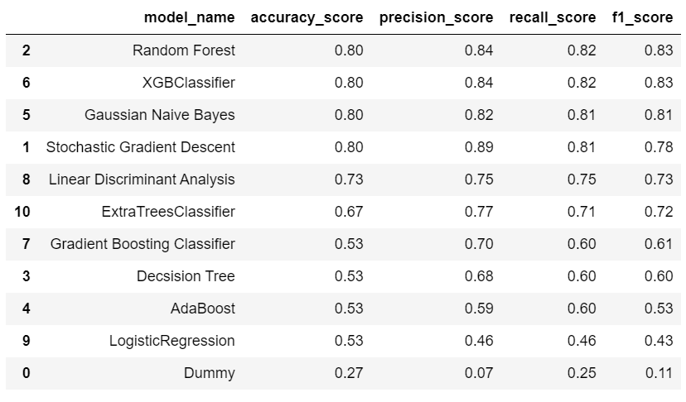
Modeling
Classifiers
Performance report indicates that Random Forest out perform all the selected classifier models by scoring 80% before parameter tunning

Slide 15
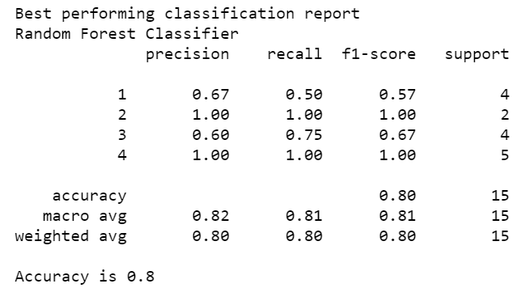
Modeling
Best performing Classifier
The best performing model after parameter tuning. The accuracy is still 80%
And can still be improved.
It was obtained through grid search

Slide 16
More Exploration to consider
IMPROVE THE MODEL
Should I include all variables in the main model
How can I balance the dataset?
Over and Under sampling? SMOTE or Generate the synthetic minority class(Mandarin)?
More classifiers to consider and deep learning if necessary
Correlated features(Multicollinearity). Delete width or mass(Based on which feature is less correlated to the target)

Slide 17
Solution & Production architecture
Business inputs
Data Scientist
Data
Machine Learning Model
Data Engineering
Machine Learning Engineer
Data Pipeline
Modeling Training
Model Deployment
Model Monitoring

Slide 18
Summary
Can width, mass and height alone be used to classify different types of fruits?
At the moment NO
Considering other factors mentioned above. YES

Slide 19
THANK YOU

